Slide 1
Cody Ch 11: Correlation
11.1 Person Correlation Coefficient
11.2 Spearman Nonparametric Correlations

Slide 2
Re-Create Cody Work Files
Navigate to your copy of the Cody folder
Double-click the Create_Datasets.sas program.
Run the program
Check the LOG for errors
Examine the STATS library contents
Notes:
Correct Answers: a, b, c

Slide 3
Cody Ch 11: Correlation
11.1 Person Correlation Coefficient
11.2 Spearman Nonparametric Correlations

Slide 4
Person Correlation Coefficient
Measures the strength of the relationship between two variables
Variables are usually continuous but also can be binary or ordinal
-1 >= correlation <= 1
if > 0 then positive relationship
if < 0 then negative relationship
if = 0 then no relationship
Strongly influenced by outliers

Slide 5

Correlation Does not Imply Causality

Slide 6
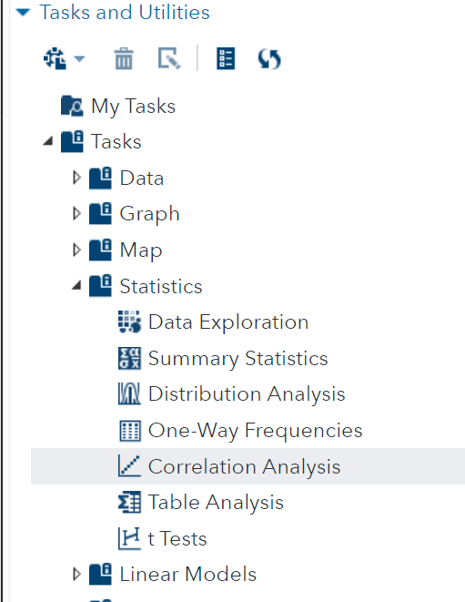
Correlation Task
Correlation Analysis is under Statistics

Slide 7
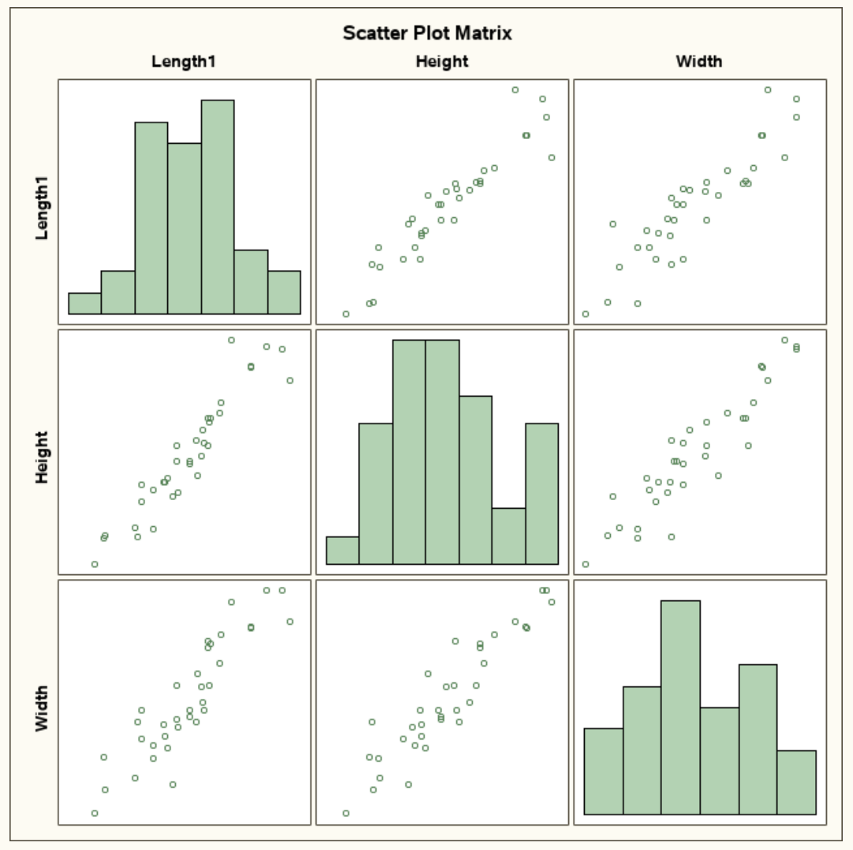
11.01 Demo
Notes:
Type answer here

Slide 8
11.02 Activity
Select Tasks and Utilities in the Navigation pane. Expand Tasks, expand Statistics and double-click Correlation Analysis.
Select the STATS.EXERCISE data set
Select Pushups, Flexibility and Strength as the Analysis variables
On the OPTIONS tab, under STATISTICS select Selected statistics for Display statistics: and check Correlations and Display p-values. .
On the OPTIONS tab, under PLOTS select Matrix of scatter plots for Type of plot: and check Include histograms.
Select the Running Icon
Notes:
Type answer here

Slide 9
11.03 Multiple Choice Question
The p value of a correlation coefficient tests the null hypothesis that the correlation = 0. What can be said about the correlation of Pushups vs Strength?
It is insignificant and we cannot reject H₀
It’s highly unlikely to get a coefficient as large or larger than .22151 if H₀ is true.
There is a causal effect of Pushups on Strength
Notes:
Correct Answers: a, b, c

Slide 10

11.03 Multiple Choice Question
The p value of a correlation coefficient tests the null hypothesis that the correlation = 0? What can be said about the correlation of Pushups vs Strength?
It is insignificant and we cannot reject H₀
It’s highly unlikely to get a coefficient as large or larger than .22151 if H₀ is true.
There is a causal effect of Pushups on Strength
Notes:
Correct Answers: a, b, c

Slide 11
Cody Ch 11: Correlation
11.1 Person Correlation Coefficient
11.2 Spearman Nonparametric Correlations

Slide 12
11.04 Activity
We suspect that our strength samples may not be from a normal population.
Use nonparametric analysis.
Edit the task from Activity 11.02
On the Settings tab, under STATISTICS, expand Nonparametric Correlations and check Spearman’s rank-order correlation
Select the Running Icon
Notes:
Type answer here

Slide 13
11.05 True/False Question
Using the nonparametric analysis, we conclude that our previous interpretation of the relationship between Flexibility and strength was incorrect.
True
False
Notes:
Correct Answers: a, b, c

Slide 14
11.05 True/False Question
Using the nonparametric analysis, we conclude that our previous interpretation of the relationship between Flexibility and strength was incorrect.
True
False
Notes:
Correct Answers: a, b, c

Slide 15
Questions?

