Slide 1
Cody Ch 12: Simple and Multiple Regression
12.1 Simple Regression
12.1 Multiple Regression

Slide 2
Cody Ch 12: Simple and Multiple Regression
12.1 Simple Regression
12.1 Multiple Regression

Slide 3
Regression
Simple Regression
Enables prediction of one variable based on the values of another variable
Multiple Regression
Enables prediction of one variable based on the values of two or more variables
Assumptions
Residuals are Normally Distributed
Homogenous variance across the independent variables

Slide 4
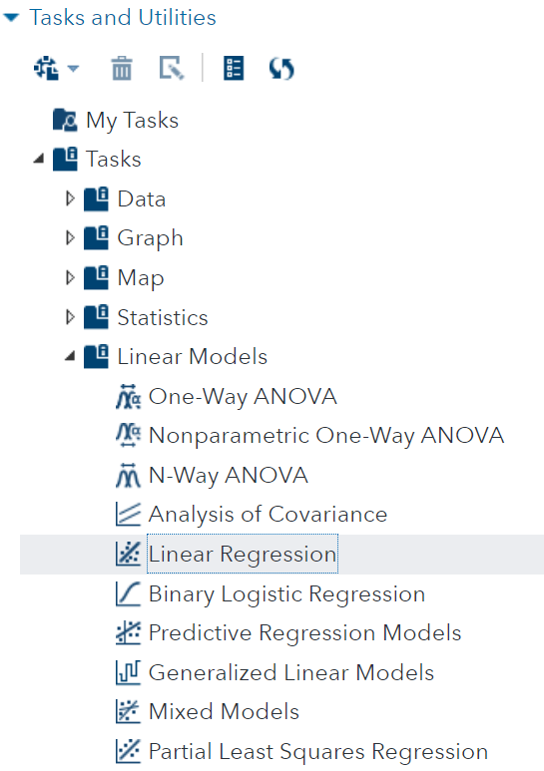
Linear Regression Task
Correlation Analysis is under Statistics

Slide 5
12.01 Activity
Select Tasks and Utilities in the Navigation pane. Expand Tasks, expand Linear Models and double-click Linear Regression
Select the STATS.EXERCISE2 data set
Select Pushups as the Dependent variable
Select Strength as the Continuous variable
On the MODEL tab, Click Edit
In the Model Effects Builder select Strength and click Add
Click OK
Select the Running Icon
Notes:
Type answer here

Slide 6
12.02 Multiple Choice Question
Use the information in the Parameter Estimates table to compute the predicted number of pushups a person with strength of 50 could do.
41 pushups
It’s not possible to compute
30 pushups
Notes:
Correct Answers: a, b, c

Slide 7

12.02 Multiple Choice Question
Use the information in the Parameter Estimates table to compute the predicted number of pushups a person with strength of 50 could do.
41 pushups
It’s not possible to compute
30 pushups
Notes:
Correct Answers: a, b, c

Slide 8
Cody Ch 12: Simple and Multiple Regression
12.1 Simple Regression
12.1 Multiple Regression

Slide 9
12.03 Activity
We would like to add additional predictor (independent) variables to our model. Let’s explore further…
Select Tasks and Utilities in the Navigation pane. Expand Tasks, expand Statistics and double-click Correlation Analysis.
Select the STATS.EXERCISE2 data set
Select Flexibility, Strength, Pushups, and Endurance as the Analysis variables
On the OPTIONS tab, under STATISTICS select Selected statistics for Display statistics: and check Correlations and Display p-values. .
On the OPTIONS tab, under PLOTS select Matrix of scatter plots for Type of plot: and check Include histograms.
Select the Running Icon
Notes:
Type answer here

Slide 10
Questions?

