Slide 1
Lesson 6: Descriptive Statistics - Univariate
6.1 Descriptive Statistics for Continuous Variables
6.2 Using Classification Variables
6.3 Creating a Box Plot

Slide 2
Lesson 6: Descriptive Statistics - Univariate
6.1 Descriptive Statistics for Continuous Variables
6.2 Using Classification Variables
6.3 Creating a Box Plot

Slide 3
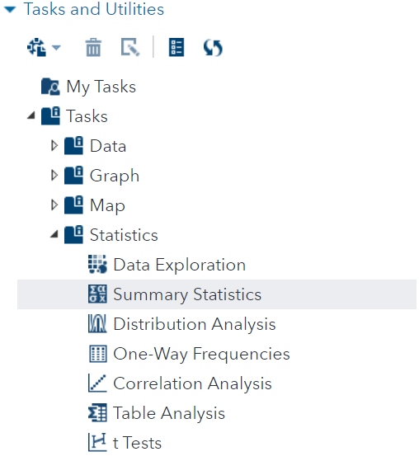
Descriptive Statistics
The “Summary Statistics” Task is your fist step in understanding your data.

Slide 4
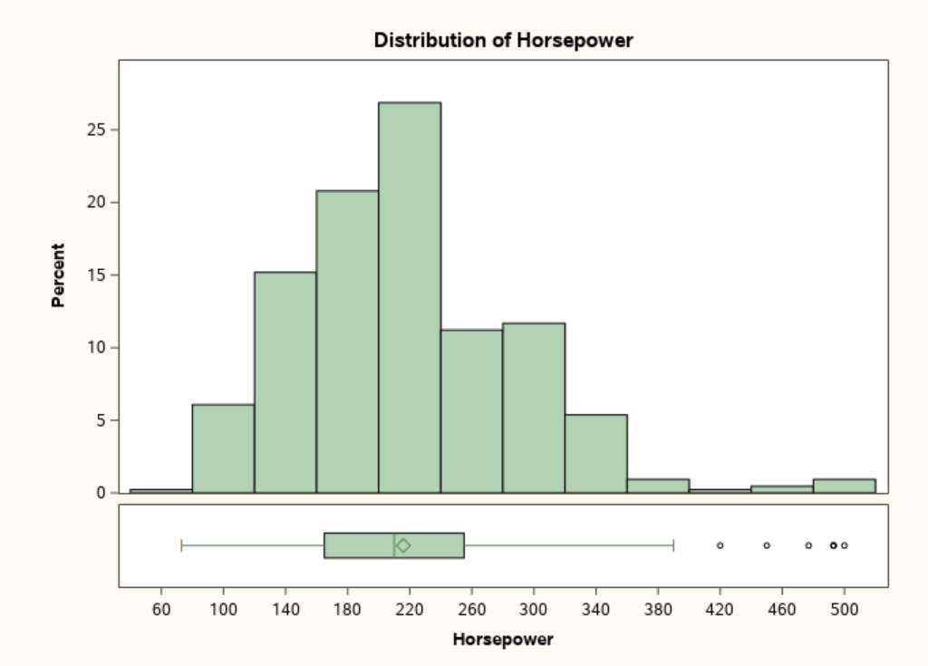
Distribution of HP Skewed to the Right

Slide 5
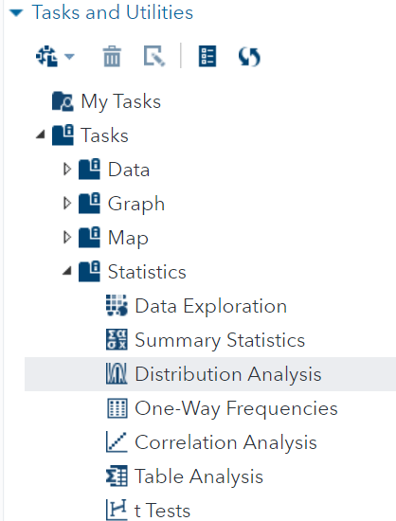
Demo: Distribution Analysis
The “Distribution Analysis” Task helps up us geta closer look at a variable's distribution.
Notes:
This Analysis will produce a Q-Q plot to check the quantiles of horsepower against a normal distribution quantiles. If the data is normally distributed, then the Q-Q plot will fall along a straight line.
Selecting Skewness and Kurtosis in the inset statistics.

Slide 6
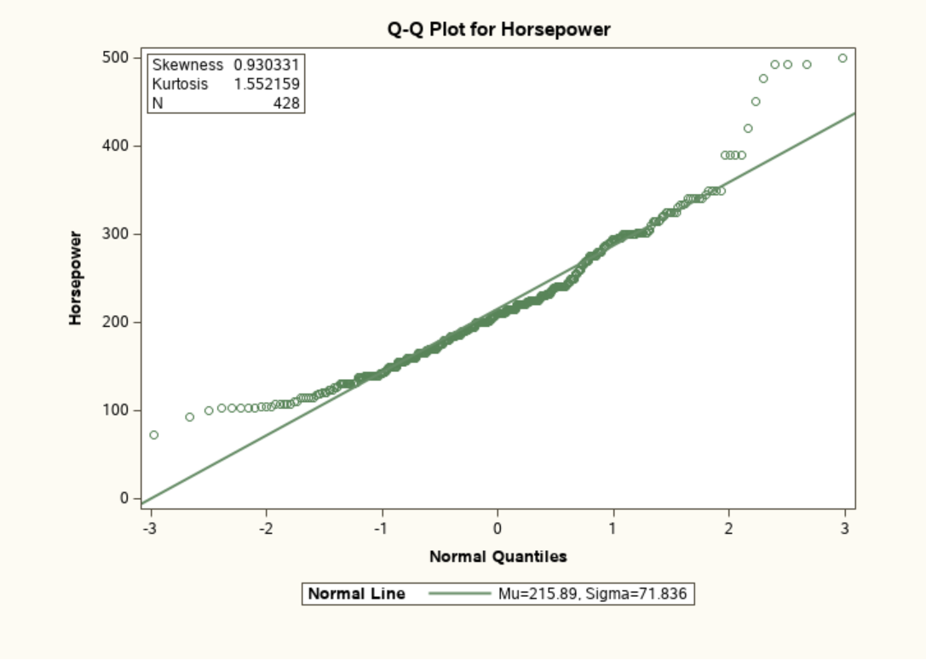
Demo: Distribution Analysis

Slide 7
Distribution Analysis
Confirms positive skewness
Notes:
“Values for Skewness and Kurtosis close to zero result from
distributions that are close to normal. Positive values for skewness,
as in this plot, indicate a positively skewed distribution (extreme
values in the right tail). Positive values for kurtosis (as in this
example) indicate both that the distribution is too peaked
(leptokurtic) and that the tails (left and right side of the distribution)
contain more data values than a normal distribution. Negative
values for kurtosis indicate that the distribution is too flat
(platykurtic) and that there are too few data values in the tails of
the distribution.” (Cody 77)
“running parametric tests such as t tests and ANOVA. Parametric
tests rely on the data values being distributed in a specific way,
such as a normal distribution. Nonparametric methods are often
described as distribution-free methods.” (Cody 77)
?? Kurtosis of normal is 3: https://en.wikipedia.org/wiki/Kurtosis

Slide 8
Lesson 6: Descriptive Statistics - Univariate
6.1 Descriptive Statistics for Continuous Variables
6.2 Using Classification Variables
6.3 Creating a Box Plot

Slide 9
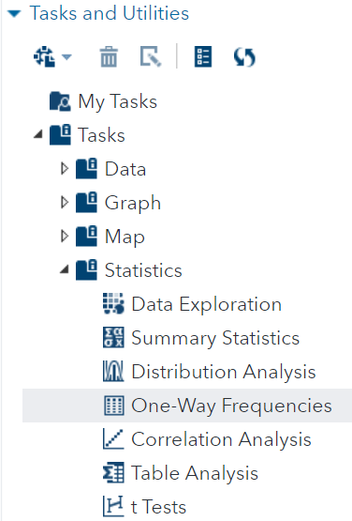
Investigating Categorical Variables
Use “One-Way Frequencies” Task to explore cylinder distribution.

Slide 10
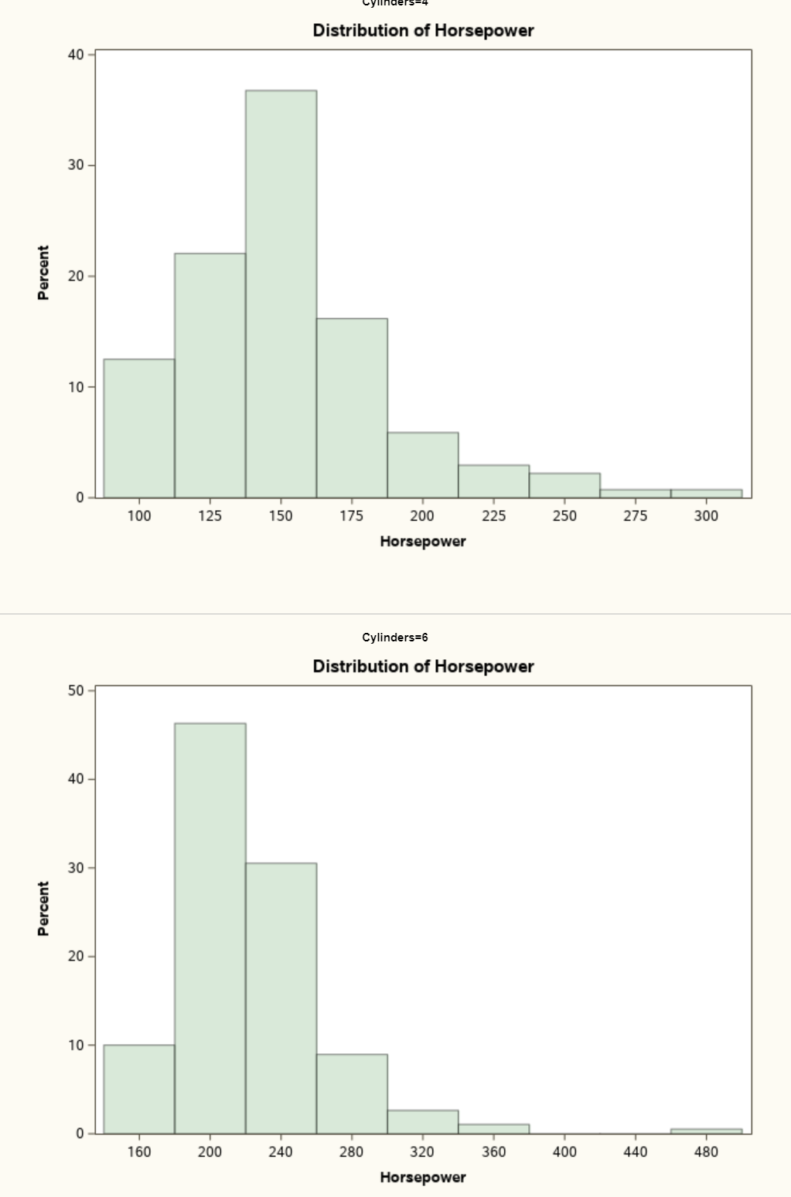
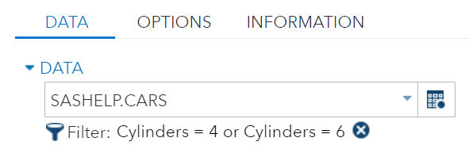
Distribution of HP for 4 and 6 cyl Cars

Slide 11
Lesson 6: Descriptive Statistics - Univariate
6.1 Descriptive Statistics for Continuous Variables
6.2 Using Classification Variables
6.3 Creating a Box Plot

Slide 12
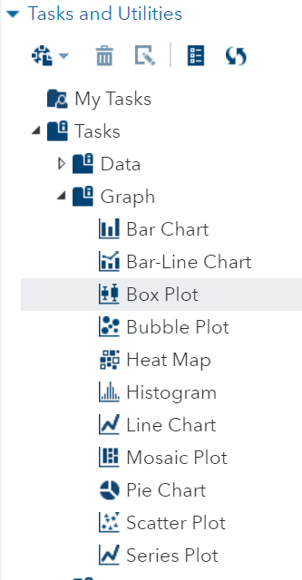
Box Plot
The “Box Plot” Task is an essential part of EDA.

Slide 13
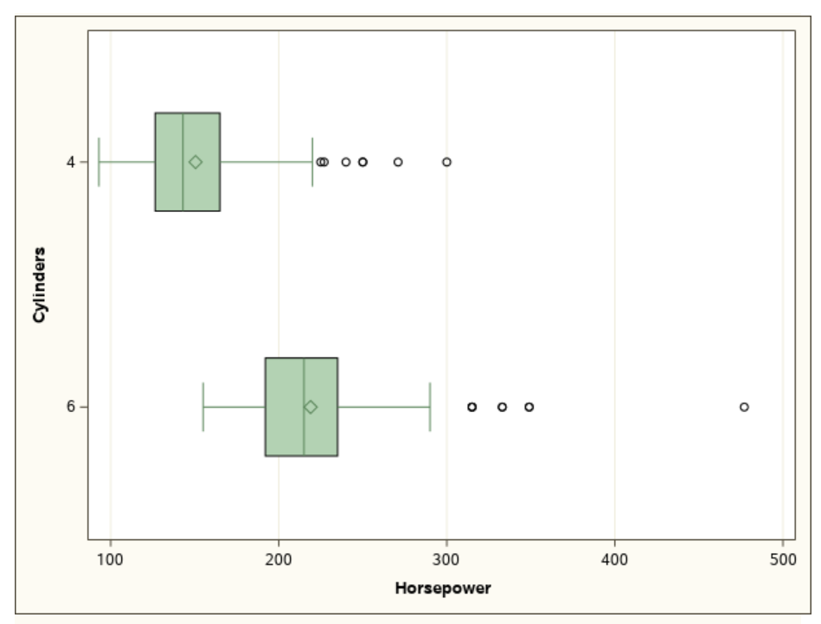
Box-Plot
1.5 Quartiles
Outliers
Median
Mean
25%
Q1
75%
Q3
Notes:
The mean higher than the median confirms the right skewness.
The box contains 50% of all the data values.
The distance between Q1 and Q3 is “interquartile range”

Slide 14
Questions?

