Slide 1
Lesson 6: Descriptive Statistics - Univariate
6.1 Descriptive Statistics for Continuous Variables
6.2 Using Classification Variables
6.3 Creating a Box Plot

Slide 2
Lesson 6: Descriptive Statistics - Univariate
6.1 Descriptive Statistics for Continuous Variables
6.2 Using Classification Variables
6.3 Creating a Box Plot

Slide 3
Descriptive Statistics (Getting to Know Your Data)

Slide 4
Descriptive Statistics (Getting to Know Your Data)
Univariate – analysis of one variable e.g., height, weight, milage
PROC UNIVARIATE
Measures of Central Tendency
mean
median
mode
Measures of variability
range
variance
standard deviation

Slide 5
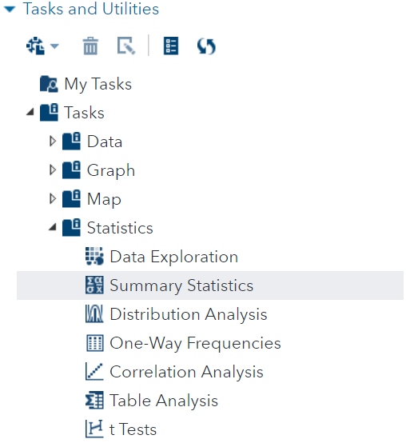
Descriptive Statistics (Getting to Know Your Data)
The “Summary Statistics” Task is your fist step in understanding your data.

Slide 6
6.01 Activity
NOTE: As you complete each step, observe the generated code being built on the right
Select Tasks and Utilities in the Navigation pane. Expand Tasks, expand Statistics and double-click Summary Statistics.
On the left side of the top ribbon of the new Summary Statistics tab, select Split.
In the center of the top ribbon, select the 4-arrow icon to maximize your view.
On the Data tab, use the Data navigation on the left to select SASHELP.CARS data set.
Select MSRP, Horsepower and Weight as your Analysis variables. (hold ctrl key as you select)
On the Options tab, under Basic Statistics, select Mean, Standard deviation, Number of observations and Number of missing values
Expand Additional Statistics and select Skewness and Kurtosis
Expand PLOTS and select Histogram with Add normal density curve and Add inset statistics
Select the Running Icon
.
Notes:
Type answer here

Slide 7
6.01 Multiple Answer Question
Which variables from the SASHELP.CARS data set display skewness?
MSRP
Horsepower
Weight
Select all that apply
Notes:
Correct Answers: a, b, c

Slide 8

6.01 Multiple Choice Answers
Which variables from the SASHELP.CARS data set display skewness?
MSRP
Horsepower
Weight
Notes:
Correct Answers: a, b, c

Slide 9
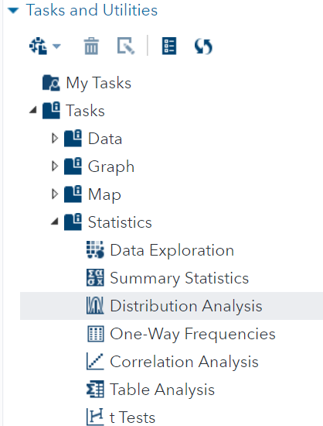
Demo: Distribution Analysis
The “Distribution Analysis” Task helps up us geta closer look at a variable's distribution.
Notes:
This Analysis will produce a Q-Q plot to check the quantiles of horsepower against a normal distribution quantiles. If the data is normally distributed, then the Q-Q plot will fall along a straight line.
Selecting Skewness and Kurtosis in the inset statistics.

Slide 10
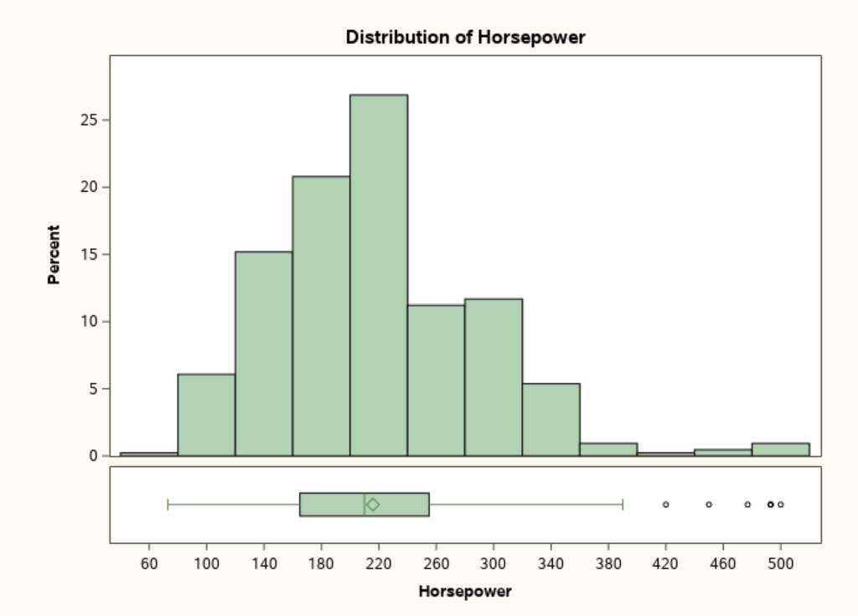
Distribution of HP Skewed to the Right

Slide 11
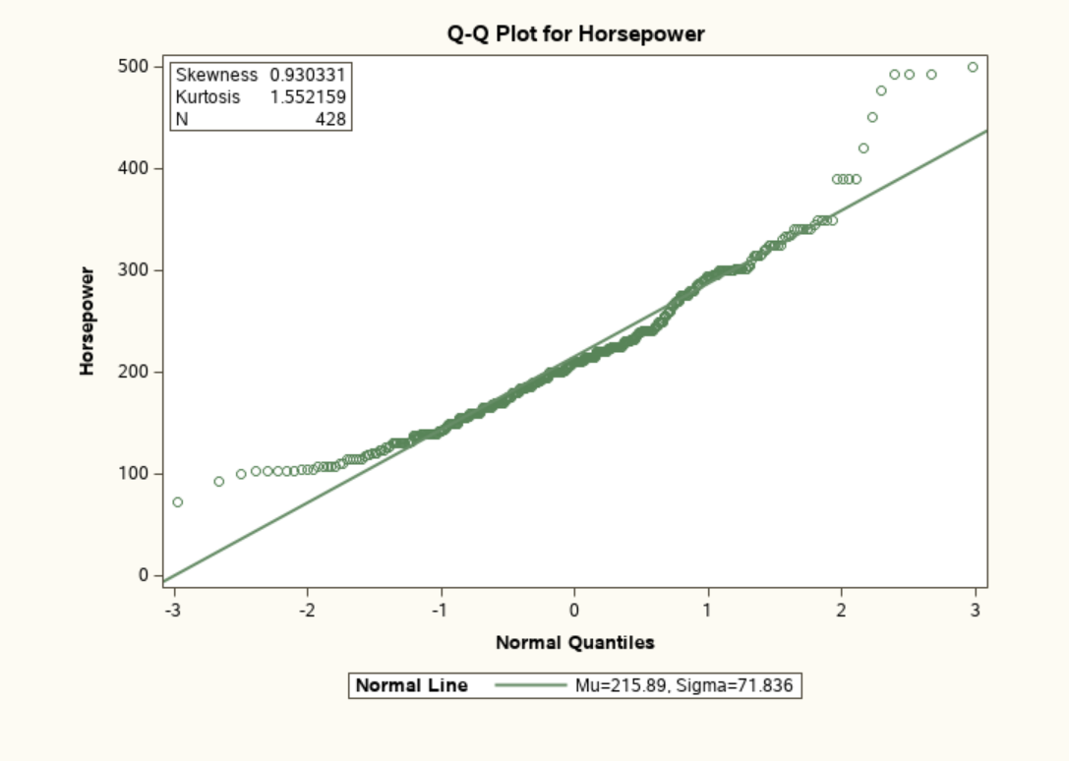
Demo: Distribution Analysis

Slide 12
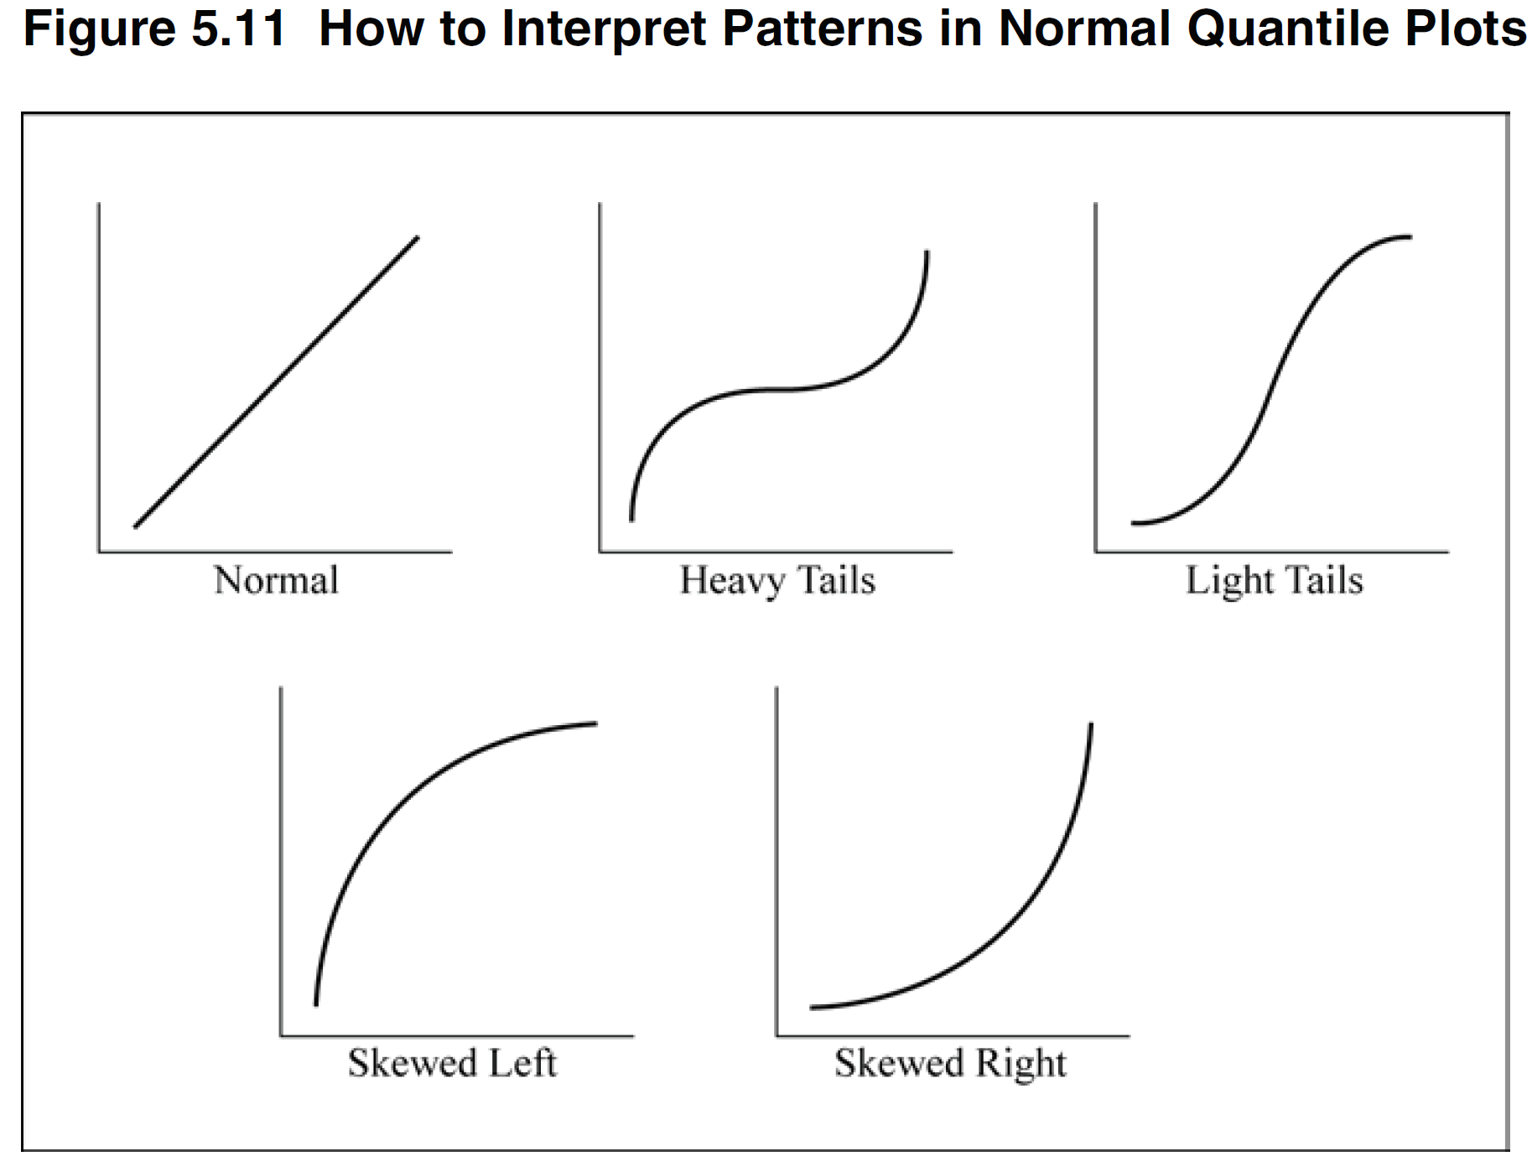
Interpreting Q-Q Plots
Schlotzhauer 149

Slide 13
Distribution Analysis
Confirms positive skewness
Notes:
“Values for Skewness and Kurtosis close to zero result from
distributions that are close to normal. Positive values for skewness,
as in this plot, indicate a positively skewed distribution (extreme
values in the right tail). Positive values for kurtosis (as in this
example) indicate both that the distribution is too peaked
(leptokurtic) and that the tails (left and right side of the distribution)
contain more data values than a normal distribution. Negative
values for kurtosis indicate that the distribution is too flat
(platykurtic) and that there are too few data values in the tails of
the distribution.” (Cody 77)
“running parametric tests such as t tests and ANOVA. Parametric
tests rely on the data values being distributed in a specific way,
such as a normal distribution. Nonparametric methods are often
described as distribution-free methods.” (Cody 77)
?? Kurtosis of normal is 3: https://en.wikipedia.org/wiki/Kurtosis

Slide 14
6.02 Activity
NOTE: As you complete each step, observe the generated code being built on the right
You may need to select the 4-way arrow icon to minimize your view to see the navigation pane on the left
Select Tasks and Utilities in the Navigation pane. Expand Tasks, expand Statistics and double-click Distribution Analysis.
On the Data tab, use the Data navigation on the left to select SASHELP.CARS data set.
Select Horsepower as your single Analysis variables.
Under CHECKING FOR NORMALITY select Normal quantile-quantile plot and Add inset Statistics.
Expand Inset Statistics and select Skewness and Kurtosis
Select the Running Icon
Notes:
Type answer here

Slide 15
6.02 True or False Question
The Q-Q Plot helps in an assessment of the fit of a univariate variable to a normal distribution?
True
False

Slide 16
6.02 True or False Answer
The Q-Q Plot helps in an assessment of the fit of a univariate variable to a normal distribution?
True
False

Slide 17
Lesson 6: Descriptive Statistics - Univariate
6.1 Descriptive Statistics for Continuous Variables
6.2 Using Classification Variables
6.3 Creating a Box Plot

Slide 18
Investigating Categorical Variables
Investigating the effect of a categorical variable
such as “Cylinders” on horsepower.
First step is to generate a frequency table.
Second step is to use a filter to select the categories
you are interested in.

Slide 19
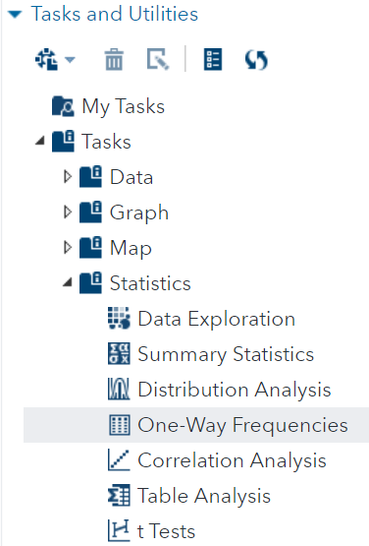
Investigating Categorical Variables
Use “One-Way Frequencies” Task to explore cylinder distribution.

Slide 20
6.03 Activity
NOTE: As you complete each step, observe the generated code being built on the right
You may need to select the 4-way arrow icon to minimize your view to see the navigation pane on the left
Select Tasks and Utilities in the Navigation pane. Expand Tasks, expand Statistics and double-click One-Way Frequencies.
On the Data tab, use the Data navigation on the left to select SASHELP.CARS data set.
Select Cylinders as your single Analysis variables.
Select the Running Icon

Slide 21
6.03 Multiple Choice Question
Given the frequency report of Cylinders, what is the most likely course for further analysis?
Use all Cylinder categories
Only use categories 4, 6 and 8
There are not enough degrees of freedom for this variable to be used further.

Slide 22
6.03 Multiple Choice Answer
Given the frequency report of Cylinders, what is the most likely course for further analysis?
Use all Cylinder categories
Only use categories 4, 6 and 8
There are not enough degrees of freedom for this variable to be used further.

Slide 23
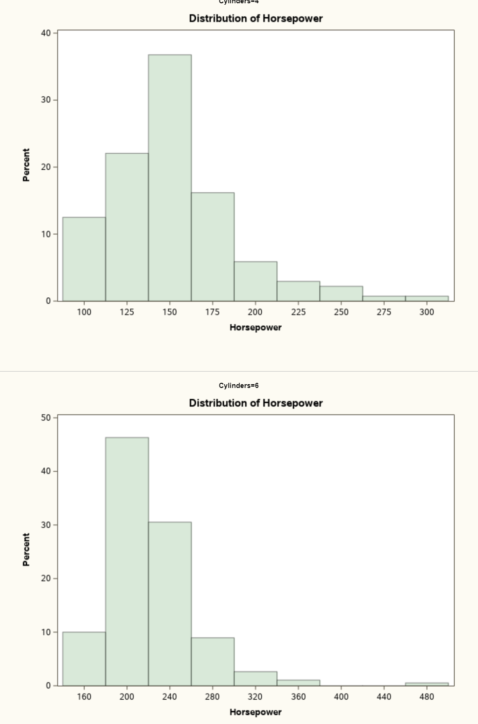
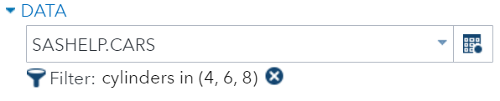
Distribution of HP for 4 and 6 cyl Cars
Demo

Slide 24
Lesson 6: Descriptive Statistics - Univariate
6.1 Descriptive Statistics for Continuous Variables
6.2 Using Classification Variables
6.3 Creating a Box Plot

Slide 25
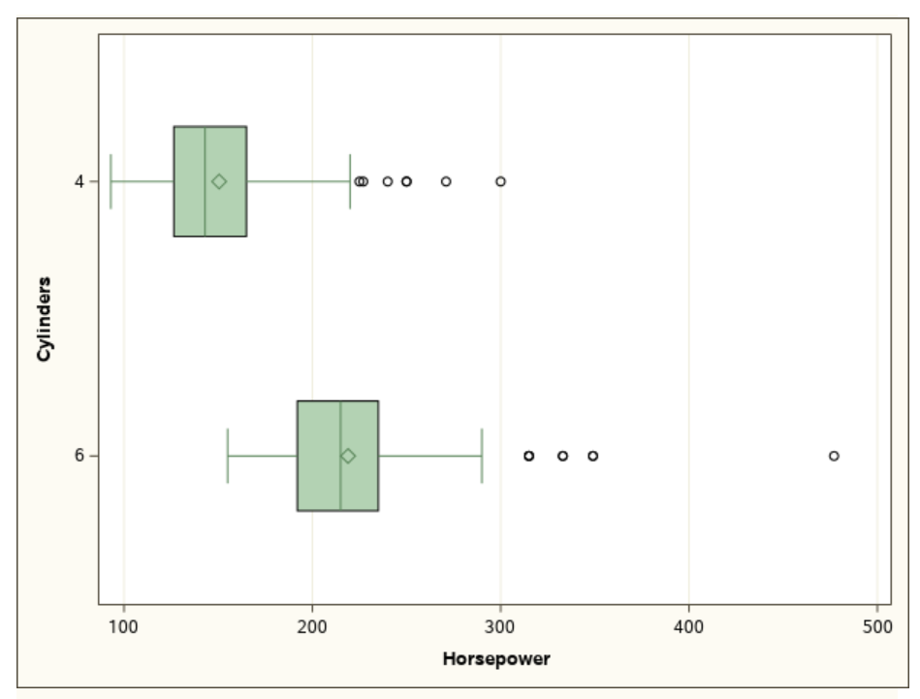
Box-Plot
1.5 Quartiles
Outliers
50% of Data Values
Median
Mean
25%
Q1
75%
Q3
Notes:
The mean higher than the median confirms the right skewness.
The box contains 50% of all the data values.
The distance between Q1 and Q3 is “interquartile range”

Slide 26
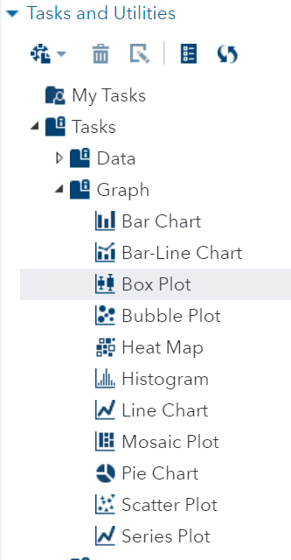
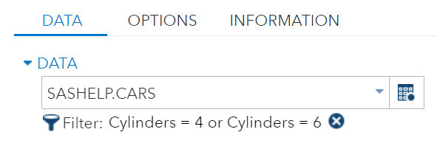
Box Plot
The “Box Plot” Task helps us understand fitness to normality.

Slide 27
6.04 Activity
NOTE: As you complete each step, observe the generated code being built on the right
You may need to select the 4-way arrow icon to minimize your view to see the navigation pane on the left
Select Tasks and Utilities in the Navigation pane. Expand Tasks, expand Graph and double-click Box Plot.
On the Data tab, use the DATA navigation on the left to select SASHELP.CARS data set.
Underneath the DATA navigation, select Filter and configure it to only include 4-, 6- and 8-cylinder cars.
Select Horizontal plot orientation.
Select Horsepower as your Analysis variable.
Select Cylinders as your Category.
Select the Running Icon

Slide 28
Questions?

