Slide 1
Cody Ch 7: One-Sample Tests
7.1 One-Sample t Test
7.2 Nonparametric One-Sample t Test

Slide 2
Preliminary Data Steps
Copy the Cody folder from my_shared_file_links/u50425759/MSDS5163 to Files(Home)
Double-click the Create_Datasets.sas program.
Edit line 8 to read:
libname Stats “~/stats”;
Right-click Files (Home) and select New->Folder
name the folder “stats”
Run the program
Check the LOG for errors
Examine the STATS library contents
Notes:
Correct Answers: a, b, c

Slide 3
SAS Data Set Naming Convention
Dot
Library
Data Set
STATS.EXERCISE
/home/u50425759/stats/exercise.sas7bdat
NOTE: The WORK library is the default (if you don’t specify a two-part name).
All data in WORK are deleted at the end of your SAS session.

Slide 4
Cody Ch 7: One-Sample Tests
7.1 One-Sample t Test
7.2 Nonparametric One-Sample t Test

Slide 5
One-Sample t Test
Used to determine if a single sample comes from a population with a known mean.

Slide 6
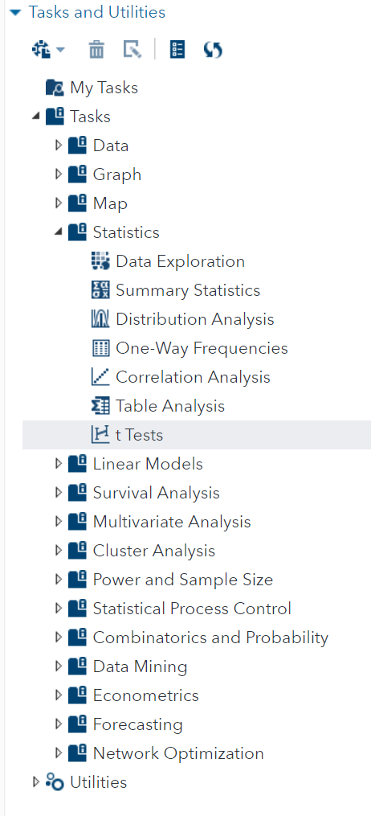
t Test
Use the “t Tests” task to test the mean against a known.

Slide 7
7.01 Activity
A teacher wants to know if her student’s SAT scores are above the national average of 1068
Import Cody/SAT_Scores.xlsx. Set the OUTPUT DATA to WORK.SAT_SCORES
Run the import task
Examine the WORK.SAT_SCORES data set
Select Tasks and Utilities in the Navigation pane. Expand Tasks, expand Statistics and double-click t Tests.
Select the WORK.SAT_SCORES data set and One-sample test
On the OPTIONS tab, configure a two-tailed test for H₀ of Mean = 1068
Select Test for normality
Select the Running Icon
Notes:
Type answer here

Slide 8
7.01 Multiple Choice Question
According to the p-value, what can we say about the Null Hypothesis H₀ that the class mean = national average?
The degrees of freedom are too small to say anything significant.
The class mean (1270.6) is not significantly different than the National average (1068)
It’s very unlikely that we would see a class mean as high as 1270 if H₀ were True
Notes:
Correct Answers: a, b, c

Slide 9

7.01 Multiple Choice Question
According to the p-value, what can we say about the Null Hypothesis H₀ that the class mean = national average?
The degrees of freedom are too small to say anything significant.
The class mean (1270.6) is not significantly different than the National average (1068)
It’s very unlikely that we would see a class mean as high as 1270 if H₀ were True
Notes:
Correct Answers: a, b, c

Slide 10
Cody Ch 7: One-Sample Tests
7.1 One-Sample t Test
7.2 Nonparametric One-Sample t Test

Slide 11
Nonparametric One-Sample Tests
PROBLEM: Suppose the Tests for Normality, Histogram, Box and Q-Q plots indicated that your sample was not from a normally distributed population or your sample size is very small.
SOLUTION: Use the Wilcoxon Signed Rank Test

Slide 12
7.02 Activity
To measure the effectiveness of a Training Session, the difference between the before and after scores are to be tested for zero.
If your SAS session is restarted, re-run Cody/Create_Datasets.sas
Select Tasks and Utilities in the Navigation pane. Expand Tasks, expand Statistics and double-click t Tests.
Select the WORK.BEFORE_AFTER data set and One-sample test
Select Difference as the Analysis variable
On the OPTIONS tab, configure a two-tailed test for H₀ of Mean = 0
Select Test for normality
Select the Running Icon
Notes:
Type answer here

Slide 13
7.02 True or False Question
All of the Test for Normality and plots indicate that this data is normally distributed.
True
False
Notes:
Correct Answers: a, b, c

Slide 14
7.02 True or False Question
The test for normality and plots indicate that this data is normally distributed.
True
False
Notes:
Correct Answers: a, b, c

Slide 15
7.03 Activity
Re-configure the t test you ran in activity 7.02 to run a nonparametric test
Select Sign test and Wilcoxon signed rank test on the OPTIONS tab
Select the Running Icon
Examine the Variable: Difference table at the bottom of the RESULTS
Notes:
Type answer here

Slide 16
Explanation of Signed Rank Test (Cody 101)
To conduct a Signed Rank Test, take the absolute
value of all your differences (that is, ignore any minus signs) and
rank them. If the difference is zero, ignore that value. Next
determine the sign for each rank, based on the original values. If
the null hypothesis is true, the positive and negative ranks should
be about equal. If most of the higher ranks are of the same sign,
you might have evidence to reject the null hypothesis.

Slide 17
7.02 True or False Question
According to the Signed Rank Test, the training session had a significant impact on the improvement of student scores.
True
False
Notes:
Correct Answers: a, b, c

Slide 18
7.02 True or False Question
According to the Signed Rank Test, the training session had a significant impact on the improvement of student scores.
True
False
Notes:
Correct Answers: a, b, c

Slide 19
Questions?

