Slide 1
Cody Ch 8: Two-Sample Tests
8.1 Unpaired t Test
8.2 Paired t Test

Slide 2
Re-Create Cody Work Files
Navigate to your copy of the Cody folder
Double-click the Create_Datasets.sas program.
Run the program
Check the LOG for errors
Examine the STATS library contents
Notes:
Correct Answers: a, b, c

Slide 3
SAS Data Set Naming Convention
Dot
Library
Data Set
STATS.EXERCISE
/home/u50425759/stats/exercise.sas7bdat
NOTE: The WORK library is the default (if you don’t specify a two-part name).
All data in WORK are deleted at the end of your SAS session.

Slide 4
Cody Ch 8: Two-Sample Tests
8.1 Unpaired t Test
8.2 Paired t Test

Slide 5
Unpaired t Test
(t Test for Independent Groups)
Used to compare means between two independent groups.
Assumptions:
Normally distributed measures for both groups
Variances are the the same in both groups

Slide 6
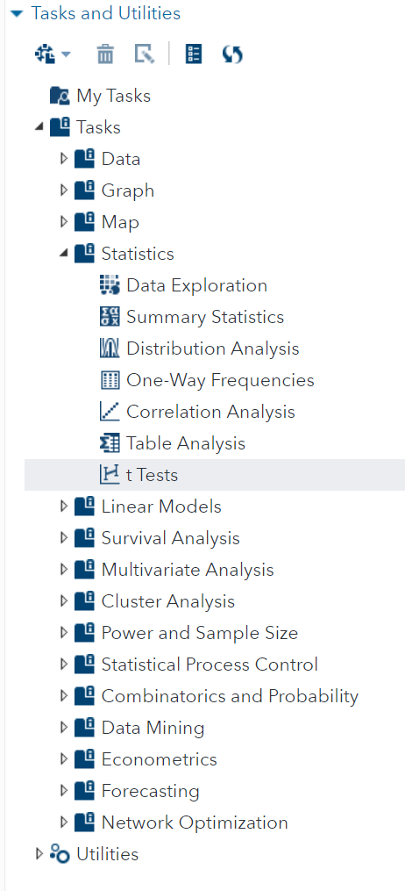
Two-Sample t Test
Also use the “t Tests” task to run a two-sample test as we did for one-sample case

Slide 7
8.01 Activity
We want to test the mean reading speed of males and females
Select Tasks and Utilities in the Navigation pane. Expand Tasks, expand Statistics and double-click t Tests.
Select the STATS.READING data set and Two-sample test
Select Words_per_Minute as the Analysis variable
Select Gender as the Groups variable
On the OPTIONS tab, configure a two-tailed test for H₀ of Mean = 0
Select Test for normality
Under PLOTS, select Selected Plots and select Histogram and box plot, Normality plot and Confidence interval plot.
Select the Running Icon
Notes:
Type answer here

Slide 8
8.02 Multiple Choice Question
The first two tables show the tests for normality for Females and Males. The null hypothesis is that they are normally distributed.
Are we able to reject the null hypothesis?
Yes
No
Notes:
Correct Answers: a, b, c

Slide 9

8.02 Multiple Choice Question
The first two tables show the tests for normality for Females and Males. The null hypothesis is that they are normally distributed. Are we able to reject the null hypothesis?
Yes
No
Notes:
Correct Answers: a, b, c

Slide 10
8.03 Multiple Choice Question
The null hypothesis for reading speeds is that the mean reading speed for Females versus Males is the same.
Are we able to reject the null hypothesis?
Yes
No
Notes:
Correct Answers: a, b, c

Slide 11
8.03 Multiple Choice Question
The null hypothesis for reading speeds is that the mean reading speed for Females versus Males is the same.
Are we able to reject the null hypothesis?
Yes
No
Notes:
Correct Answers: a, b, c

Slide 12
HOMEWORK Nonparametric Two-Sample Tests
PROBLEM: What if we find our two populations do not satisfy the assumptions of normal distribution with equal variances?
SOLUTION: The Wilcoxon Rank Sum test is the nonparametric counterpart to the Student’s t test.
Study Cody pp 112-118 and run the exercise at home.
Notes:
Correct Answers: a, b, c

Slide 13
Cody Ch 8: Two-Sample Tests
8.1 Unpaired t Test
8.2 Paired t Test

Slide 14
Paired t Test
(t Test for dependent Groups)
Two measurements taken from a subject before and after a treatment.
Subjects paired together based on one or more characteristics and randomly assigned different treatments.

Slide 15
8.04 Activity
Can 30 minutes of yoga lower a subject’s heart rate?
Import the Yoga.xslx workbook in the Cody folder into a WORK.YOGA dataset.
Select Tasks and Utilities in the Navigation pane. Expand Tasks, expand Statistics and double-click t Tests.
Select the WORK.YOGA data set and Paired test
Select Before as the Group 1 variable
Select After as the Group 2 variable
No changes are needed on the OPTIONS tab
Select the Running Icon
Notes:
Type answer here

Slide 16
8.05 Multiple Choice Question
The null hypothesis is that the before and after mean heart rates for the subjects are the same.
Are we able to reject the null hypothesis and conclude that yoga helped reduce heart rate?
Yes
No
Notes:
Correct Answers: a, b, c

Slide 17
8.05 Multiple Choice Question
The null hypothesis is that the before and after mean heart rates for the subjects are the same.
Are we able to reject the null hypothesis and conclude that yoga helped reduce heart rate?
Yes
No
Notes:
Correct Answers: a, b, c

Slide 18
Questions?

