Slide 1
Cody Ch 9: Comparing More Than
Two Means (ANOVA)
9.1 One-Way ANOVA
9.2 Nonparametric One-Way ANOVA

Slide 2
Re-Create Cody Work Files
Navigate to your copy of the Cody folder
Double-click the Create_Datasets.sas program.
Run the program
Check the LOG for errors
Examine the STATS library contents
Notes:
Correct Answers: a, b, c

Slide 3
Cody Ch 9: Comparing More Than
Two Means (ANOVA)
9.1 One-Way ANOVA
9.2 Nonparametric One-Way ANOVA

Slide 4
One-Way ANOVA
Used to compare means between more than two groups.
Assumptions:
Normally distributed measures for each groups
Variances in each group are equal

Slide 5
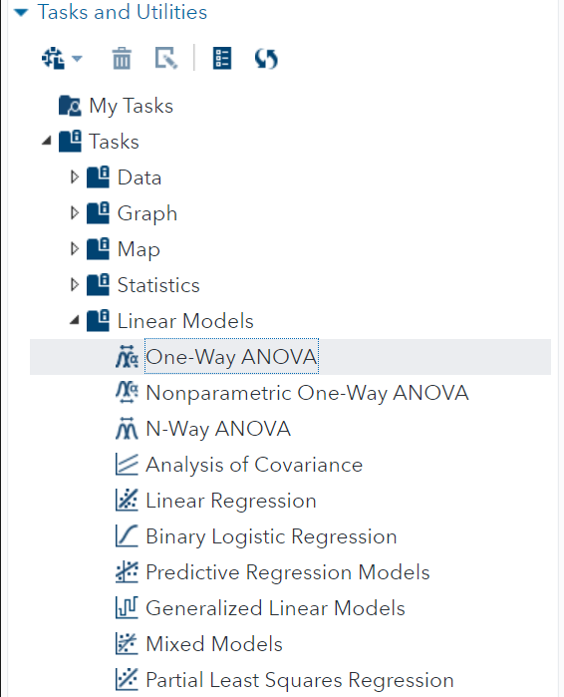
One-Way ANOVA
Let’s explore the One-Way ANOVA task

Slide 6
9.01 Activity
We would like to determine the effectiveness of three different methods to improve reading speed between males and females
Select Tasks and Utilities in the Navigation pane. Expand Tasks, expand Linear Models and double-click One-Way ANOVA.
Select the STATS.READING data set and Two-sample test
Select Words_per_Minute as the Analysis variable
Select Method as the Categorical variable
On the OPTIONS tab, select Levene for the test of equal variance
Select the Running Icon
Notes:
Type answer here

Slide 7
9.02 Multiple Choice Question
Which method improved reading speed?
  A
  B
  C
Notes:
Correct Answers: a, b, c

Slide 8

9.02 Multiple Choice Question
Which method improved reading speed?
  A
  B
  C
Notes:
Correct Answers: a, b, c

Slide 9
Cody Ch 9: Comparing More Than
Two Means (ANOVA)
9.1 One-Way ANOVA
9.2 Nonparametric One-Way ANOVA

Slide 10
Not Normal?
PROBLEM: You suspect the distribution assumptions are not satisfied
SOLUTION: Use the nonparametric One-Way ANOVA task

Slide 11
9.03 Activity
We would like to analyze the weights of three species of fish
Select Tasks and Utilities in the Navigation pane. Expand Tasks, expand Linear Models and double-click Nonparametric One-Way ANOVA
Select the SASHELP.FISH data set
Create a filter on the DATA to select Bream, Roach and Pike fish only:
  Species in ("Bream", "Roach", "Pike")
Select Weight as the Dependent variable
Select Species as the Classification variable
On the OPTIONS tab, select Pairwise multiple comparisons analysis (asymptotic only) under Additional Tests
Select the Running Icon
Notes:
Type answer here

Slide 12
Questions?

