Slide 1
Cody Ch 10: N-Way ANOVA
10.1 Two-Way ANOVA
10.2 Models with Significant Interaction

Slide 2
Re-Create Cody Work Files
Navigate to your copy of the Cody folder
Double-click the Create_Datasets.sas program.
Run the program
Check the LOG for errors
Examine the STATS library contents
Notes:
Correct Answers: a, b, c

Slide 3
Cody Ch 10: N-Way ANOVA
10.1 Two-Way ANOVA
10.2 10.2 Models with Significant Interaction

Slide 4
N-Way ANOVA
Used to compare means among more than one independent groups.
Assumptions:
Normally distributed measures for each groups
Variances in each group are equal

Slide 5
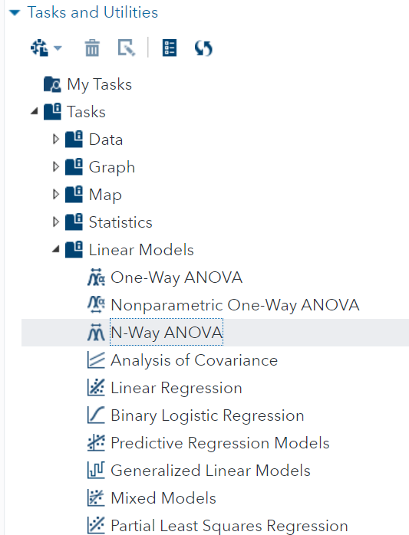
Two-Way ANOVA
Now let’s expand on what we have learned using the N-Way ANOVA task

Slide 6
10.01 Activity
We would like to determine the effect of gender and training on the ability to do pushups
Select Tasks and Utilities in the Navigation pane. Expand Tasks, expand Linear Models and double-click N-Way ANOVA.
Select the STATS.EXERCISE data set
Select Pushups as the Dependent variable
Select Gender and Training as the Factors
On the MODEL tab, select Edit
Select Gender and Training and click Full Factorial
On the OPTIONS tab select Default and additional statistics
Deselect Sequential sum of squares (Type 1), but keep Type 3
Select the Running Icon
Notes:
Type answer here

Slide 7
10.02 Multiple Choice Question
Which factor(s) had a significant impact on pushups?
Gender
Training
Gender*Training
Gender and Training
Gender, Training and Gender*Training
Notes:
Correct Answers: a, b, c

Slide 8

10.02 Multiple Choice Question
Which factor(s) had a significant impact on pushups?
Gender
Training
Gender*Traing
Gender and Training
Gender, Training and Gender*Training
Notes:
Correct Answers: a, b, c

Slide 9
Cody Ch 10: N-Way ANOVA
10.1 Two-Way ANOVA
10.2 10.2 Models with Significant Interaction

Slide 10
10.03 Activity
We would like to determine the effective of gender and dose on a person’s strength
Edit the task from Activity 10.01
Select Strength as the Dependent variable
Select Gender and Dose as the Factors
Use the same Model as before
On the OPTIONS tab select Perform multiple comparisons
Deselect Sequential sum of squares (Type 1) but keep Type 3
Select the Running Icon
Notes:
Type answer here

Slide 11
10.04 Multiple Choice Question
How should you interpret the Gender*Dose significance?
Dose had the same effect on Males as Females
Dose positively impacted Males more than Females
Dose positively impacted Females more than Males
Notes:
Correct Answers: a, b, c

Slide 12
10.04 Multiple Choice Question
How should you interpret the Gender*Dose significance?
Dose had the same effect on Males as Females
Dose positively impacted Males and negatively impacted Females
Dose positively impacted Females and negatively impacted Males
Notes:
Correct Answers: a, b, c

Slide 13
10.05 Activity
We would like to untangle the effect of Gender*Dose
Edit the task from Activity 10.03
On the OPTIONS tab, under STATISTICS, select Default and additional statistics
Select All effects
Select the Running Icon
Notes:
Type answer here

Slide 14
Questions?

