Slide 1
SAS Viya Training
Three hands-on lectures from SAS Education
Thursdays: April 15, 22 and 29 from 5:30-8:30
We would not have Data Mining class on April 19 or 21
Register for Viya for Learners
https://www.sas.com/en_us/software/viya-for-learners.html
Brief Walk-Through

Slide 2
Cody Ch 13: Binary Logistic Regression
13.1 Odds Ratios
13.2 Single Predictor Logistic Regression
13.3 Continuous Variables as a Predictor
13.4 Three Classification Variables
13.5 Concordant Discordant Pairs

Slide 3
Binary Logistic Regression
Predicting the probability of a binary outcome:
1 or 0
Poor Care or Good Care
Heart Disease or No Heart Disease
Use one or more predictor variables or “risk factors”
Smoking, Age, Cholesterol, Gender, etc.

Slide 4
Cody Ch 13: Binary Logistic Regression
13.1 Odds Ratios
13.2 Single Predictor Logistic Regression
13.3 Continuous Variables as a Predictor
13.4 Three Classification Variables
13.5 Concordant Discordant Pairs

Slide 5
Probability and Odds
Probability of Success
No. Success / Total
0 ≤ P ≤ 1
Odds of Success
No. Success / No. Failures
Odds Ratio
Odds Group 1 / Odds Group 2

Slide 6
Example of Probability and Odds
In a fictitious health study, 5 people out of 100 who had low cholesterol had heart attacks while 15 people out of 70 who had high cholesterol had heart attacks.
Probability of heart attack overall is:
20/170 = 0.12
Odds of Low Cholesterol group having heart attack is:
O_{L} = 5/95 or 0.053
Odds of High Cholesterol group having heart attack is:
O_{H} = 15/55 or 0.273
Odds Ratio for High Cholesterol vs Low Cholesterol is:
O_{H}/O_{L} = 0.273/0.053 = 5.15
People with High Cholesterol are 5.15 times more likely to experience a heart attack compared to Low Cholesterol

Slide 7
Cody Ch 13: Binary Logistic Regression
13.1 Odds Ratios
13.2 Single Predictor Logistic Regression
13.3 Continuous Variables as a Predictor
13.4 Three Classification Variables
13.5 Concordant Discordant Pairs

Slide 8
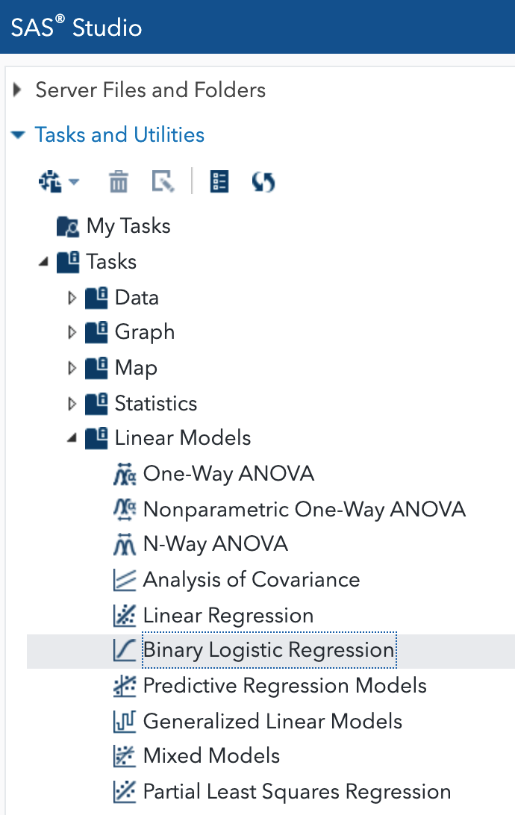
Binary Logistic Regression Task
Binary Logistic Regression is under Linear Models

Slide 9
13.01 Activity
We would like to investigate the role Gender plays on likelihood of heart attack.
Select Tasks and Utilities in the Navigation pane. Expand Tasks, expand Linear Models and double-click Binary Logistic Regression
Select the STATS.RISK data set
Select Heart_Attack as the Response variable
In the Event of interest: drop-down, select 1 (yes had heart attack)
Select Gender for the Classification variables:
Expand Parameterization of Effects and select Reference Coding
On the MODEL tab, verify that Main effects model is selected
Select the Running Icon
Notes:
Type answer here

Slide 10
13.02 Multiple Choice Question
Which statement about Gender and Heart Attack is True
Gender is not a significant factor in likelihood of heart attack
The Cholesterol*Gender interaction is a significant factor in Heart Attack
Males are almost 2.7 times more likely to have a heart attack than Females.
Notes:
Correct Answers: a, b, c

Slide 11
13.02 Multiple Choice Question
Which statement about Gender and Heart Attack is True?
Gender is not a significant factor in likelihood of heart attack
The Cholesterol*Gender interaction is a significant factor in Heart Attack
Males are almost 2.7 times more likely to have a heart attack than Females.
Notes:
Correct Answers: a, b, c

Slide 12
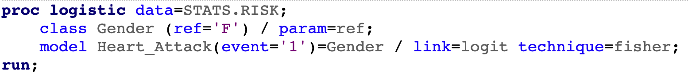
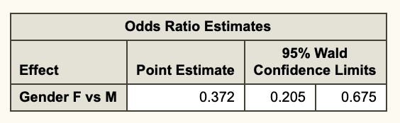
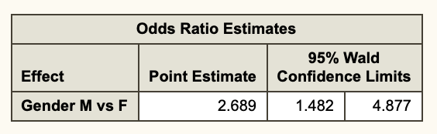
Demo of Reference Values
In the previous analysis, Male was our reference value and the Odds Ratio was expressed a Female vs Male. What we we would like to switch that around?
Notes:
Type answer here

Slide 13
Cody Ch 13: Binary Logistic Regression
13.1 Odds Ratios
13.2 Single Predictor Logistic Regression
13.3 Continuous Variables as a Predictor
13.4 Three Classification Variables
13.5 Concordant Discordant Pairs

Slide 14
13.03 Activity
We would like to investigate the role Cholesterol plays on likelihood of heart attack.
Start a new Binary Logistic Regression task using the STATS.RISK data set
Select Heart_Attack as the Response variable
In the Event of interest: drop-down, select 1 (yes had heart attack)
Select Chol for the Continuous variables:
Expand Parameterization of Effects and select Reference Coding
On the MODEL tab, verify that Main effects model is selected
Select the Running Icon
Notes:
Type answer here

Slide 15
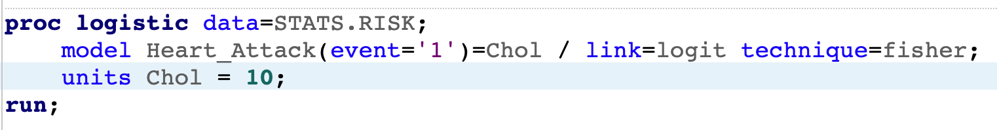
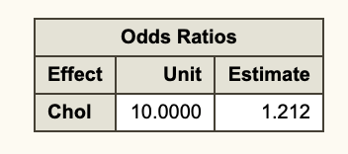
13.04 Demo
The previous analysis showed a 1.019 increase in risk with each “unit” of cholesterol. What is the risk per 10 units?
To find out, we can edit the code and rerun the analysis.
This tells us that for every 10 units of cholesterol, there is a 21% increase risk of heart attack
Notes:
Type answer here

Slide 16
Cody Ch 13: Binary Logistic Regression
13.1 Odds Ratios
13.2 Single Predictor Logistic Regression
13.3 Continuous Variables as a Predictor
13.4 Three Classification Variables
13.5 Concordant Discordant Pairs

Slide 17
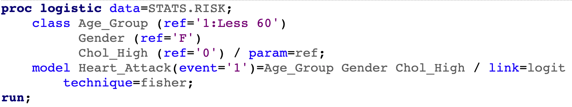
13.04 Activity
We would like to investigate the role that Cholesterol, Age and Gender play in heart attack risk.
Start a new Binary Logistic Regression task using the STATS.RISK data set
Select Heart_Attack as the Response variable
In the Event of interest: drop-down, select 1 (yes had heart attack)
Select Age_Group, Gender and Chol_High for the Classification variables:
Expand Parameterization of Effects and select Reference Coding
On the MODEL tab, verify that Main effects model is selected
On the CODE tab select Edit so you can edit the generated code
Select the Running Icon
Notes:
Type answer here

Slide 18
13.05 Multiple Choice Question
Which statement gives a relative order of risk factors from high to low?
Age, Cholesterol, Gender
Gender, Age, Cholesterol
Cholesterol, Gender, Age
Notes:
Correct Answers: a, b, c

Slide 19
13.05 Multiple Choice Question
Which statement gives a relative order of risk factors from high to low?
Age, Cholesterol, Gender
Gender, Age, Cholesterol
Cholesterol, Gender, Age
Notes:
Correct Answers: a, b, c

Slide 20
Cody Ch 13: Binary Logistic Regression
13.1 Odds Ratios
13.2 Single Predictor Logistic Regression
13.3 Continuous Variables as a Predictor
13.4 Three Classification Variables
13.5 Concordant Discordant Pairs

Slide 21
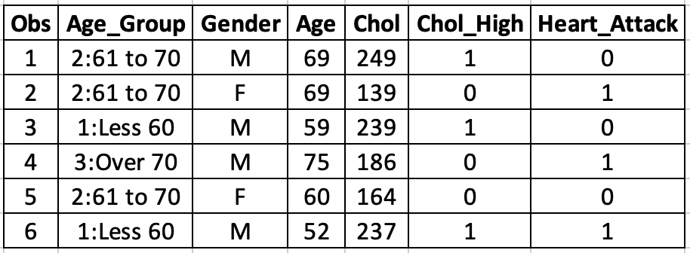
Concordant/Discordant Analysis

Slide 22
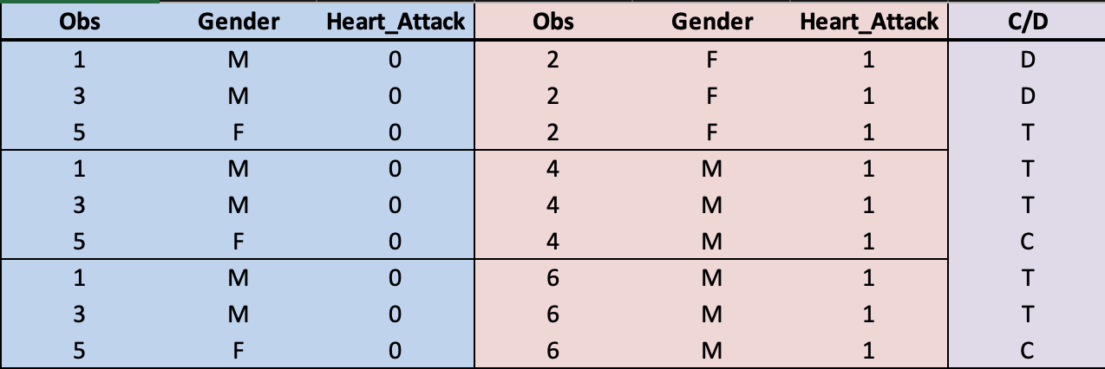
Concordant/Discordant Analysis
Discordant = 2
Concordant = 2
Ties = 5

Slide 23
Questions?

