Slide 1



Slide 2
What is Pandas?

Slide 3
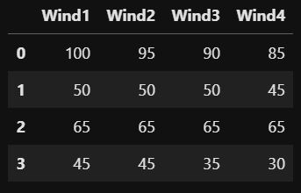
Axis
Axis = 1
Means across Axis 1
92.50
Axis = 0
48.75
65.00
38.75
Means down Axis 0
65.00
48.75
65.00
38.75

