Slide 1
Welcome to Information Structures Getting Started
Don Koch
dokoch@lipscomb.edu
919-649-0447

Slide 2
Topics
Data Science Tools
SAS
Python
Getting Your PC Configured
Python Data Structures

Slide 3
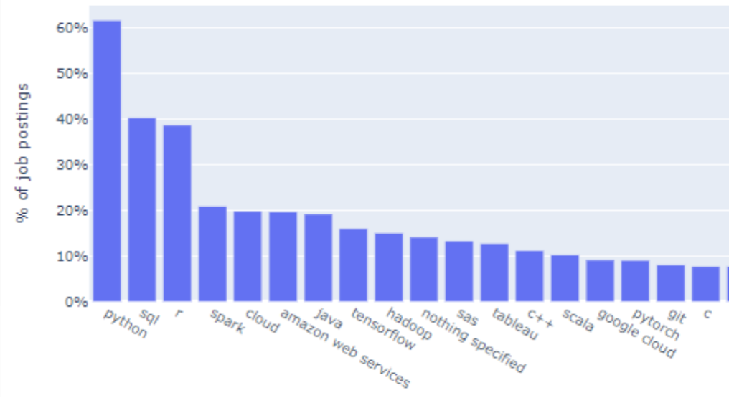
Tools Employers are Looking for
What are the In-Demand Skills for Data Scientists in 2020

Slide 4
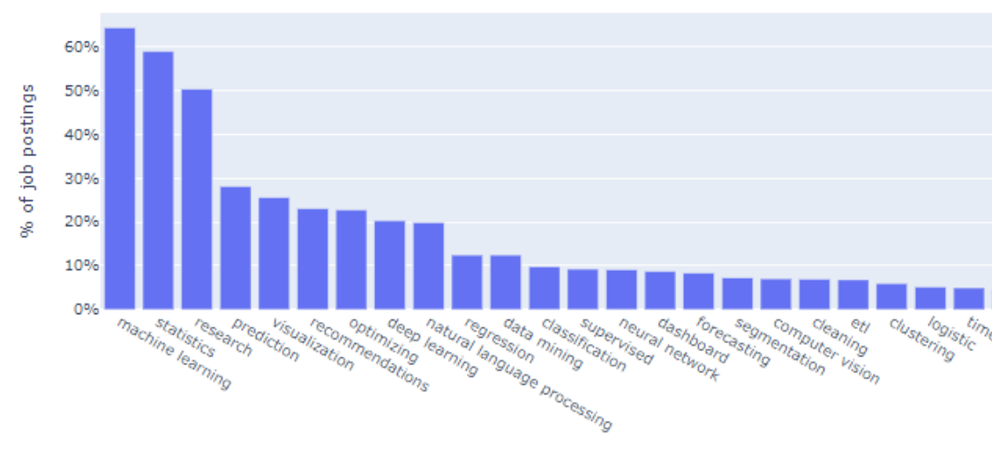
Skills Employers are Looking For
What are the In-Demand Skills for Data Scientists in 2020

Slide 5
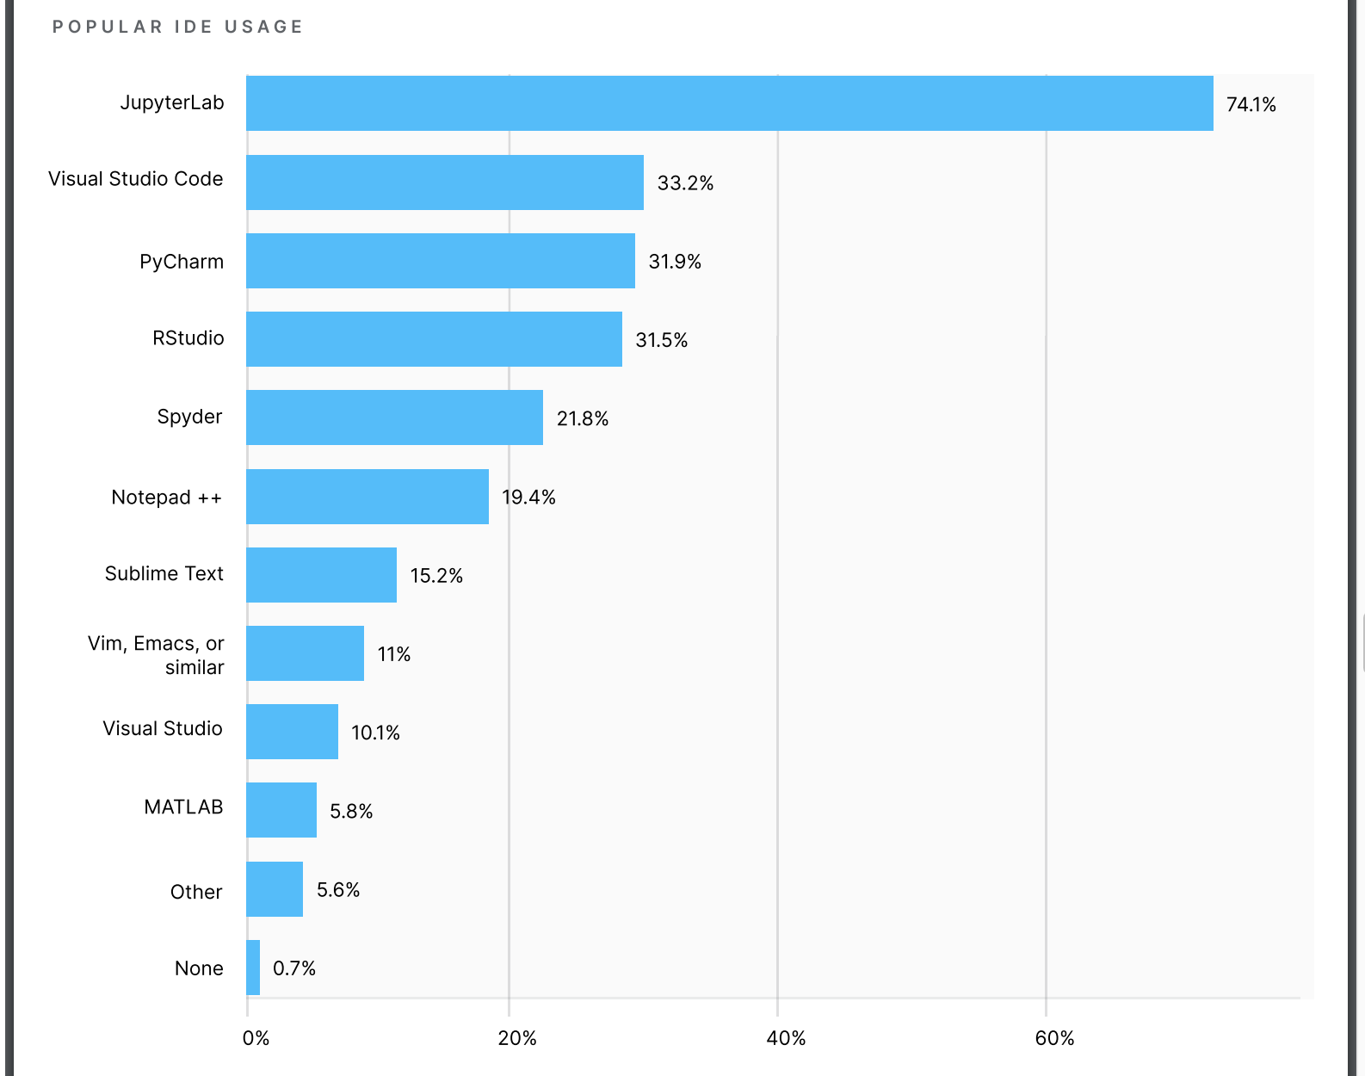
IDE Usage
State of Data Science and Machine Learning 2020

Slide 6
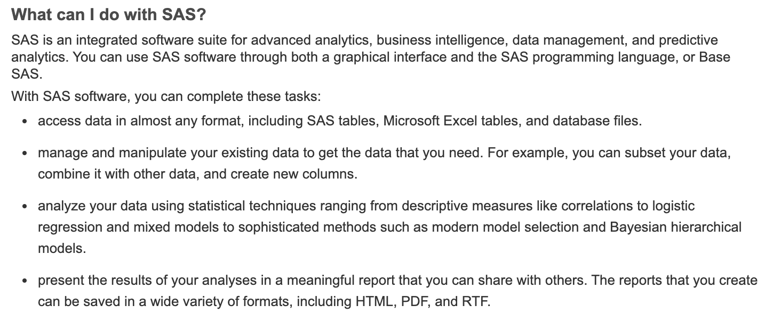
SAS
Founded in 1976 – 44 years ago
Used by almost every Fortune 500 Company
Thousands of SAS jobs on Indeed.com for example
Astounding breadth of capability

Slide 7
Python
Python is a programming language.
Free and Open Source Software (FOSS)
Extended by a vast library of packages
From PyPi
Used extensively for Data Science
Libraries exist to support almost every human endeavor

Slide 8
Software Installation
Anaconda: Easiest way to get a full-featured Python install
https://www.anaconda.com/products/individual#Downloads
Java: Required for SASPy
https://java.com
SASPy: Python library for SAS/Python connection
Launch Anaconda
Launch JupyterLab
File -> New -> Terminal
conda install saspy

Slide 9
REPL
Read
Execute
Print
Loop

Slide 10
Configure SASPy
Create ”sascfg_personal.py”
Create “.authinfo”

