Slide 1

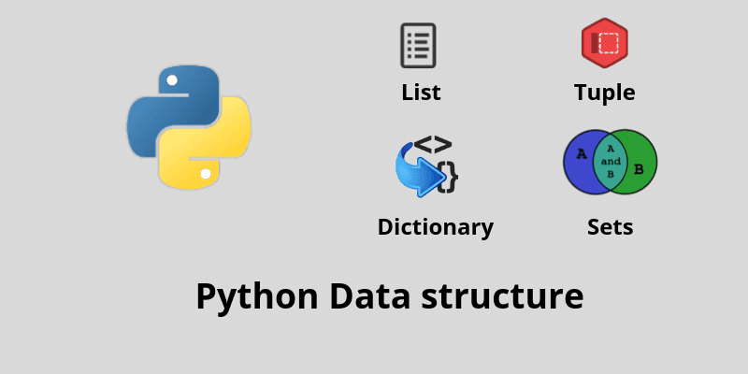

Slide 2

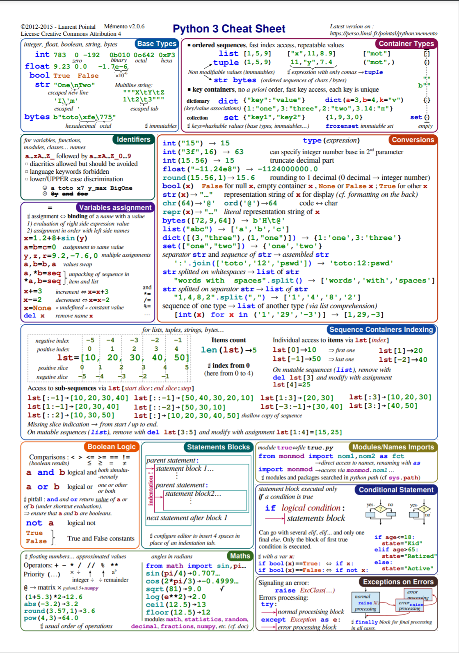



The Python 3 Cheat Sheet
https://perso.limsi.fr/pointal/python:memento

Slide 3
Numbers

Slide 4
Types of Numbers
Integer (int)
Float (float)
Complex (complex)

Slide 5
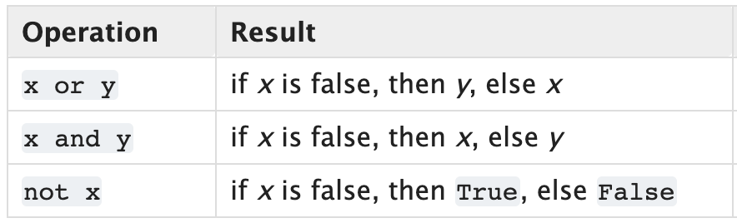
Boolean Operators

Slide 6
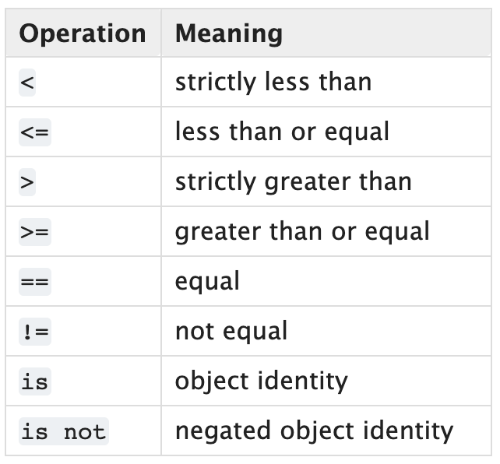
Comparisons

Slide 7
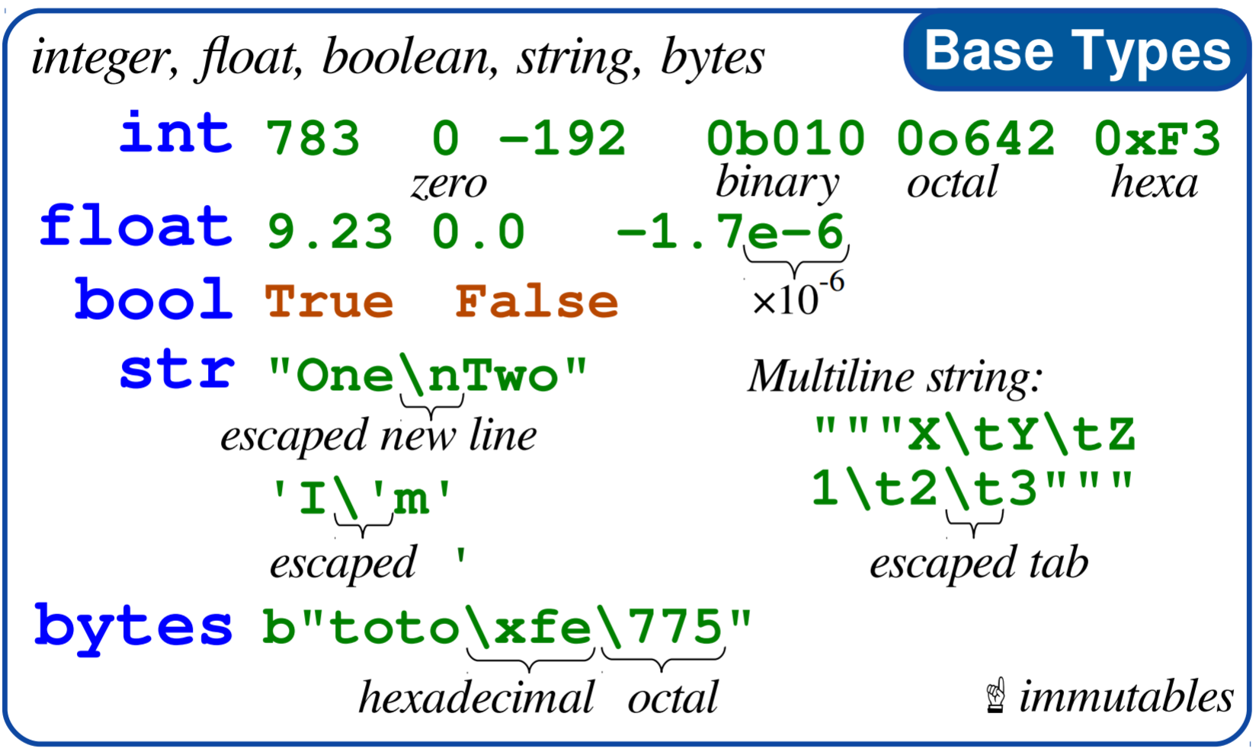
Cheat Sheet

Slide 8
Sequences
Python

Slide 9
Sequences
Finite ordered sets of N items
Indexed by non-negative integers: 0, 1, …, N-1
len() returns number of items N
Slicing a sequence ’seq’
seq[i:j] selects all items between i and j-1
Extended slicing with a ”step”
Seq[i:j:k] selects items at k intervals between I and j-1

Slide 10
Sequence Types
There are three basic sequence types
list
tuple
range

Slide 11
Immutable Sequences (cannot be changed)
Strings
A sequence of Unicode in range of U+0000 to U+10FFFF
‘Hello World’
Tuples
A sequence of arbitrary Python Objects separated by commas
4, ‘four’, 3.14 often written with optional parens (4, ‘four’, 3.14)
Bytes
Array of 8-bit bytes, integers 0 to 255
b’Hello World’

Slide 12
Mutable Sequences (can be changed)
Lists
Sequence of arbitrary Python objects, separated by commas in [ ]
[4, ‘four’, 3.14] brackets required
Byte Arrays
Like immutable bytes objects but mutable
Only created with bytarray() constructor

Slide 13
Sequence Operations

Slide 14
Mutable Sequence Operations

Slide 15
Literals
Notations for constant values

Slide 16
String Literals
Unicode => 1-4 bytes per character
”Hello”
’Hello’
f”Hello, I’m {name}”

Slide 17
Byte Literals
Not Unicode => 1 byte per character
b”Hello”
b’Hello’
B”Hello”
B’Hello’

Slide 18
Integer Literals
Regular Integers 42
True or False Same as 1 or 0
Hexadecimal 0xFFDA0
Binary 0b01001
Octal 0o1743

Slide 19
Floating Point Literals
42.
3.14
.031
2.99792e8
1_000_000

Slide 20
Imaginary Literals
3.14j
10.j
10j
.001j
1e100j
3.14e-10j
3.14_15_93j

Slide 21
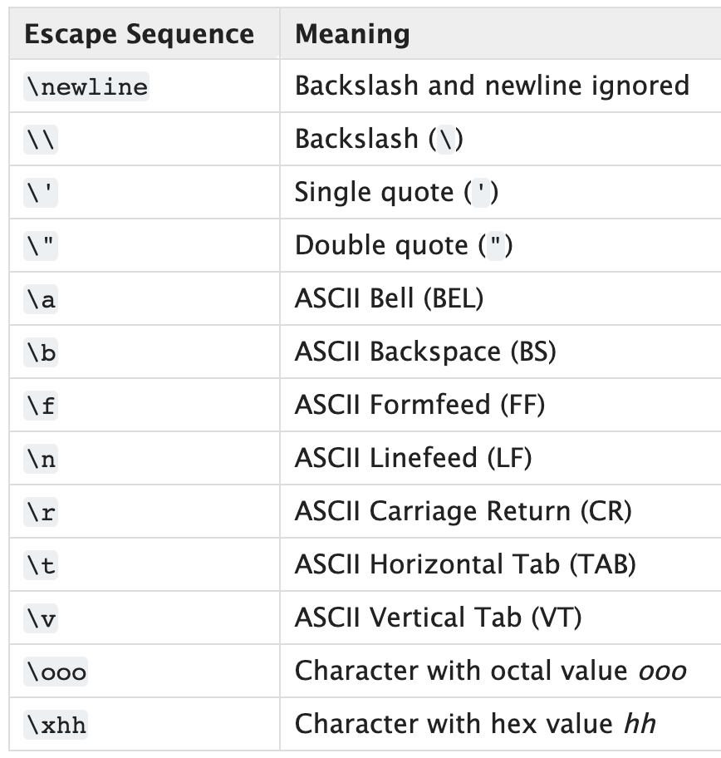
Escape Sequences

