Slide 1

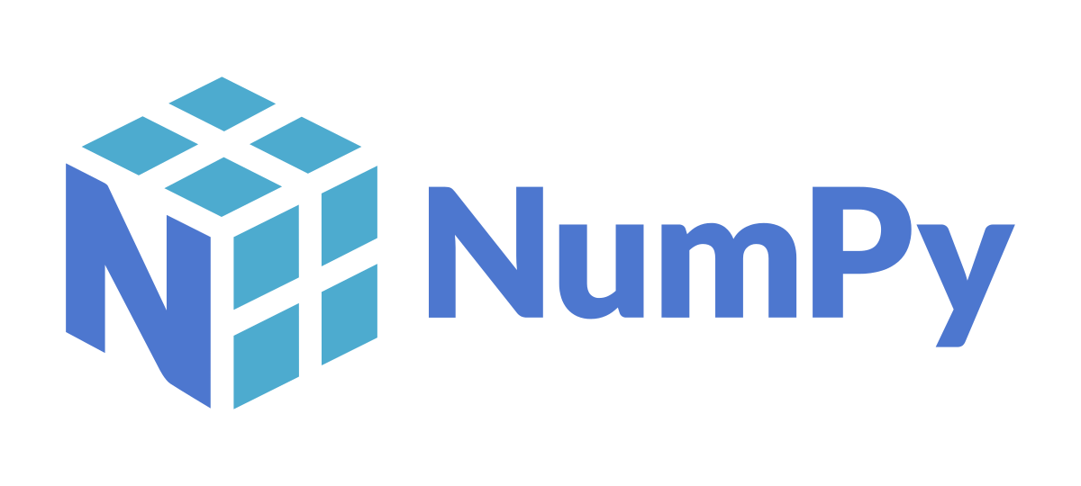

Slide 2
What is Numpy?
A Python Library for Numerical Computing
Created in 2005
100% FOSS
Numpy.org
https://numpy.org/doc/stable/user/whatisnumpy.html

Slide 3
Who Uses Numpy?
Over 20,000 packages depend on numpy
pandas
matplotlib
scikit-learn
keras
scipy
scikit-image
statsmodel

Slide 4
Key Features
Core is a Multidimensionally Array Object
ndarray : n-dimensional array of homogenous data types
Many routines for fast operations on the ndarray
Highly optimized compiled code and efficient memory utilization
Supports large data operations more efficiently
Simpler than base Python code

Slide 5
For example a and b are two lists of numbers of equal length We wish to multiply them together, element by element
Basic Python Code
c = []
for i in range(len(a)):
c.append(a[i] * b[i])
NumPy Code
c = a * b

Slide 6
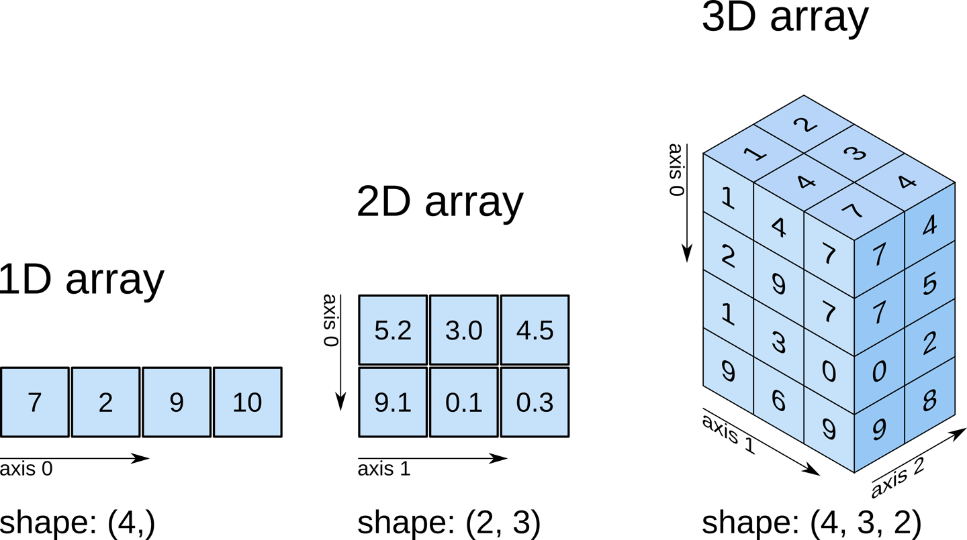
ndarray all objects are same type
https://medium.datadriveninvestor.com/artificial-intelligence-series-part-2-numpy-walkthrough-64461f26af4f

Slide 7
ndarray
One Dimensional Array
[2, 3, 4]
Two Dimensional Array
[[2, 3, 4],
[6, 7, 8]]
Three Dimensional Array
[[[2, 3, 4],
[6, 7, 8]],
[[10, 11, 12],
[13, 14, 15]]]

