Slide 1
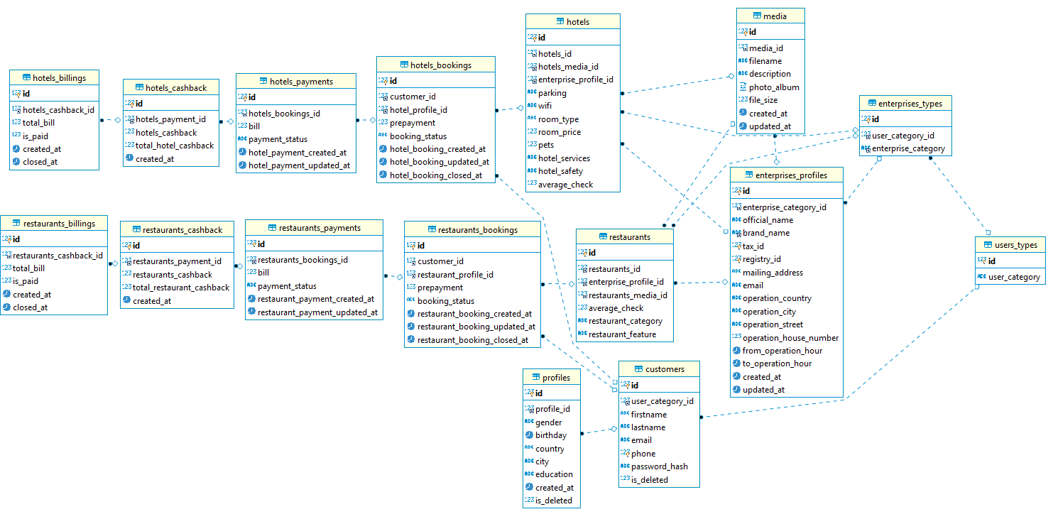
MOTU ERDiagram

