Slide 1
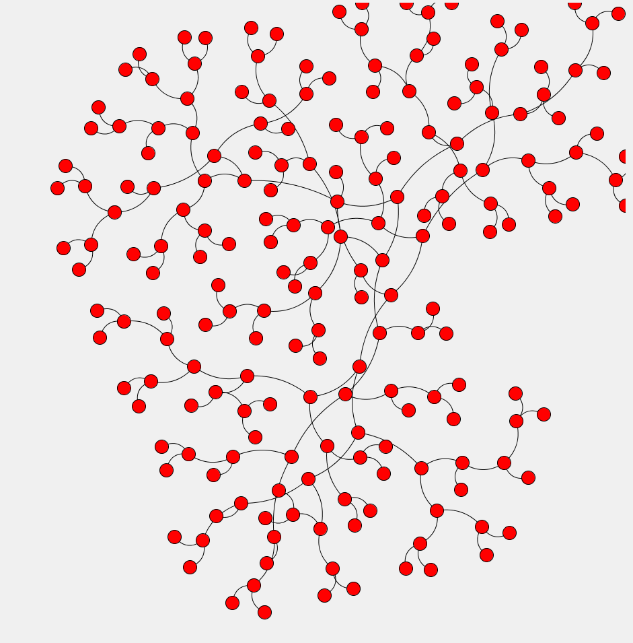
Datasets and slides:
https://github.com/doktor-nick/intro-to-network-viz
Introduction to Network Visualisation and Cytoscape
Nick Hamilton
n.hamilton@imb.uq.edu.au
IMB, RCC & QCIF - UQ
Power corrupts.
PowerPoint corrupts absolutely.
- Edward Tufte
Notes:
Next phase of the genome revolution
Sequencing of many genomes and proteomes, has created the need for large-scale systematic approaches to understand the functions of the tens of thousands of proteins
High-throughput automated fluorescent microscope imaging technologies for screenings of protein localisation enable 100’s images/second to be taken
Whole genome screens: Huh et al. (Nature 425) screened 4156 proteins representing 75% of yeast proteome and manually classified the images into 22 localisations
Estimated that a whole human genome RNAi screen could be done in 2 weeks but would produce 1,000,000 images!

Slide 2
Fundamental Ideas of
Networks / Graphs

Slide 3
Core Definitions
A network or graph is a collection of nodes or vertices
and a set of edges that connect pairs of nodes.
Edges may be undirected or directed or have loops
A graph might have multiple disconnected components
source target
3 components
Notes:
A graph represents relational information.

Slide 4
A simple example
Nodes: people in this Zoom
Edges: “are friends”
Nodes: people in this Zoom
Edges: “likes”
Notes:
Sitting next to.
Mathematicians!
Likes may not be reciprocated.

Slide 5
Which graph bit is the most important?
For an undirected graph, the degree of a node is the number of edges connected to a node
Degree 6
Degree 0
If the graph is directed, define in-degree and out-degree defined similarly
In-degree 2
Out-degree 4
Notes:
First question: most imporant bits.
Killworth et al. (2006) went so far as to declare that estimating the degree distribution is “one of the grails of social network theory.“
Like more people than like them.

Slide 6
Robustness: What happens if I break it?
Node Deletion. Take the graph and delete a node and all
its edges.
Node separation set: a subset of nodes whose deletion causes the number of components in the graph to increase
Mutations reducing activity in the p53 gene are present in over 50% of human tumours! (Haupt et al. 2003)
Notes:
The other way to look at importance that is very popular with biologists is …
Robustness of the network%%%
First example, can see have not broken too much.
Edge deletion: block the interaction between the pair

Slide 7
Robustness: What happens if I break it?
Edge Deletion. Delete an edge (but not the nodes it joins)
Cut set: as for node separation set, but deleting edges
Network Robustness: how hard is it to break the network?
Delete a random node or edge: it is still connected?
Notes:
Interfere with an interaction.
P53 network is said to be quite robust, except for the hub nodes : small world network
Blocking a transformation in metabolic network
CF Military communication networks.

Slide 8
What are the (functional) modules?
Components
But what about:
Mathematicians
Biologists
Clique. A subset of nodes, each pair joined by an edge
A maximal clique is contain in no larger clique

Slide 9
Clustering Coefficient
How do we tell if a node u is in a cluster?
C_{u} = 8/21
u
C_{u} = 0
u
Why? - Lots of triangles on the node
- i.e. mutual connection
For a node u of degree k, where there are e edges between neighbours of u, define the cluster coefficient C_{u} as:
C_{u} = e / [k(k-1)/2]
# triangles on u
Maximum possible # triangles on u
For a graph, then define the average cluster coefficient
Notes:
Maximum possible would be 1 for a node in a clique.]
Can then use this to measure modularity in biological networks, turns out these networks are much more modular than you might expect
Compared to, say, a random graph.

Slide 10
Introduction to Cytoscape for
Creating and Visualising Networks

Slide 11
What we will cover in this introduction
Basic interactive graph creation and interaction
Simple formats for creating networks in Excel
Network Analyser for basic network statistics
Styles in Cytoscape
Apps in Cytoscape
Network layout
Network filtering and selection
Getting more help
Notes:
Do for imaging what bioinformatics has done for sequencing.
Biologists are often still looking at a single image at a time.

Slide 12
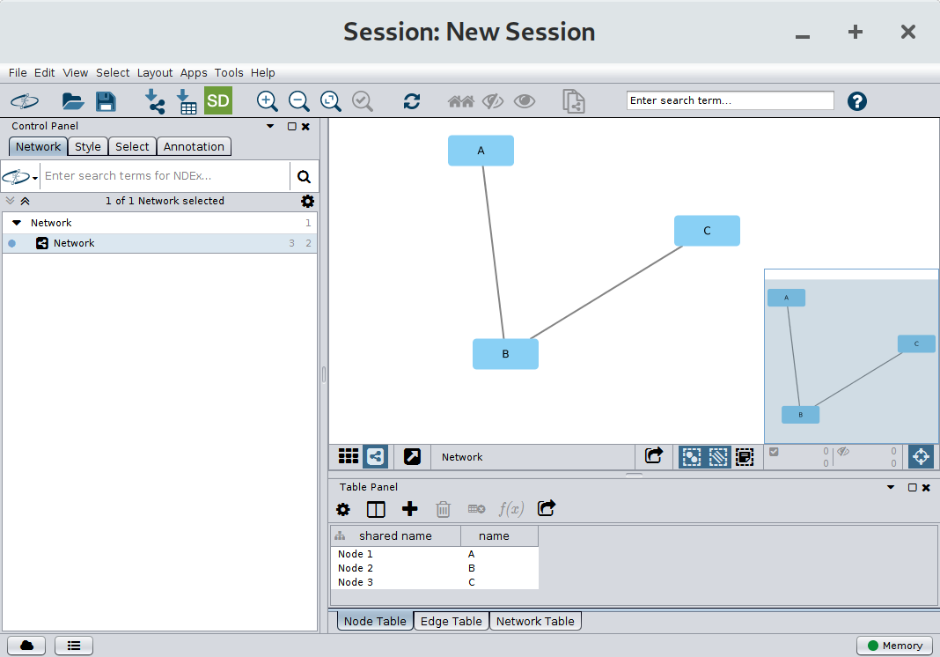
Overview of the Cytoscape Interface
Notes:
Do for imaging what bioinformatics has done for sequencing.
Biologists are often still looking at a single image at a time.

Slide 13
Some Example Networks in Cytoscape

Slide 14
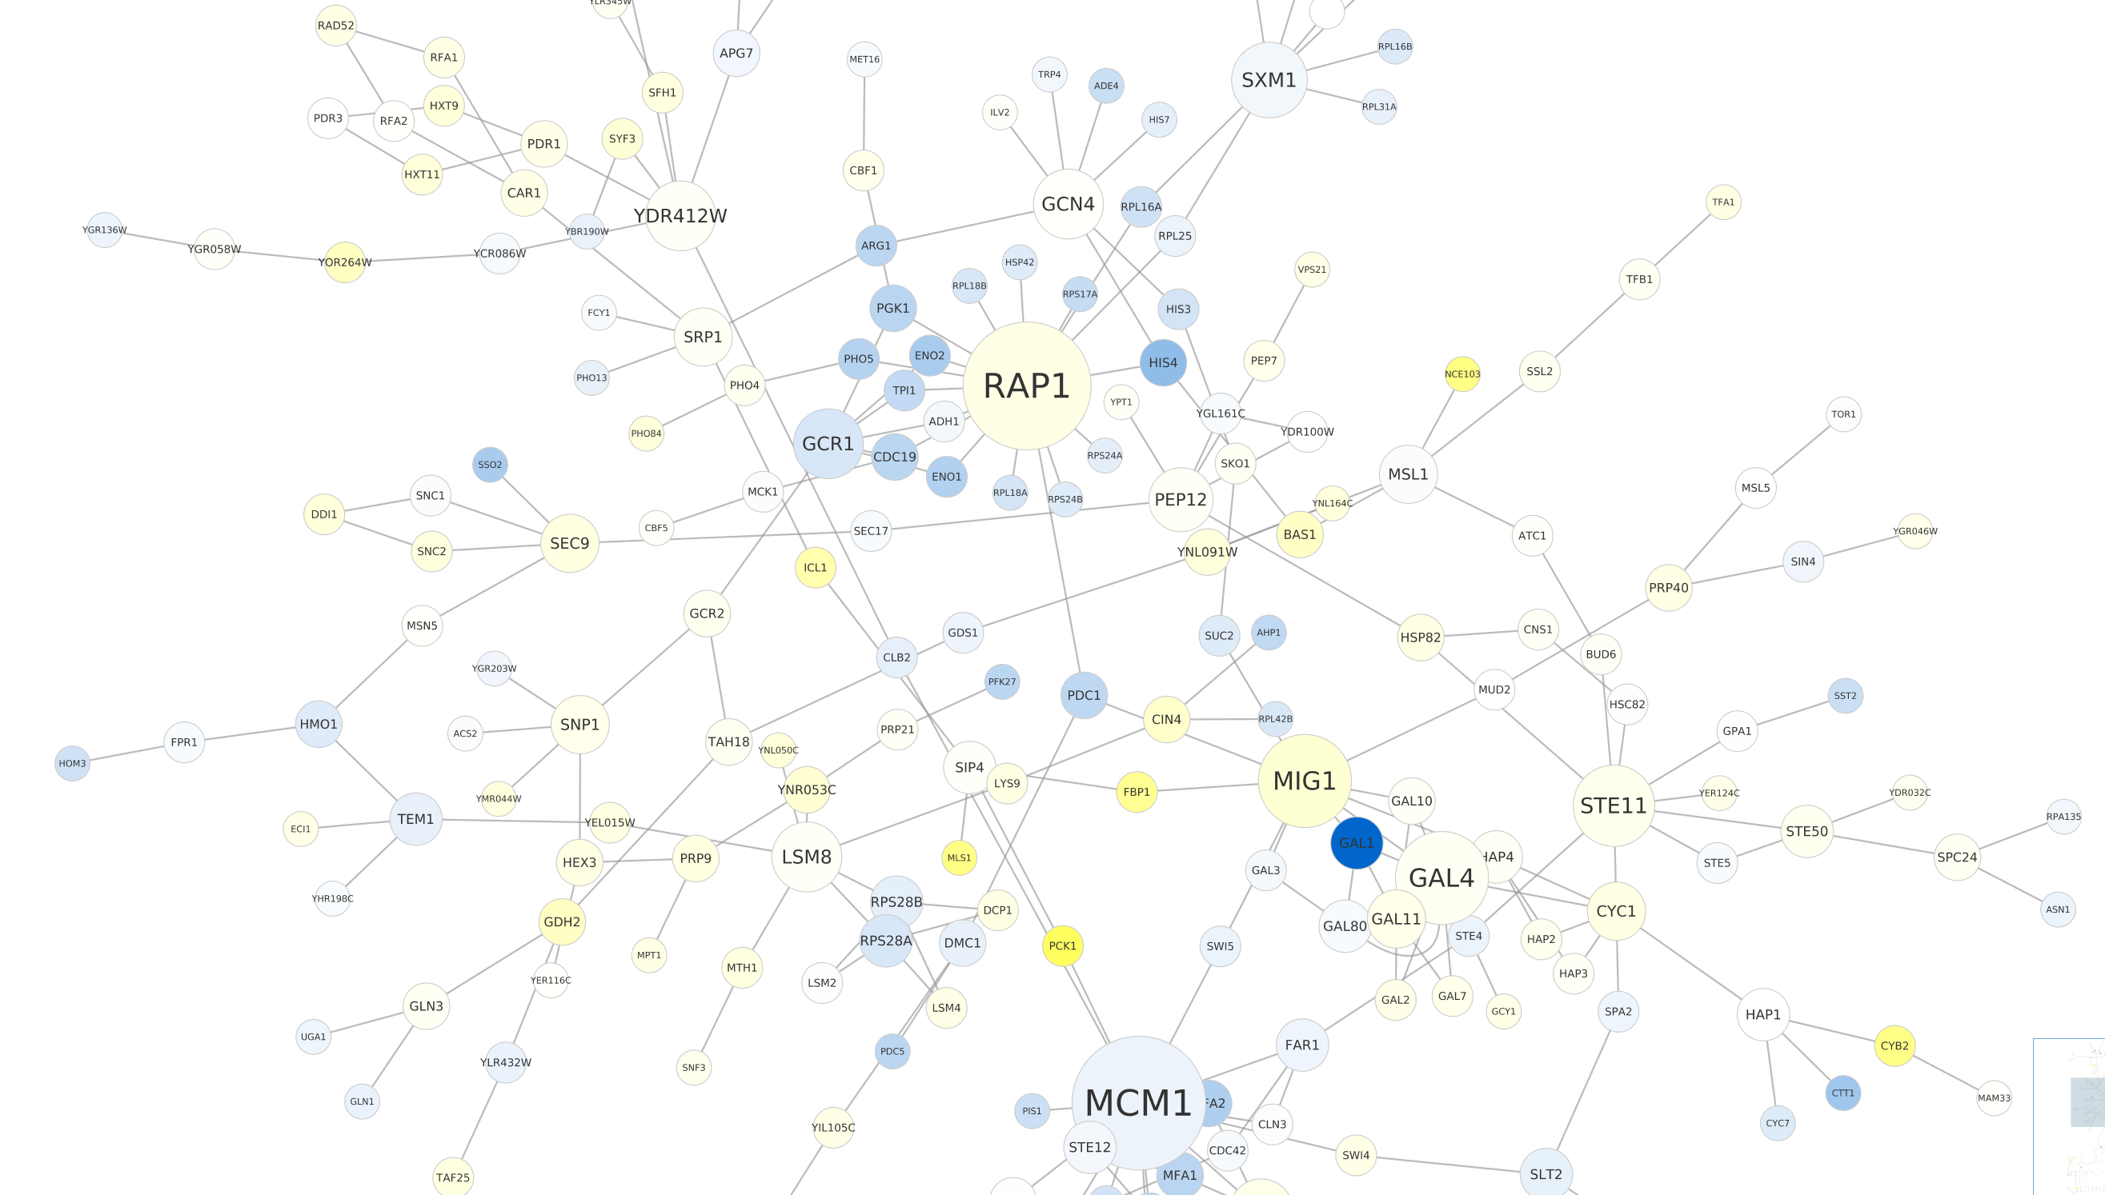
Examples: Yeast Perturbation Network
Nodes are proteins. GAL1, GAL4, GAL80 are transcription factors which have been perturbed. Size represents number of interactions. Colour represents expression level when GAL1 is perturbed.
Tutorial on protein expression data in Cytoscape:
https://cytoscape.org/cytoscape-tutorials/protocols/basic-data-visualization/#/
Notes:
Do for imaging what bioinformatics has done for sequencing.
Biologists are often still looking at a single image at a time.

Slide 15
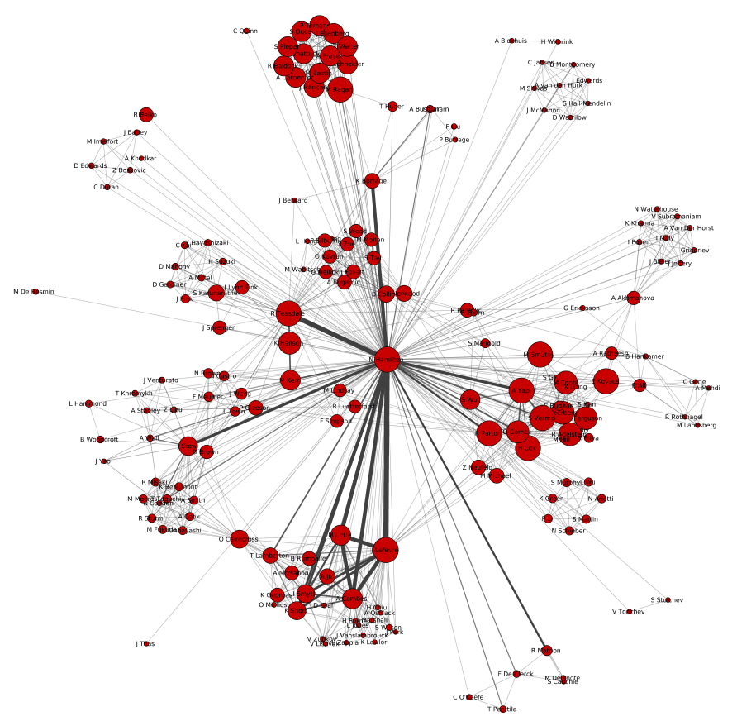
Example: Co-publication Network
Who has published
with Dr Nick?
Notes:
Do for imaging what bioinformatics has done for sequencing.
Biologists are often still looking at a single image at a time.

Slide 16
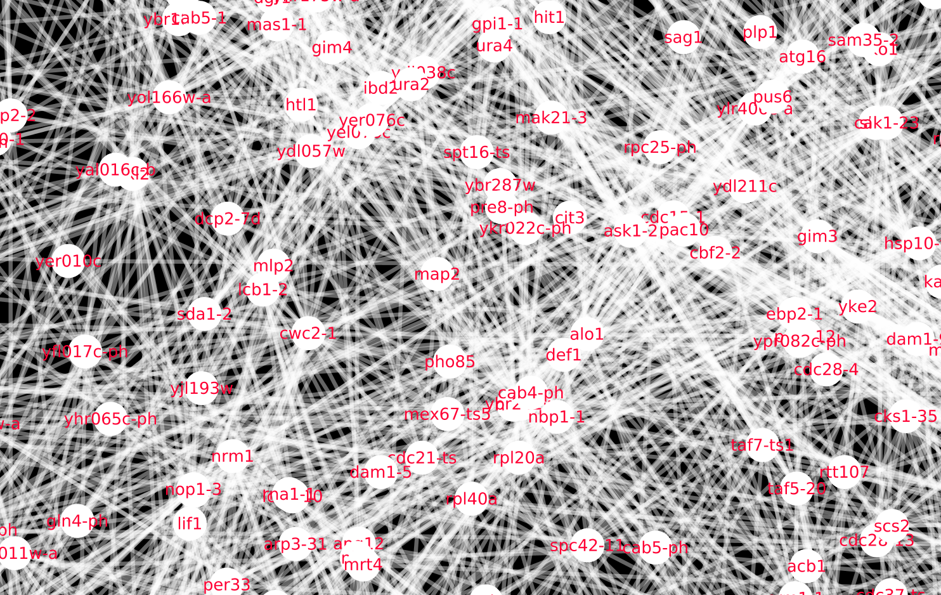
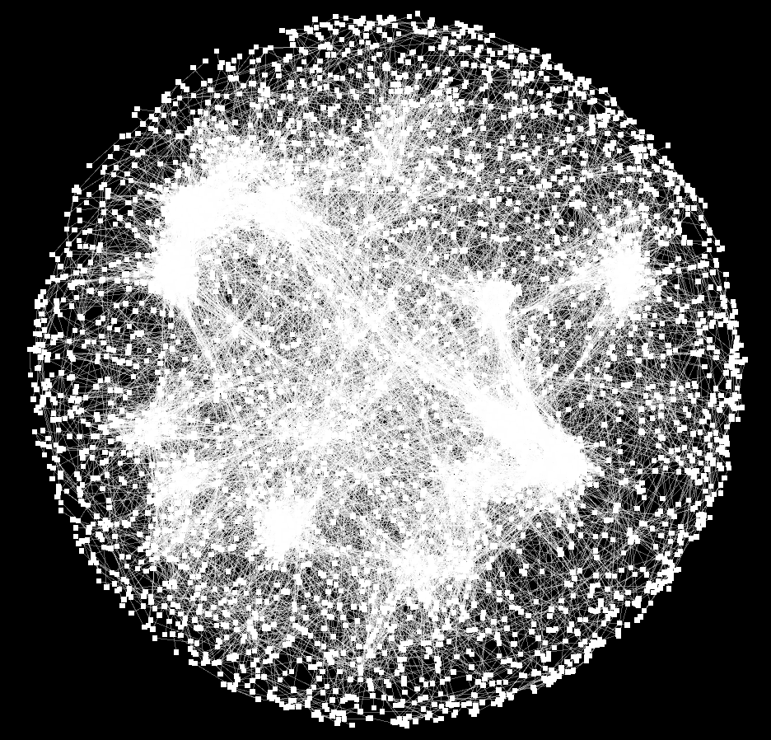
Examples: Yeast Gene Interactions
Notes:
Do for imaging what bioinformatics has done for sequencing.
Biologists are often still looking at a single image at a time.

Slide 17
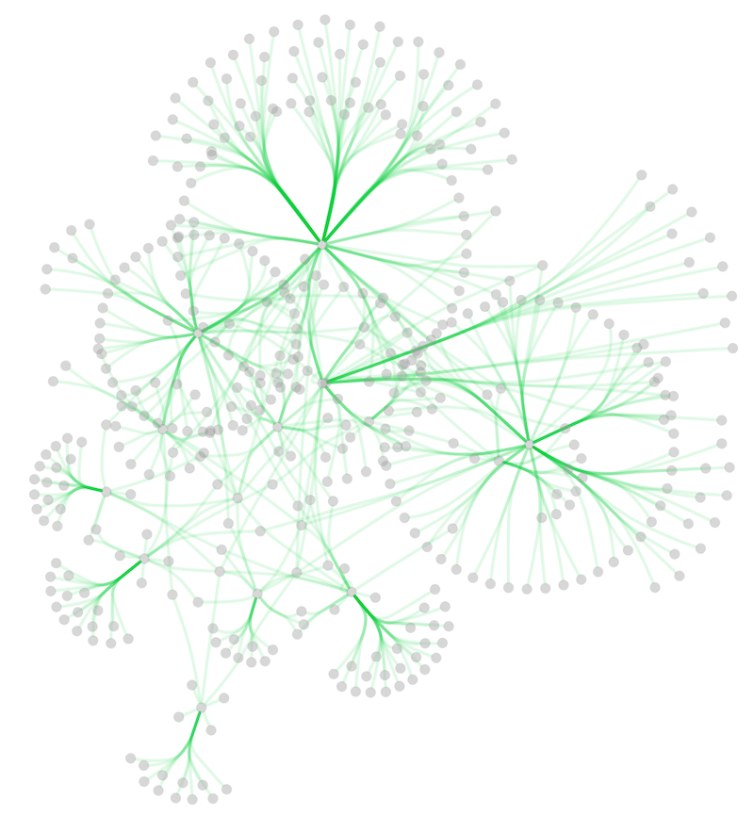
Bundling edges
From: http://manual.cytoscape.org/en/stable/Navigation_and_Layout.html
Notes:
Do for imaging what bioinformatics has done for sequencing.
Biologists are often still looking at a single image at a time.

Slide 18
Exercise: Create a simple graph interactively
Create a new empty network
Select: File →New Network → Empty
Give it a name, e.g. “My Network”, and click OK.
Add 3 nodes
Right click on the canvas and select: Add → Node 3 times
Rename the nodes in the Table Panel
Change the “name” column to “A”, “B” and “C”
Add some edges
Right click on a node and select: Add → Edge
Left click on a node to connect to the selected node
Notes:
Do for imaging what bioinformatics has done for sequencing.
Biologists are often still looking at a single image at a time.

Slide 19
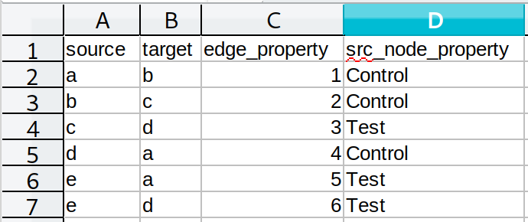
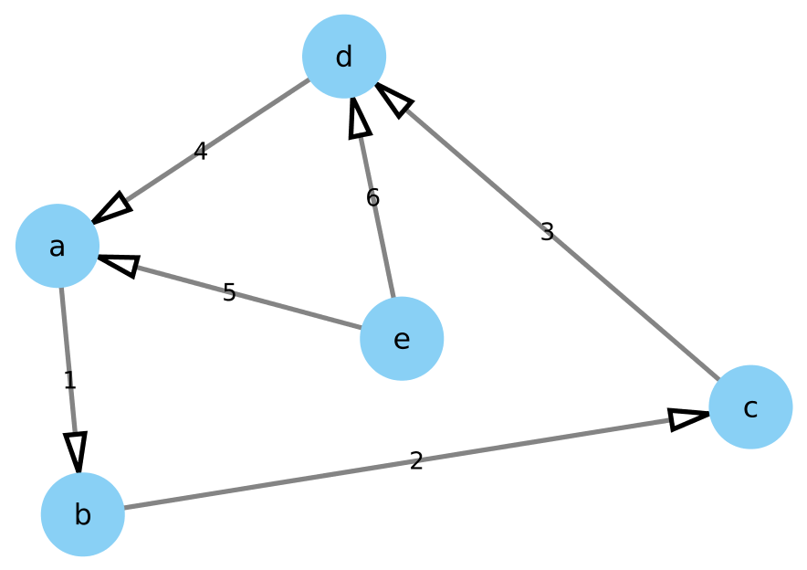
Describing a network in a (Excel) File
An simple format in Excel can describe edges
Each row corresponds to an edge, e.g. a → b
A column can be labelled in any way you like, but each column will typically correspond to a property of:
- source nodes, target nodes, edges
Notes:
Do for imaging what bioinformatics has done for sequencing.
Biologists are often still looking at a single image at a time.

Slide 20
Exercise: Importing a Network from a (Excel) File
File → Import → Network From File
Select file example_edges.csv
You need to tell the importer
    Which column is the source nodes
    Which column are the target nodes
    Whether other columns are properties of source/target/edge
Notes:
Do for imaging what bioinformatics has done for sequencing.
Biologists are often still looking at a single image at a time.

Slide 21
Exercise: Create a simple Excel edge graph
Create an Excel file that describes a network that -
Has nodes Alice, Bob and Charlie
Represents that
      Alice likes Bob
      Bob dislikes Charlie
      Charlie likes Alice
      Alice is a Scientist
      Bob is a Historian
      Charlie is an Engineer
You will need columns for source (person), target (person),
relationship (like/dislike), job
Import this into Cytoscape (if you get stuck, have a look at file ABC.csv)
Notes:
Do for imaging what bioinformatics has done for sequencing.
Biologists are often still looking at a single image at a time.

Slide 22
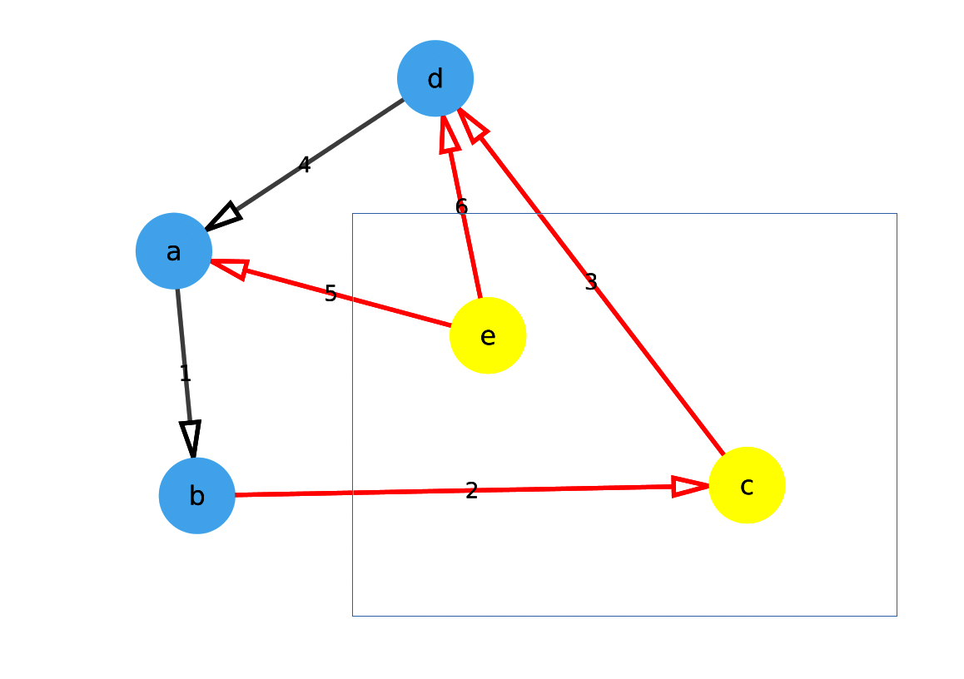
Moving and selecting node and edges manually
Select individual nodes or edges: Left mouse click
Add to selection: Ctl + left mouse click
Select multiple nodes and edges: Shift + left mouse drag
Move a node: Mouse left click drag
Shift dragging to select
Notes:
Do for imaging what bioinformatics has done for sequencing.
Biologists are often still looking at a single image at a time.

Slide 23
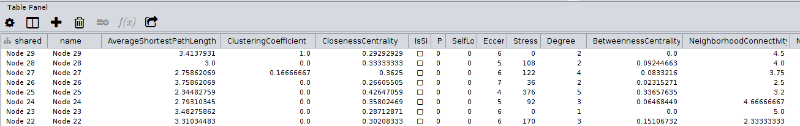
Network Analyser
Cytoscape has a built in function that generates many
of the commonly used network statistics or measures
Tools → Analyse Network
The results can then be seen in Table Panel
By clicking on the table headings, results are sorted, so that the
large degree nodes can be easily found, for instance
Try running Network Analyser on the networks you have made
Notes:
Do for imaging what bioinformatics has done for sequencing.
Biologists are often still looking at a single image at a time.

Slide 24
Styles in Cytoscape

Slide 25
Styles in Cytoscape
Cytoscape has a number of built in styles that define the colours, shapes and line types of the network visualisation
These can be found in the Style tab of the Control Panel
Once selected a Style may be modified to change the colours or shapes of nodes or edges, or add images or annotations
Style properties can also be mapped using node/edge Table properties
E.g. the colour and/or size of a node could correspond to the degree (number of edges) of a node
Mappings can be continuous, discrete or “pass through”
Notes:
Do for imaging what bioinformatics has done for sequencing.
Biologists are often still looking at a single image at a time.

Slide 26
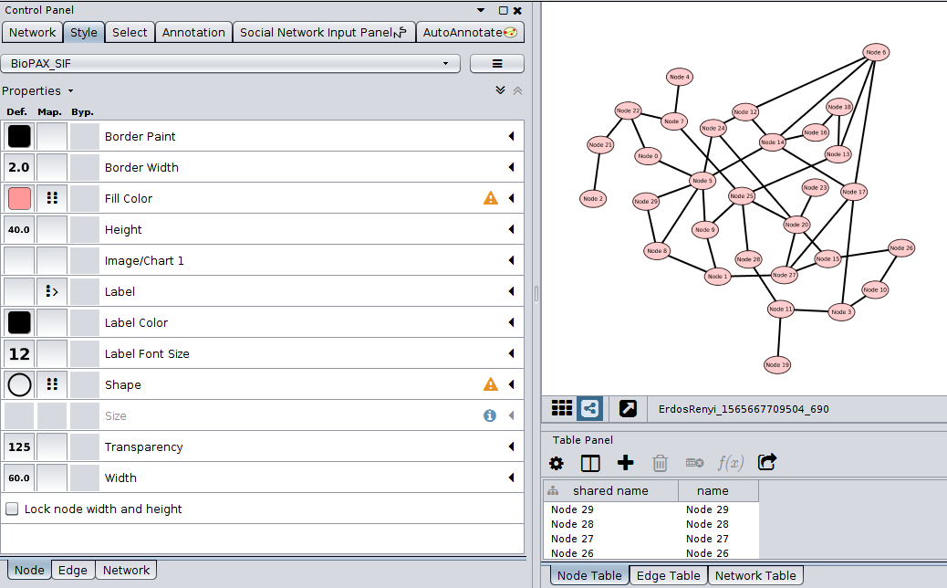
The Style tab
Default property column
Mapping column
Current Style Select
Notes:
Do for imaging what bioinformatics has done for sequencing.
Biologists are often still looking at a single image at a time.

Slide 27
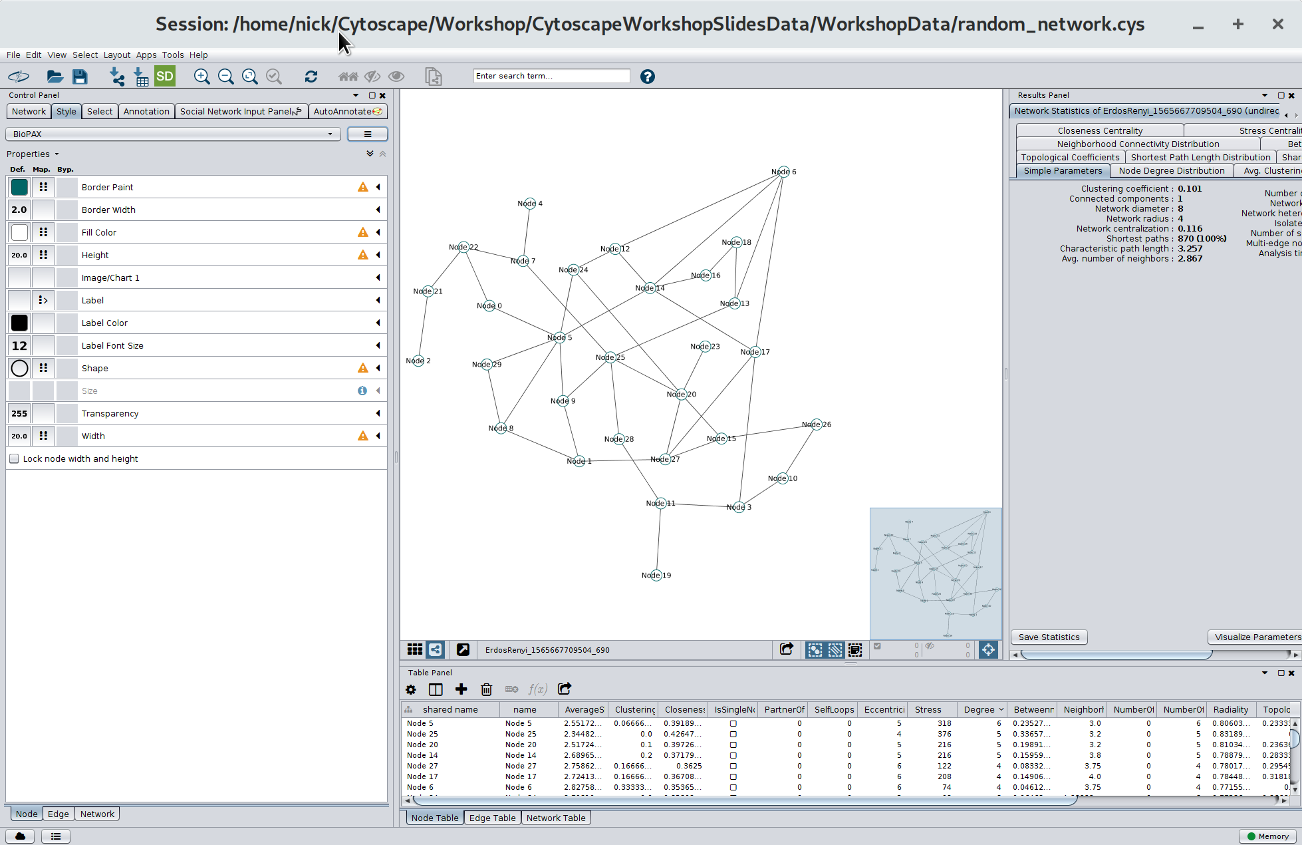
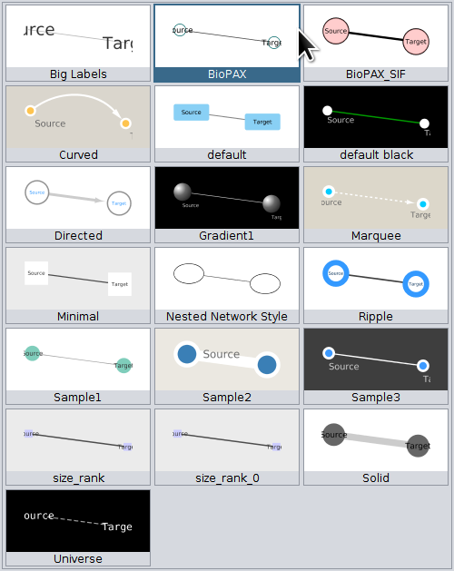
Built in Styles in Cytoscape
Notes:
Do for imaging what bioinformatics has done for sequencing.
Biologists are often still looking at a single image at a time.

Slide 28
Changing Style Properties
To change the Default color/shape etc of nodes
    Select the Style tab and select the Node subtab
    Click on the Default (Def.) column of the property to change
    Select the new Default colour/shape etc
To Map a node property to depend on a column in the node table
    Select the Style tab and select the Node subtab
    Click on the Map column of the property, e.g. size or colour, to change
Column/Mapping type selection sub-menus will appear
    Select the Node table Column to use for the mapping
    Select whether to use a continuous, discrete, or pass through mapping
    Continuous mapping will give a default colour scheme, for instance, a discrete mapping may need further selections, e.g. different colours for each value
Similarly for edges
Notes:
Do for imaging what bioinformatics has done for sequencing.
Biologists are often still looking at a single image at a time.

Slide 29
Types of mapping for node & edge table data
Discrete Mapping
There are a small number of different cases and you want a different colour/size/shape for each based on a column in your edge or node table
Continuous mapping
Each node or edge has a continuous number associated with it, i.e. temperature or expressions level, so use this number as a size or colour on a spectrum for the node or edge
Passthrough Mapping
Values in a network column are passed directly to the property. Typically used for node/edge labels.
Notes:
Do for imaging what bioinformatics has done for sequencing.
Biologists are often still looking at a single image at a time.

Slide 30
Exercise: Visualising the Moreno Sociograms
- Who wants to sit next to whom?
In 1934 Moreno published a classic study in social networks on relationships between
children in the classroom and how these change over time. In it each child was invited to
pick two other children they would like to sit next to in the class. The results were visualised
as networks. Here we will look at the grade 3 class.
File → Open the network Sociogram3-boy-girl.cys
Run the Network Analyser to calculate network statistics (with ‘treat as directed’ selected)
1. Map the Fill Colour of nodes by a discrete map of the Sex property and choose different colours for Boys and Girls.
2. Map the Node Size to a continuous mapping of the indegree.
[Bonus: If you’re feeling tricky, see if you can put arrow heads on the edges]
Who is most popular? Who doesn't like anyone? What is noticeable about boys/girls?
Notes:
Do for imaging what bioinformatics has done for sequencing.
Biologists are often still looking at a single image at a time.

Slide 31
Other things you can do with Styles
Create new styles
Add images/charts/graphics to nodes
Fine tune label positions
For more: http://manual.cytoscape.org/en/stable/Styles.html
Notes:
Do for imaging what bioinformatics has done for sequencing.
Biologists are often still looking at a single image at a time.

Slide 32
Apps in Cytoscape

Slide 33
Apps in Cytoscape
Cytoscape has an App Store built in that can extend its functionality. For instance:
DynNetwork: Visualise dynamic networks
Mclique: find maximal cliques
Yfiles: different layout algorithms
ANIMO: dynamic modelling of biological networks
Social Network: import publication graphs
dot-app: Import/export of Graphviz files in Cytoscape
Notes:
Do for imaging what bioinformatics has done for sequencing.
Biologists are often still looking at a single image at a time.

Slide 34
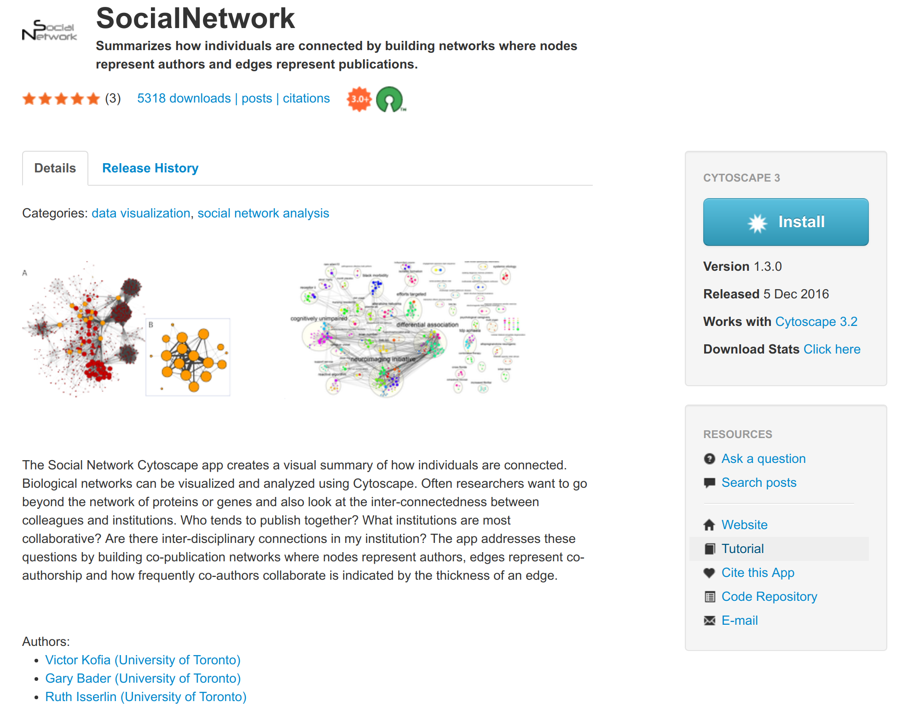
Each App has documentation and a tutorial
Notes:
Do for imaging what bioinformatics has done for sequencing.
Biologists are often still looking at a single image at a time.

Slide 35
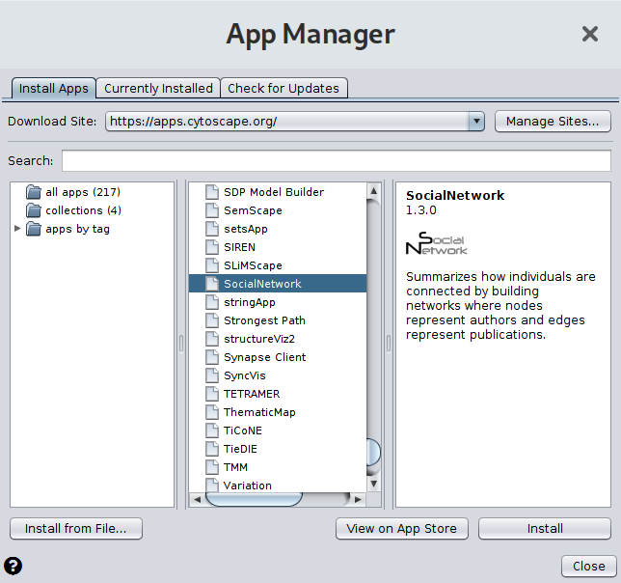
Exercise: Install the Social Network App
and the dot-app App
Click Apps → App Manager to
start the manager
Scroll down and select
SocialNetwork
To see documentation click
View on App Store
Click Install
Similarly for dot-app
Notes:
Do for imaging what bioinformatics has done for sequencing.
Biologists are often still looking at a single image at a time.

Slide 36
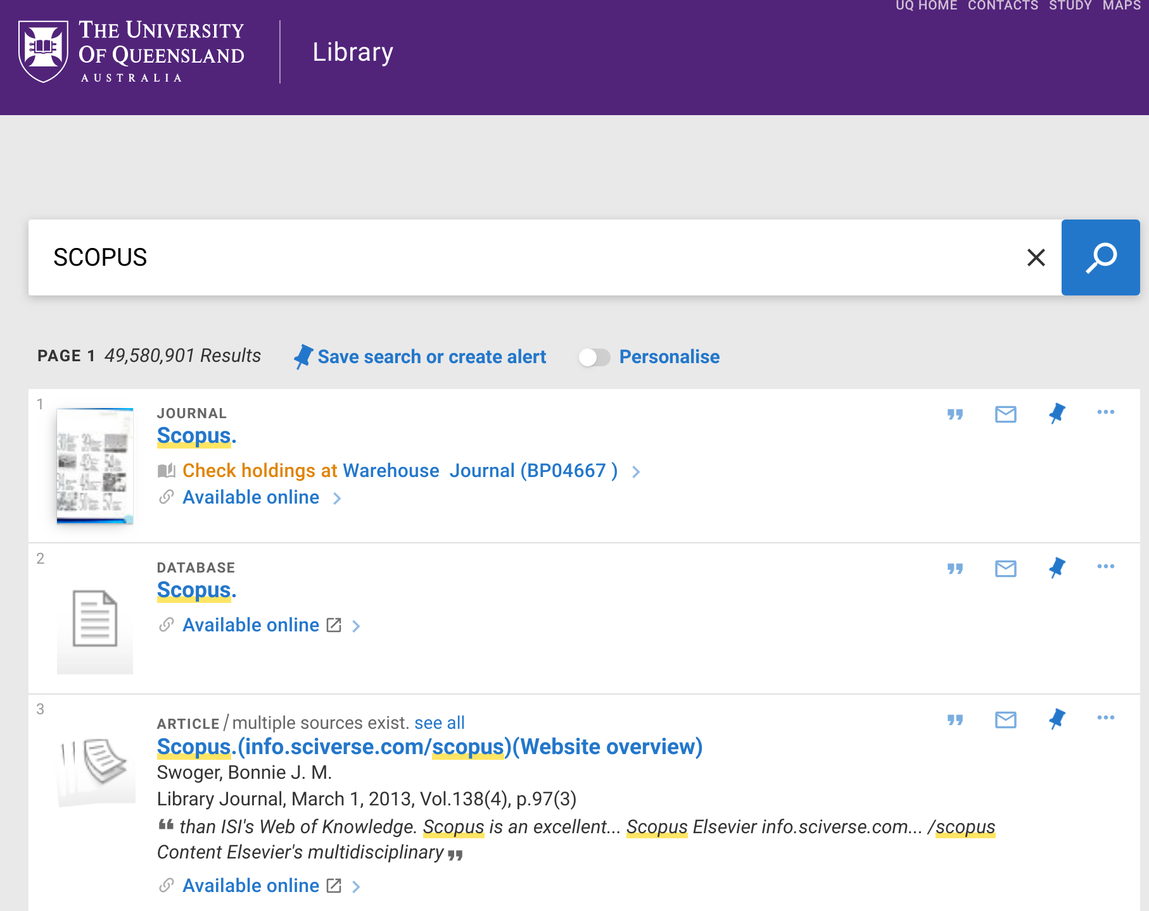
Extension Exercise:
Downloading your SCOPUS publications
For UQ researchers search for SCOPUS in the library catalogue
http://library.uq.edu.au/screens/opacmenu.html
and select the
Database/ Available online result
Monash go directly to
https://go.openathens.net/redirector/www.monash.edu?url=https://www.scopus.com
Login using your UQ/Monash credentials when requested
Notes:
Do for imaging what bioinformatics has done for sequencing.
Biologists are often still looking at a single image at a time.

Slide 37
Extension Exercise:
Downloading your SCOPUS publications
In SCOPUS select Authors search and put in you name or ORCID
Select the author that is you, and click “Show Documents”
Check select “All” then click “Export”
Select “CVS” as the method of export
Click the “Export” button
Note: the “Author Id” column needs to be deleted once downloaded as SCOPUS have recently changed format
Open the downloaded file in Excel, delete the column, and save.
Notes:
Do for imaging what bioinformatics has done for sequencing.
Biologists are often still looking at a single image at a time.

Slide 38
Extension Exercise:
Downloading your SCOPUS publications
In SCOPUS select Authors search and put in you name or ORCID
Select the author that is you, and click “Show Documents”
Check select “All” then click “Export”
Select “CVS” as the method of export
Click the “Export” button
Note: the “Author Id” column needs to be deleted once downloaded as SCOPUS have recently changed format
Open the downloaded file in Excel, delete the column, and save.
Notes:
Do for imaging what bioinformatics has done for sequencing.
Biologists are often still looking at a single image at a time.

Slide 39
Exercise: Importing a SCOPUS network
into Cytoscape
Start the Social Network App
      Apps→ Social Network→ Show Social Network
A Social Network tab should appear on the Control Panel
Select that tab and then select File Input as SCOPUS
Click “...” to select the nhamilton_scopus.csv file containing SCOPUS network
Click Create Network and a (possibly messy) network should be visualised
Observe the horrible mess
Notes:
Do for imaging what bioinformatics has done for sequencing.
Biologists are often still looking at a single image at a time.

Slide 40
Network Layout in Cytoscape

Slide 41
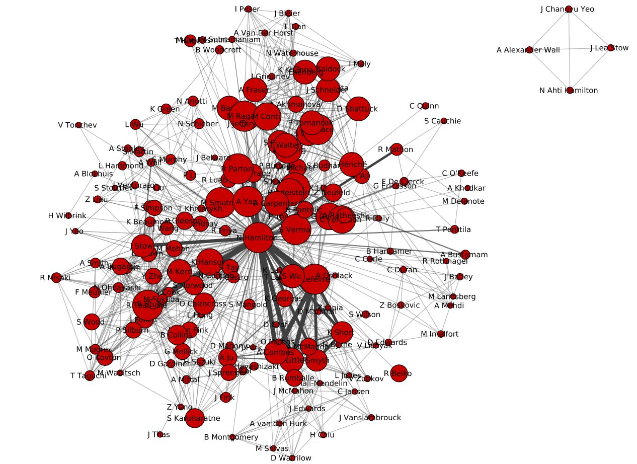
Different approaches to layout of networks
Different networks will suit different methods of layout
No one algorithm is best for all
What is a good/bad layout?
- avoid edge/node crossing
- allows you to find structure and see relationships
Notes:
Do for imaging what bioinformatics has done for sequencing.
Biologists are often still looking at a single image at a time.

Slide 42
Layout algorithms in Cytoscape
Cytoscape has several built in methods of laying out graphs to make them pretty or to help you find information in them
The following slides outline some of these, and borrow heavily images from the Cytoscape documentation at
http://manual.cytoscape.org/en/stable/Navigation_and_Layout.html
Notes:
Do for imaging what bioinformatics has done for sequencing.
Biologists are often still looking at a single image at a time.

Slide 43
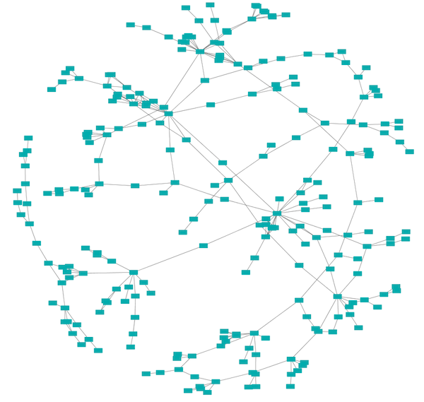
Spring Layout
Each edge is a “spring”, each node “repels” all the others
Force of the spring can be proportional to an edge weight
A good generic algorithm to try first
Image: http://manual.cytoscape.org/en/stable/Navigation_and_Layout.html
Notes:
Do for imaging what bioinformatics has done for sequencing.
Biologists are often still looking at a single image at a time.

Slide 44
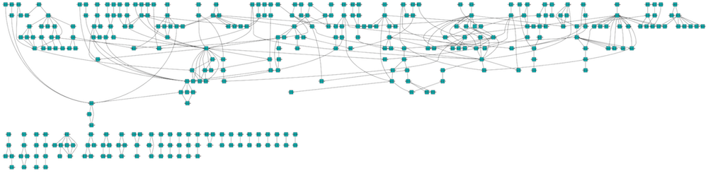
Hierarchical Layout
For when there are layers or flow in your network
Image: http://manual.cytoscape.org/en/stable/Navigation_and_Layout.html
Notes:
Do for imaging what bioinformatics has done for sequencing.
Biologists are often still looking at a single image at a time.

Slide 45
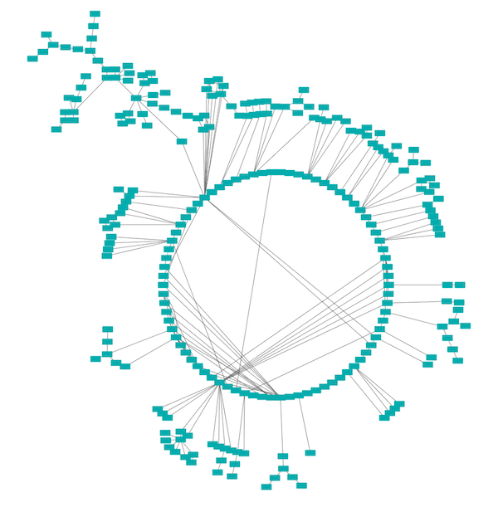
Circle Layout
Attempts to arrange nodes in circular layers
Image: http://manual.cytoscape.org/en/stable/Navigation_and_Layout.html
Notes:
Do for imaging what bioinformatics has done for sequencing.
Biologists are often still looking at a single image at a time.

Slide 46
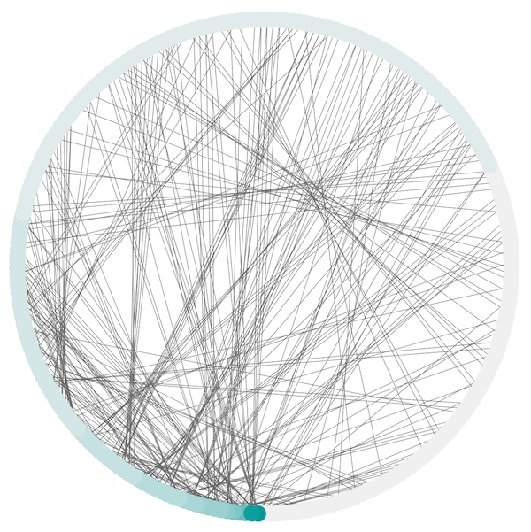
Attribute Circle Layout
Nodes are on a circle, but are grouped according to an property you select in the Node Table
Image: http://manual.cytoscape.org/en/stable/Navigation_and_Layout.html
Notes:
Do for imaging what bioinformatics has done for sequencing.
Biologists are often still looking at a single image at a time.

Slide 47
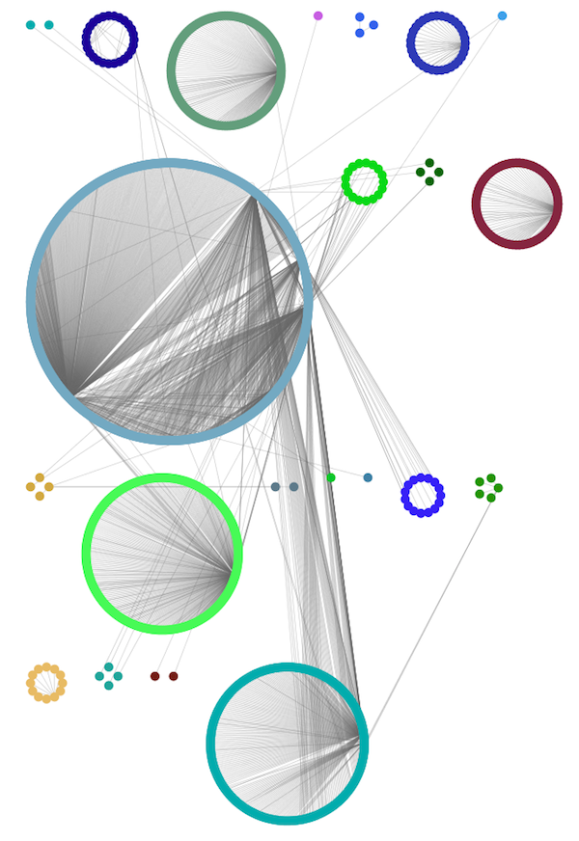
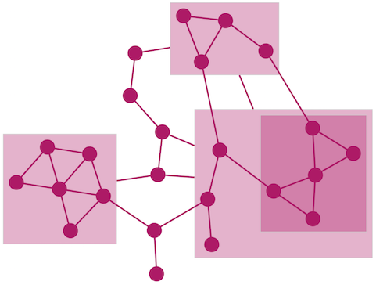
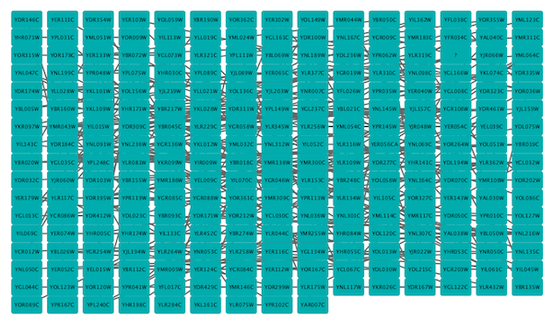
Also ...
See the documentation for more
http://manual.cytoscape.org/en/stable/Navigation_and_Layout.html
Notes:
Do for imaging what bioinformatics has done for sequencing.
Biologists are often still looking at a single image at a time.

Slide 48
Additional methods: yFiles layout algorithms
Circular Layout
Hierarchic Layout
Hierarchic Layout Selected Nodes
Organic Layout
Orthogonal Layout
Radial Layout
Tree Layout
Orthogonal Edge Router
Organic Edge Router
Documentation and Examples
https://www.yworks.com/products/yfiles-layout-algorithms-for-cytoscape
Notes:
Do for imaging what bioinformatics has done for sequencing.
Biologists are often still looking at a single image at a time.

Slide 49
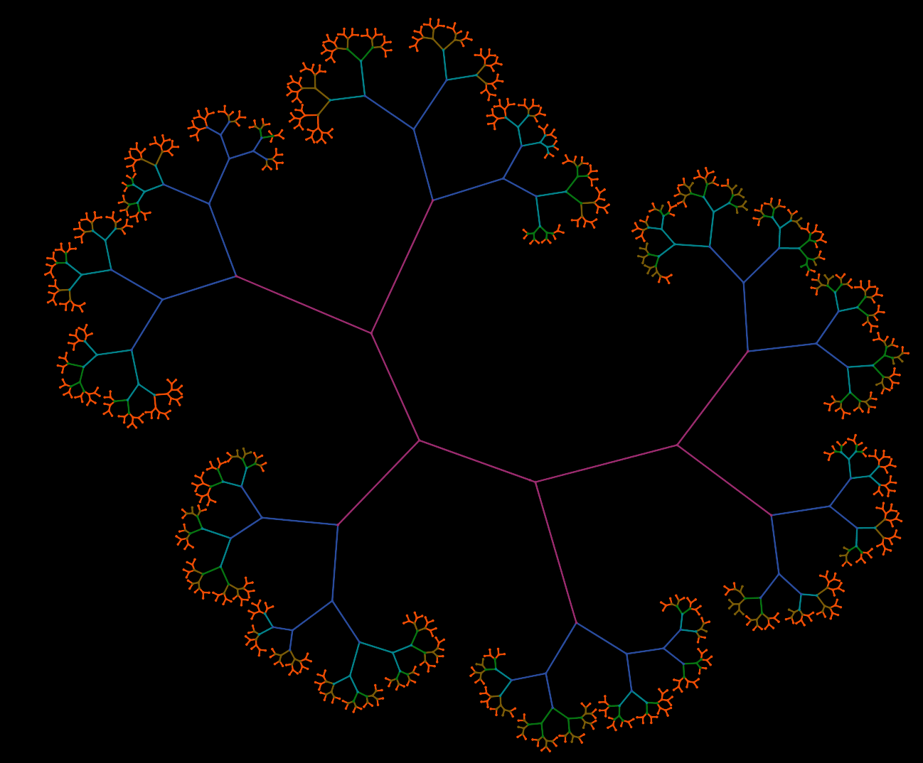
Yfiles Layout
Yfiles layouts seem to be “better” than the in-built methods
The “Organic” method can be a good method to try first
Notes:
Do for imaging what bioinformatics has done for sequencing.
Biologists are often still looking at a single image at a time.

Slide 50
Exercise: Installing yFiles layout
To install the yFiles layout methods
Layout → Install yFiles
The yFiles methods are then available under the Layout menu
More information on yFiles
https://www.yworks.com/products/yfiles-layout-algorithms-for-cytoscape
Notes:
Do for imaging what bioinformatics has done for sequencing.
Biologists are often still looking at a single image at a time.

Slide 51
Exercise: Trying different layout algorithms
Try out some of the built in and yFiles layout
algorithms on your own (if you have it) or Dr Nick’s SCOPUS publication network
Which look good/bad? Why?
Are there clusters of authors? What properties cluster them?
Do you notice anything unusual?
Are there any errors in the data?
Import (File → Import Network from File) the network
kidney_stages7-12.dot
and try some different layouts
Notes:
Do for imaging what bioinformatics has done for sequencing.
Biologists are often still looking at a single image at a time.

Slide 52
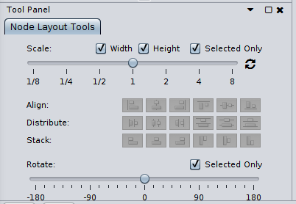
Node Layout Tools for Scaling
Select Layout → Layout Tools and a panel
will appear in the bottom left corner
This can be used to scale the relative size of (selected) nodes to the edge length, or rotate (selected) parts
Notes:
Do for imaging what bioinformatics has done for sequencing.
Biologists are often still looking at a single image at a time.

Slide 53
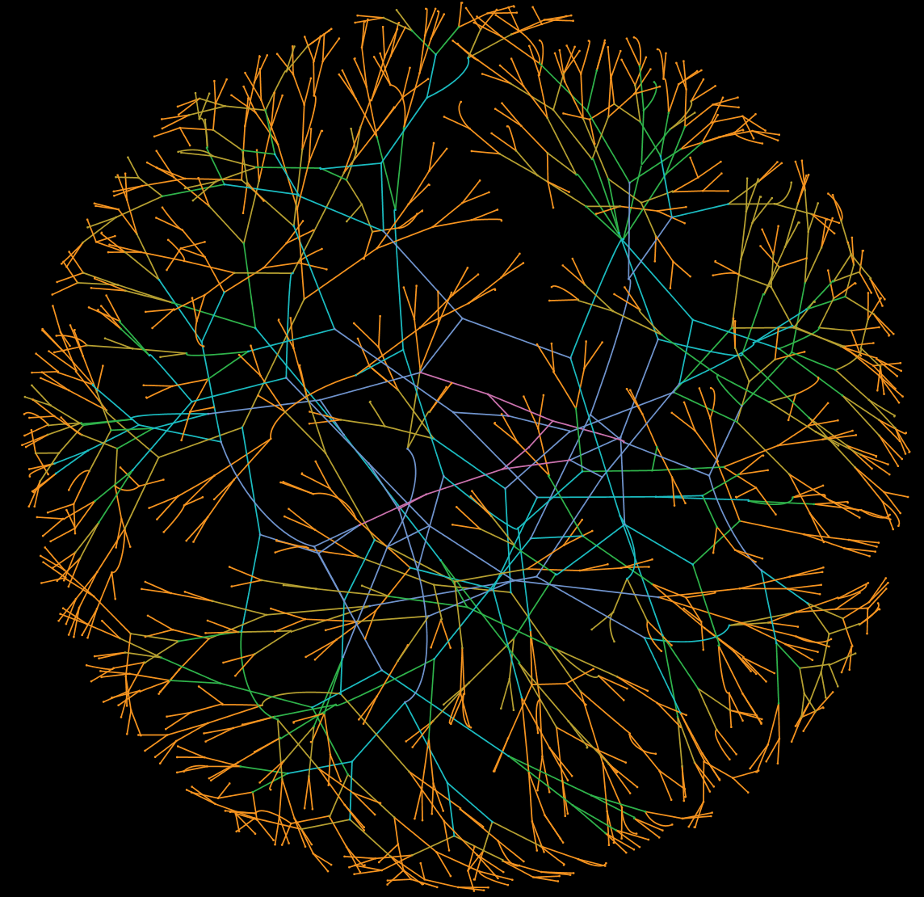
Dealing with edge overlaps
Often edges will overlap, perhaps unnecessarily
Dealing with this can be complicated
The simplest approach is to try a different algorithm, or fix the “errors” by hand if there are only a small number of them
Also, parameters to the layout algorithm can be tweaked
Layout → Settings
Try reducing gravity,
increasing repulsion
Notes:
Do for imaging what bioinformatics has done for sequencing.
Biologists are often still looking at a single image at a time.

Slide 54
Network Filtering

Slide 55
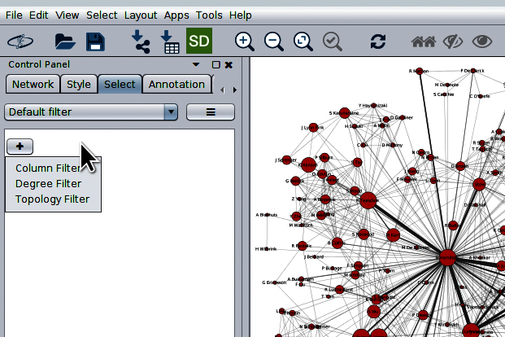
Network Filtering
Sometimes you may want to select nodes or edges
in a network based on some property they have
Cytoscape has facilities for selecting based on column data in the Table Panel, the degree of nodes, or the topology
Notes:
Do for imaging what bioinformatics has done for sequencing.
Biologists are often still looking at a single image at a time.

Slide 56
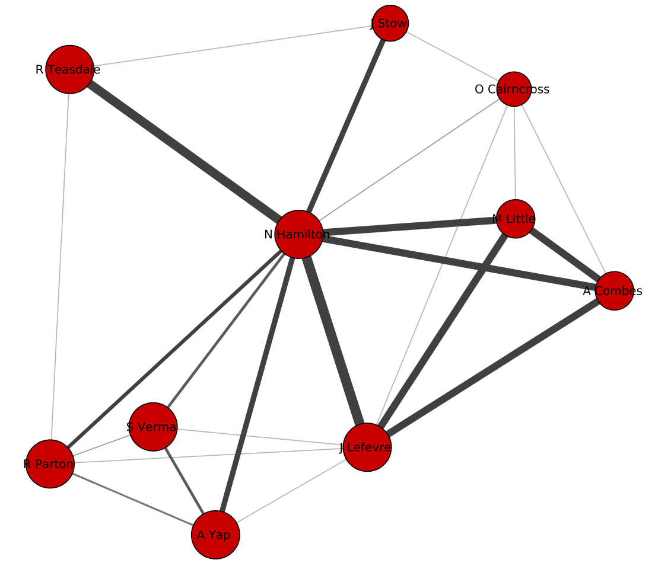
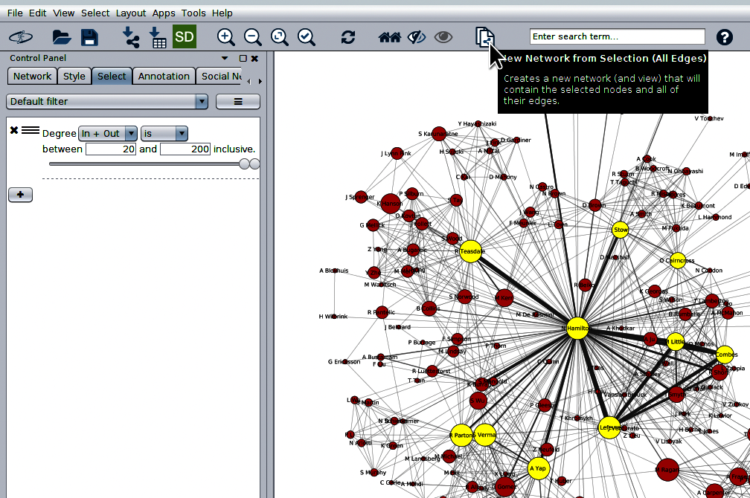
Network Filtering
Once a filter has created a selection a new graph is
easily created from that selection
Notes:
Do for imaging what bioinformatics has done for sequencing.
Biologists are often still looking at a single image at a time.

Slide 57
Other things you can do in Cytoscape
Nested networks
Edge bending and bundling
Column data functions – a bit like functions in Excel
Annotations with images/shapes/text/arrows
Link out to web URLs
Use cytoscape.js for javascript networks in web pages
Control Cytoscape from R or other programming languages
And many more things …
http://manual.cytoscape.org/en/stable/
Notes:
Do for imaging what bioinformatics has done for sequencing.
Biologists are often still looking at a single image at a time.

Slide 58

Getting more help
A quick tour of Cytoscape
http://manual.cytoscape.org/en/stable/Quick_Tour_of_Cytoscape.html
The Cytoscape User manual
http://manual.cytoscape.org/en/stable/
Cytoscape Tutorials
https://github.com/cytoscape/cytoscape-tutorials/wiki
Online Help Groups
https://groups.google.com/forum/?fromgroups#!forum/cytoscape-helpdesk
Hacky Hour at UQ: every Tuesday 3-4pm online via Zoom
@HackyHourStLuc
Notes:
Do for imaging what bioinformatics has done for sequencing.
Biologists are often still looking at a single image at a time.

