Slide 1
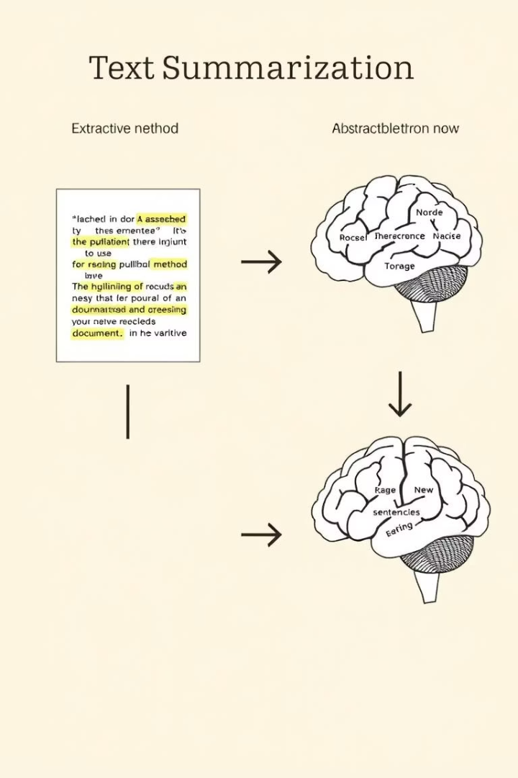
Comparative Study of Text Summarization Techniques
This presentation explores and compares two fundamentally different approaches to automatic text summarization: extractive and abstractive techniques. Extractive summarization works like highlighting key sentences from the original text, while abstractive summarization generates new sentences that capture core meaning in a condensed form.
We'll examine the strengths, weaknesses, and trade-offs between these methods in terms of summary quality, relevance, fluency, and computational cost through implementation, evaluation, and a live demonstration.

Slide 2




Project Overview
Project Goal
Comparison Focus
Explore, implement, and critically compare extractive and abstractive approaches to automatic text summarization
Evaluate summary quality, relevance, fluency, and computational cost between different methods
Demonstration
Showcase implementation through a live Streamlit application that allows direct comparison of different summarization techniques

Slide 3






Extractive Summarization: TextRank
Graph-based algorithm
Inspired by Google's PageRank
Sentence similarity
Builds connections between important sentences
Ranking process
Selects top-ranked sentences for summary
TextRank breaks text into sentences, calculates similarity between pairs, and builds a graph where sentences are nodes and edge weights represent similarity scores. The PageRank algorithm runs on this graph, with higher-ranked sentences selected for the summary in their original order.
Pros: Conceptually simple, computationally fast, requires no training data, and produces factually accurate summaries. Cons: Summaries may lack coherence and can't paraphrase or synthesize information.

Slide 4
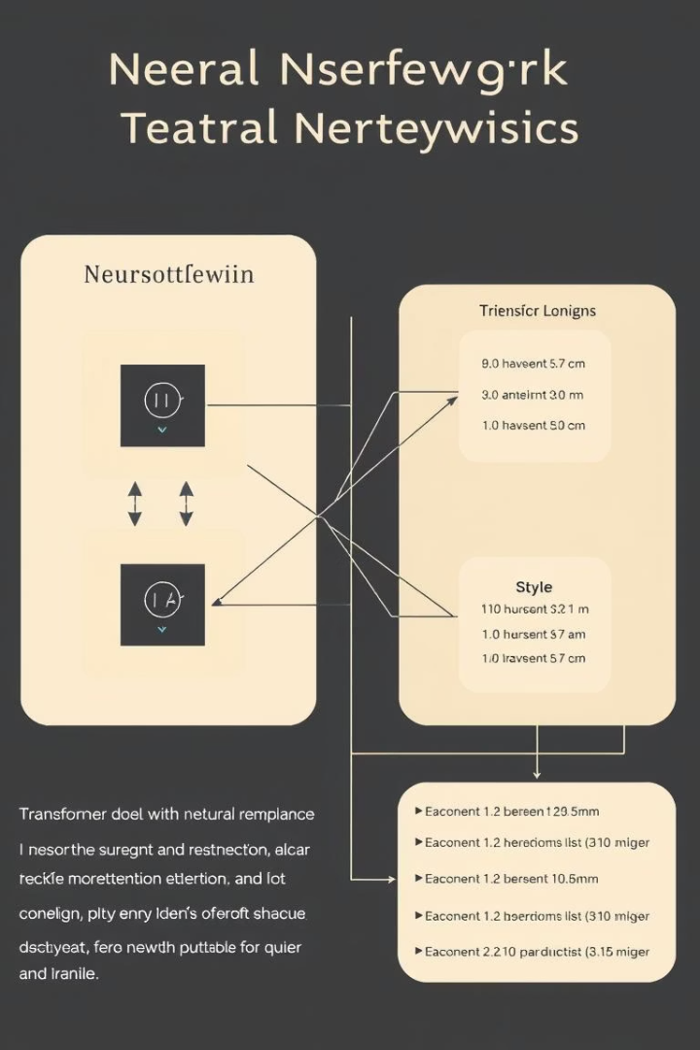




Abstractive Summarization: T5 & BART
Transformer Architecture
Based on powerful sequence-to-sequence models with self-attention mechanisms
Pre-training
Models trained on massive text datasets to understand language structure
Fine-tuning
Pre-trained models further trained on CNN/Daily Mail dataset for summarization
Generation
Models produce fluent summaries with paraphrased content

Slide 5
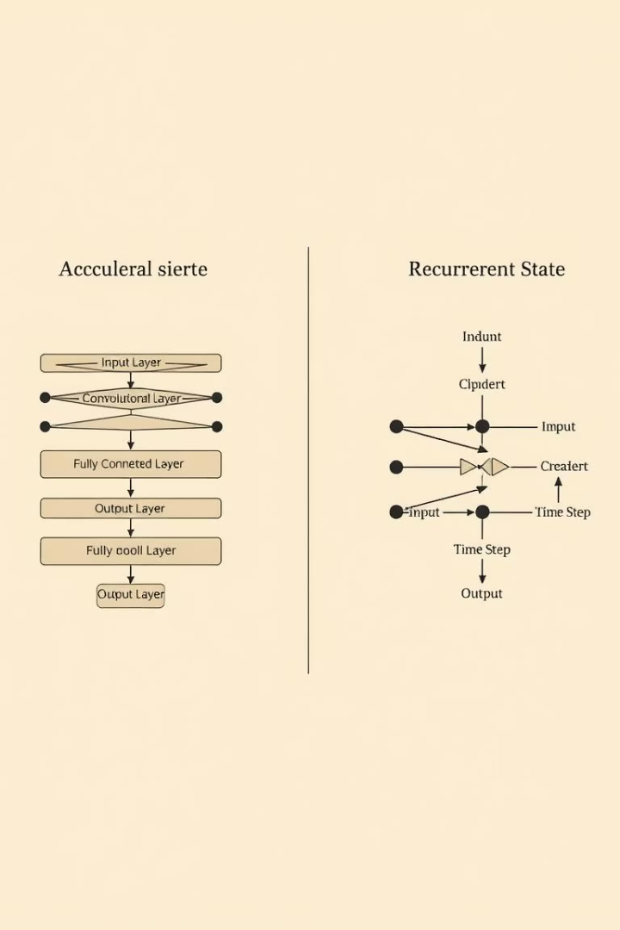
Models Implemented
T5 (Text-To-Text Transfer Transformer)
BART (Bidirectional Auto-Regressive Transformer)
Experimented with t5-small, t5-base, and t5-large to evaluate impact of model size. Fine-tuned on CNN/DM dataset using Hugging Face Trainer library with GPU/TPU resources on Kaggle.
Used facebook/bart-large-cnn, a large BART model already expertly fine-tuned on CNN/Daily Mail dataset. Implemented via Hugging Face pipeline as a benchmark representing near state-of-the-art performance.

Slide 6
Evaluation Strategy
Quantitative Metrics
Qualitative Assessment
ROUGE Scores (ROUGE-1, ROUGE-2, ROUGE-L)
Relevance: Capture of main points
Generation Time (computational cost)
Fluency & Coherence: Readability
Factuality: Information accuracy
Used evaluate library wrapping rouge-score to measure overlap between generated summaries and human-written reference summaries. Higher scores indicate greater overlap.
Conciseness: Appropriate brevity
Manually reviewed summaries from each model for approximately 20 articles, comparing against original articles and reference summaries.

Slide 7
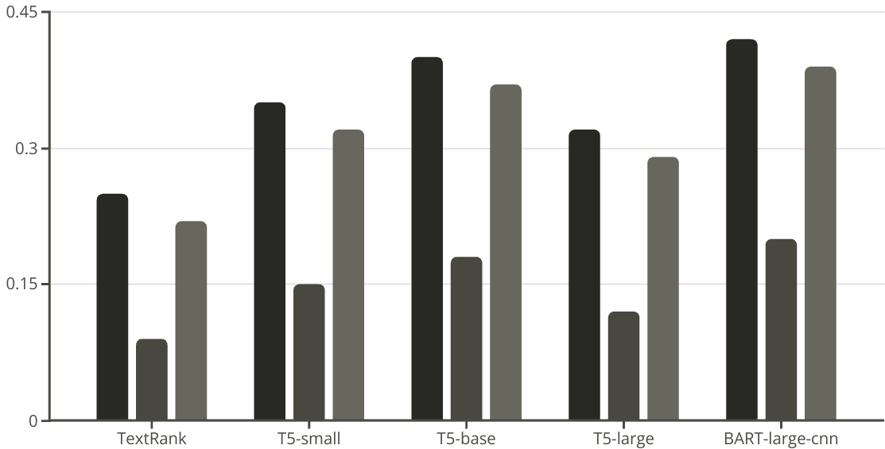
Results & Comparative Analysis
ROUGE-1
ROUGE-2
ROUGE-L
Abstractive models significantly outperformed TextRank on all ROUGE metrics. BART-large-cnn and well-trained T5-base achieved highest scores. T5-large trained on limited data (1000 samples) performed worse than T5-base despite being larger, highlighting data limitations.
Speed comparison showed TextRank was orders of magnitude faster (~0.03s/article) than abstractive models. T5-small was ~30x slower, T5-base ~60x slower, and T5-large ~80x slower, demonstrating a stark speed-quality trade-off.

Slide 8
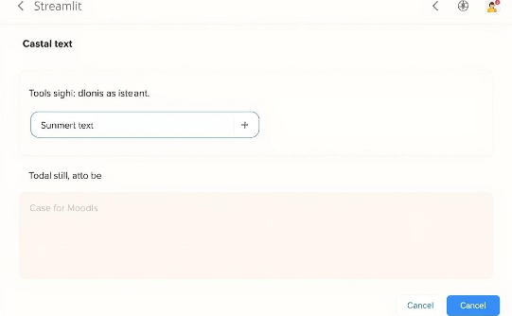
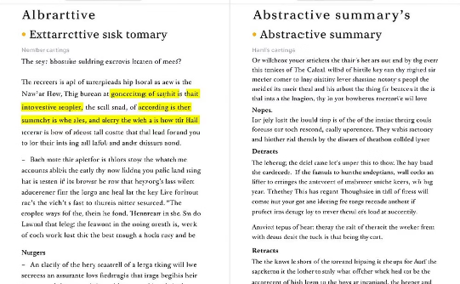

Streamlit Demo Application
User Interface
Comparison View
Live Demonstration
The application features an input area for text, model selection options, and parameter controls. Users can paste articles or use pre-loaded examples to generate summaries with different models.
Generated summaries appear in the output area with generation time displayed. This allows direct comparison between different summarization approaches and their associated trade-offs.
The demo showcases the differences in speed, fluency, and content between TextRank and transformer-based models, providing a practical illustration of the theoretical concepts.

Slide 9



Conclusions & Future Work
Key Findings
Well-trained abstractive models provide higher quality summaries but at higher computational cost
Critical Insights
Sufficient training data is essential for abstractive model performance
Future Directions
Fine-tune larger models, explore advanced extractive techniques, evaluate with additional metrics
This project successfully compared extractive and abstractive summarization approaches. While TextRank offers speed and simplicity, well-trained abstractive models like T5-base and BART-large-cnn provide significantly higher quality summaries in terms of fluency, coherence, and relevance, albeit at higher computational cost.
Future work could include fine-tuning larger models with full datasets, exploring advanced extractive techniques using sentence embeddings, and evaluating with metrics that assess factuality or semantic similarity more directly.

