Slide 1
Analyzing the report of Swedish Motor Insurance
By Dola Ghosh

Slide 2
Description of the Project
Business Problem: The purpose of the Project is to analyze the Claims and Payment of the Swedish Motor Insurance Company and also the factors responsible for increase and decrease of “claims” and “payment”.
Business Solution: To build Linear Regression Model with the given dataset to find out the most significant factors affecting “Payment” and “claims” so that the Motor Insurance Company can take adequate business steps.

Slide 3
Analysis of the dataset
Bonus : the number of years, plus one, since the last claims
Make : 1-8 are eight car models. All other models are Make 9
Insured : Number of years insured in policy-years
Claims: Number of claims
Payment: Total value of payments in Skr (Swedish Krona)
Kilometers travelled per year
1: < 1000 2: 1000-15000 3: 15000-20000
4: 20000-25000 5: > 25000
Zone Geographical zone
1: Stockholm, Göteborg, and Malmö with surroundings
2: Other large cities with surroundings
3: Smaller cities with surroundings in southern Sweden
4: Rural areas in southern Sweden
5: Smaller cities with surroundings in northern Sweden
6: Rural areas in northern Sweden
7: Gotland
Dependent Variables for two models are “Payment” and “Claims” and both are Continuous

Slide 4
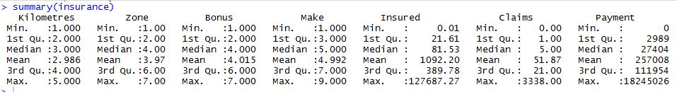
Descriptive Statistics
The Descriptive Statistics of all the Variables of the Swedish Motor Insurance Company Dataset

Slide 5
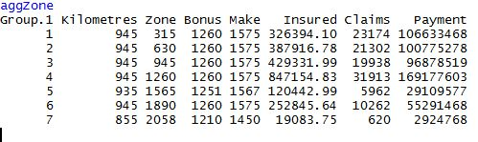
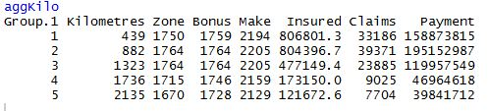
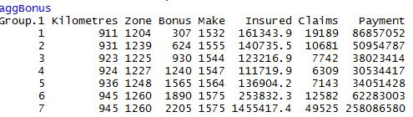
Aggregation Based on Zone, Kilometer and Bonus (sum of each category)
"Zone 4: Rural areas in southern Sweden" has the highest Insured, Claims and Payment"
"Kilometers 2:
1000-15000 km has the highest Claims and Payment"
"Bonus 7: No of policy years has the highest Insured, Claims Payment"

Slide 6
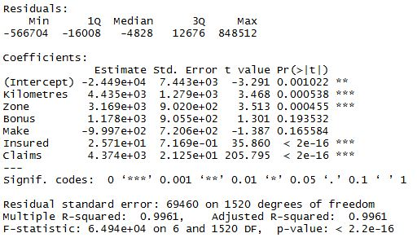
Model Interpretation (“Payment”)
1. Relationship of Dependent Variable “Payment” with all the Independent Variable : Claims , Insured, Make, Bonus, Zone, Kilometres
2.Claims , Insured ,Zone, Kilometres have P VALUES LESS THAN 0.05 , all these Variables are SIGNIFICANT
3. Slope of the Significant variables and the RELATIONSHIP BETWEEN DEPENDENT VARIABLE AND SIGNIFICANT INDEPENDENT VARIABLE
1 unit increase in claims will increase Payment by 4.374e+03
1 unit increase in Insured will increase Payment by 2.571e+01
1 unit increase in Zone will increase Payment by 3.169e+03
1 unit increase in Kilometres will increase Payment by 4.435e+03
4. THE R SQUARE VALUE is 99.61% : RSQ > 70% , THE QUALITY OF MODEL IS GOOD
5. THE ADJUSTED R SQ VALUE is 99.61% : which is > 70% . Hence the Model is a “Good Model”. ADJUSTED R SQ VALUE is also EQUAL TO R SQ .

Slide 7
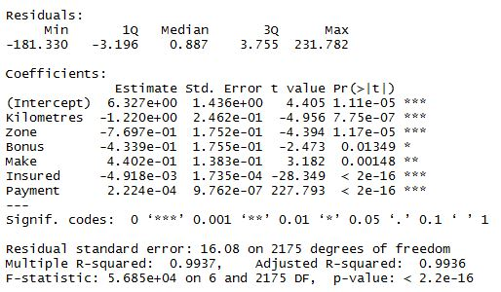
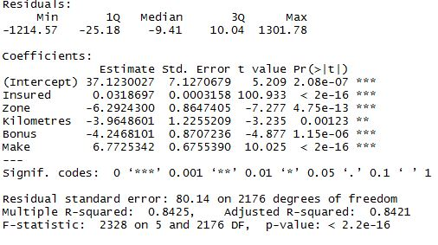
Model Interpretation (“Claims”)
1. Relationship of Dependent Variable “Claims” with all the Independent Variable : Payment , Insured, Make, Bonus, Zone, Kilometres
2.Payment , Insured, Make, Bonus, Zone, Kilometres have P VALUES LESS THAN 0.05 , all these Variables are SIGNIFICANT
3. Slope of the Significant variables and the RELATIONSHIP BETWEEN DEPENDENT VARIABLE AND SIGNIFICANT INDEPENDENT VARIABLE
1 unit increase in payment will increase claims by 2.224e-04
1 unit decrease in Insured will increase claims by 4.918e-03
1 unit increase in Make will increase claims by 4.402e-01
1 unit decrease in Bonus will increase claims by 4.339e-01
1 unit decrease in Zone will increase claims by 7.697e-01
1 unit decrease in Kilometres will increase claims by 1.220e+00
4. THE R SQUARE VALUE is 99.37% : RSQ > 70% , THE QUALITY OF MODEL IS GOOD
5. THE ADJUSTED R SQ VALUE is 99.36% : which is > 70% . Hence the Model is a “Good Model”. ADJUSTED R SQ VALUE is also EQUAL TO R SQ .

Slide 8
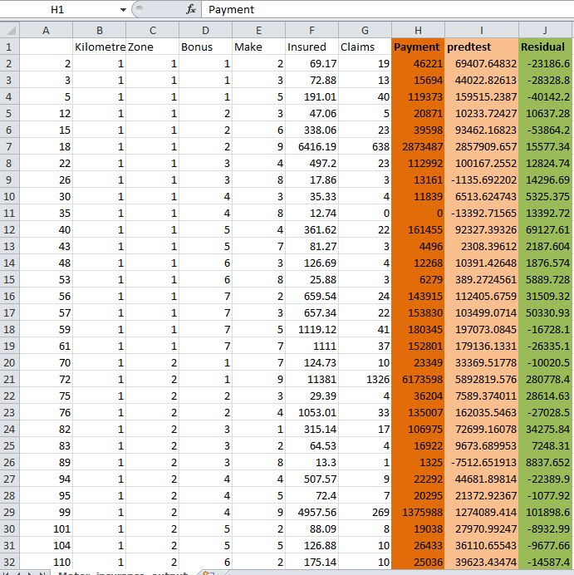
Output File

Slide 9
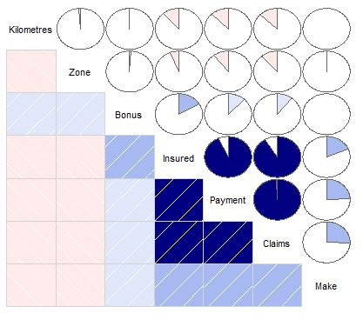
Correlation Plot

Slide 10
Conclusion
The “R Output file” shows that the “Residual” is “not very high” and so it can be assumed that it is a “good model”.
R SQUARE VALUE of the “Model(PAYMENT)”with the Dependent Variable as “Payment” is “99.61 %” which shows it is a “Very Good Model”.
R SQUARE VALUE of the “Model(CLAIMS)”with the Dependent Variable as “Claims” is “99.37%” which shows it is a “Very Good model”.
The Correlation Plot shows that “ Payment”, “Claims” and “Insured” are “Strongly Positively Correlated”. Payment by the Insurance company is strongly related to number of claims and the number of insured policy years. “Payment increases” with the increase of “Claims and Insured”
The Swedish Motor Insurance Company can also assess that people from “Rural areas in southern Sweden”, people “who travel between 1000-15000 km per year” and people with “Bonus : 7” bring the most Payment and Claims to the Company. This information will help the Insurance Company take a decision where their next “Branch Office” should be opened so that it is easier for most of their customers and they can retain their customers.

Slide 11
Thank You

