Slide 1
THIRD-PARTY IMS APPLICATION SERVER
B2BUA Number Translation & Routing POC
Signalling-only SIP B2BUA - Declarative YAML routing - Carrier-grade observability
Version 0.5.0 · SIP / RFC 3261 · Signalling Only
Dolan Shu
September 2026
Notes:
This project is a proof-of-concept for a third-party IMS Application Server: a B2BUA positioned outside the carrier network, connecting to the operator's S-SBC via SIP trunk.
Core capabilities are number translation and intelligent routing, purely on the signalling plane with no media processing. Current version v0.5.0 with all M0-M4 milestones completed.

Slide 2
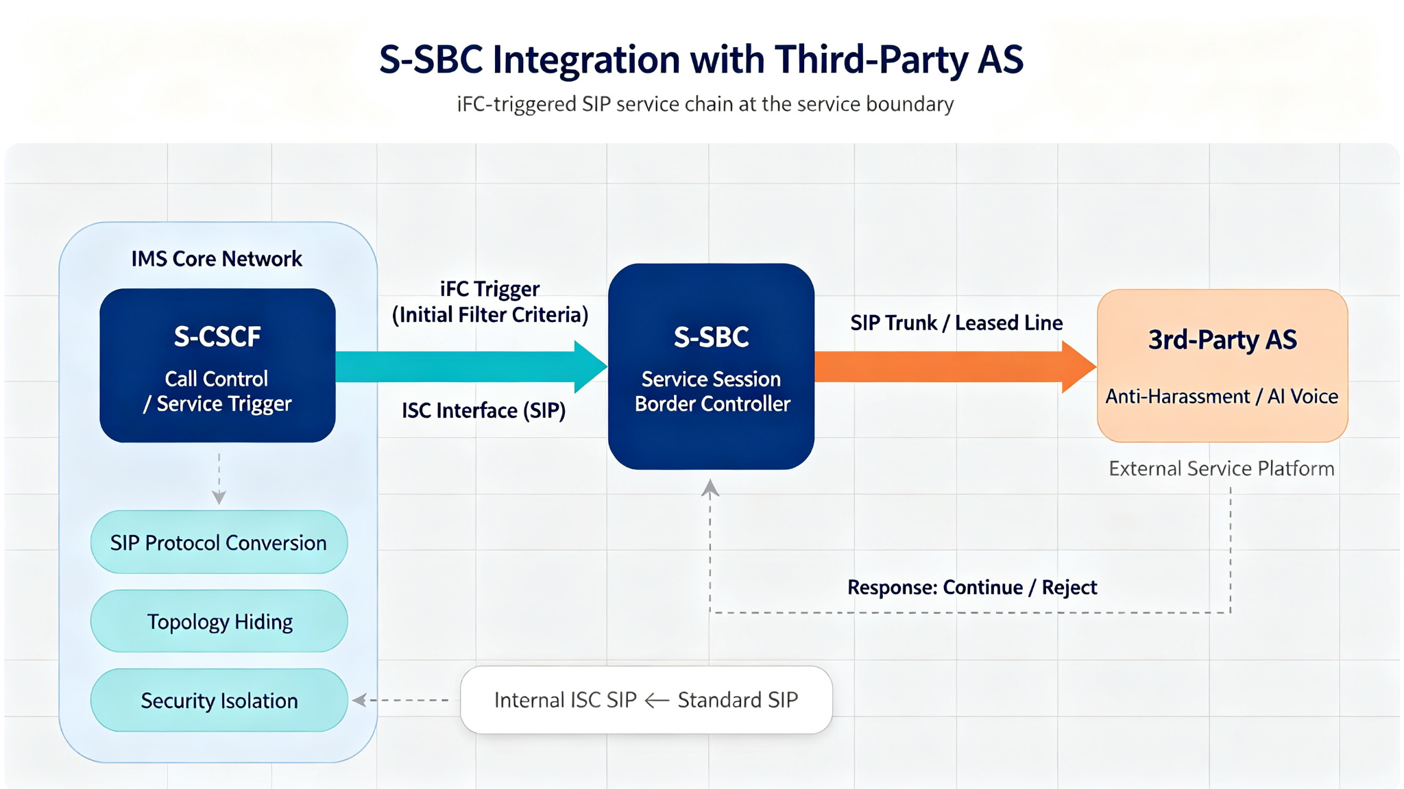
01 / POSITIONING
B2BUA outside the carrier network, signalling only
IMS
Notes:
This slide shows where the project sits in the carrier network: it is a third-party Application Server outside the IMS core, reached via the S-SBC SIP trunk.
The dashed IMS box encompasses the IMS Core Network (S-CSCF, SIP protocol conversion, topology hiding, security isolation) and the S-SBC at the service boundary. The 3rd-Party AS sits outside, reached over a SIP trunk / leased line.
Key boundaries: signalling only (no RTP), B2BUA not 302 redirect, switching from Mock to real S-SBC is config-only.

Slide 3
02 / ARCHITECTURE
Three-process isolation in Docker Compose
DOCKER HOST (compose)
Container: console
Container: s-sbc-mock
console_app
s_sbc_mock
python -m s_sbc_mock.main
UDP 15060 - UAC side
UDP 15061 - UAS side
Container: as
python -m console_app.main
TCP 8000 - Web UI
HTTP proxy to :8080
as_app
python -m as_app.main
UDP 5060 - SIP trunk
TCP 8080 - internal API
Simulates S-CSCF trigger
Simulates core network
Same SIP stack as AS
Configurable via .env
Dark ops dashboard
Real-time message flow
SVG topology view
Stats panel
B2BUU core
Routing engine
Number translation
Structured logging
Health check :8080
Notes:
The system runs as three separate Docker containers orchestrated by docker compose. This is ADR-0002: sippy's ED2 loop blocks the main thread, so it cannot share an event loop with a web server.
Each container has its own network namespace and ports. The AS is the core B2BUA, s-sbc-mock simulates the operator side, and console provides the ops UI. Switching from Mock to a real S-SBC requires only environment variable changes, no code changes.

Slide 4
03 / SIGNALLING FLOW
Full call flow: INVITE relayed after number translation
UAC (S-CSCF)
Third-Party AS (B2BUA)
UAS (Core Network)
INVITE sip:+8613800138000@as
R-MOB-CM-40 match -> 013800138000
INVITE sip:013800138000@s-sbc
100 Trying
100 Trying
180 Ringing
180 Ringing
200 OK
200 OK
ACK
ACK
SIP headers and SDP body pass through verbatim; only the Request-URI number is rewritten. The Call-ID links both legs for end-to-end tracing.
Notes:
This diagram shows the complete call signalling flow. The UAC sends INVITE to the AS, which matches the routing rule and translates the number from E.164 to national format, then sends a new INVITE upstream.
Responses (100, 180, 200 OK) are relayed segment by segment back to the UAC. The SDP and SIP headers pass through unchanged; only the Request-URI is rewritten. ACK is handled by the SIP transaction layer automatically.

Slide 5
04 / ROUTING ENGINE
Declarative YAML rules: data is policy, hot-reloaded
Rule example (config/routing_rules.yaml)
Rule set overview
# Mobile number translation
- rule_id: R-MOB-CM-40
priority: 100
match:
called_prefixes:
["+86134", "+86135", ...]
number_format: e164
action:
kind: route
translate:
to_format: national
strip_prefix: "+86"
prepend: "0"
next_hops: [s-sbc-primary, s-sbc-failover]
17
6
4
Routing rules
Next hops (primary + backup)
Number formats
Priority match - rules evaluated by priority ascending, first match wins
Exact + prefix - called_numbers exact or called_prefixes prefix
Format-aware - filter by e164 / national / short_code / international
Hot reload - 1s poll detects file changes; bad config falls back to old rules
Failover - next_hops list tried in order on failure
Notes:
The routing engine is the core business logic. All routing policy is written as YAML data, not code - this is ADR-0004.
Rules match by priority ascending, support both exact number and prefix matching, and can be filtered by number format. The current rule set has 17 rules and 6 next hops covering mobile, fixed, international, short code, and emergency scenarios.
The rules file supports hot reload with 1-second polling. If a new config has a syntax error, the old rules are kept.

Slide 6
05 / NUMBER TRANSLATION
Four number formats interconverted: E.164, national, short, intl
Scenario | Inbound | Outbound | Rule / logic
Mobile | +8613800138000 | 013800138000 | R-MOB-CM-40 - strip +86, prepend 0
Shanghai fixed | +862161800001 | 02161800001 | R-FIX-SH-60 - strip +86, prepend 0
PBX extension | 6001 | +86216186001 | R-PBX-30 - prefix +8621618
International | 0012125550100 | +12125550100 | R-INTL-80 - strip 00, prepend +
Emergency | 110 | 110 | R-EMG-01 - pass through unchanged
Blocked service | +861681234567 | 603 Decline | R-BLOCK-90 - policy rejection
Notes:
Number translation is the core business capability. The system supports interconversion between four number formats: E.164 international, national 0-prefix, short code, and international 00-prefix.
The table shows typical scenarios: mobile numbers from E.164 to national, PBX extensions expanded to full numbers, international calls from 00-prefix to +-prefix, emergency short codes passed through, and value-added service numbers blocked with 603.

Slide 7
06 / ERROR HANDLING
Four error branches with explicit SIP responses
404
603
CANCEL
403
No matching rule
Policy rejection
Caller cancels
Unknown peer
Callee matches no enabled rule
Error: AS-ROUTE-001
e.g. +9991234567
Rule action = reject (blocked services)
Error: AS-ROUTE-002
e.g. +861681234567
Caller sends CANCEL before answer
Response: 487 Request Terminated
Release upstream leg
Source not in whitelist
Error: AS-PEER-001
Unified error code system
All internal errors use the AS-XXX-NNN format, mapped to SIP status codes in errors.py. Every error has structured logging fields and an acceptance test.
Next-hop failover: when the primary next hop does not respond within 3 seconds, the backup is tried automatically - transparent to the caller.
Notes:
The system has complete error handling. Four typical exception scenarios have explicit SIP responses: no matching rule returns 404, policy rejection returns 603, caller CANCEL is handled, and unauthorized peer addresses return 403.
All internal errors use a unified AS-XXX-NNN error code system mapped to SIP standard status codes. Next-hop failover switches from primary to backup after 3 seconds.

Slide 8
07 / OBSERVABILITY
Carrier-grade observability: structured logs, Call-ID tracing
Structured logging & end-to-end tracing
Ops console (separate process)
{
"timestamp": "2026-09-16T10:23:41Z",
"level": "INFO",
"call_id": "call-001@office.example",
"direction": "inbound",
"peer": "127.0.0.1:15060",
"rule_id": "R-MOB-CM-40",
"event": "call_relayed"
}
Real-time message flow - direction color-coded, Call-ID filter, payload expansion
Rule hit highlight - which rule each call matched, at a glance
Stats panel - call volume, disposition, rule hit bar charts
SVG topology - real-time call path from S-SBC to next hop
Dark ops theme - pure HTML/CSS/JS, zero frontend dependencies
WebSocket push - 1s poll of TraceRecorder for incremental events
Every log line carries the Call-ID, linking both legs of a call. Built-in counters cover total calls, disposition breakdown, error code distribution, rule hit distribution, and peer status.
Notes:
Observability is fundamental to a carrier-grade system. All logs are structured JSON, each line carrying the Call-ID for full call lifecycle tracing.
The ops console runs as a separate process and communicates with the AS via internal API, providing real-time message flow, rule hit highlighting, stats panel, and SVG topology. It uses pure HTML/CSS/JS with no frontend framework.

Slide 9
08 / TECH & ADR
Six architecture decision records lock the tech stack
Tech stack (locked)
Language | Python 3.10
SIP stack | sippy 2.4.2 (RFC 3261)
Web | FastAPI + uvicorn
Deps | uv + uv.lock
Quality | ruff - mypy - pytest
Deploy | docker compose
CICD | github action
License | Apache-2.0
ADR-0001 - sippy chosen as SIP stack and B2BUA framework
ADR-0002 - console as separate process, internal API
ADR-0003 - UDP only (POC scope)
ADR-0004 - declarative YAML rules with hot reload
ADR-0005 - Mock S-SBC on same SIP stack as AS
ADR-0006 - signalling plane only, no media
Architecture decision records
Notes:
All technical choices are documented as ADRs. sippy is a mature RFC 3261 SIP stack providing a B2BUA framework, avoiding hand-rolling a SIP protocol stack.
Six key decisions cover everything from transport to business logic: why sippy, why separate console process, why UDP only, why rules as data, why Mock shares the stack, and why signalling-only.

Slide 10
09 / MILESTONES
All M0-M4 milestones complete, v0.5.0 ready
M0
M1
M2
M3
M4
Foundation
Signalling path
Number translation
Ops console
Acceptance
Project skeleton - toolchain
sippy validation - docs baseline
Sample routing data
Full call flow
Pass-through - structured logs
Health check - graceful shutdown
Rule engine - hot reload
Error branches - failover
Error code system
FastAPI - WebSocket
Real-time flow - topology view
Stats panel
Full acceptance evidence
Docs review - release
v0.5.0
119
3
6
v0.5.0
tests all passing
test layers (unit / integration / e2e)
architecture decision records
current version
Notes:
The project progressed through five milestones, all completed. M0 builds the skeleton, M1 establishes the signalling path, M2 implements number translation and routing, M3 builds the ops console, and M4 completes acceptance and documentation.
119 test cases pass across unit, integration, and end-to-end layers. All architecture decisions are documented in ADRs. Current version is v0.5.0.

Slide 11
10 / RESTRICTIONS & TODO
Known restrictions and items to be completed
RESTRICTIONS
TODO
Current POC limitations by design
Roadmap to production-grade
- UDP transport only, no TCP or TLS
- Source IP whitelist only, no SIP Digest auth
- Single peer pair, no multi-S-SBC routing
- No persistence; calls lost on restart
- No CDR generation or billing interface
- No DoS protection, rate limiting, or CAC
- Local file logs only, no central collection
- Local YAML + .env config only
- Add TCP and TLS transport (SIPS)
- SIP Digest authentication and TLS certs
- Multi-S-SBC peer group with smart failover
- Session persistence and restart recovery
- Per-call CDR generation and reporting
- Rate limiting, CAC, and black/white lists
- Centralized log collection and alerting
- Managed config service and secret management
Notes:
As a POC, this project intentionally implements only the core signalling logic. Every restriction is explicitly registered in production-gaps.md - not forgotten, but a conscious trade-off.
The left column lists current limitations: UDP-only, IP-whitelist-only, single peer, no persistence, no CDR, no security hardening, local logs, local config.
The right column lists the TODO roadmap to production: TLS, Digest auth, multi-S-SBC failover, session recovery, CDR, rate limiting, centralized observability, and managed configuration.

Slide 12
THIRD-PARTY IMS / SIP APPLICATION SERVER
Signalling-only B2BUA, POC verified
Declarative routing rules - multi-format number translation - carrier-grade observability
v0.5.0
119
6 ADR
Apache-2.0
Current version
tests all passing
architecture decisions
Open source license
Notes:
This POC validates the core technical feasibility of a third-party IMS Application Server: a sippy-based B2BUA signalling plane, declarative YAML routing engine, multi-format number translation, structured logging, and real-time ops console.
All M0-M4 milestones are complete, 119 tests pass, and 6 architecture decisions are documented. Current version v0.5.0, Apache-2.0 open source.
Next step: evolve to production-grade deployment following the registered restriction and TODO roadmap.

Slide 13
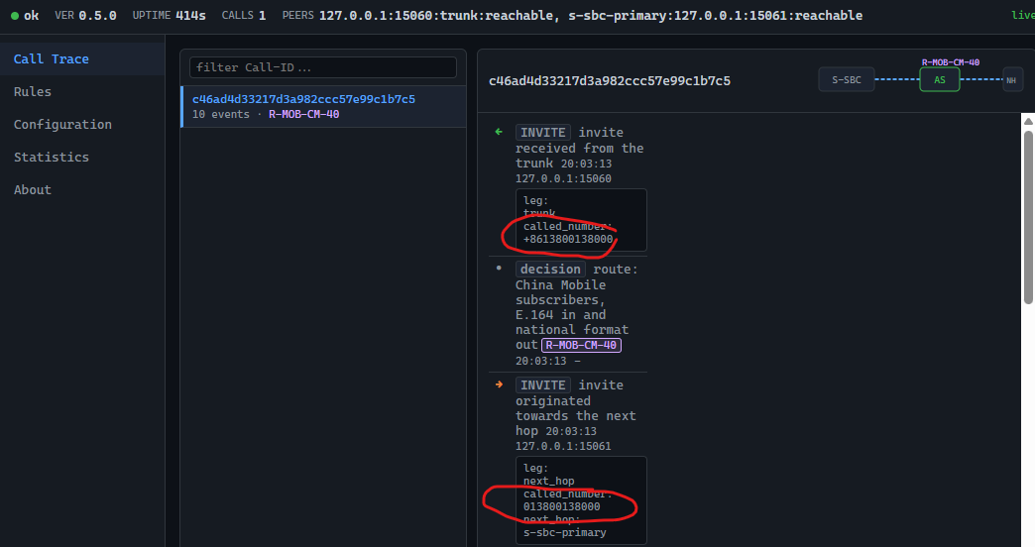
Demo - Call Trace
Notes:
This POC validates the core technical feasibility of a third-party IMS Application Server: a sippy-based B2BUA signalling plane, declarative YAML routing engine, multi-format number translation, structured logging, and real-time ops console.
All M0-M4 milestones are complete, 119 tests pass, and 6 architecture decisions are documented. Current version v0.5.0, Apache-2.0 open source.
Next step: evolve to production-grade deployment following the registered restriction and TODO roadmap.

Slide 14
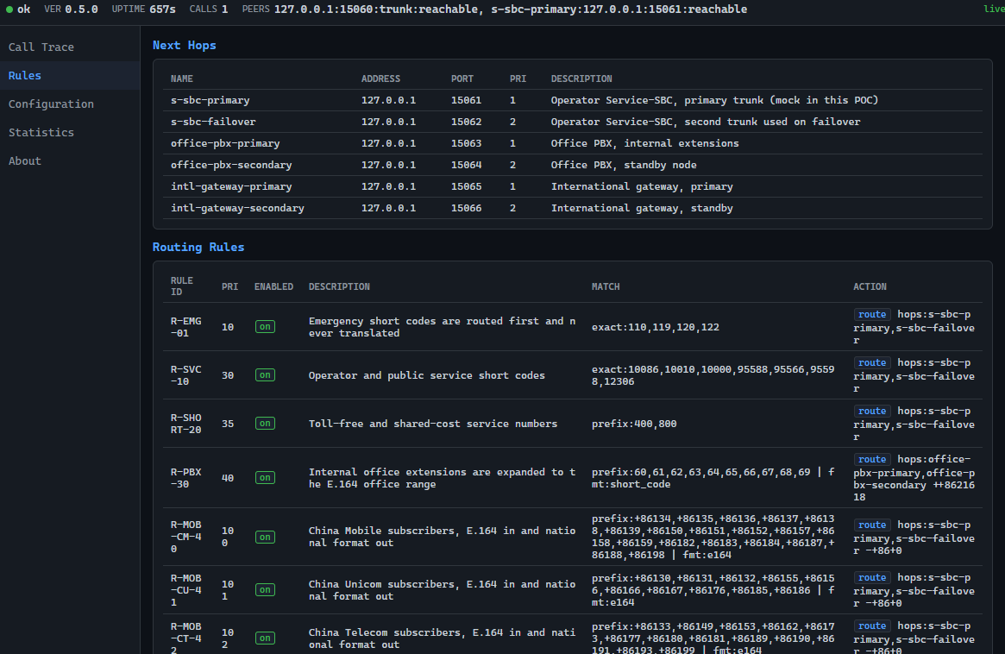
Demo cont - Rules
Notes:
This POC validates the core technical feasibility of a third-party IMS Application Server: a sippy-based B2BUA signalling plane, declarative YAML routing engine, multi-format number translation, structured logging, and real-time ops console.
All M0-M4 milestones are complete, 119 tests pass, and 6 architecture decisions are documented. Current version v0.5.0, Apache-2.0 open source.
Next step: evolve to production-grade deployment following the registered restriction and TODO roadmap.

