Slide 2
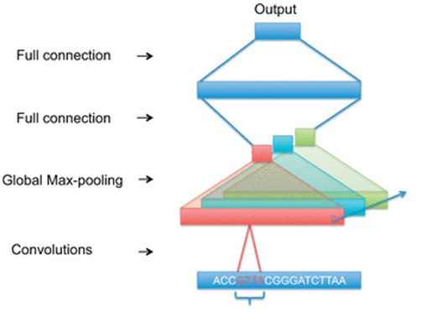
General network architecture
The kernels should locate motifs.
More kernels can detect different motifs.
The purpose of global max pooling is to determine if a motif exists in the input sequence or not.

Slide 3
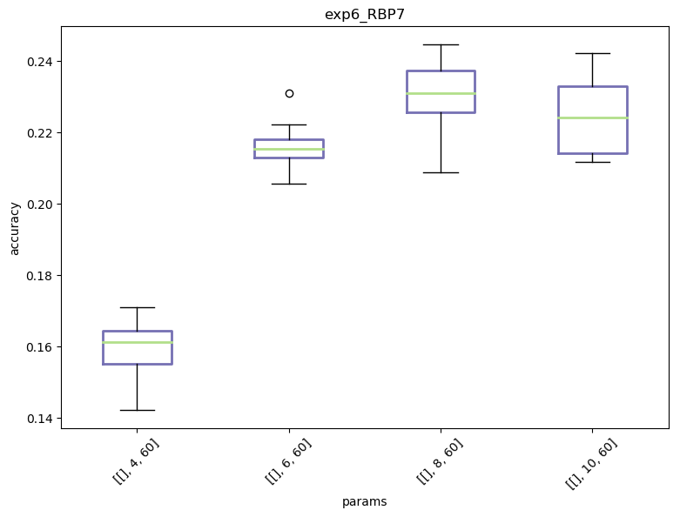
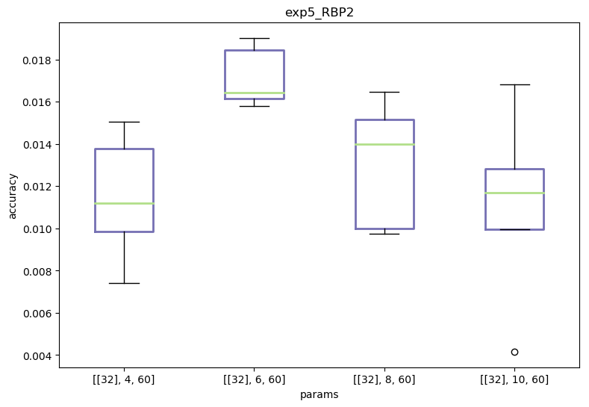
Choosing kernel size
Different RBP’s have different performances with different kernel sizes.
This can be explained by varying motifs lengths in different RBP’s.

Slide 4
Choosing kernel size
The solution?
Using different kernels with different sizes!

Slide 5
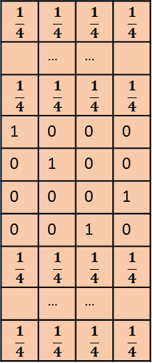
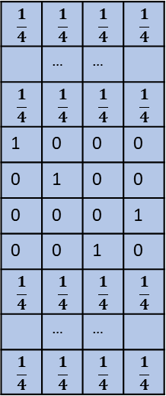
$$\frac{1}{4}$$ | $$\frac{1}{4}$$ | $$\frac{1}{4}$$ | $$\frac{1}{4}$$
 | … | …
$$\frac{1}{4}$$ | $$\frac{1}{4}$$ | $$\frac{1}{4}$$ | $$\frac{1}{4}$$
0 | 0 | 0 | 1
0 | 0 | 1 | 0
1 | 0 | 0 | 0
0 | 1 | 0 | 0
$$\frac{1}{4}$$ | $$\frac{1}{4}$$ | $$\frac{1}{4}$$ | $$\frac{1}{4}$$
 | … | …
$$\frac{1}{4}$$ | $$\frac{1}{4}$$ | $$\frac{1}{4}$$ | $$\frac{1}{4}$$
Convolution Layer
Padding size - 5
Kernel size=6
Global max pooling
Kernel size=6
Strides - 1
ATCG
$$\frac{1}{4}$$ | $$\frac{1}{4}$$ | $$\frac{1}{4}$$ | $$\frac{1}{4}$$
 | … | …
$$\frac{1}{4}$$ | $$\frac{1}{4}$$ | $$\frac{1}{4}$$ | $$\frac{1}{4}$$
0 | 0 | 0 | 1
0 | 0 | 1 | 0
1 | 0 | 0 | 0
0 | 1 | 0 | 0
$$\frac{1}{4}$$ | $$\frac{1}{4}$$ | $$\frac{1}{4}$$ | $$\frac{1}{4}$$
 | … | …
$$\frac{1}{4}$$ | $$\frac{1}{4}$$ | $$\frac{1}{4}$$ | $$\frac{1}{4}$$
Kernel size=8
Global max pooling
Kernel size=8
Padding size - 7
Strides - 1

Slide 6
$$\frac{1}{4}$$ | $$\frac{1}{4}$$ | $$\frac{1}{4}$$ | $$\frac{1}{4}$$
 | … | …
$$\frac{1}{4}$$ | $$\frac{1}{4}$$ | $$\frac{1}{4}$$ | $$\frac{1}{4}$$
0 | 0 | 0 | 1
0 | 0 | 1 | 0
1 | 0 | 0 | 0
0 | 1 | 0 | 0
$$\frac{1}{4}$$ | $$\frac{1}{4}$$ | $$\frac{1}{4}$$ | $$\frac{1}{4}$$
 | … | …
$$\frac{1}{4}$$ | $$\frac{1}{4}$$ | $$\frac{1}{4}$$ | $$\frac{1}{4}$$
Padding size - 5
…
Kernel size=6
Number of kernels of size 6
ATCG
Concat
$$\frac{1}{4}$$ | $$\frac{1}{4}$$ | $$\frac{1}{4}$$ | $$\frac{1}{4}$$
 | … | …
$$\frac{1}{4}$$ | $$\frac{1}{4}$$ | $$\frac{1}{4}$$ | $$\frac{1}{4}$$
0 | 0 | 0 | 1
0 | 0 | 1 | 0
1 | 0 | 0 | 0
0 | 1 | 0 | 0
$$\frac{1}{4}$$ | $$\frac{1}{4}$$ | $$\frac{1}{4}$$ | $$\frac{1}{4}$$
 | … | …
$$\frac{1}{4}$$ | $$\frac{1}{4}$$ | $$\frac{1}{4}$$ | $$\frac{1}{4}$$
…
Kernel size=8
Number of kernels of size 8
Padding size - 7

Slide 7
$$\frac{1}{4}$$ | $$\frac{1}{4}$$ | $$\frac{1}{4}$$ | $$\frac{1}{4}$$
 | … | …
$$\frac{1}{4}$$ | $$\frac{1}{4}$$ | $$\frac{1}{4}$$ | $$\frac{1}{4}$$
0 | 0 | 0 | 1
0 | 0 | 1 | 0
1 | 0 | 0 | 0
0 | 1 | 0 | 0
$$\frac{1}{4}$$ | $$\frac{1}{4}$$ | $$\frac{1}{4}$$ | $$\frac{1}{4}$$
 | … | …
$$\frac{1}{4}$$ | $$\frac{1}{4}$$ | $$\frac{1}{4}$$ | $$\frac{1}{4}$$
Padding size - 5
Kernel size=6
ATCG
…
Prediction
$$\frac{1}{4}$$ | $$\frac{1}{4}$$ | $$\frac{1}{4}$$ | $$\frac{1}{4}$$
 | … | …
$$\frac{1}{4}$$ | $$\frac{1}{4}$$ | $$\frac{1}{4}$$ | $$\frac{1}{4}$$
0 | 0 | 0 | 1
0 | 0 | 1 | 0
1 | 0 | 0 | 0
0 | 1 | 0 | 0
$$\frac{1}{4}$$ | $$\frac{1}{4}$$ | $$\frac{1}{4}$$ | $$\frac{1}{4}$$
 | … | …
$$\frac{1}{4}$$ | $$\frac{1}{4}$$ | $$\frac{1}{4}$$ | $$\frac{1}{4}$$
Dense layer
size
Kernel size=8
Padding size - 7

