Slide 2
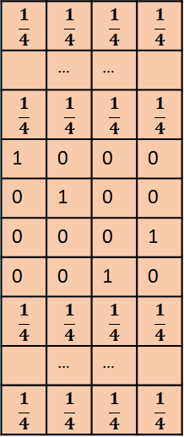
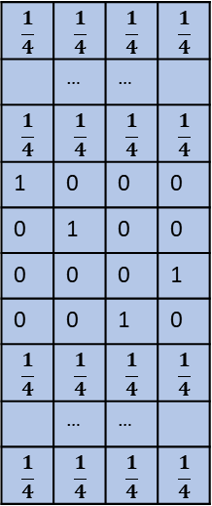
$$\frac{1}{4}$$ | $$\frac{1}{4}$$ | $$\frac{1}{4}$$ | $$\frac{1}{4}$$
 | … | …
$$\frac{1}{4}$$ | $$\frac{1}{4}$$ | $$\frac{1}{4}$$ | $$\frac{1}{4}$$
0 | 0 | 0 | 1
0 | 0 | 1 | 0
1 | 0 | 0 | 0
0 | 1 | 0 | 0
$$\frac{1}{4}$$ | $$\frac{1}{4}$$ | $$\frac{1}{4}$$ | $$\frac{1}{4}$$
 | … | …
$$\frac{1}{4}$$ | $$\frac{1}{4}$$ | $$\frac{1}{4}$$ | $$\frac{1}{4}$$
Convolution Layer
Padding size - 5
Kernel size=6
Max pooling
Kernel size=6
Strides - 1
ATCG
$$\frac{1}{4}$$ | $$\frac{1}{4}$$ | $$\frac{1}{4}$$ | $$\frac{1}{4}$$
 | … | …
$$\frac{1}{4}$$ | $$\frac{1}{4}$$ | $$\frac{1}{4}$$ | $$\frac{1}{4}$$
0 | 0 | 0 | 1
0 | 0 | 1 | 0
1 | 0 | 0 | 0
0 | 1 | 0 | 0
$$\frac{1}{4}$$ | $$\frac{1}{4}$$ | $$\frac{1}{4}$$ | $$\frac{1}{4}$$
 | … | …
$$\frac{1}{4}$$ | $$\frac{1}{4}$$ | $$\frac{1}{4}$$ | $$\frac{1}{4}$$
Kernel size=8
Kernel size=8
Max pooling
Padding size - 7
Strides - 1

Slide 3
$$\frac{1}{4}$$ | $$\frac{1}{4}$$ | $$\frac{1}{4}$$ | $$\frac{1}{4}$$
 | … | …
$$\frac{1}{4}$$ | $$\frac{1}{4}$$ | $$\frac{1}{4}$$ | $$\frac{1}{4}$$
0 | 0 | 0 | 1
0 | 0 | 1 | 0
1 | 0 | 0 | 0
0 | 1 | 0 | 0
$$\frac{1}{4}$$ | $$\frac{1}{4}$$ | $$\frac{1}{4}$$ | $$\frac{1}{4}$$
 | … | …
$$\frac{1}{4}$$ | $$\frac{1}{4}$$ | $$\frac{1}{4}$$ | $$\frac{1}{4}$$
Padding size - 5
…
Kernel size=6
Number of kernels of size 6
ATCG
Concat
$$\frac{1}{4}$$ | $$\frac{1}{4}$$ | $$\frac{1}{4}$$ | $$\frac{1}{4}$$
 | … | …
$$\frac{1}{4}$$ | $$\frac{1}{4}$$ | $$\frac{1}{4}$$ | $$\frac{1}{4}$$
0 | 0 | 0 | 1
0 | 0 | 1 | 0
1 | 0 | 0 | 0
0 | 1 | 0 | 0
$$\frac{1}{4}$$ | $$\frac{1}{4}$$ | $$\frac{1}{4}$$ | $$\frac{1}{4}$$
 | … | …
$$\frac{1}{4}$$ | $$\frac{1}{4}$$ | $$\frac{1}{4}$$ | $$\frac{1}{4}$$
…
Kernel size=8
Number of kernels of size 8
Padding size - 7

Slide 4
$$\frac{1}{4}$$ | $$\frac{1}{4}$$ | $$\frac{1}{4}$$ | $$\frac{1}{4}$$
 | … | …
$$\frac{1}{4}$$ | $$\frac{1}{4}$$ | $$\frac{1}{4}$$ | $$\frac{1}{4}$$
0 | 0 | 0 | 1
0 | 0 | 1 | 0
1 | 0 | 0 | 0
0 | 1 | 0 | 0
$$\frac{1}{4}$$ | $$\frac{1}{4}$$ | $$\frac{1}{4}$$ | $$\frac{1}{4}$$
 | … | …
$$\frac{1}{4}$$ | $$\frac{1}{4}$$ | $$\frac{1}{4}$$ | $$\frac{1}{4}$$
Padding size - 5
Kernel size=6
ATCG
…
Prediction
$$\frac{1}{4}$$ | $$\frac{1}{4}$$ | $$\frac{1}{4}$$ | $$\frac{1}{4}$$
 | … | …
$$\frac{1}{4}$$ | $$\frac{1}{4}$$ | $$\frac{1}{4}$$ | $$\frac{1}{4}$$
0 | 0 | 0 | 1
0 | 0 | 1 | 0
1 | 0 | 0 | 0
0 | 1 | 0 | 0
$$\frac{1}{4}$$ | $$\frac{1}{4}$$ | $$\frac{1}{4}$$ | $$\frac{1}{4}$$
 | … | …
$$\frac{1}{4}$$ | $$\frac{1}{4}$$ | $$\frac{1}{4}$$ | $$\frac{1}{4}$$
Dense layer
size
Kernel size=8
Padding size - 7

