Slide 2
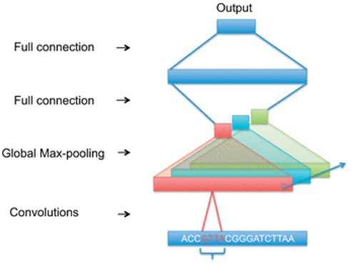
General network architecture
The kernels should locate motifs.
More kernels can detect different motifs.
The purpose of global max pooling is to determine if a motif exists in the input sequence or not.

Slide 3
Choosing kernel size
Different RBP’s have different performances with different kernel sizes.
This can be explained by varying motifs lengths in different RBP’s.
Solution? Use more than one kernel size in our network.

Slide 4
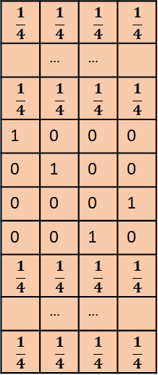
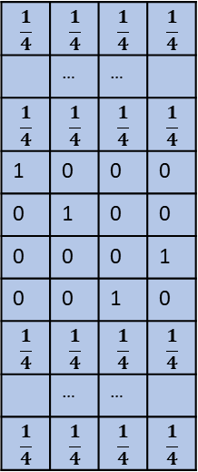
$$\frac{1}{4}$$ | $$\frac{1}{4}$$ | $$\frac{1}{4}$$ | $$\frac{1}{4}$$
 | … | …
$$\frac{1}{4}$$ | $$\frac{1}{4}$$ | $$\frac{1}{4}$$ | $$\frac{1}{4}$$
0 | 0 | 0 | 1
0 | 0 | 1 | 0
1 | 0 | 0 | 0
0 | 1 | 0 | 0
$$\frac{1}{4}$$ | $$\frac{1}{4}$$ | $$\frac{1}{4}$$ | $$\frac{1}{4}$$
 | … | …
$$\frac{1}{4}$$ | $$\frac{1}{4}$$ | $$\frac{1}{4}$$ | $$\frac{1}{4}$$
Convolution Layer
Padding size - 5
Kernel size=6
Max pooling
Kernel size=6
Strides - 1
ATCG
$$\frac{1}{4}$$ | $$\frac{1}{4}$$ | $$\frac{1}{4}$$ | $$\frac{1}{4}$$
 | … | …
$$\frac{1}{4}$$ | $$\frac{1}{4}$$ | $$\frac{1}{4}$$ | $$\frac{1}{4}$$
0 | 0 | 0 | 1
0 | 0 | 1 | 0
1 | 0 | 0 | 0
0 | 1 | 0 | 0
$$\frac{1}{4}$$ | $$\frac{1}{4}$$ | $$\frac{1}{4}$$ | $$\frac{1}{4}$$
 | … | …
$$\frac{1}{4}$$ | $$\frac{1}{4}$$ | $$\frac{1}{4}$$ | $$\frac{1}{4}$$
Kernel size=8
Kernel size=8
Max pooling
Padding size - 7
Strides - 1

Slide 5
$$\frac{1}{4}$$ | $$\frac{1}{4}$$ | $$\frac{1}{4}$$ | $$\frac{1}{4}$$
 | … | …
$$\frac{1}{4}$$ | $$\frac{1}{4}$$ | $$\frac{1}{4}$$ | $$\frac{1}{4}$$
0 | 0 | 0 | 1
0 | 0 | 1 | 0
1 | 0 | 0 | 0
0 | 1 | 0 | 0
$$\frac{1}{4}$$ | $$\frac{1}{4}$$ | $$\frac{1}{4}$$ | $$\frac{1}{4}$$
 | … | …
$$\frac{1}{4}$$ | $$\frac{1}{4}$$ | $$\frac{1}{4}$$ | $$\frac{1}{4}$$
Padding size - 5
…
Kernel size=6
Number of kernels of size 6
ATCG
Concat
$$\frac{1}{4}$$ | $$\frac{1}{4}$$ | $$\frac{1}{4}$$ | $$\frac{1}{4}$$
 | … | …
$$\frac{1}{4}$$ | $$\frac{1}{4}$$ | $$\frac{1}{4}$$ | $$\frac{1}{4}$$
0 | 0 | 0 | 1
0 | 0 | 1 | 0
1 | 0 | 0 | 0
0 | 1 | 0 | 0
$$\frac{1}{4}$$ | $$\frac{1}{4}$$ | $$\frac{1}{4}$$ | $$\frac{1}{4}$$
 | … | …
$$\frac{1}{4}$$ | $$\frac{1}{4}$$ | $$\frac{1}{4}$$ | $$\frac{1}{4}$$
…
Kernel size=8
Number of kernels of size 8
Padding size - 7

Slide 6
$$\frac{1}{4}$$ | $$\frac{1}{4}$$ | $$\frac{1}{4}$$ | $$\frac{1}{4}$$
 | … | …
$$\frac{1}{4}$$ | $$\frac{1}{4}$$ | $$\frac{1}{4}$$ | $$\frac{1}{4}$$
0 | 0 | 0 | 1
0 | 0 | 1 | 0
1 | 0 | 0 | 0
0 | 1 | 0 | 0
$$\frac{1}{4}$$ | $$\frac{1}{4}$$ | $$\frac{1}{4}$$ | $$\frac{1}{4}$$
 | … | …
$$\frac{1}{4}$$ | $$\frac{1}{4}$$ | $$\frac{1}{4}$$ | $$\frac{1}{4}$$
Padding size - 5
Kernel size=6
ATCG
…
Prediction
$$\frac{1}{4}$$ | $$\frac{1}{4}$$ | $$\frac{1}{4}$$ | $$\frac{1}{4}$$
 | … | …
$$\frac{1}{4}$$ | $$\frac{1}{4}$$ | $$\frac{1}{4}$$ | $$\frac{1}{4}$$
0 | 0 | 0 | 1
0 | 0 | 1 | 0
1 | 0 | 0 | 0
0 | 1 | 0 | 0
$$\frac{1}{4}$$ | $$\frac{1}{4}$$ | $$\frac{1}{4}$$ | $$\frac{1}{4}$$
 | … | …
$$\frac{1}{4}$$ | $$\frac{1}{4}$$ | $$\frac{1}{4}$$ | $$\frac{1}{4}$$
Dense layer
size
Kernel size=8
Padding size - 7

