Slide 1
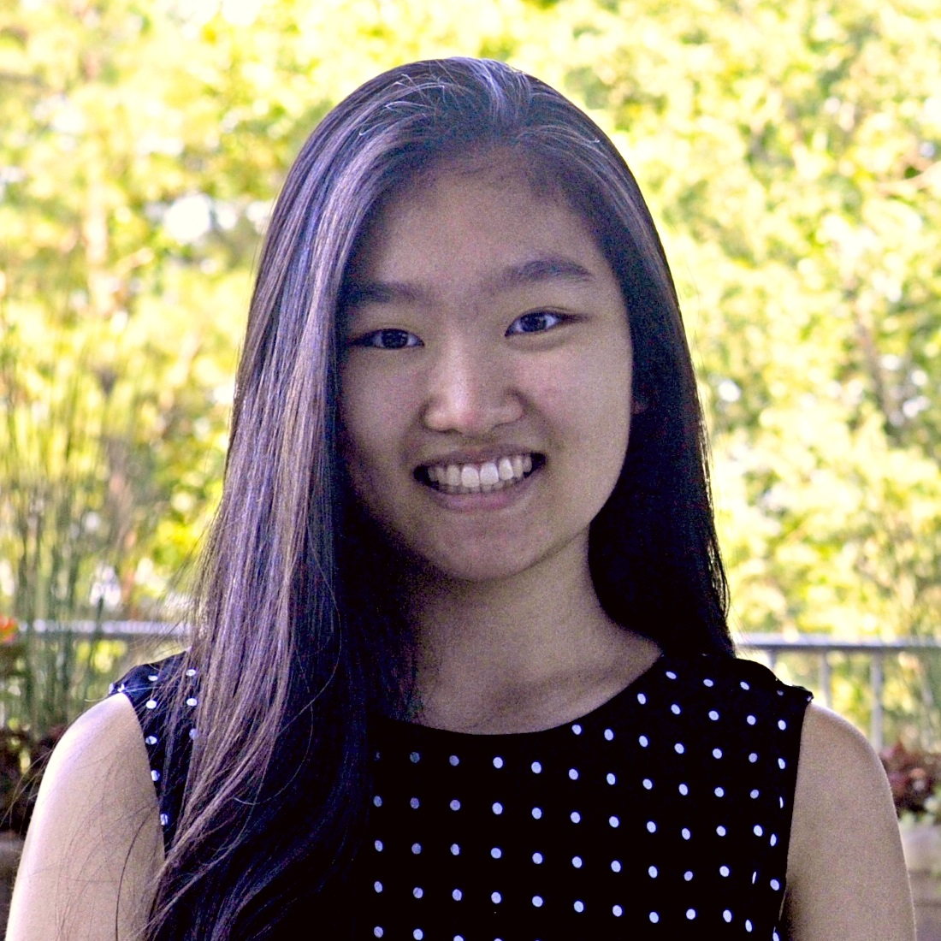
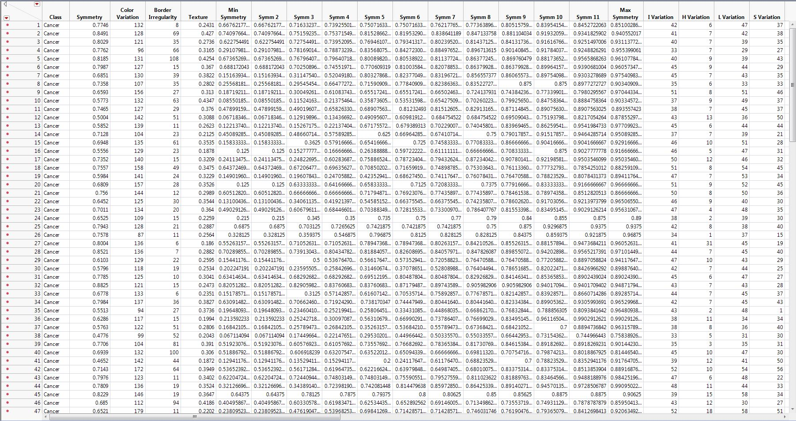
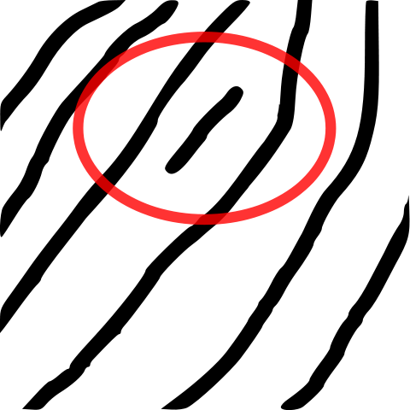
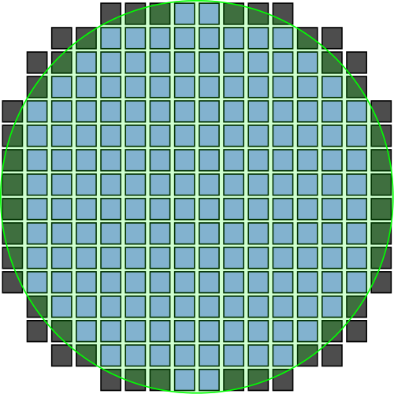
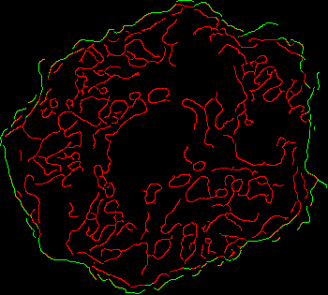
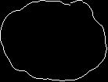
Contents
Overview
Methods
Results
Discussion
Objective & Summary
Materials and Methods
Research Implications
The objective of this project is to use image analysis in JMP to develop an automated program for extracting metrics from skin lesion images.
First, the program segments the skin lesion outer border from the original image.
Then, algorithms extract 44 characteristic metrics from images, such as texture, symmetry, border irregularity, and variation of color, hue, saturation, luminance, and intensity.
JMP Pro
JMP Scripting Language
Sample collection
Image processing
Variable analysis
JMP image analysis techniques and algorithms similar to those created in this study have numerous applications in a variety of different fields, including:
Character recognition
Wildlife identification
Facial, fingerprint recognition
Topography, geological mapping
Manufacturing defect identification
Results
The program successfully segmented lesion images and compiled metrics into a data table that can be further analyzed with statistical models.
Symmetry
Texture
Border Irregularity
Illustration of various variable analysis and metric extraction algorithms
Two applications of image analysis: fingerprint recognition and manufacturing

Slide 2
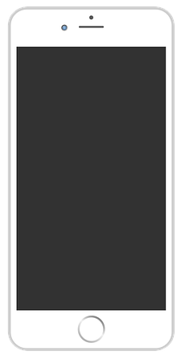
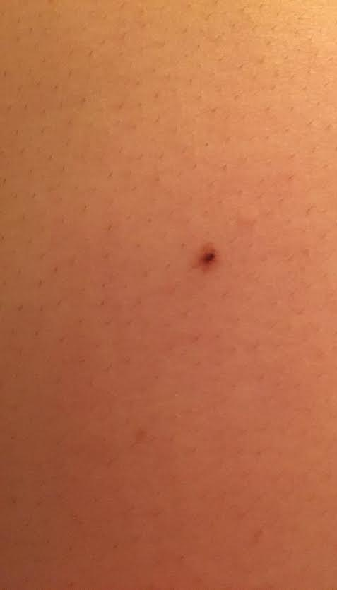
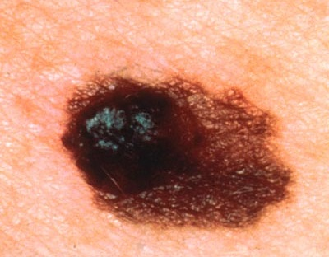
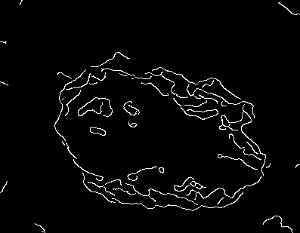
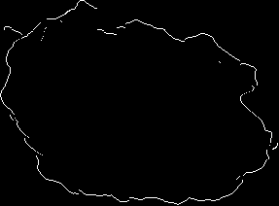
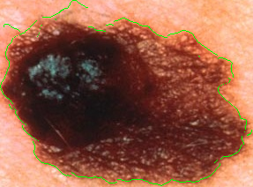
Contents
Overview
Methods
Results
Discussion
Sample Collection
Image Processing (isolating lesion and outer border)
Image samples were collected via photography and online search.
The best images are in good focus and as close as possible to the lesion. Dermoscopy images were found to be too detailed for reliable analysis.
Automated algorithm’s main steps, starting with original image:
Detect edges using ‘canny’ filter
Convert image to black and white – 30% red, 59% green, 11% blue
Apply despeckle, reduce noise, and canny filters
Remove surrounding noise in four directions
Loop through image matrix for white segments that are detached from largest white cluster
Isolate lesion outer border from four directions
Of remaining white pixels, only keep outermost white pixel on every row and column
Crop image to fit lesion exactly
Crop image within dimensions bounded by outermost white pixel in each direction
As needed, images were adjusted for overexposure.
Distracting features, such as the outline of an arm, were cropped out.
1 original
2 detect border
variable analysis
3 remove noise,
isolate border
4 overlaid image
Home

Slide 3
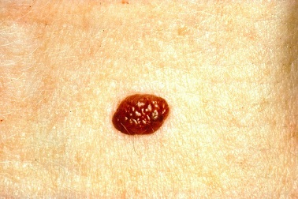
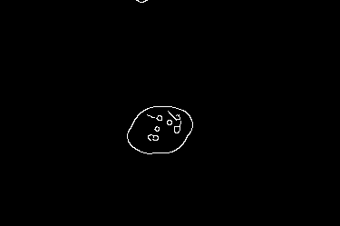
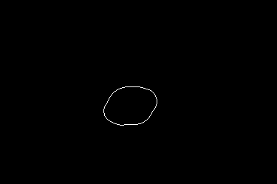


Contents
Overview
Methods
Results
Discussion
Image Processing – Sample Code Snippets
Detect edges
Isolate outer border
imgBW = newImage(img);
{r, g, b} = imgBW << get pixels("rgb");
i = .30*r + .59*g + .11*b;
imgBW << set pixels("rgb", {i,i,i});
imgEdge = newImage(imgBW);
imgEdge << filter("despeckle");
imgEdge << filter("despeckle");
imgEdge << filter("despeckle");
imgEdge << filter("reduce noise", 2.2);
imgEdge << filter("canny");
whiteCount = 0;
for(j = 1, j <= numCols, j++, //loop through and record all white pixels
whiteCount = 0;
for(i = 1, AND(whiteCount == 0, i <= numRows), i++,
if(coord[i, j] == 1,
whiteCount++;
insertInto(coordRow, i); //insert the white coordinate in the matrix
insertInto(coordCol, j);
);
);
);
Remove surrounding noise
Crop image for fit
coord = J(numRows, numCols); //stores B&W RGB pixel values
table = New Table("Pixel Data", "private", //new table
newColumn("Y", set values(shape(repeat(1::numRows, numCols)`, numCols, numRows))),
newColumn("X", set values(repeat(1::numCols, numRows))),
newColumn("R", set values(r))
);
for each row(
coord[:y, :x] = :R;
); //each row has one pixel’s data
//crop image to perfectly fit the mole, both B&W and color
onlyMole = newImage(outerBorder);
onlyMole << crop( left(le - 1), top(to - 1), bottom(bo + 1), right(ri + 1));
onlyMoleC = newImage(img);
onlyMoleC << crop(left(le - 1), top(to - 1), bottom(bo + 1), right(ri + 1));
Home

Slide 4

Contents
Overview
Methods
Results
Discussion
Variable Analysis – Asymmetry
Algorithm: Rotate outline image in intervals, measuring comparative distances to points on either side of center line, with a tolerance level of 5% (for the difference between each pair of distances)
Formula:
All derived metrics: average symmetry; individual rotation symmetries (sorted ascending)
Scale: 0 – 1 (least to most symmetrical)
while(currentAngl <= endDegree,
...
coordColRot = {}; //to store the rotated values of white pixels
coordRowRot = {};
//rotating the col & row values, using the 'x' shift equation for Col, 'y' shift for Row
for(j = 1, j <= N Items(coordColShft), j++,
insertInto(coordColRot, coordColShft[j] - midX);
insertInto(coordRowRot, coordRowShft[j] - midY);
coordColTemp = coordColRot[j];
coordColRot[j] = Round((coordColRot[j] * cos(currentAngl)) + (coordRowRot[j] * sin(currentAngl)));
coordRowRot[j] = Round((coordRowRot[j] * cos(currentAngl)) - (coordColTemp * sin(currentAngl)));
coordColRot[j] += midX;
coordRowRot[j] += midY;
);
...
);
JMP features shown: image manipulation, matrices,
lists, mathematical functions
Home

Slide 5
Contents
Overview
Methods
Results
Discussion
Variable Analysis – Border Irregularity
Algorithm: Calculate slope for adjacent pairs of border pixels, counting the instances where the slope changes signs (i.e. -2, -1, 4; 2, 0, 0, -1)
All derived metrics: border irregularity count
Scale: 4 – ~100 (least to most irregular)
for(j = 1, j <= 4, j++,
match(j,
1, endOfSide = numCols, //assign the length of the side currently being analyzed
2, endOfSide = numCols,
3, endOfSide = numRows,
4, endOfSide = numRows,
numCols
);
for(i = 1, AND(i < endOfSide, N Items(coordColBig) != 0), i++, //create list of all the slopes
if(coordColBig[i] == coordColBig[i + 1],
continue();
);
slope = ((coordRowBig[i + 1] - coordRowBig[i]) / (coordColBig[i + 1] - coordColBig[i]));
insertInto(slopes, slope); //create list of all the slopes for later analysis
totalPairs++;
);
);
...
JMP features shown: lists, logical operators, conditional functions, mathematical functions
Home

Slide 6
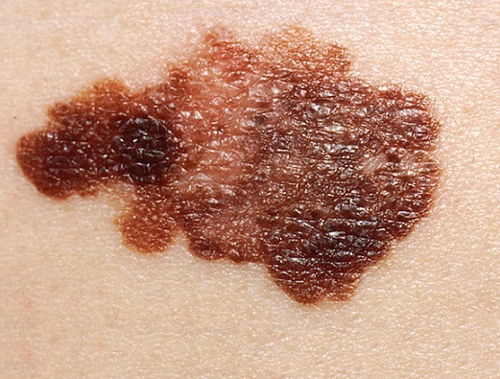
Contents
Overview
Methods
Results
Discussion
Variable Analysis – Color Variation
Algorithm: Create ‘bins’ of small ranges for each color variable (red, green, blue, hue, luminance, saturation, intensity), 0 – 0.01, 0.01 – 0.02, etc. and count the number of significant bins (number of pixels in a variable’s bin is ≥ average of all the buckets for that variable)
All derived metrics: maximum, minimum variation bin indices, variation value for each color variable; total variation
Scale: ~50 - ~200 (least to most variation)
intens = newImage(imgBW);
intensity << crop( left(le - 1), top(to - 1), bottom(bo + 1), right(ri + 1));
{r2, g2, b2} = intens << get pixels("rgb"); //get rgb pixels of the intensity image cropped
{red, green, blue} = onlyMoleC << get pixels("rgb");
colorImgPix = onlyMoleC << get pixels(); // get rgb pixels of the color image cropped
{h, l, s} = ColorToHLS(colorImgPix); //get the HLS values of the color image
...
variation = 0;
binCtsI = J(1, numBins, 0); //counting intensity variation
binCtsH = J(1, numBins, 0); //counting hue variation
...
for(i = 1, i <= numRows, i++, //calculating variation for each type of color variable
...
if(AND(r2[i, j] > (k / numBins), r2[i, j] <= ((k + 1) / numBins)),
binCtsI[k + 1]++;
);
...
);
JMP features shown: image functions (duplication, cropping, pixel retrieval, HLS conversion), matrices, logical operators, mathematical functions
Home

Slide 7
Contents
Overview
Methods
Results
Discussion
Variable Analysis – Texture
Algorithm: Calculate percentage of white pixels removed after segmenting outer border of lesion to determine how varied the interior of the lesion appears to the computer
All derived metrics: texture percentage
Formula:
Scale: 0 – 1 (least to most texture present)
//all the insides become red
for(i = 1, i <= nrow(textureCoord), i++,
for(j = 1, j <= ncol(textureCoord), j++,
if(textureCoord[i, j] == 1,
textureR[i, j] = 1;
);
);
);
//all the outsides become green
for(i = 1, i <= N Items(coordRow), i++,
textureR[coordRow[i], coordCol[i]] = 0;
textureG[coordRow[i], coordCol[i]] = 1;
textureB[coordRow[i], coordCol[i]] = 0;
);
textureShown = newImage("rgb", {textureR, textureG, textureB});
textureShown << crop( left(le - 1), top(to - 1), bottom(bo + 1), right(ri + 1));
JMP features shown: image functions (creation through RGB, cropping), matrices, lists
Home

Slide 8
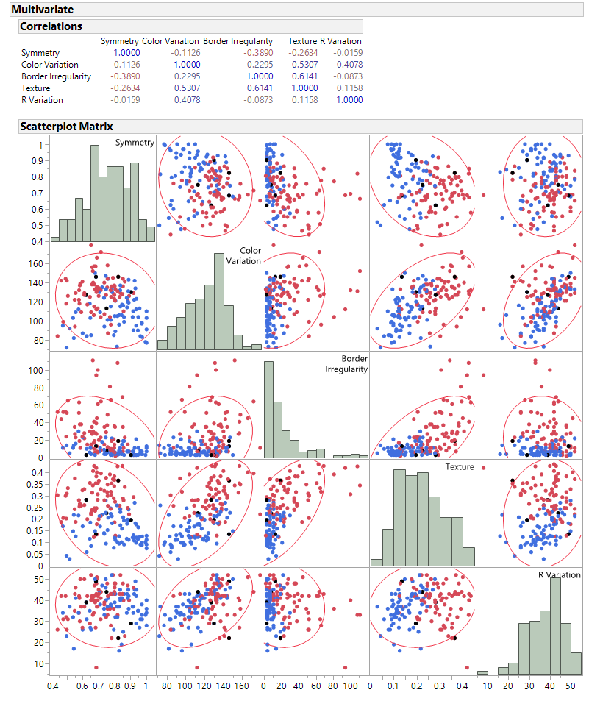
Contents
Overview
Methods
Results
Discussion
Data Table Creation, Variable Correlation and Distribution Evaluation
Automated program creates data table with all extracted metrics (sample size of 153, 44 variables), which can be used in statistical analysis
Correlation scatterplots and distributions for the 5 primary variables
Home

Slide 9
Contents
Overview
Methods
Results
Discussion
Discussion and Future Research
Resources
After developing this program, I’d like to continue implementing new image analysis techniques in future research.
Future goals:
Improve algorithms (specifically, extract more variables from the border irregularity analysis)
Develop more JMP image analysis techniques
Support more features (batch processing analysis, etc.)
Experiment with other image analysis applications, such as character recognition and manufacturing defect identification
Julia Gong’s JMP Blog and JMP User Community Profile: http://blogs.sas.com/content/jmp/author/juliagong/
https://community.jmp.com/people/juliagong
Image samples (from Wikipedia)
Border irregularity algorithm in MatLab by Tim Kam Lee
Feature extraction in MatLab by Amran Hossen Bhuiyan, et. al.
Feature extraction in dermoscopy images by Nabin K. Mishra and M. Emre Celebi
Image segmentation in mobile devices by Luís Rosado and Maria João M. Vasconcelos
Images used in PowerPoint (fingerprint analysis, semiconductor, iPhone)
Acknowledgement
I’d like to thank John Ponte and Dan Valente for their mentorship and guidance, and Diana Levey and the JMP marketing team for their support and encouragement.
Home

Slide 10

Figure 1
Contents
Overview
Methods
Results
Discussion
Back
Data table generated from automated metric extraction program, which can be used in statistical analysis

Slide 11
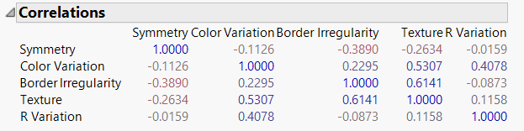
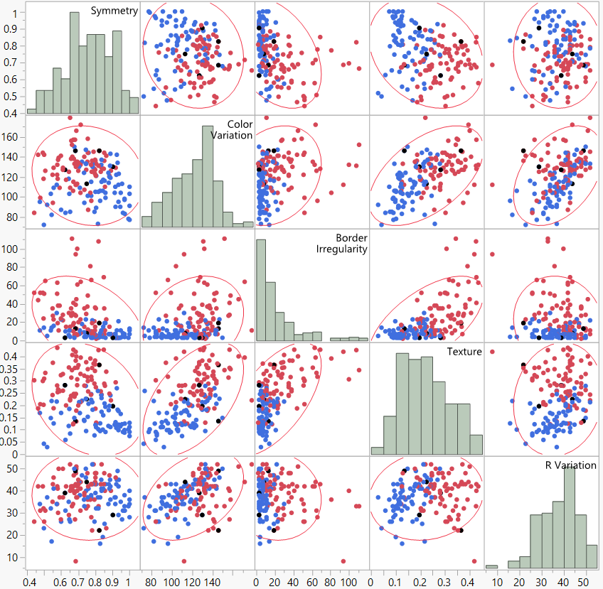
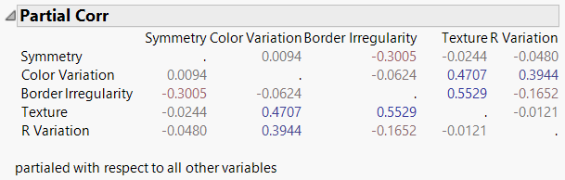
Figure 2
Contents
Overview
Methods
Results
Discussion
Correlation coefficients and partial correlation coefficients for the 5 primary variables
Partial correlation coefficients for the 5 primary variables with respect to all other variables
Correlation scatterplots and distributions for the 5 primary variables (symmetry, color variation, border irregularity, texture, and redness variation)
Given the uncorrelated nature of these variables and their small correlation coefficients, each of these variables has unique contributions to the characterizations of the images.
Back

