Slide 1
Parser
Frame
Experts
Memory
English Sentence

Slide 2
GAUNTLET
Question Expert
M2 Memory Interface
Raw
LLMerger
World

Slide 3
Shovel
Actor:
Swung
Movement:
From the man,
To the zombie
Path:

Slide 4
Thing
|
Frame
|
Trajectory
Thing
|
Animal
|
Bird
|
Robin
Thing
(Sequence)
Thing
|
Path
Thing
Thing
Thing
(Sequence)
Thing
|
Movement
|
Fly
…
…
Thing
|
Animal
|
Bird
|
Robin
Thing
|
Plant
|
Tree
|
Oak

Slide 5
Thing 2
Thing 1

Slide 6
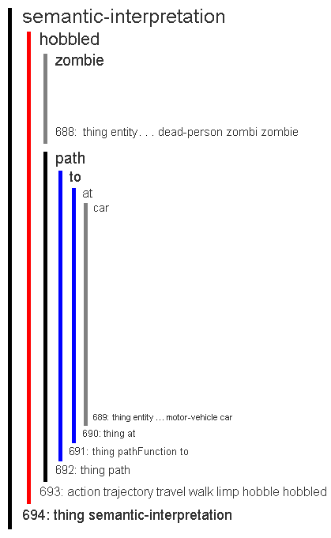

Slide 7
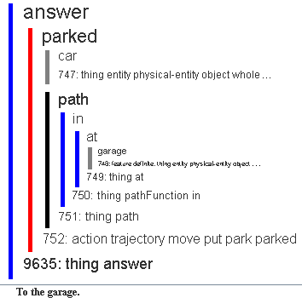

Slide 8
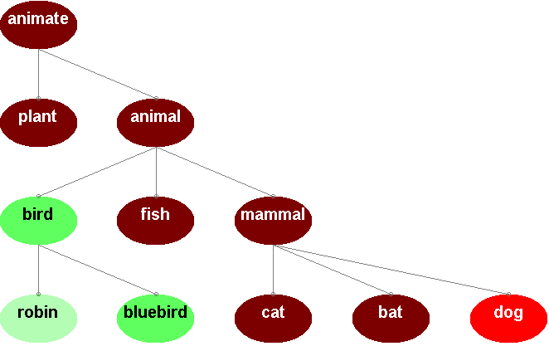

Slide 9
Thing:
“A dog ran to a house.”
Chain 1:
“A cat ran to a house.”
Near Neighbor
Chain 2 (two misses away):
“A dinosaur ran to a tree.”
Neighbor
Chain 3 (three misses away):
No
Neighbor

