Slide 1
Evolutionary Rescue in Conservation: A Theoretical Model inspired by the Iberian Lynx (Lynx pardinus)
THEE Research Practical
Damian Vogt
24.11.2025
Notes:
Hi everyone and thank you for joining me in my project presentation about …

Slide 2
Contents
Model Graph (Life cycle)
What is the model about?
Why is this model interesting?
Methods, Variables and Parameters
Results and Interpretation
Limitations and Outlook
Notes:
Quick overview what s coming your way:
First i wanna show you a graphic representation of my model just for better understanding
Then i want to discuss what this framework is actually about and why it might be interesting to look at
Then we will dive into all the maths methods and details of this model before we
Look at the results and move into
The discussion, outlook and limitations.

Slide 3
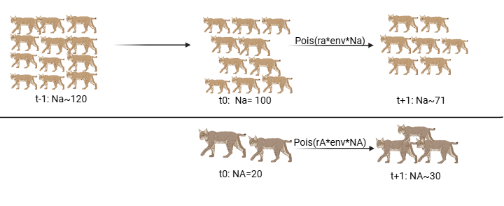
Life Cycle (non-panmictic)
Notes:
Now we simulate the outcome of the next generations respectively and we see what happens to the genotypes and overall population trajectories (we simulate until max_gen is reached)
Randomly draw offspring from pois each generation
Ra is frequency dependent with respect to K, and at small population sizes also under allee effect, meaning growth is hindered due to factors such as fragmentation or just overall difficulties finding mates.
So this scenario is non-diploid and non-panmictic as i mentioned (they dont mix) and there is always only 2 types present in the population at all times.
Another modeling approach is to change this

Slide 4
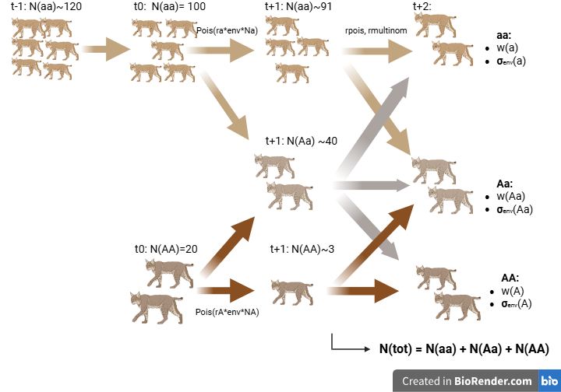
Life Cycle (panmictic, diploid)
Notes:
How does this work in my model
First step is to calculate the offspring each genotype has in the next generation. Then in a next step, we calculate the allele counts and frequencies under HWE, then finally before the next generation is simulated, number of individuals for next generation is selected by rmultinom, so alleles get assigned to offspring
Each genotype has is own distinct fitness value w, as well as environment sensitivity.
Total population is calculated from number of individual of each genotype.

Slide 5
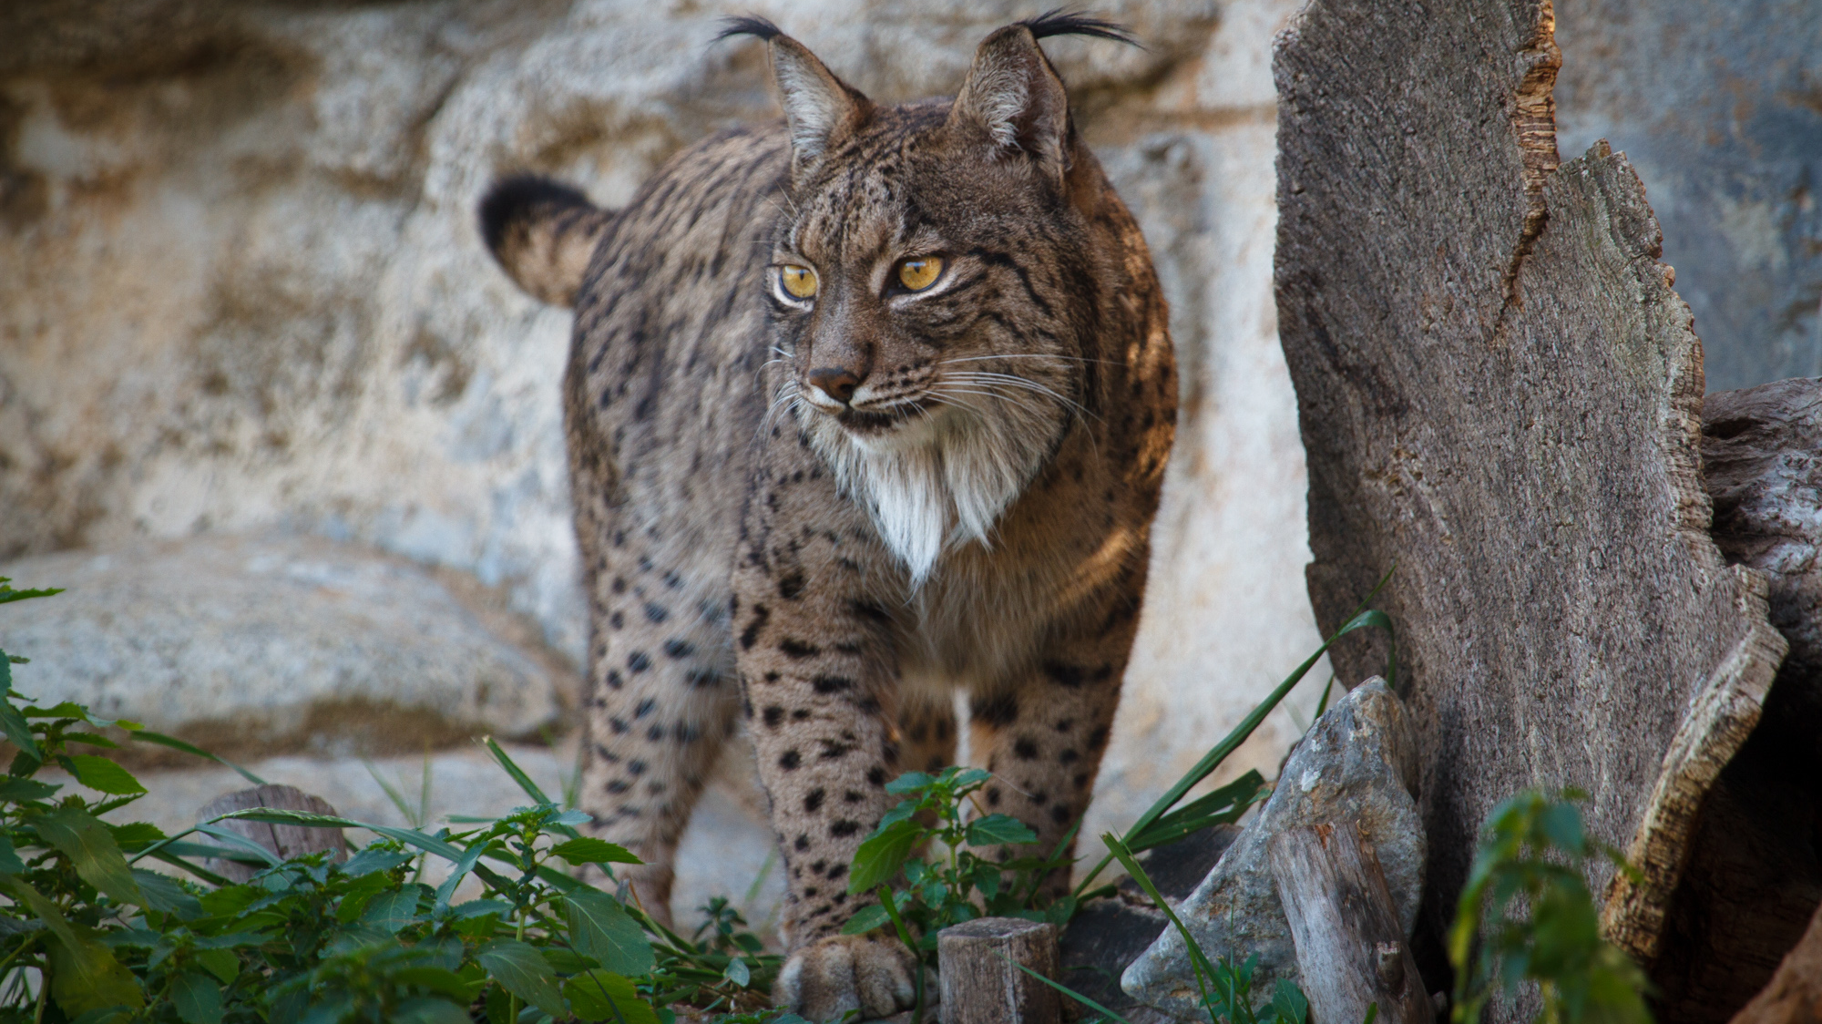
What is this model about?
Possible Scenarios of evolutionary rescue by initial mutant introduction
Orientation on real-life example of Iberian Lynx
Conservation: extensive ex-situ breeding programs, long-living and repeated reintroductions to wild populations
Questions: How do extinction probabilities vary under fitness-plasticity or strength of environmental fluctuation?
What is the minimal Introduction number so Population recovers by evolutionary rescue?
Picture source: https://www.ebd.csic.es/sites/default/files/imagenes/2025-07/20220301_linceiberico.jpg
Notes:
So what is my model about:
- I investigated …(point 1) under different assumptions and introduction sizes
- This model is inspired by a real example, the one of the conservational rescue of the iberian lynx that started before I was born and is still ongoing today, and this specific example really fascinated me a bit so I also wanted to challenge it a little. Why? Because
I wanted to see if there might be a possible rescue that is different from the classical conservation approaches that include… (point 3)
So the questions I investigated in this model are:
… (point 4 and 5)

Slide 6
Why is this an interesting model?
Biological/conservational relevance
Conservation approaches: extensive, resource-intense, repeated interventions into ecosystem and population dynamics (ethical concerns for ex-situ breeding?)
Especially in highly endangered species/populations
How can evolutionary rescue help population recovery?
What is the role of environmental stochasticity in recovery and population trajectory?
Notes:
Okay and why might this model be (moderately) interesting?
So i think a few things i mentioned in my last slide have at least some biological or conservational relevance
So i believe the most conventional conservational approaches are very… (point 2), (point 3 )
(point 4)
(point 5)

Slide 7
Model Parameters and Values
N(a): | Wildtype population | Dens: | Density dependence effect on total population | R(a): | Expected mean population growth („Lambda“) for Wildtype
N(A): | Mutant population | Allee: | Allee-effect on total population | R(A): | Expected mean population growth for Mutant
N(Aa): | Heterozygote population | Sigma_env(a): | SD of environmental stochasticity | R(Aa): | Expected mean population growth („Lambda“) for Heterozygote
N(tot): | Total population | Sigma_env(A): | SD of environmental stochasticity | A: | Allee-parameter
W(a): | Wildtype fitness | Sigma_env(Aa): | SD of environmental stochasticity | K: | Carrying Capacity
W(A): | Mutant fitness | Env: | Annual Env. Stochasticity (drawn from normal distribution) | P(a): | Allele frequency (a)
W(Aa): | Heterozygote Fitness | Max_gen: | Maximum generation | P(A): | Allele-frequency (A)
Notes:
Dens: which i will show you later
Explain what is an allee effect

Slide 8
Methods
Simulation of non-panmictic population
Simulation of panmictic-diploid population
Survival probabilities of Wt-population under varying environmental stochasticity
Survival probabilities of Wt-population under varying intrinsic fitness values
Estimation of population rescue depending on introduction number

Slide 9

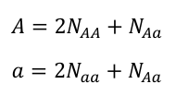





Methods: The math behind the model
Simulation of non-panmictic population:
Simulation of panmictic diploid population:
Hardy-Weinberg Equilibrium Formula
We draw random offspring via “rmultinom” for the next generation and simulate the diploid population over 100 generations as in the previous case.
Notes:
Non-panmictic:
Next generation offspring get drawn by poisson distribution
Expected population growth is a product of intrinsic fitness, density dependence with respect to K, allee effect eith respect to A (to the power of 0.5 for weakend allee efect, because populations otherwise are not able to recover)
Env: the yearly environmental effect is drawn by normal dist, sd being the genotype dependent „sigma_env“ value)
Same formula applies for Mutant genotype/A genotype
2. diploid:
First allele count is determined in the population
Calculations of allele frequencies under HWE

Slide 10
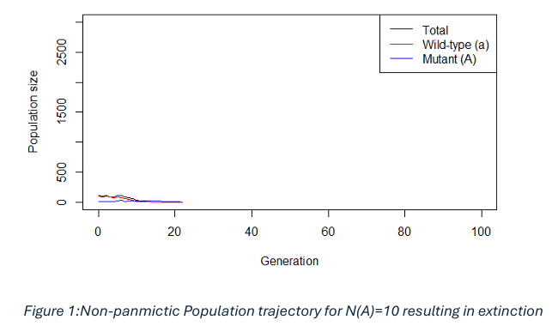
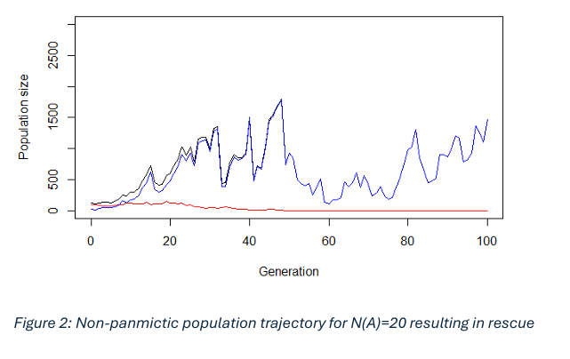
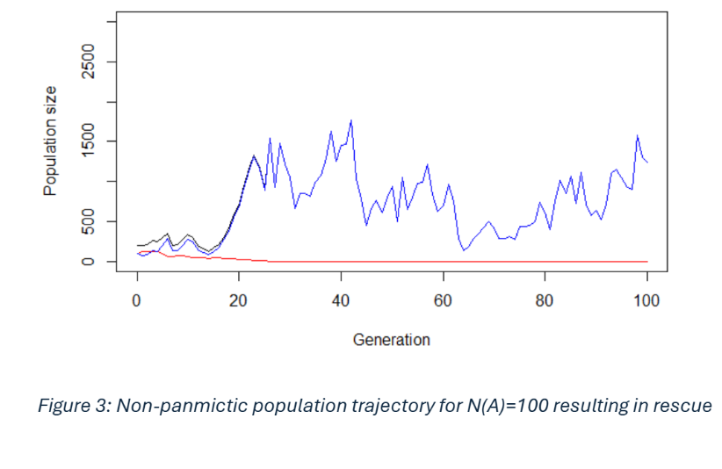
Results and Interpretation
Non-panmictic simulation
Wildtype almost always dies out, even after initial rebound
Wildtype populations get “replaced” by fitter mutants
Notes:
Figure for different numbers of introduced mutant individuals (10, 20, 100)
Singular runs/simulations: possible outcomes
slide

Slide 11
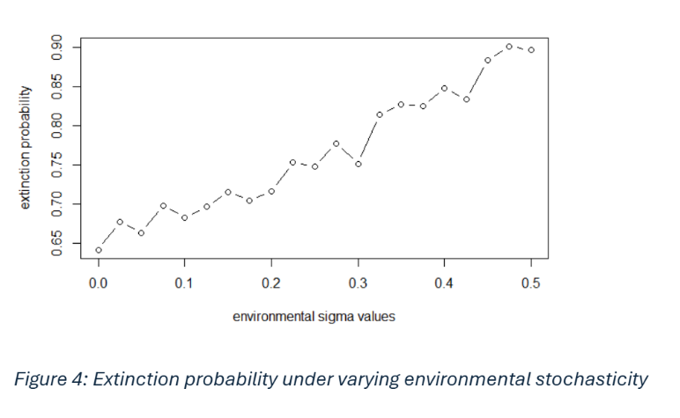
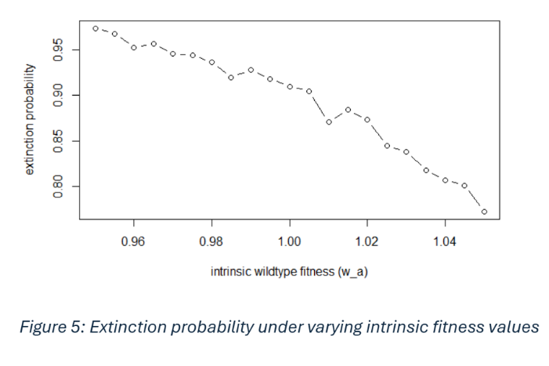
Results and Interpretation
Notes:
Then next i calculated extinction probabilities of our initial wildtype population of 100 indiv. Under variation of environmental fluctuation or sensitivity (left) and fitness (right) you notice there are interesting trends and there seem to be pos. Corr. With ext. Prob and increased env. Fluctuation
And you might also notice here on the right where i investigated fitness of a, it is really only a small range of variation from slightly disadvantageous (0.95) to slightly beneficial (1.05), but we notice interesting changes in ext. Probabilities accross 1000 simulation runs, falling from >95% 8almost certain extinction) to below 80% when genotypes are slightly beneficial.

Slide 12
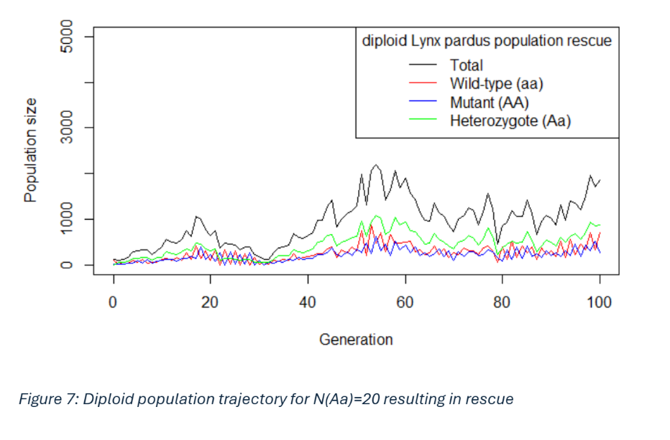
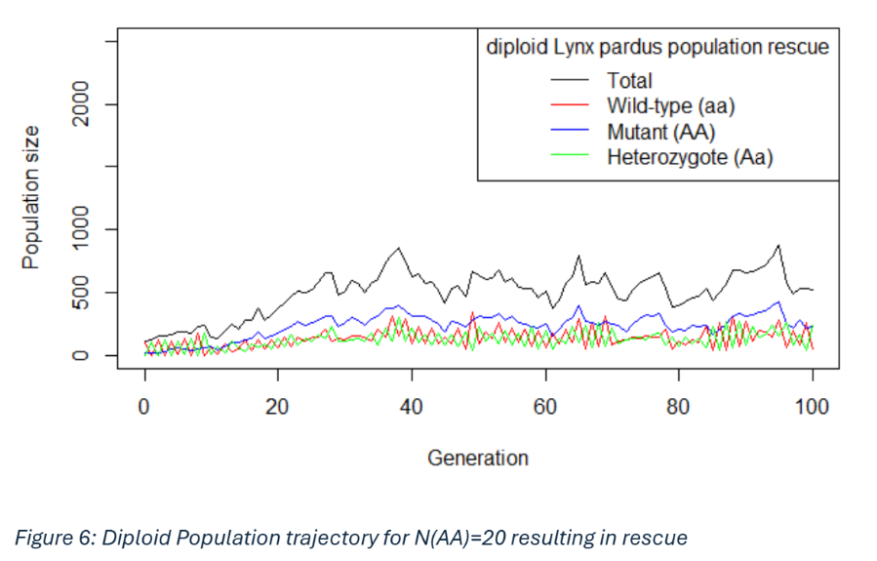
Results and Interpretation
Notes:
These are some results from our model, only with diploid panmictic conditions.
On the left you see a possible outcome across 100gen, assuming that introduced mutant genotypes are heterozygotes (Aa). Meaning that, all demographic parameters and fitness are the same for homo and heterozygous mutants (AA and Aa) We observe that heterozygote establishes as the predominant genotype, and here the wildtype is actuay able to stay present in the pop. They seem to be under some lotka volterra type pattern, always changing frequencies around an equilibrium, but the wildtype actually seeming a bit more established on average.
On the right we assume the introduced mutants are homozygous AA, and here we have three distinct genotypes and demographic parameters for each. Interestingly, AA seems to establish as the dominant genotype over time, and this tyme aa and Aa clashing around an equilibrium each generation.
PLEASE NOTE: Y axis dimensions differ! First scenario seem to yield a larger tot. Pop. , but maybe it is by pure chance (single sim!)

Slide 13
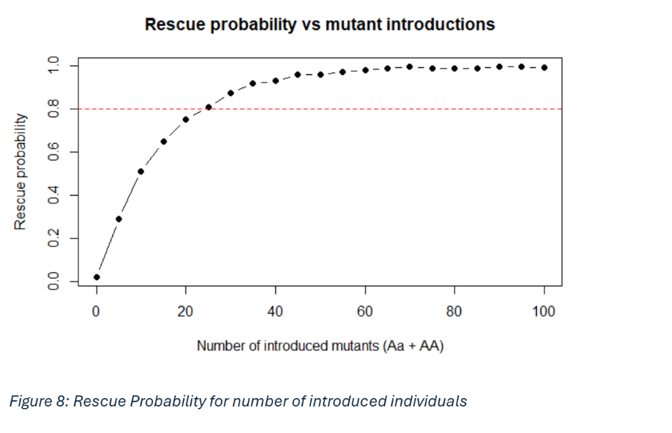
Results and Interpretation
Notes:
And finally i wanted to estimate what the minimum number of introduced individuals is that need to be introduced to rescue population (1000 sims for each number) with >80% probability. Number is 25.
In this case the introduced individuals were always in a 1:1 ratio of homo and heterozygotes. In case of odd numbers, heterozygotes got the edge, meaning if for example introduction number is 5, then there‘s 3 Aa and 2 AA. Demographic parameters apply asin the 2nd scenario where we have 3 different values for fitness and so on.

Slide 14
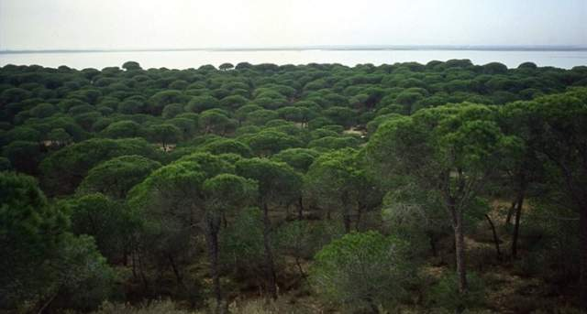
Limitations and Discussion
Time treated as discrete variable
Non-overlapping generations
Fitness linked to a single locus
Populations do not approach K
Closed population dynamics
No source-sink population dynamics
No age-stage structured populations
No „mutation rates“ or other demographic aspects
Picture source: Parque nacional coto de doñana https://www.andalucia.org/listing/do%C3%B1ana/15455102/
Notes:
So what are the limitations of this project? Well, there are many. Nut only to name a few, the most important ones:

Slide 15
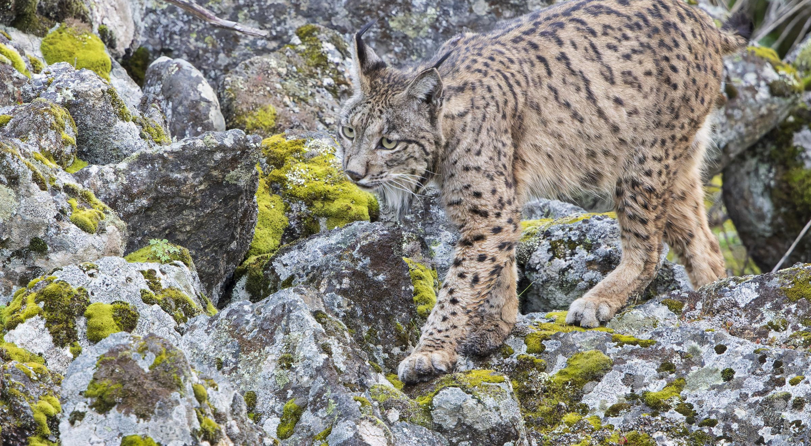
Possible (hypothetical) Next Steps
Include age- or stage structures
Incorporate further demographic rates
Overlapping generations
Picture source: https://www.mammalwatching.com/community-post/a-european-success-story-of-recovery-and-survival-for-the-iberian-lynx/
Notes:
And based off that, what could be done next (if time is/would be there)

