Slide 1
RAG Real-Life Use Case
Internal Policy Bot
Prsented By : Dolly Jain
Designation : Associate Engineer-Cadet
Organization: Cloud for Good
Date: October 16
1 / 11

Slide 2
Tesla Internal Policy Bot
An AI assistant that answers ethics and compliance questions from approved policy documents, with sources shown.
BUSINESS BENEFITS
1
Faster answers
2
Easy to Interpret
3
Auditable by design
Seconds, not a search through manuals
Same policy text behind every answer
Every answer links to its source
1 / 11

Slide 3
Scattered Documents, Difficult-to-Find Answers
KEY CHALLENGES
Scattered documents
BUSINESS IMPACT
1
Ethics, privacy, security and confidentiality rules sit in separate manuals.
Lost productive time
Skilled staff searching instead of building.
Hard to search
2
Compliance exposure
Keyword search misses answers when staff use different wording.
A misread rule can become a violation.
Inconsistent reading
Repeat questions
3
Different teams interpret the same rule differently.
Ethics teams re-answer routine queries.
Shadow AI risk
Unverifiable AI answers
4
Staff turn to unvetted external tools.
Generic chatbots answer fluently without citing company policy.
2 / 11

Slide 4
Ask in plain English and get a cited answers.
1
Ask naturally
REAL DEMO OUTPUT
SYNTHETIC POLICY
No legal titles or section numbers needed.
EMPLOYEE QUESTION
What is the statutory SLA for processing customer vehicle telemetry deletion requests?
2
Search by meaning
Finds the most relevant policy passages.
BOT ANSWER
Timeframe: process, execute and verify a complete deletion request within 30 business days of receipt.
Scope: all stored vehicle telemetry logs and associated cloud metadata (GDPR, CCPA, CPRA).
(Cited: TSLA-ETH-2026-02, Section 5.2, 30-Day Statutory Deletion SLA)
3
Answer from evidence only
Model must use retrieved text and decline otherwise.
4
Show the sources
SOURCE SHOWN IN THE UI
Document ID and excerpts shown beside the answer.
TSLA-ETH-2026-02 (customer_data_privacy.txt) | Section: Full Document
3 / 11

Slide 5
Four user groups, one simple workflow
Employees
HR & Ethics teams
Compliance teams
People managers
Get policy guidance in seconds
Fewer repetitive questions
More consistent awareness
Confident team decisions
Metric: lookup time, satisfaction
Metric: inquiry ticket volume
Metric: audit vs. expert answers
Metric: manager feedback
WORKFLOW
1 Sign in
2 Ask
3 Retrieve
4 Answer
5 Learn More
Mock login in demo
Type a question in plain English
Top 3 matching policy chunks
Grounded, cited response
Open the source excerpts
Implemented: Streamlit chat UI, source badges, chunk inspector.
4 / 11

Slide 6
RAG keeps answers grounded and policies easy to update
Approach
Plain-language
questions
Grounded in
company policy
Shows
sources
Updates without
retraining
Manual search
No
Yes
Yes
Yes
Keyword search
No
Yes
Yes
Yes
General LLM only
Yes
No
No
No
Fine-tuned LLM
Yes
Partly
No
No
RAG assistant
Yes
Yes
Yes
Yes
Trade-off: RAG quality depends on retrieval and document coverage. Qualitative assessment.
.
5 / 11

Slide 7
End-to-End RAG architecture
A. OFFLINE: DOCUMENT PREPARATION
Policy files
5 synthetic .txt docs
Loader
Doc ID, classification, date
Chunker
500 chars, 100 overlap
Embeddings
all-MiniLM-L6-v2 (384-d)
ChromaDB
250 chunks, cosine
B. REAL TIME: QUESTION ANSWERING
Employee
Streamlit chat UI
Retrieve
Embed query, top 3 chunks
Filter
Similarity at least 0.35
Generate
gpt-oss-120b on Groq
Answer
Text + sources + excerpts
Guardrails in the prompt: answer only from retrieved context, no invented policies, cite document and section, say so when information is missing. Temperature 0.0 by default.
6 / 11

Slide 8
LLM VS SLM
SMALL MODEL (SLM)
LARGE MODEL (LLM)
MODELS USED
e.g. 3B-8B
e.g. 70B-120B
Embedding
all-MiniLM-L6-v2
384-d vectors
Generation
openai/gpt-oss-120b
Handles complex questions
Better suited to multi-part responses
Flexible natural-language generation
Typically higher compute cost
Lower resource requirements
Potentially lower latency and cost
Suitable for simpler, focused tasks
May require more optimization for complex tasks
Why LLM over SLM?
Cross-Policy Reasoning: SLMs miss clauses across overlapping documents; the LLM accurately connects complex multi-policy rules.
Zero Hallucination: SLMs tend to fabricate answers when uncertain; the LLM strictly refuses out-of-scope questions.
7 / 11

Slide 9
No hallucinations flagged across 15 test questions
OVERALL (15 QUESTIONS)
CORRECTNESS BY QUESTION TYPE
0%
4 / 4
~2s
No clear gap
hallucination flagged, both configs
out-of-scope questions declined
avg latency per answer (approx.)
temp 0.0 vs 0.8, 15 questions
8 / 11

Slide 10
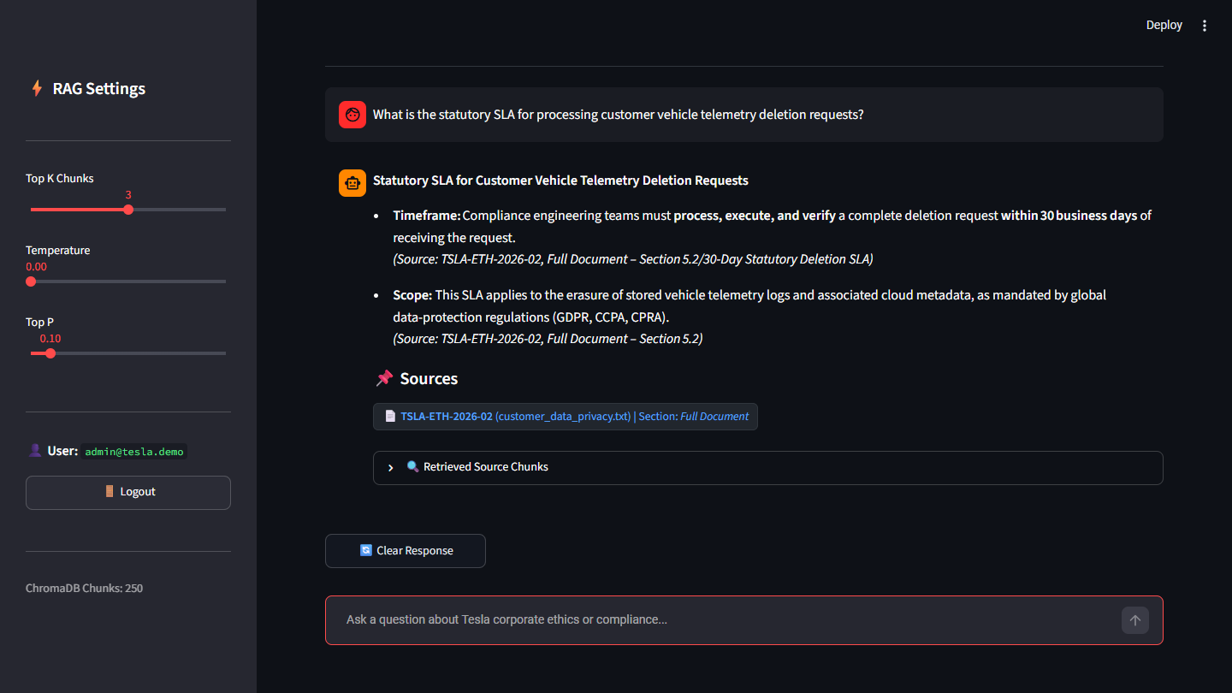
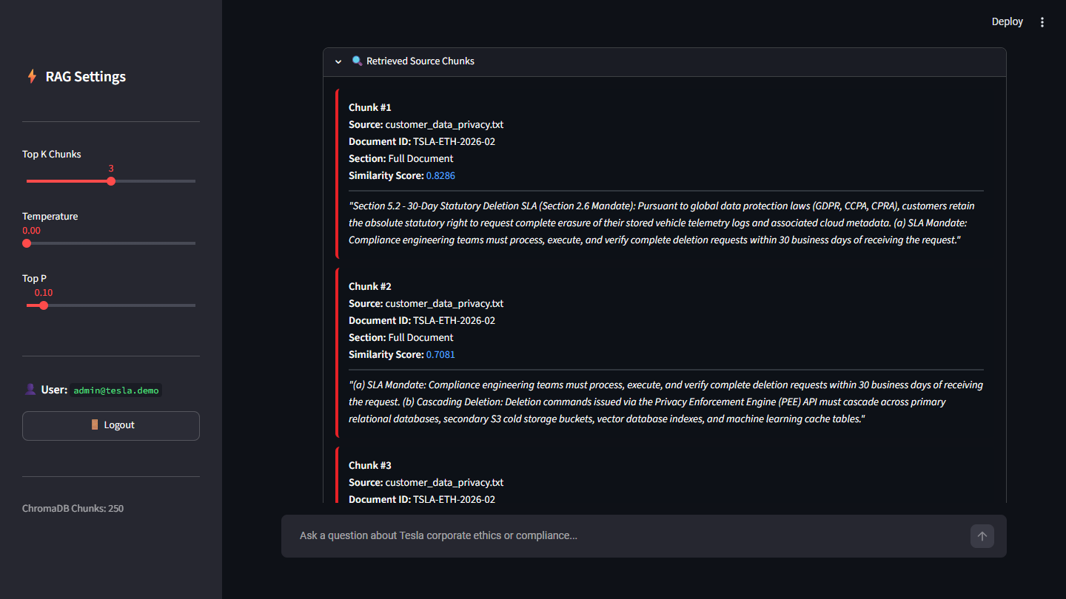
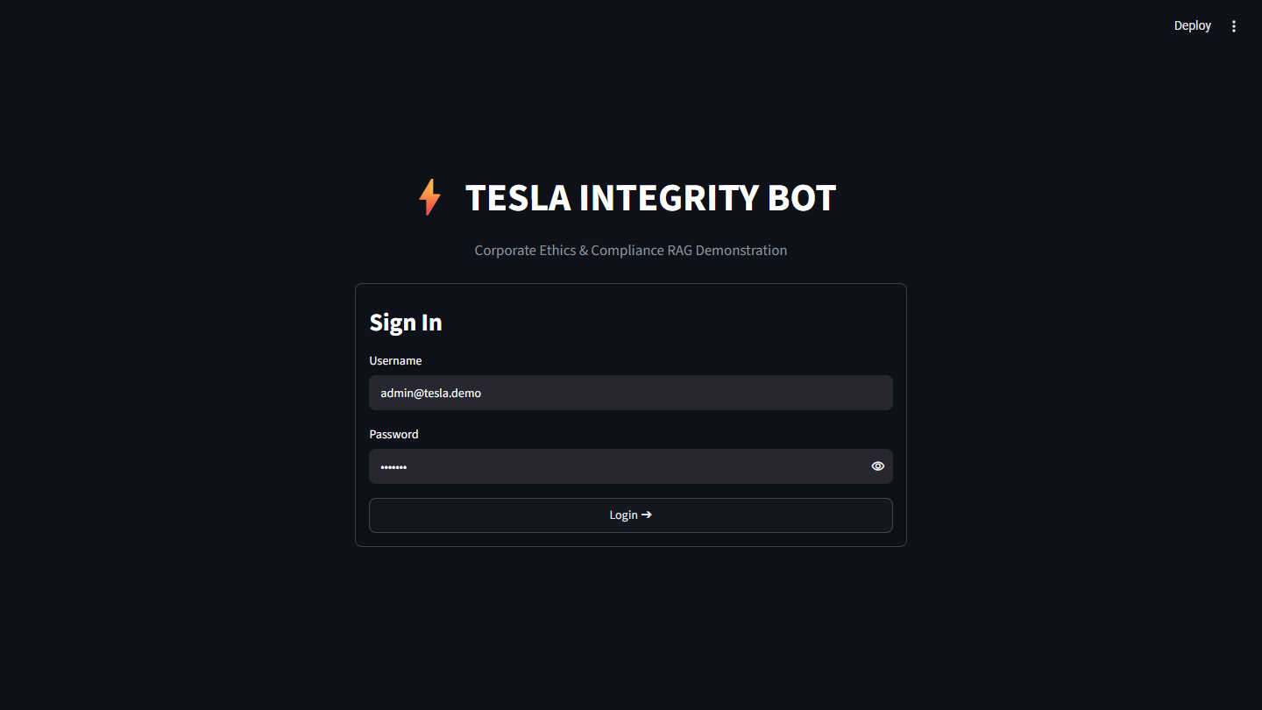
The working application
1
Grounded answer with source badge
2
Retrieved chunks with similarity scores
3
Mock sign-in
Unaltered captures of the running Streamlit app on the synthetic corpus. Any username is accepted at sign-in (mock gate). Sidebar exposes Top-K, temperature and top-p.
10 / 11

