Slide 1

Employee Data EDA
Notes:
Welcome to Employee Data EDA
In this process we will try to get the answers of some general questions related to Employee data provided.

Slide 2
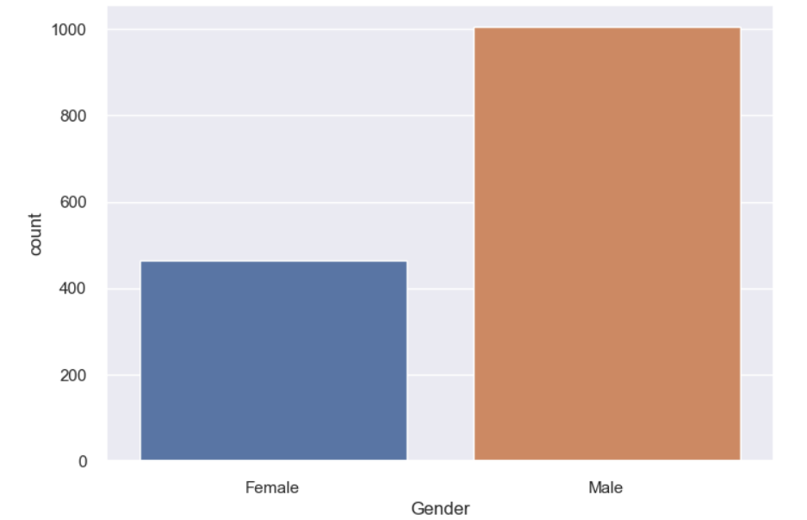
What is the ratio of males vs females in the organization?
Notes:
From the above plot it seems we have higher population of male as compared to females.

Slide 3
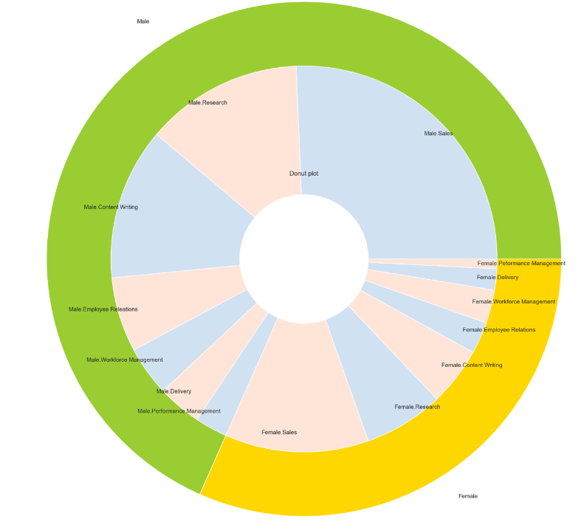
What is the ratio Male and Female in the different skill sets?
Notes:
So from the above donut pie chart and the factor plot its quite clear that we have points 1.) Organisation has got the maximum number of employee population the Sales department for both Male and Females. 2.) The second largest population lies in the Research deparment for both Male and Female. 3.) The third largest population lies in the Content Writing department for both Male and Female. 4.) We have lowest population in Performance Management.

Slide 4
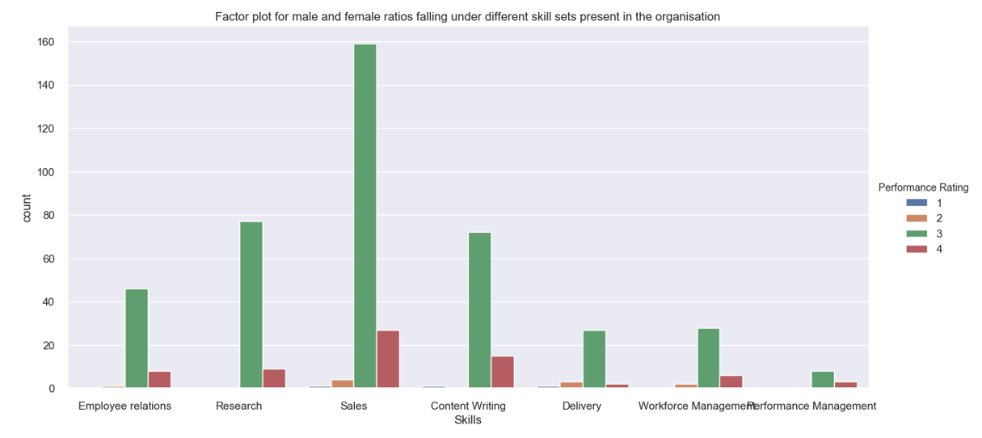
What is the distribution of ratings based on the Skill Sets? Does Rating depends on Skill Sets?
Notes:
So from the above donut pie chart and the factor plot its quite clear that we have points 1.) Organisation has got the maximum number of employee population the Sales department for both Male and Females. 2.) The second largest population lies in the Research deparment for both Male and Female. 3.) The third largest population lies in the Content Writing department for both Male and Female. 4.) We have lowest population in Performance Management.

Slide 5
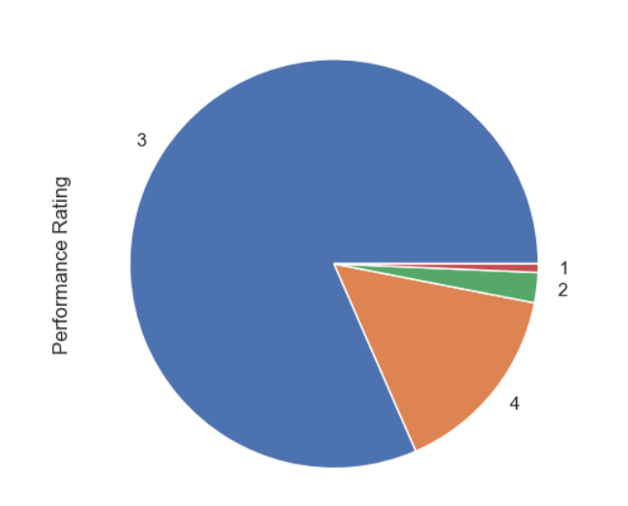
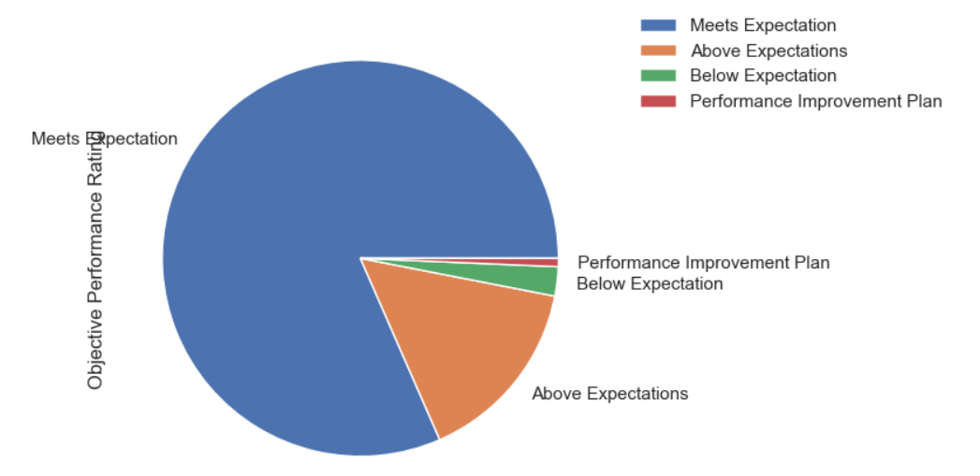
What are the ratios of people falling under the different buckets of performance ratings?
Notes:
As evident from the above graph it seems that there is no impact of the skill set on the rating. We do see a higher counts for both 3 and 4 ratings on the sales department but that's because as we have already seen the Sales is the department where most of our employee population lies.

Slide 6
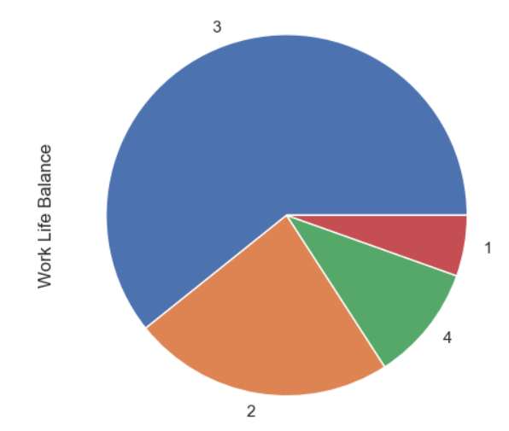
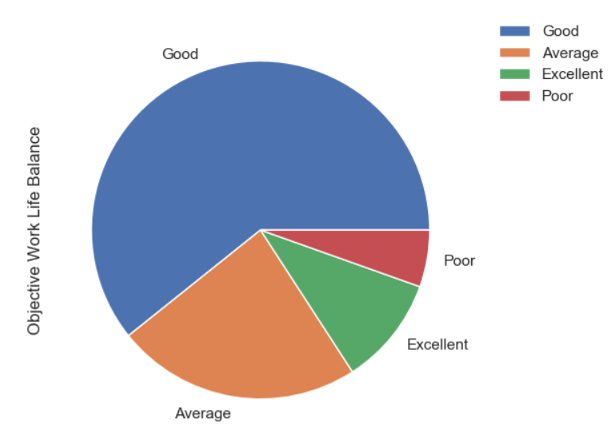
How is the work life balance in the organisation?
Notes:
So if we see the above graph it seems most of the employees have rated the "Work life balance" to be "Good" And people with "Poor" and "Excellent" are few.

Slide 7
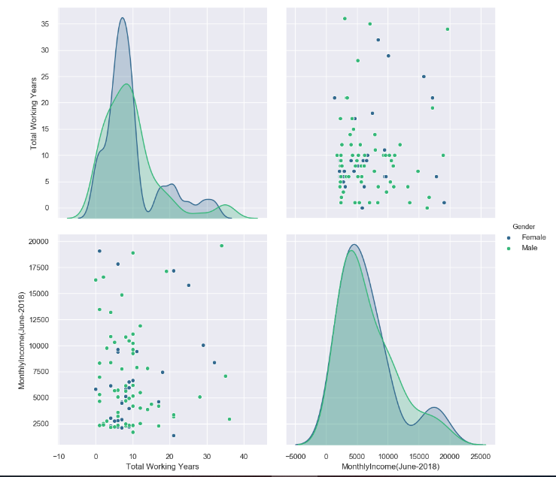
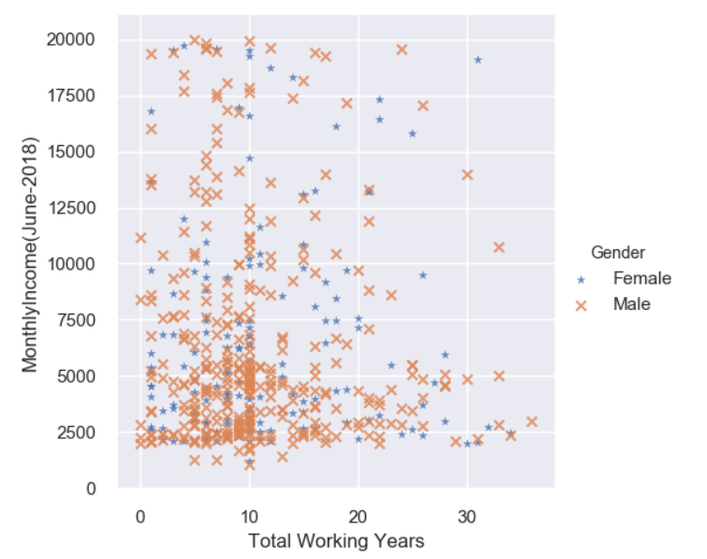
What is the impact of Gender or "Total Experience" on the Monthly Income?
Notes:
So from the Above graphs its quite clear that neither the Gender neither the Total Years of experience is much impacting the Income factor. Its quite evident that people at lower experiences too have higher income and people with higher experiences too can lower income. Also the Company is not gender biased the income dosen't depends upon your gender.

Slide 8
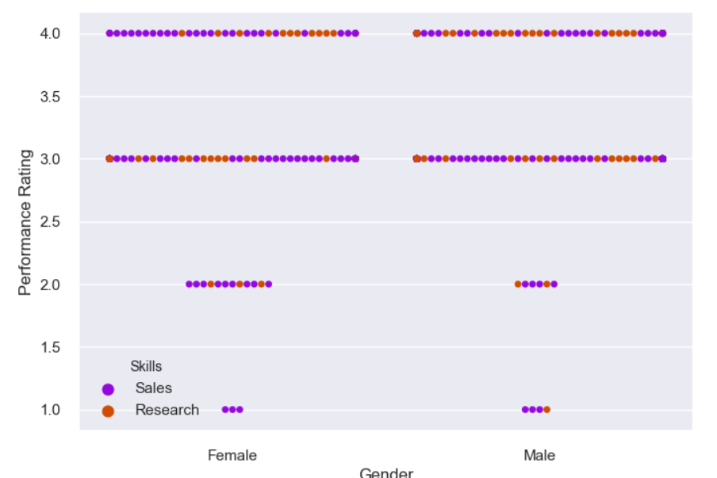
Who has got better ratings Females or Males?
Notes:
Here we have taken just the sample employees from Sales and Research dept as we have maximum employees in these two departments. Also from the graph above its quite evident that Female and Males have almost similar range of ratings apart from the rating 2(Which stands for unsatisfactory performance)

Slide 9
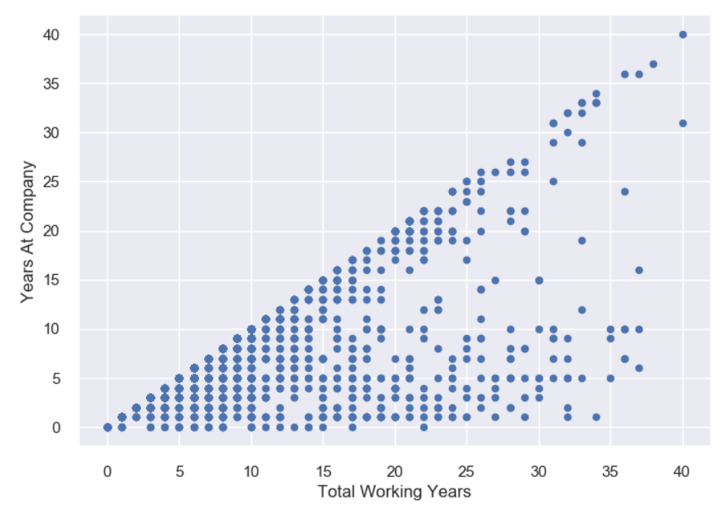
Does the 'Years at Company' is impacted by 'Total Years of Experience' ?
Notes:
Here from the above graph its quite evident that the 'Years at Company' is highly positively correlated to 'Total Working Years'. It seems once the years of experience grows up people want to get settled and get growth in the same organisation instead of trying out new organisation.

Slide 10
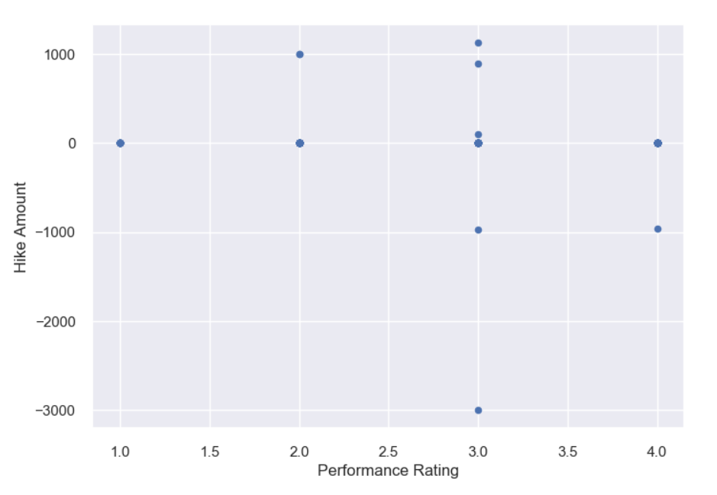
What is the average hike amount people have got in monthly income based on ratings?
Notes:
So from the above analysis we understand that:
1.) The count of employees having 0 hike is 1462(Which is a huge population), the count of employee having -ve hike is 3 and count of employee having
positive hike is just 5.
2.) This shows that almost everyone in the company has not got any hike. Only 5 people have got the hike there should be some reason for it which we can't derive from the existing dataset.In these kind of scenerios the HR or the Compay management people can be approached in order to understand what was the reason for such a unusual condition of pay raise.
3.) Also we tried to understand the relation between the rating of the employee and the hike but there is no relation between these two fields as the large population with rating 1 has also got 0 hik and having 4 rating have also received 0 hikes.
Almost around 99 % of the population has got 0 hike in year 2017 and 3 people have got –ve and 5 ppl have got +ve hike.
Its not clear from the given data what’s the reason of such an unusual hike in year 2017 for the organization we can get to understand the
reasons by getting in touch with HR or Company Management.

Slide 11
Thank You ☺

