Slide 1



Data Preprocessing & Visualization Pipeline
Name: Dolly Mishra Company Name : Nexthikes It Solution
Structured Integration and Analysis of Multiple Datasets
Objective
To clean, integrate, and visualize insights across three datasets using systematic preprocessing and EDA techniques.
Methodology Overview
Stepwise data import, preprocessing, merging, and visualization using statistical and machine learning foundations.
Tools & Techniques
Pandas for data manipulation, Matplotlib/Seaborn for visualization, and Scipy/Sklearn for statistical analysis.
Notes:
Welcome to our walkthrough of a comprehensive data preprocessing and visualization pipeline. This process is designed to integrate and analyze three distinct datasets to derive meaningful insights.
The pipeline emphasizes meticulous data cleaning—removing nulls, duplicates, and identifying outliers—followed by targeted visual exploration. By employing statistical metrics such as skewness, kurtosis, and correlation, we ensure robust understanding before merging data sources.
Our toolkit includes Python libraries such as Pandas for data wrangling, Matplotlib and Seaborn for compelling visualizations, and Scipy/Sklearn for deeper statistical analysis. Let’s explore each phase step-by-step.

Slide 2

Dataset 1: Import & Cleaning
Removing Nulls, Duplicates, and Identifying Unique Values
Data Import: Loaded Dataset 1 using Pandas, ensuring correct encoding and structure.
Null & Duplicate Removal: Eliminated missing entries and redundant records to ensure data integrity.
Unique Values: Identified categorical and numerical fields with distinct entries for feature assessment.
Photo by Jeremy Perkins on Unsplash
Notes:
In this initial step, we begin by importing Dataset 1. This involves using Pandas to read the data file with proper attention to format, encoding, and column structure.
After import, we perform essential data cleaning: removing any null values and duplicate records. This is a critical preprocessing step that helps maintain the accuracy and reliability of downstream analysis.
Finally, we examine the dataset for unique values across all features. This gives us insights into the variability of categorical columns and helps identify potential primary keys or categorical features useful for modeling. Clean data is foundational to any robust data science workflow.

Slide 3
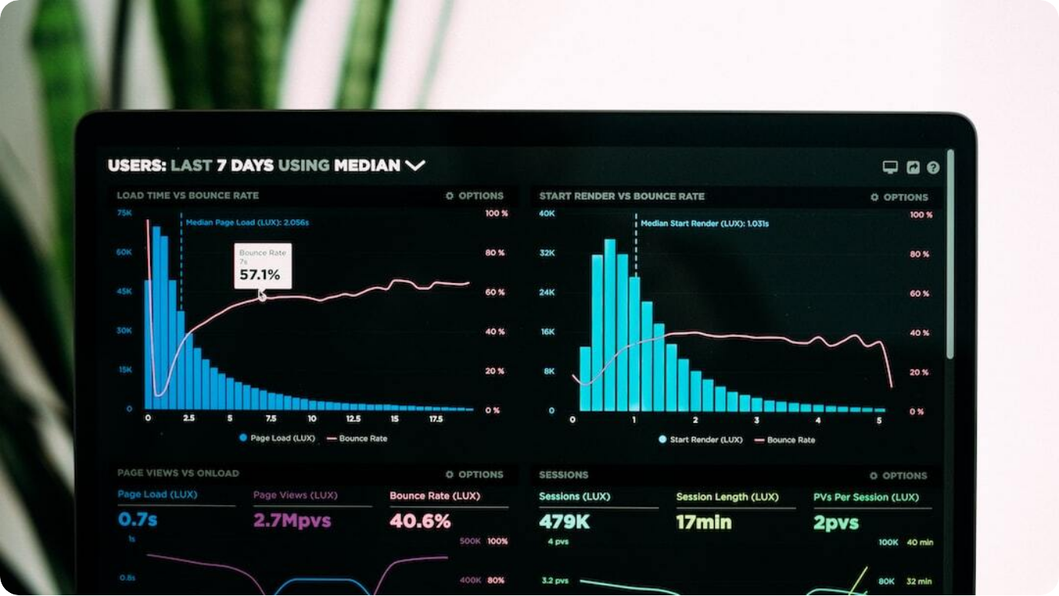
Dataset 1: Visualization
Exploring Cleaned Data Through Visual Analysis
Bar Charts: Displayed categorical frequency distributions for key variables to understand data spread.
Histograms: Visualized numerical distributions to identify patterns and irregularities.
Box Plots: Used to assess data range, medians, and potential outliers.
Photo by Luke Chesser on Unsplash
Notes:
Following data cleaning, visualization is our next step to gain a better understanding of Dataset 1. We start by generating bar charts to explore the frequency of categorical variables, giving us a quick view of dominant categories and potential class imbalance.
Histograms are then used to examine numerical columns. These reveal patterns in data distribution—whether they’re skewed, normal, or multimodal—helping us prepare for more advanced analysis.
Box plots offer additional insights, particularly about the spread and presence of outliers. This combination of visual tools allows us to thoroughly examine the structure and nuances of our cleaned data before moving to more complex operations.

Slide 4
Dataset 2: Import & Cleaning
Removing Nulls, Duplicates, and Identifying Unique Values
Data Import: Loaded Dataset 2 using Pandas, ensuring correct encoding and structure.
Null & Duplicate Removal: Eliminated missing entries and redundant records to ensure data integrity.
Unique Values: Identified categorical and numerical fields with distinct entries for feature assessment.

Slide 5
Dataset 2: Visualization
Exploring Cleaned Data Through Visual Analysis
Bar Charts: Displayed categorical frequency distributions for key variables to understand data spread.
Histograms: Visualized numerical distributions to identify patterns and irregularities.
Box Plots: Used to assess data range, medians, and potential outliers.

Slide 6

Merging Datasets 1 & 2
Data Integration & Validation
Join Strategy: Performed inner/outer joins based on shared keys to align schema and retain valid data.
Validation: Checked for merge consistency, key duplication, and data loss across datasets.
Schema Harmonization: Standardized feature names and formats for compatibility across merged datasets.
Photo by Nate Grant on Unsplash
Notes:
With both datasets cleaned and preprocessed, the next step is merging Dataset 1 and Dataset 2. Choosing the right join strategy—whether inner or outer—is critical. It ensures we preserve meaningful records while avoiding null-filled or inconsistent entries.
We then validate the merge process. This includes verifying that join keys are unique and consistent, and that we’re not inadvertently introducing duplicates or dropping valuable data. Such validation ensures integrity in the merged dataset.
Finally, schema harmonization aligns feature names, types, and structures across both datasets. This normalization step is necessary to support downstream analysis and future data integration.

Slide 7
Dataset 1 & 2: Visualization
Bar Charts: Displayed categorical frequency distributions for key variables to understand data spread.
Histograms: Visualized numerical distributions to identify patterns and irregularities.
Box Plots: Used to assess data range, medians, and potential outliers.

Slide 8



Dataset 3: Import & Preprocessing
Preparing the Final Dataset for Integration
Data Import
Loaded Dataset 3 and verified data types, encoding, and structure.
Cleaning & Imputation
Handled missing values and corrected inconsistencies in formatting.
Feature Scaling
Normalized and standardized data to align with previously merged datasets.
Notes:
We now import Dataset 3, the final source in our data pipeline. As with previous datasets, we ensure structural integrity during the loading process, confirming column formats and encoding.
Cleaning is a crucial step—this includes addressing missing values through imputation and ensuring consistency in variable formatting. These actions reduce bias and improve data quality.
Next, feature scaling is applied to harmonize Dataset 3 with the previously merged datasets. Using normalization or standardization, we ensure that feature ranges and distributions are comparable, paving the way for smooth integration in the final merged set.

Slide 9

Dataset 3 merging with dataset get by datsaet 1 and 2:
Handling Outliers, Normalization & Feature Scaling
Outlier Treatment: Applied capping and transformation methods (e.g., log, sqrt) to minimize outlier influence.
Normalization: Standardized data using z-score and min-max scaling for consistent feature distributions.
Feature Engineering: Derived new variables from existing features to enhance predictive potential.
Photo by ev on Unsplash
Notes:
After statistical analysis, the preprocessing of Dataset 2 is crucial to prepare it for integration and modeling. We start by addressing outliers not just by removing them, but also through transformation techniques such as logarithmic and square root functions, which preserve data while reducing skew.
Next, we normalize the dataset. Two main techniques are applied: z-score standardization, which centers data around zero with unit variance, and min-max scaling to compress features into a common range. This ensures model convergence and comparability.
Additionally, we explore feature engineering—creating new attributes that may capture hidden patterns or amplify predictive power. These preprocessing steps form the backbone of reliable data integration and modeling phases that follow.

Slide 10
Merged Dataset & Dataset 3: Visualization
Bar Charts: Displayed categorical frequency distributions for key variables to understand data spread.
Histograms: Visualized numerical distributions to identify patterns and irregularities.
Box Plots: Used to assess data range, medians, and potential outliers.

Slide 11



Final Merge & Visualization
Integrated Dataset Analysis
Merging Datasets
Combined Dataset 3 with merged Dataset 1 & 2 ensuring schema and key consistency.
Final Quality Checks
Revalidated data integrity post-merge for completeness and redundancy.
Unified Visualization
Visualized integrated data using composite plots and trend mapping.
Notes:
This step marks the full integration of all datasets. Dataset 3 is merged with the existing combined Dataset 1 and 2. We ensure that the join keys and data schemas are compatible for a seamless merge.
Following the merge, comprehensive quality checks are conducted. These include validating data completeness, checking for duplicated records, and ensuring that transformations have not disrupted data structure.
Finally, we visualize the fully integrated dataset. These visuals combine insights from all three sources, providing a unified view of trends, anomalies, and interactions. These consolidated visuals set the foundation for the final statistical analysis and modeling.

Slide 12




Dataset 2: Statistical Analysis
Outliers, Skewness, Kurtosis & Correlation
Outlier Detection
Utilized IQR and Z-score techniques to flag extreme values; visualized via box plots.
Skewness & Kurtosis
Calculated metrics to assess data symmetry and tail behavior for normality assumptions.
Correlation Analysis
Generated correlation matrix and heatmap to explore linear relationships across features.
Heatmaps
Displayed correlations and data concentration across merged features.
Notes:
Upon importing Dataset 2, our focus shifts to understanding its statistical characteristics. This involves a deep dive into metrics that signal data behavior and quality.
We first identify outliers using both Interquartile Range (IQR) and Z-score methods. These statistical tools help us isolate anomalous values which could distort analysis. Box plots provide a clear visual of these outliers.
Next, we examine skewness and kurtosis. Skewness reveals the asymmetry of data distributions, while kurtosis indicates the sharpness or flatness of the data tails. These are crucial for assumptions in modeling.
Finally, we compute correlations between variables using Pearson's coefficient. A correlation heatmap then visually highlights strong linear relationships, helping us detect multicollinearity or potential predictive features. These insights will guide our preprocessing and modeling strategies.

Slide 13

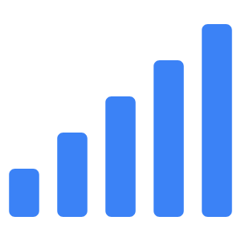
Final Statistical Reanalysis
Outliers, Skewness, Kurtosis & Correlation
Outlier Reassessment
Detected new outliers introduced during final merge using Z-score and IQR.
Skewness & Kurtosis Recalculated
Updated metrics confirmed distributional shifts post-merging.
Updated Correlation Matrix
Correlation recalculated across all unified features to detect multivariate relations.
Notes:
Now that the full dataset is integrated, we revisit our statistical metrics to ensure that the final dataset retains analytic quality.
First, we re-assess outliers. With the final merge potentially introducing new extreme values, Z-score and IQR methods are reapplied to ensure accuracy and robustness. These are crucial for ensuring that future models are not skewed by anomalies.
Skewness and kurtosis are recalculated across all features. Shifts in data distribution can occur due to merging or transformation steps, so confirming updated symmetry and tail behavior is essential for modeling assumptions.
Finally, we regenerate the correlation matrix for the entire unified dataset. This helps surface new inter-feature relationships, reinforcing our understanding of data dependencies and informing feature selection for advanced analytics or machine learning.

