Slide 1
MOVIE RECOMMENDATION SYSTEM USING DATA ANALYTICS ALGORITHM
Present by Dolly Rana(287)
Satyam Tiwari (305)

Slide 2




Agenda
Introduction
Objectives
Problem definition
Literature survey
Methodology
Collaborative filtering

Slide 3



Introduction
Recommender System is a system that seeks to predict or filter preferences according to the user's choices.
Recommender systems are utilized in a variety of areas including movies, music, news, books, research articles.
Recommendation System provides you with the recommendations of the movies that are similar to the ones that have been watched in the past.
Recommendation systems have been around us for quite some time now. Youtube, Facebook, Amazon, and many others provide some sort of recommendations to their users.

Slide 4


Objectives
User will login the page & it will open home page so in that multiple movies get and search bar , search the movie or user get the recommend movie from another user based on rating system
Multiple user can login the page and they will rated the movie and they can also get the recommend movie all such system will stored in database
User can get the movie recommendation algorithm (Collaborative filtering) which suggests new movies based on the ratings given by users.

Slide 5

Problem definition
The model can only make recommendations based on existing interests of the user. In other words, the model has limited ability to expand on the users' existing interests.
These systems work on individual users’ ratings, hence limiting your choice to explore more so i.e Content Filtering which is based on a Content filtering computes the user will get the get recommend movies from dataset randomly

Slide 6
Literature survey
An earlier proposed MOVREC, a movie recommendation system based on collaborative filtering approaches. Collaborative filtering takes the data from all the users and based on that generates recommendations. A hybrid system has been presented by Virk et al.
This system combines both collaborative and content-based method. De Campos et al also made an analysis of both the traditional recommendation techniques. which is a combination of Bayesian network and collaborative technique.
Movie Recommender, a system that uses the user’s history in order to generate recommendations. Sharma and Maan in their paper analyzed various techniques used for recommendations, collaborative, hybrid and content-based recommendations.

Slide 7
Methodology
Step 1 : New user will sign in or sign up with page login credentials
Step 2 : Home page will display and user get multiple movie that contains a search bar that allows him to search for a particular movie user can text movie name.
Step 3 : User can give rating to the movies.
Step 4 : User can get movie recommendation (Collaborative Filtering) which suggests new movies based on the ratings given by user.

Slide 8
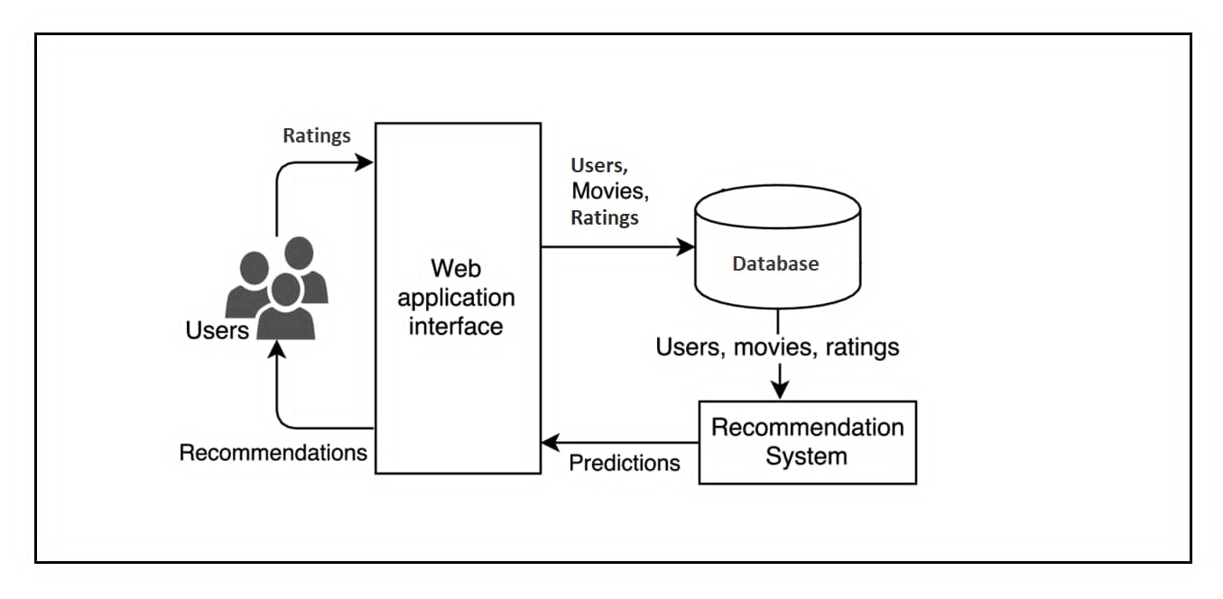

Slide 9



Collaborative Filtering
Collaborative Filtering : Collaborative filtering is a family of algorithms where there are multiple ways to find similar users or items and multiple ways to calculate rating based on ratings of similar users.
When we want to recommend something to a user, the most logical thing to do is to find people with similar interests, analyze their behavior, and recommend our user the same items. Or we can look at the items similar to ones which the user bought earlier, and recommend products which are like them.
Chooses items based on the correlation between people with similar preferences. Rate items based on ratings of the users that rated the same items.

Slide 10
Pearson’s Method
Pearson’s method is a kind of memory based communitarian sifting calculation. Pearson's connection mirrors the level of direct relationship between two factors, i.e. the degree to which the factors are connected, and extend from +1 to - 1. (+1 is positive rating & -1 is negative rating )
a: the active user u: another of the users of the system n: the number of items that both the active user and all recommender users have rated ra: is the average ratings of the active user ru is the average of another user u’s ratings w(a,u) the degree of correlation between user a and user u.

Slide 11

Thank you

