Slide 1

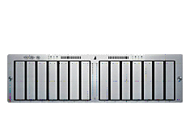
<WTCP Gateway S/W 구조>
O&M
Agent
Management
Client
Application
Application
SNMP
이동통신 상용망
UDP
W-TCP
Linux OS
IP (IPSec)
Communication Protocols
BTS
Kernel
BSC
HA
WTCP L4 Switch
PDSN
BSC
BTS
Contents Server
Contents Server

