Slide 1


Final presentation
Machine Learning Framework for Energy Consumption Prediction in Production
GET STARTED

Slide 2
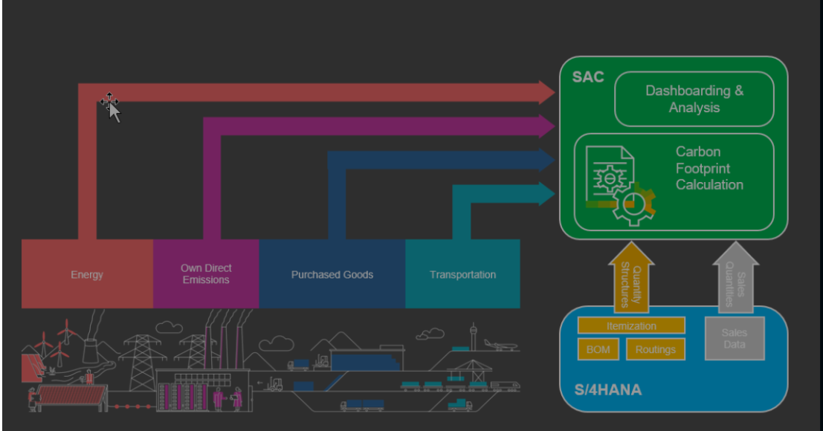
Introduction
Background
Energy needs to be used very efficiently in today’s world.
The industrial sector consumed almost 157 exajoules of energy. (38% of the global total energy consumption)
Differentiate energy consumption based on the type of consumption namely buildings (own direct emissions), transportation, purchased goods, and energy generation.

Slide 3
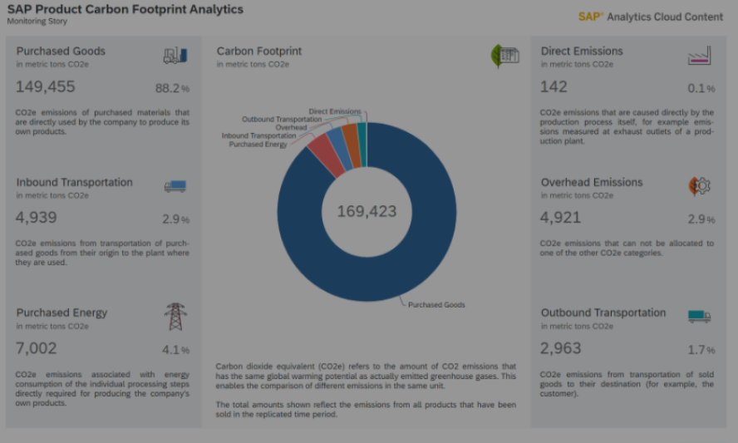
Introduction
Background
To monitor and achieve our targets, it is important to develop a dependable forecasting
tool
Database: The Industrial Assessment Center
contains data from all
assessments conducted on manufacturing facilities
that include plant area, production
hours, number of employees, annual sales and regions. The dependent variable is
annual energy consumption.

Slide 4
BUILDING AND EVALUATING THE ML MODEL
Exploring the data set
MODELING
Splitting Train Test Data
Feature Selection
Building the Models (Linear / Polynomial Regressions)
Data Type
Value Counts
Descriptive Statistics
Unbalanced data sets
MODELING
DATA SET
PREDICTION/EVALUATION
Data cleaning
PREDICTION EVALUATION
Drop unnecessary columns
Drop NaNs
Label encoding
Clean outliers
Correlations
DATA CLEANING
Evaluation
Changing the Train Data Set

Slide 5
COUNTRY'S ASSESSMENTS
MIDWEST
106
WEST
668
NORTHEAST
1225
SOUTH
1296
States
Northeast: Connecticut, Maine, Massachusetts, New Hampshire, Rhode Island, Vermont, New Jersey, New York, Pennsylvania. • Midwest: Illinois, Indiana, Michigan, Ohio, Wisconsin, Iowa, Kansas, Minnesota, Missouri, Nebraska, North Dakota, South Dakota.36 • South: Delaware, Florida, Georgia, Maryland, North Carolina, South Carolina, Virginia, District of Columbia, West Virginia, Alabama, Kentucky, Mississippi, Tennessee, Arkansas, Louisiana, Oklahoma, Texas. • West: Arizona, Colorado, Idaho, Montana, Nevada, New Mexico, Utah, Wyoming, Alaska, California, Hawaii, Oregon, Washington.
Companies evaluated
• Gross annual sales below $100 million
• Fewer than 500 employees at the plant site
• Annual energy bills more than $100,000 and less than $2.5 million

Slide 6
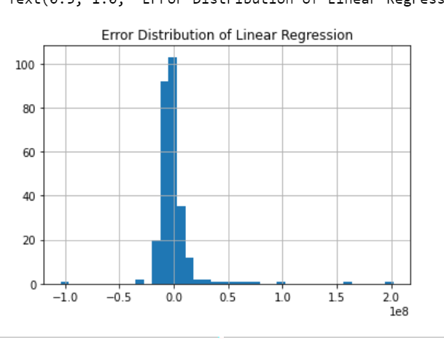
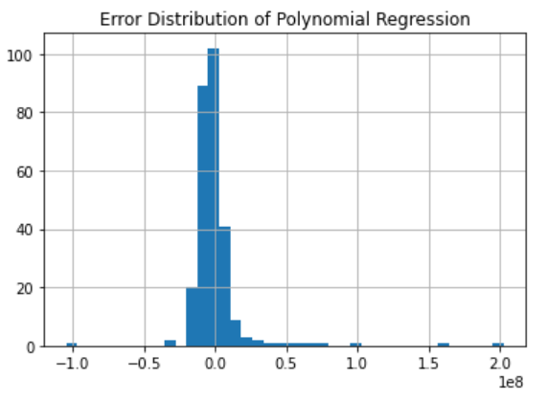
Normal Distribution Regression Model

Slide 7
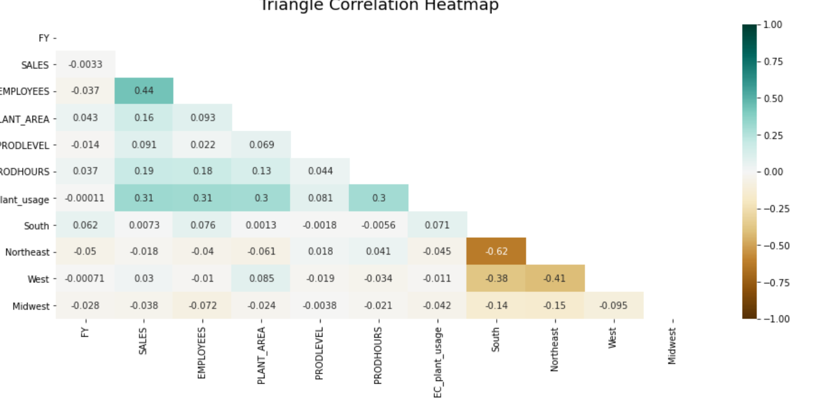
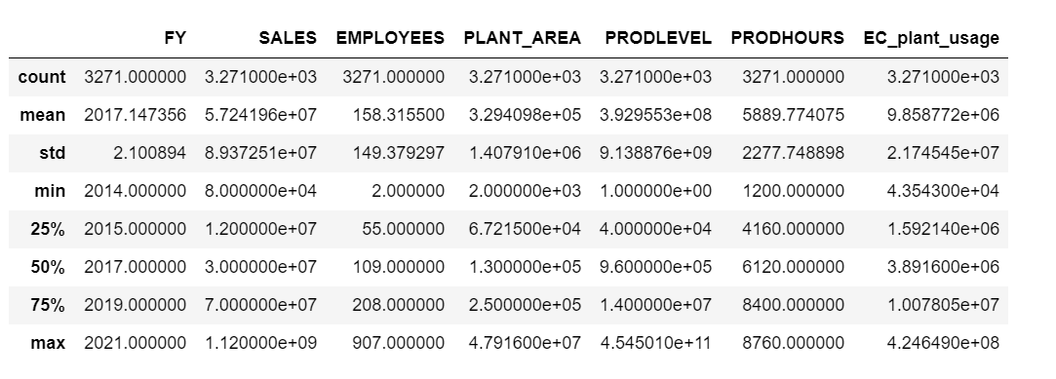
Dependent / Independent Variables
Model Variable | T(0.025) | Significance
Region | 1.96 | No
Sales | 1.96 | Yes
Number of Employees | 1.96 | Yes
Plant Area | 1.96 | Yes
Production Hours | 1.96 | Yes

Slide 8
Model Results
Model | Without Random Forest | Wirth Random Forest
Linear Regression | 56.1% | 33.5%
Polynomial Regression | 52.54% | 32.35%

Slide 9
CONCLUSIONS
Both models seem to be a good fit, especially with the random forest selection
Following extensions can be done:
A
Cost analysis
B
Enhancement of product sector analysis
C
Usage of data loggers – analysis over time

