Slide 1
Java for IOI

Slide 2
Java vs C++
Advantages
Disadvantages
Very good IDE support
Powerful debugger and exception system
Quick documentation
Zero pointer shenanigans
Verbose
Slower than C++
Garbage collection overhead
No/difficult low-level control

Slide 3
How Java works (and why you should care)
A native program – the JVM – starts up and reads your compiled Java program
The JVM has 2 jobs:
Recompile the Java bytecode into native machine code (JIT)
Perform maintenance tasks in the background (mostly memory management)

Slide 4
Java’s design
Designed for enterprise – very formal and flexible
Everything is classes and objects
There are no pointers
For speed in Java:
Avoid creating new objects (when we really don’t need to)
Avoid ‘disposing’ objects (when we really don’t need to)

Slide 5
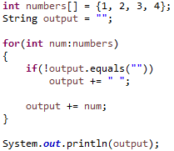
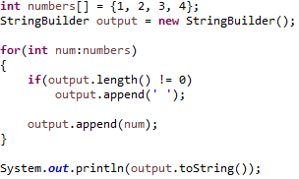
Strings are immutable
Don’t append to Strings in a loop – this creates a new String every time
Use StringBuilder

Slide 6
Avoid the ‘primitive wrappers’
Integer, Double, etc. instead of int, double
1 instance per value*!
But… generics can only use primitive wrapper classes
Use arrays of primitives, or make your own data structures if really necessary
array > ArrayList > LinkedList

Slide 7
I/O in Java
Do not use Scanner!
Use BufferedReader
And use StringTokeniser for multiple lines
.split() is about 2x slower
And then Integer.parseInt() or double.parseDouble() etc. to convert the Strings
For output, System.out.print() works fine (buffered internally)

Slide 8
Other notes
Check out the methods in the primitive classes
Integer, Double, Collections, Arrays
Various utilities for sorting, type conversions, etc.
Implement ‘comparable’ in your classes for easy sorting
Keep everything in one file
Append ‘static’ to everything
Don’t use packages
You can use inner classes
Don’t use exceptions for logic

