Slide 1
Computational Geometry
Robin Visser

Slide 2
Terminology
Point
Line
Line segment
Ray

Slide 3
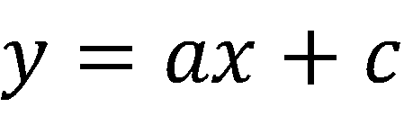
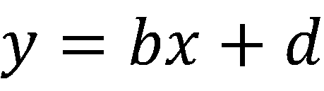
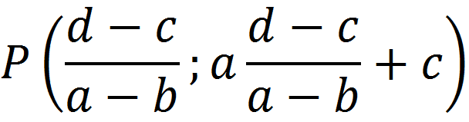
Line – Line Intersection
Given two lines, calculate their intersection.
Can do a similar thing for line segments; must just check whether intersection lies within the range of segment.

Slide 4
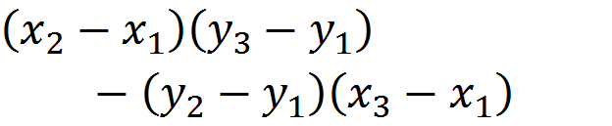
CCW Function
Determine whether a given set of three ordered points go counter-clockwise or clockwise. Use this:
If 0, then collinear
If positive, then “left turn”
If negative, then “right turn”

Slide 5
Convex Hull
Jarvis March (“Gift Wrapping” algorithm) - Runs in O(nh) (Worst case: O(n²) )
Graham Scan - Runs in O(n log n)

Slide 6
Jarvis March
Pick a point on convex hull.
Loop through all points and find the one that forms the minimum sized anticlockwise angle off the horizontal axis from the previous point.
Continue until you encounter the first point.

Slide 7
Graham Scan
Pick a point on convex hull.
Sort all other points angularly around this point.
Add the first two points to the hull.
For every next point, check if that point, along with the preceding two, form a “right turn” or a “left turn”.
If “right turn”, remove second last point, if “left turn”, move on to next point.
Continue until you encounter the first point.

Slide 8
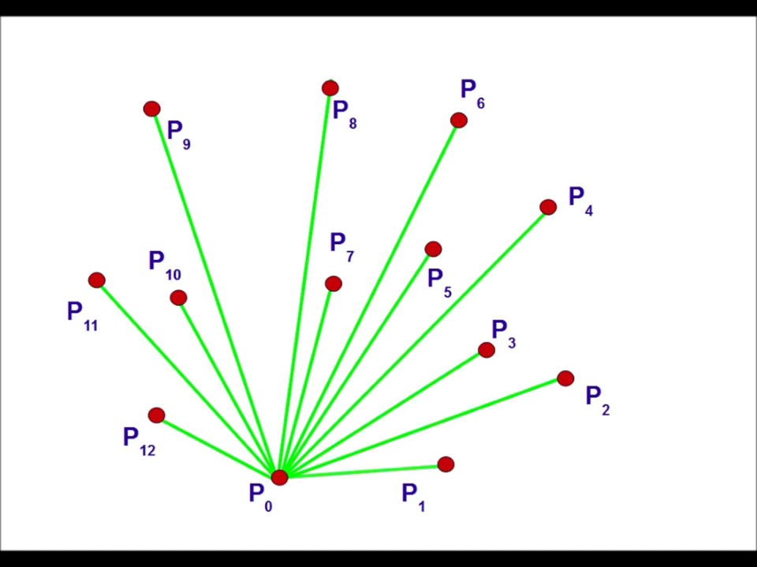
Graham Scan

Slide 9
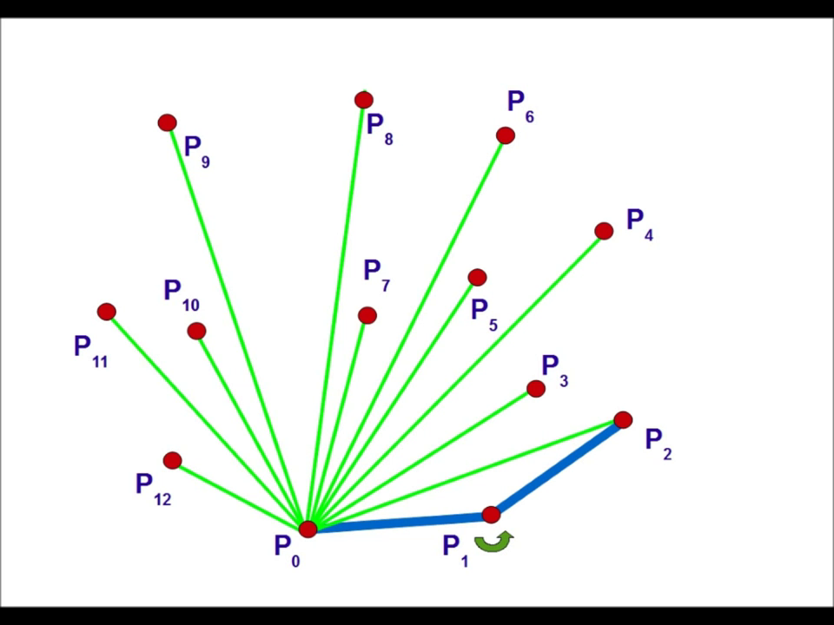
Graham Scan

Slide 10
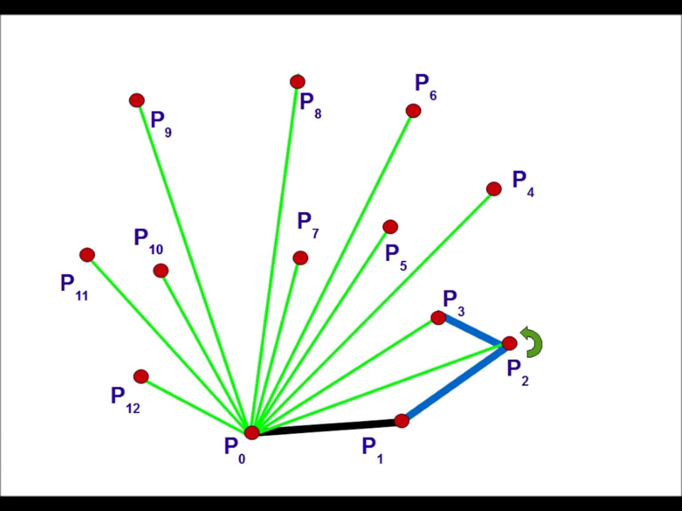
Graham Scan

Slide 11
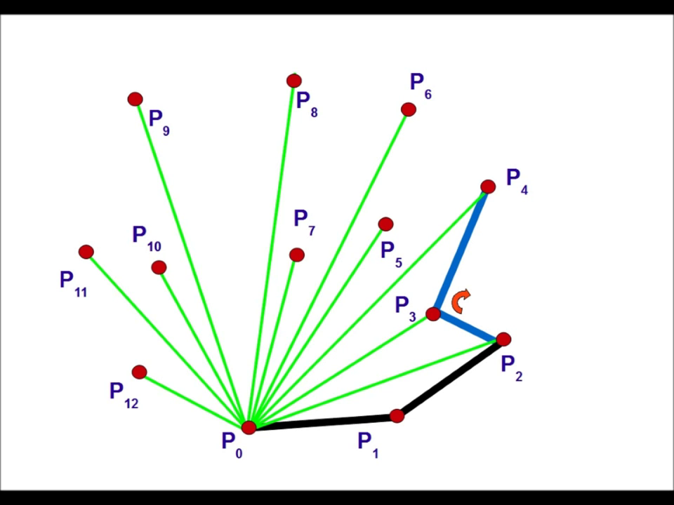
Graham Scan

Slide 12
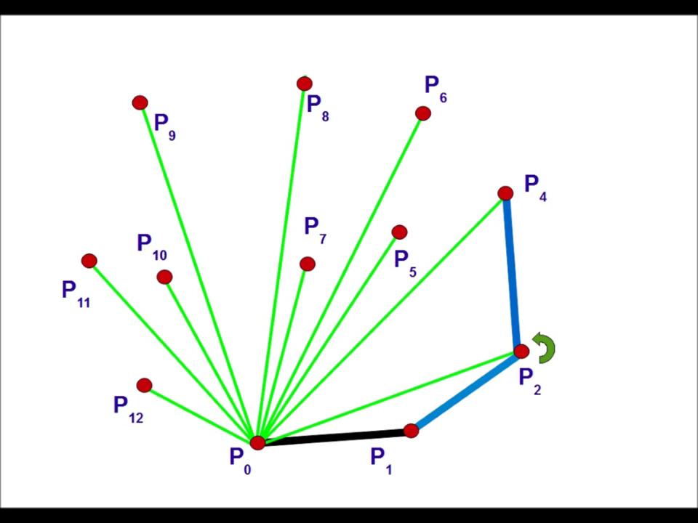
Graham Scan

Slide 13
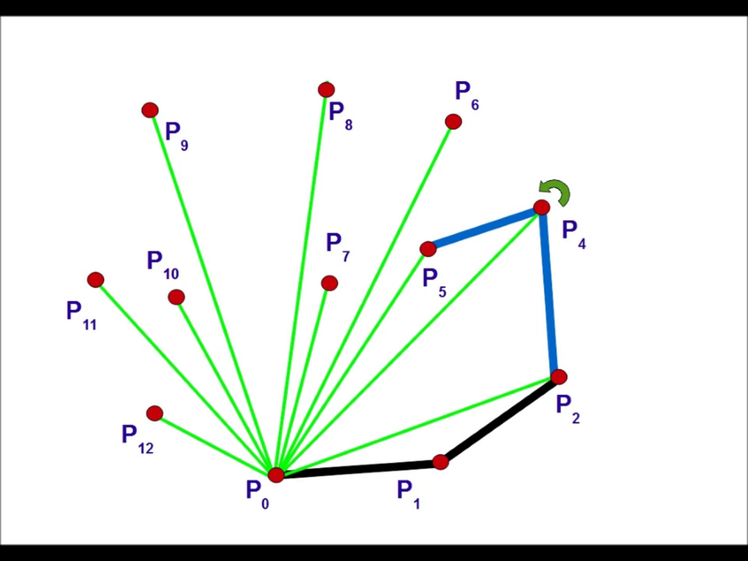
Graham Scan

Slide 14
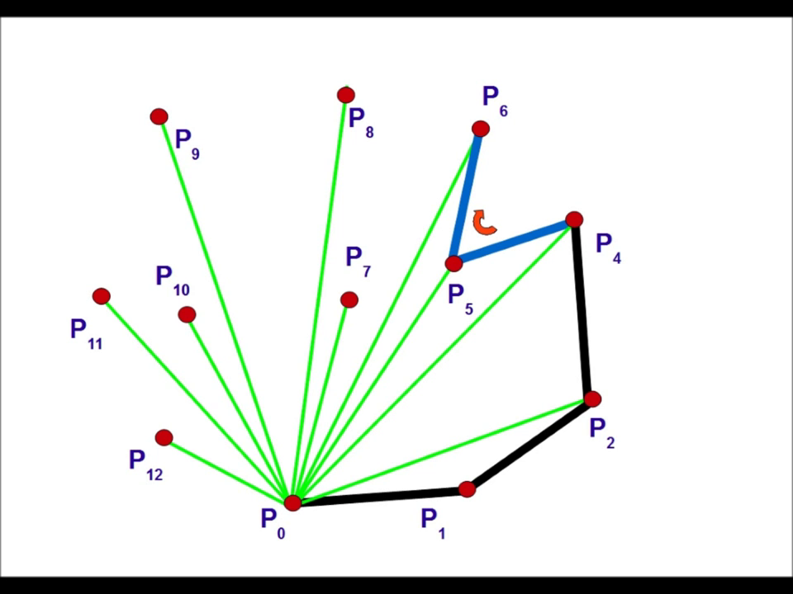
Graham Scan

Slide 15
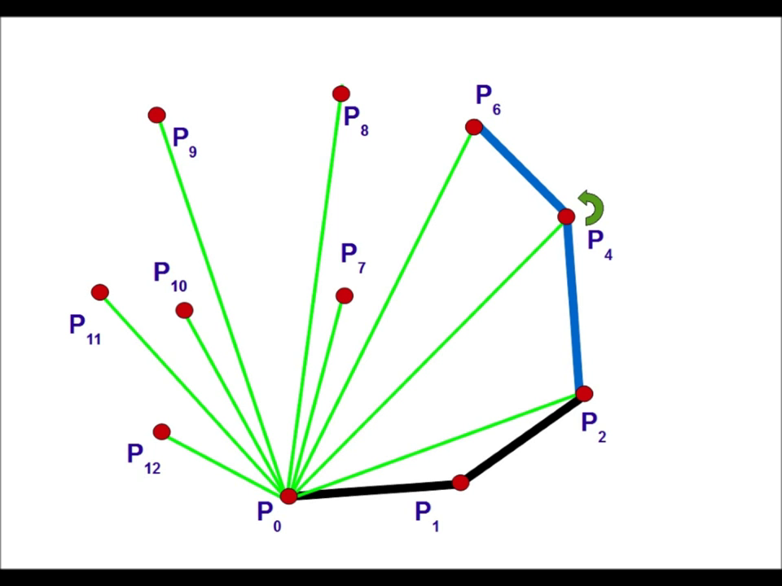
Graham Scan

Slide 16
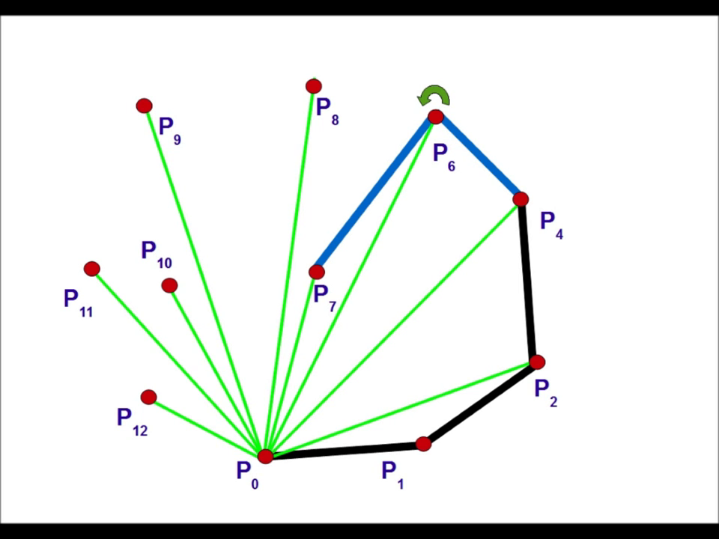
Graham Scan

Slide 17
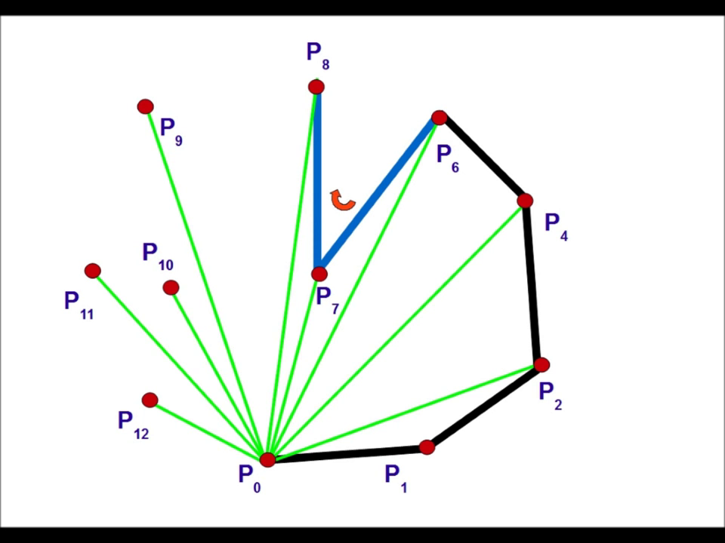
Graham Scan

Slide 18
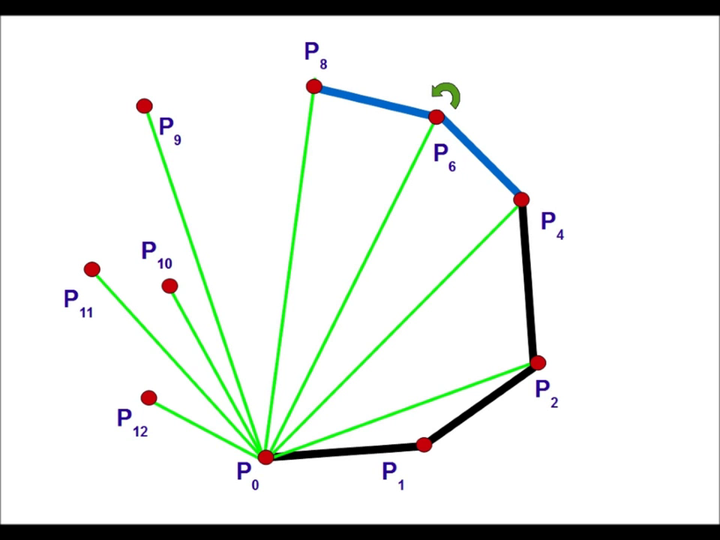
Graham Scan

Slide 19
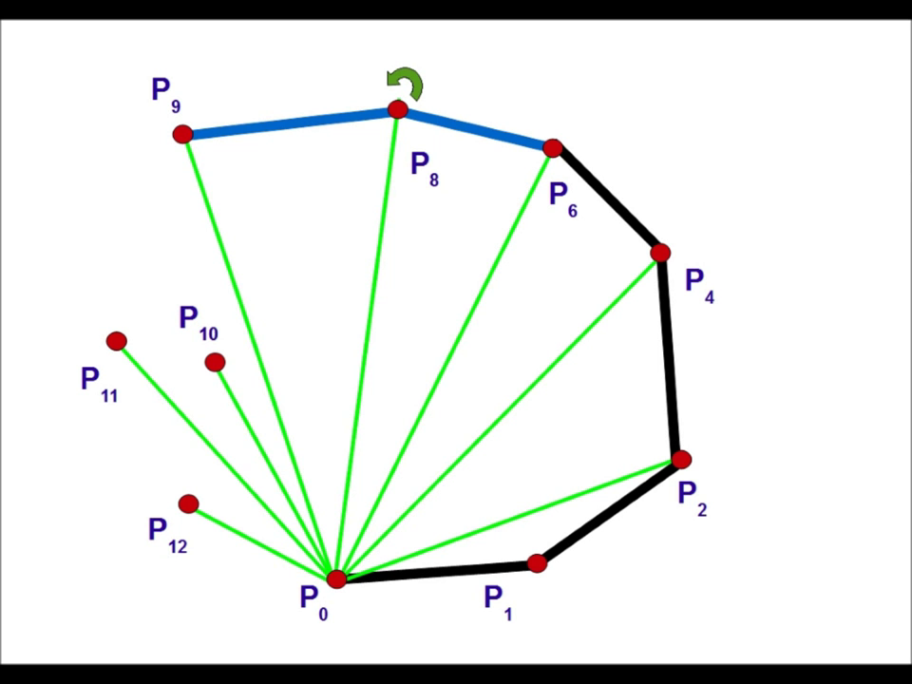
Graham Scan

Slide 20
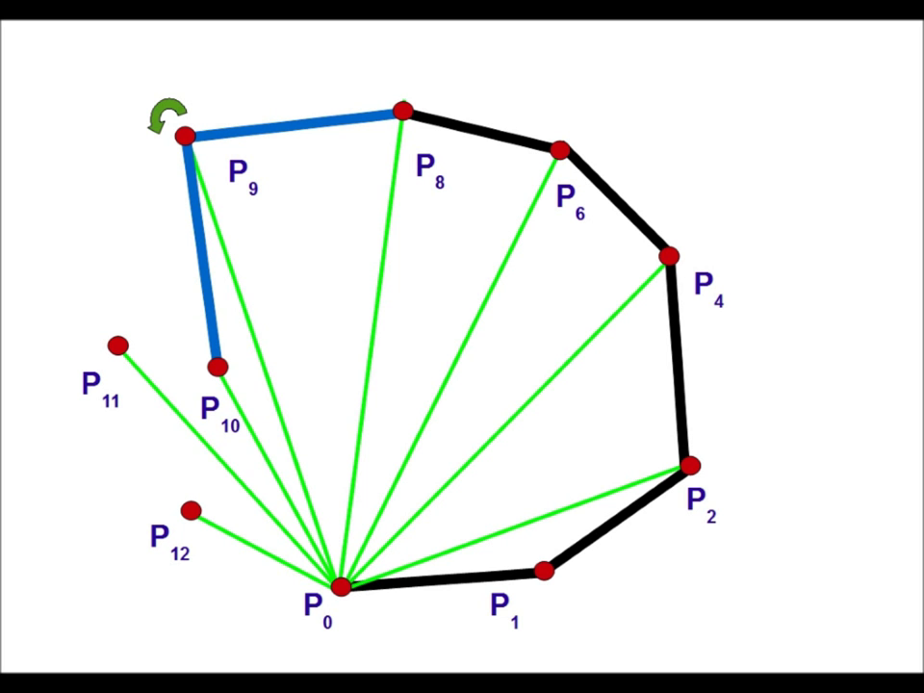
Graham Scan

Slide 21
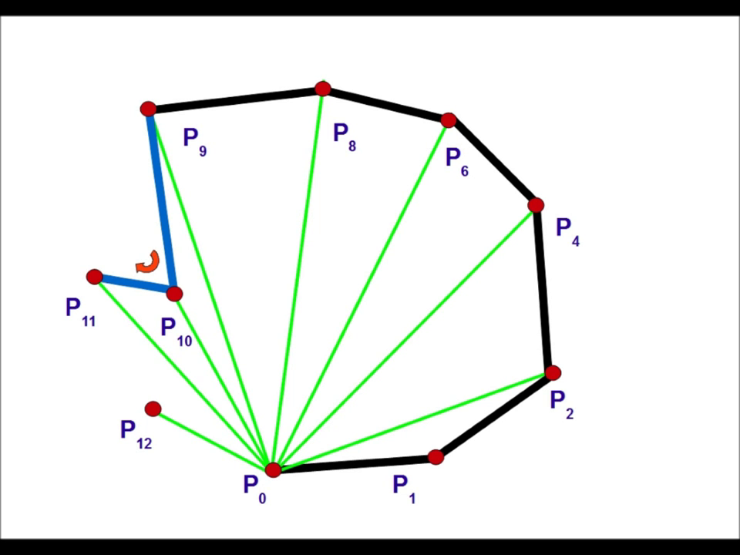
Graham Scan

Slide 22
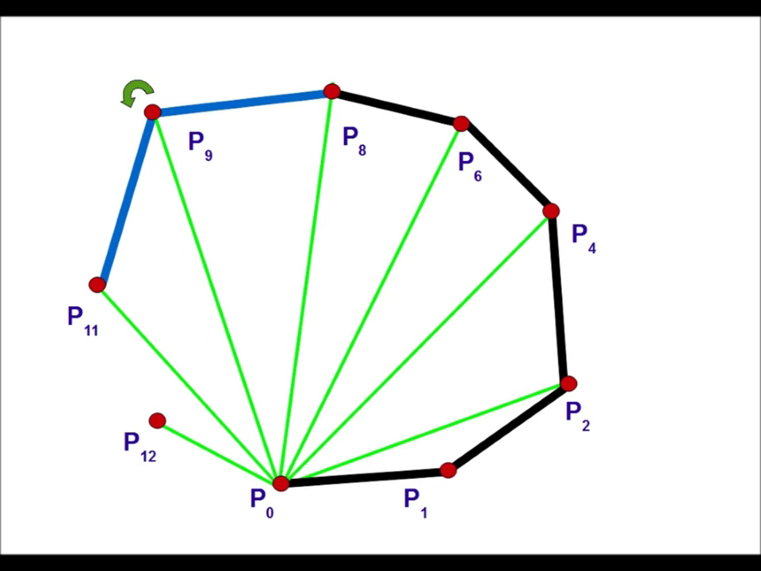
Graham Scan

Slide 23
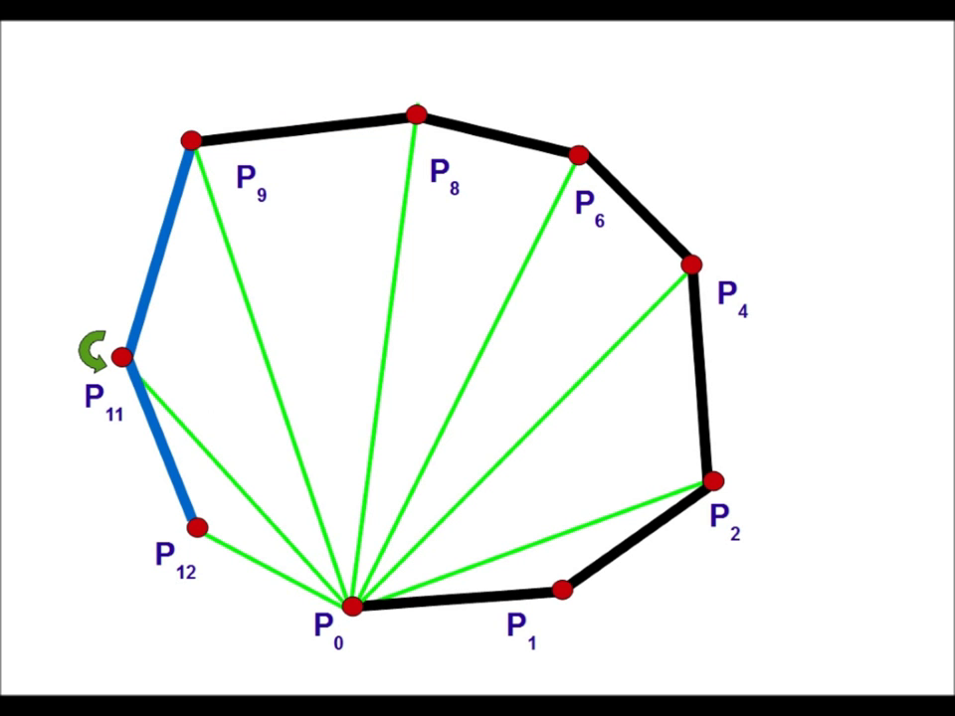
Graham Scan

Slide 24
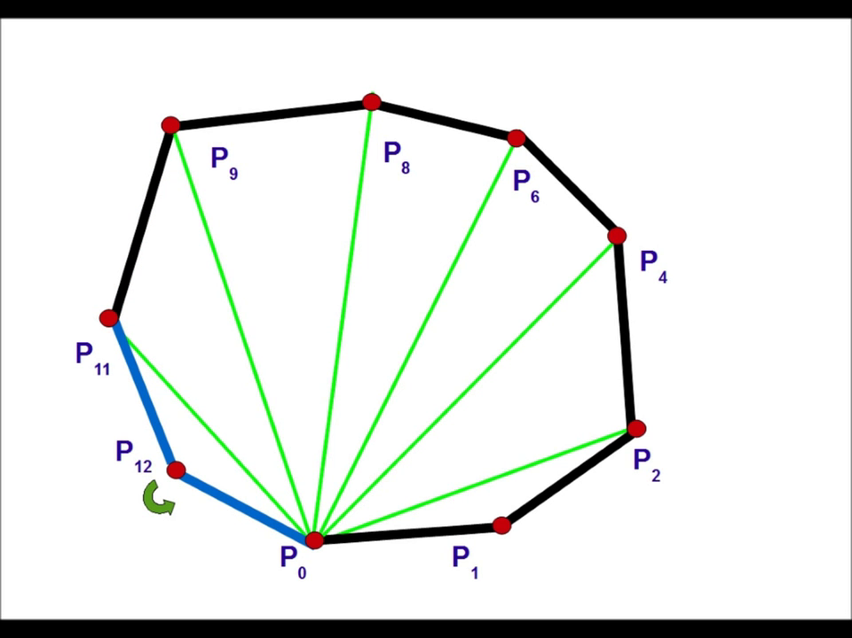
Graham Scan

Slide 25
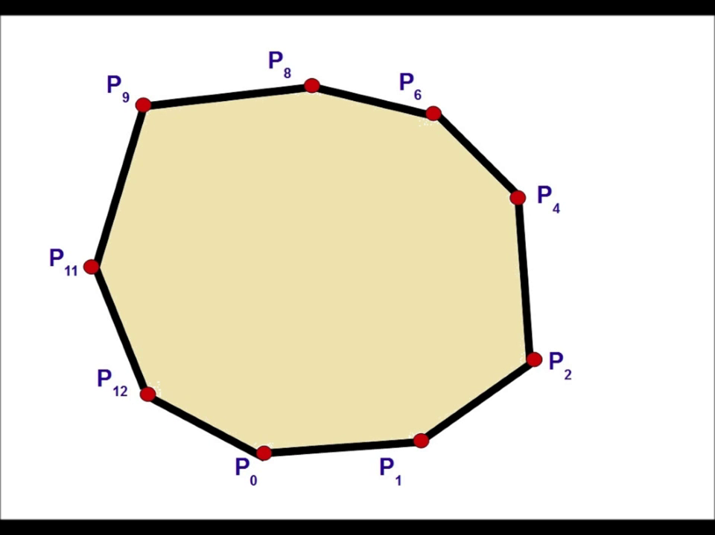
Graham Scan

Slide 26
Point in Polygon
Extend point in random direction (forming a ray)
Find number intersections with polygon.
If even → outside
If odd → inside

Slide 27
Point in Polygon
Extend point in random direction (forming a ray)
Find number intersections with polygon.
If even → outside
If odd → inside

Slide 28
Point in Polygon
Extend point in random direction (forming a ray)
Find number intersections with polygon.
If even → outside
If odd → inside

Slide 29
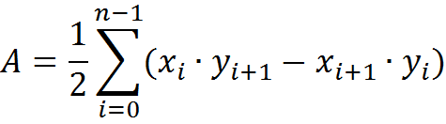
Area of Polygon
Formula for the area of a polygon given n vertices in order:

Slide 30
Questions?

