Slide 1
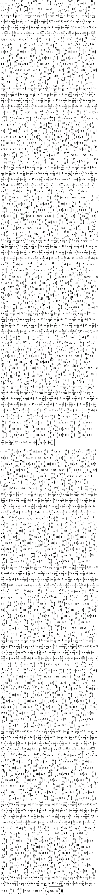
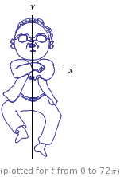

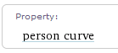
Graph Algorithms

Slide 2
Overview
Bellman-Ford: single-source shortest distance
O(VE) for graphs with negative edges
Detects negative weight cycles
Floyd-Warshall: All pairs shortest distance
O(V^3)

Slide 3
Bellman-Ford
Weight function w(a,b): weight of the direct path from a to b
Each vertex v has attributes:
d: current minimum distance from start to v
Previous: the vertex in the current shortest path from start to v just before v
Relax(u,v,w):
if v.d>u.d+w(u,v)
v.d=u.d+w(u,v)
v.previous=u

Slide 4
Bellman Ford
Bellman-Ford(G,w,s)
Set all v.d=∞ and s.d=0
Set all v.previous=null
For i=1 to |G.V|-1
For each edge (u,v) in G.E
Relax(u,v,w)

Slide 5
Why does it work?
The shortest path from s to v contains at most |G.V|-1 edges. Consider a shortest path p <s,v1,v2,v3,v4…,vn>. For each iteration of the first for loop we add a vertex to this shortest path. E.g.: v1.previous=S. The shortest path from S to v1 is saved as v1.d. We now add v2 (because it is reachable from v1) and v2.previous=v1. This is never overwritten because v1 is indeed in the shortest path from s to v2 (because otherwise p would not be the shortest path: otherwise replace v1 by vx and we have created a shorter path). By induction it follows that after |G.V|-1 iterations we have considered all shortest paths with |G.V|-1 edges.

Slide 6
Negative Cycle Check
For each edge (u,v) in G.E
if v.d>u.d+w(u,v)
return False
Return True
Proof:
Returns true correctly because: v.d=s(s,d)<=s(s,u)+w(u,v)=u.d+w(u,v)
Suppose <v0,v2,….,vn> is a negative edge cycle accessible from s where v0=vn:
Assume returns true. Then vi.d<=v(i-1).d+w(v(i-1),vi) for 1 to n.
Sum from i=1 to n-> 0<=w(v(i-1),vi), which contradicts:
sum_1_n(w(vi-1,vi))<0

Slide 7
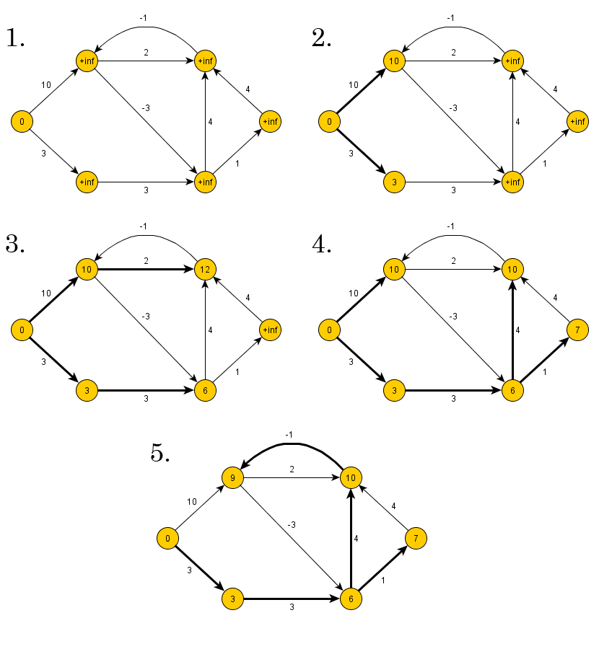

Slide 8
Floyd-Warshall
Shortest-Path algorithm has optimum substructure:
Consider shortest path v1->v2 with intermediate vertex vi. Then v1->…->vi must be the shortest path from v1->vi and vi->…->v2 must be the shortest path from vi->v2. Dynamic programming:
We don’t know which intermediate vertex to choose. We want all pair shortest-paths.

Slide 9
Floyd-Warshall
Define A[a][b][k] to be the length of the shortest path from a to b with possible intermediate vertices 1,2,3,…k.
Set A[a][b][0] to the weight of the edge connecting a to b.
Recursive relation: A[a][b][k+1]=
Min(A[a][k+1][k]+A[K+1][b][k]), A[a][b][k])
Because we only need a single level of k we can use O(V^2) memory if desirable.

Slide 10
Code:
Set A[a][b][0]=w(a,b)
For k=1 to |V|
For a=1 to |V|
for b=1 to |V|
A[a][b][k]=min(A[a][b][k-1],A[a][k][k-1]+A[k][b][k-1])
O(V^3) time

Slide 11
