Slide 1
Balanced Binary Search Trees
Ralph McDougall
9 February 2019

Slide 2
What is a BBST?
In graph theory, a tree is a connected, undirected graph that does not contain any cycles
A binary tree is a tree with one “root” node and where each node has at most two “child” nodes
A binary search tree is a binary tree where each node is assigned some value and the property holds that for each node V, all nodes in the left subtree of V have a value less than that of V and all nodes in the right subtree of V have a value greater than that of V
A balanced binary search tree is a binary search tree where all leaf nodes are as close as possible to the root

Slide 3
Why is a binary search tree useful?
If you want to query whether a given value is in the tree, you can easily find where it would be if it were in the tree
If the value A is less than the value of some node V, then you know that A must lie in the left subtree of V and vice versa
This makes querying whether or not a value is in a dataset significantly faster than naively checking every value in the dataset
Since one would expect the maximum height of the tree to be logN where N is the number of nodes present, BSTs allow for O(logN) queries

Slide 4
Why is a balanced binary search tree useful?
Optimal BSTs are efficient because of the property that their height is logN
However, it is not guaranteed that the height is always logN. If new values are inserted into the tree, one would add them as children of some leaf nodes
This can lead to the height of the tree becoming very large and thus reducing the runtime to O(N)
A balanced binary search tree introduces extra conditions that must be satisfied at all times when adding values to ensure that the height stays as small as possible

Slide 5
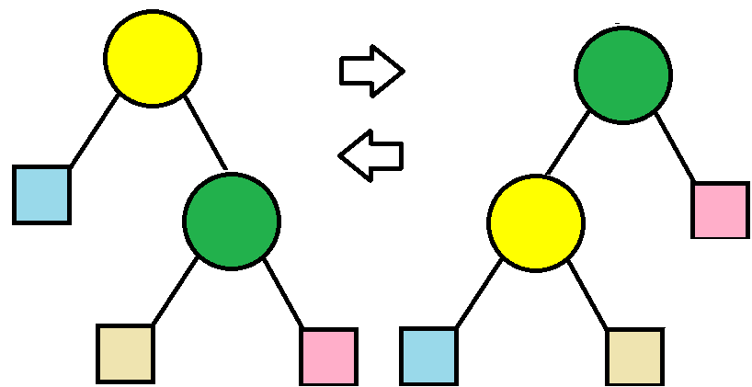
Tree rotations
In order to restructure the tree, BBSTs use “tree rotations”

Slide 6
Tree Rotations (continued)
Tree rotations help to shorten the maximum distance from the root to a leaf node
Different BBSTs use different heuristics to determine where tree rotations should take place

Slide 7
Types of BBSTs
AVL tree
Splay tree
Red-Black tree

Slide 8
AVL Tree
An AVL Tree maintains the property that the difference between a node’s left subtree height and right subtree height is at most 1
This means that the AVL tree always has as small of a height as possible
Since all queries are worst case O(h) where h is the height of the tree, AVL trees allow for guaranteed O(logN) queries

Slide 9
AVL Tree (continued)
AVL Insertions:
Insert a node like you would for a normal BST
Walk from the leaf node to the root
Suppose the nodes visited are V₁, V₂, V₃, …, V_{k} in that order
If V_{i} does not satisfy the AVL property anymore, perform some tree rotations with V_{i}, V_{i - 1} and V_{i - 2}
There are 4 cases to consider that affect what tree rotations should be performed (left-left, left-right, right-left, right-right)

Slide 10
AVL Tree (continued some more)
Deletion:
If you want to remove a node from the tree, perform a standard BST deletion
Walk up from where the deleted node was to the root and perform rebalancing in the same manner as was done for insertion

Slide 11
AVL Tree Performance
Queries are guaranteed to be O(logN)
Insertions are guaranteed to be O(logN)
Deletions are guaranteed to be O(logN)
There can be quite a large constant overhead as a lot of rotations may need to be performed during insertion and deletion
An AVL Tree is thus not the ideal choice if there are a lot more insertions and deletions than queries

Slide 12
Splay Tree
A splay tree utilises the 80-20 rule
80% of the queries are to 20% of the elements in a set in a lot of cases
Thus, splay trees aim to keep the most recently queried values close to the root

Slide 13
Splay Trees 2: Electric Boogaloo
Querying a splay tree is initially identical to querying a normal BST
Once the query is completed, tree rotations are performed repeatedly until the last node visited is the new root node

Slide 14
Splay Tree review
Query is O(logN) (albeit with a fairly large constant)
Insertion and deletion are O(logN) too
Splay trees are very useful because they are faster than Red-Black trees and AVL Trees in most modern situations
Splay trees are used in the gcc compiler, the implementation of the Unix malloc and for Linux loadable modules

Slide 15
Red-Black Tree
Red-Black Tree property:
Every node is either red or black
The root of the tree is always black
If a node is red, it’s children must be black
Every path from a node to all of its descendant leaf nodes has the same number of black nodes

Slide 16
Red-Black Tree: The Empire Strikes Back
For insertion, Red-Black Trees use tree rotations and recolourings
When a node V is added to the tree (standard BST insertion), mark it as red
If V’s parent and uncle are red, make them both black and make V’s grandparent red. Repeat this from V’s grandparent.
If V’s parent is red and the uncle is black, there are 4 cases of rotations with V, the parent and the grandparent. Each case has a specific tree rotation and recolouring that needs to be performed. These aren’t too difficult to figure out.

Slide 17
Red-Black Tree review
All updates and queries are O(logN)
Red-Black Trees utilise fewer tree rotations than other BBSTs, making the faster on average for lots of insertions
Red-Black Trees should be used when there is a high ratio of insertions to queries

Slide 18
The problem with BBSTs
All insertions and queries can be performed in O(logN) with all of the trees that have been covered
Which tree you want to use depends on the constraints of the scenario
A problem arises: the people that create test data often create pathological test cases that are designed to break commonly used data structures
Test-case authors can predict how these trees will look, so they know what cases test them to their limits

Slide 19
The Solution
How can the test-case authors predict how your tree will look if your program doesn’t even know how the tree will look?
Random numbers come to the rescue!

Slide 20
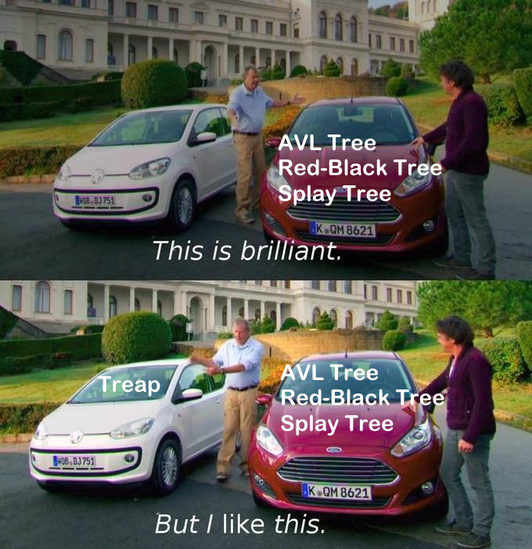

Slide 21
Treap
A Treap is the amalgamation of a tree and a heap
(By this point in the lecture, you should hopefully know what a tree is)
A heap is a data structure with the property that all of a node’s children have a value less than it (or larger than it for a min-heap)
Queries are performed identically to any BST

Slide 22
You can never have enough Treaps
Insertion:
Each node that gets inserted is assigned a random priority
The node gets inserted in the tree according to the heap property on the priorities
The value of the node is used to decide whether it should be inserted into the left or the right subtree
Assuming the priorities assigned are true random numbers, the treap will remain reasonably well balanced at all times

Slide 23
Treap Review
All queries and insertions are O(logN)
No matter what test data is given, the treap should always be balanced allowing for very fast queries
It is a good idea to seed your random number generator since your submissions should always run identically if the same input data is given

Slide 24
TL;DR
Treaps are cool

