Slide 1
Quick Sorting & Quick Selecting
Divide-and-Conquer Sorting Algorithm with Time-Complexing of O(n log n)
Algorithm for finding the Kth smallest element in unsorted array at O(n)

Slide 2
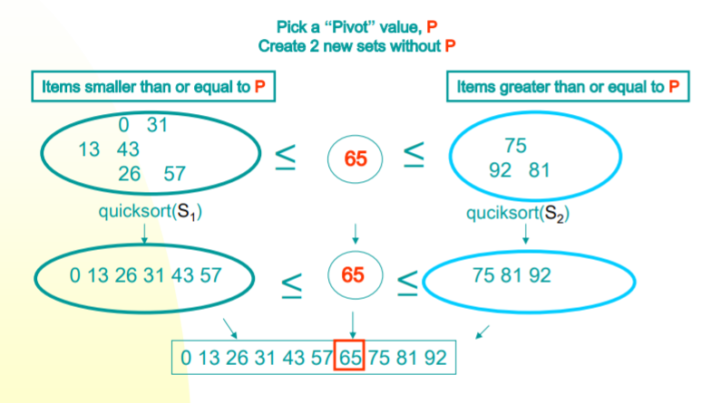
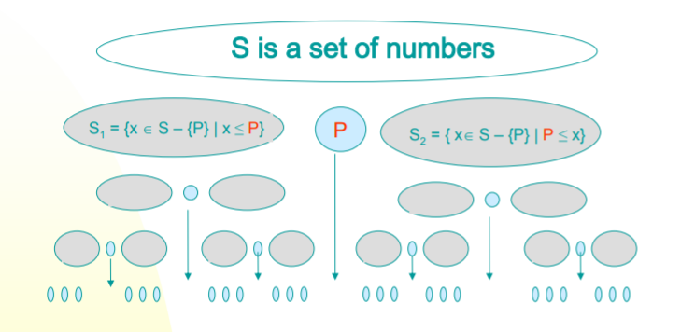
Basic Ideas

Slide 3
Basic Ideas
Pick an element, say P (the pivot)
Re-arrange the elements into 3 sub-blocks,
L: those less than or equal to ( ≤) P (the left-block S1)
P: the pivot (the only element in the middle-block)
G: those greater than or equal to ( ≥) P (the right block S 2 )
Repeat the process recursively for the left- and right- sub-blocks.
Return {quicksort( S 1), P, quicksort( S 2) }.

Slide 4
Basic Ideas
Note:
The main idea is to find the “right” position for the pivot element P.
After each “pass”, the pivot element, P, should be “in place”.
Eventually, the elements are sorted since each pass puts at least one element (i.e., P) into its final position.
Issues:
How to choose the pivot P ?
How to partition the block into sub-blocks?

Slide 5
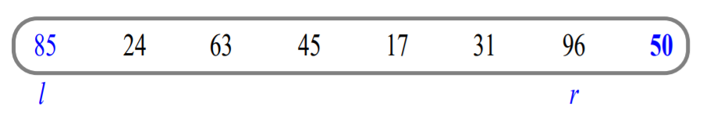
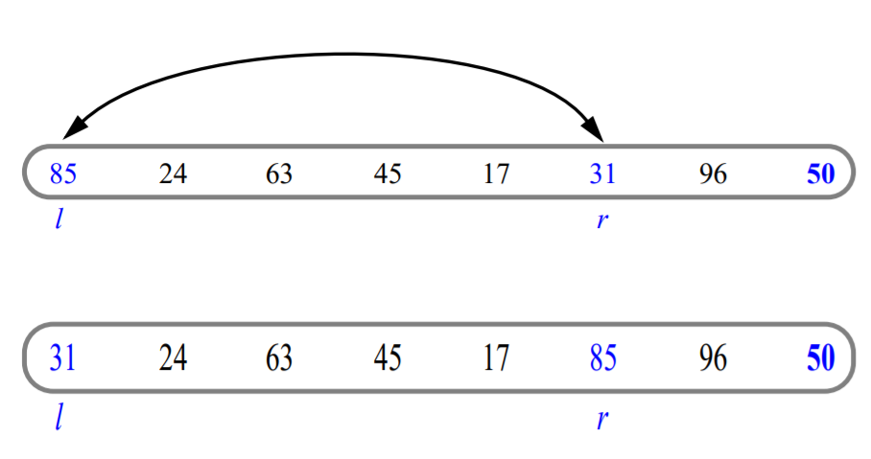
Example of Partitioning

Slide 6
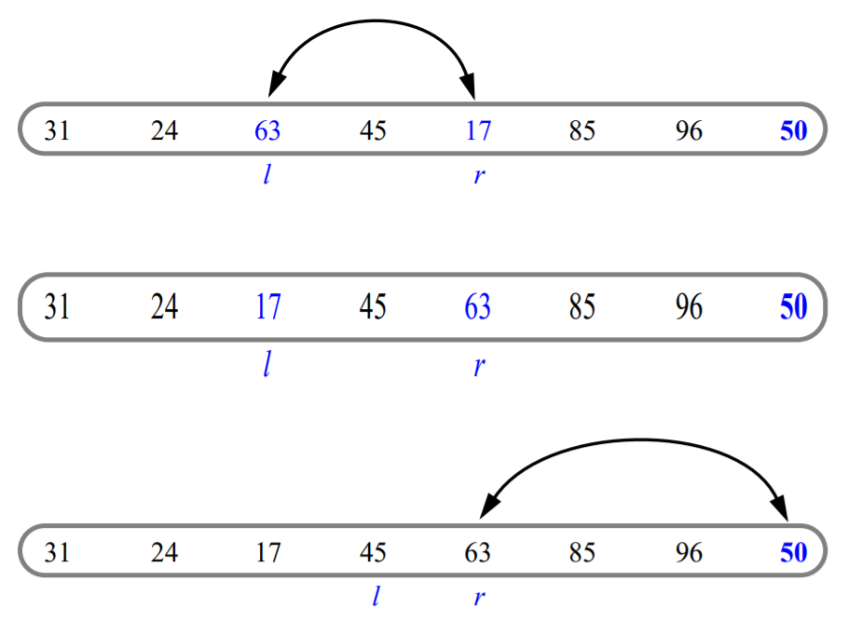
…Example of Partitioning continued

Slide 7
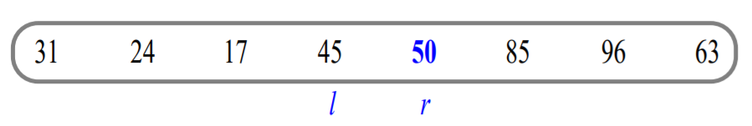
…Example of Partitioning continued

Slide 8
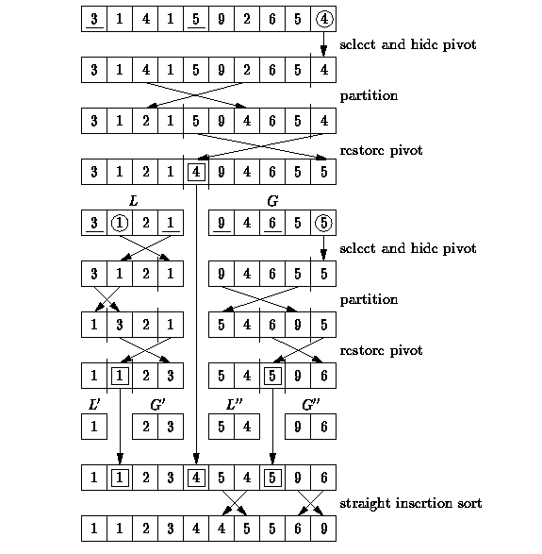
Another Quick Example

Slide 9
… Another Quick Example continued

Slide 10
Implementation : Quick Sort function
// low --> Starting index
// high --> Ending index
void quicksort (arr[], low, high) {
if (low < high) {
// pi is partitioning index
// arr[pi] is now at right place
pi = partition(arr, low, high);
quickSort(arr, low, pi - 1); // Before pi
quickSort(arr, pi + 1, high); // After pi
}
}

Slide 11
Implementation : Partitioning function
// This function sorts the array into left sub-block, pivot, right sub-block
// and returns pivot index
int partition (int arr[], int low, int high) {
int pivot = arr[high]; // pivot
int i = (low - 1); // Index of smaller element
for (int j = low; j <= high-1; j++) {
if (arr[j] <= pivot) { // If current element is smaller than or equal to pivot
i++; // increment index of smaller element
swap(&arr[i], &arr[j]);
}
}
swap(&arr[i + 1], &arr[high]);
return (i + 1);
}

Slide 12
Driver Code
void printArray(int arr[], int size) {
int i;
for (i=0; i < size; i++)
printf("%d ", arr[i]);
printf("n");
}
// Driver program to test above functions
int main() {
int arr[] = {10, 7, 8, 9, 1, 5};
int n = sizeof(arr) / sizeof(arr[0]);
quickSort(arr, 0, n-1);
printf("Sorted array: n");
printArray(arr, n);
return 0;
}
#include<stdio.h>
// A utility function to swap two elements
void swap(int* a, int* b) {
int t = *a;
*a = *b;
*b = t;
}

Slide 13
Why Quick Sort is preferred over Merge Sort for sorting Arrays?
Quick Sort in its general form is an in-place sort (i.e. it doesn’t require any extra storage)
whereas merge sort requires O(N) extra storage, N denoting the array size which may be quite expensive.
But because it has the best performance in the average case for most inputs, Quicksort is generally considered the “fastest” sorting algorithm.
Allocating and de-allocating the extra space used for merge sort increases the running time of the algorithm.
Comparing average complexity we find that both type of sorts have O(N log N) average complexity but the constants differ..

Slide 14
Quick Select
Finding the Kth smallest element in an unsorted array

Slide 15
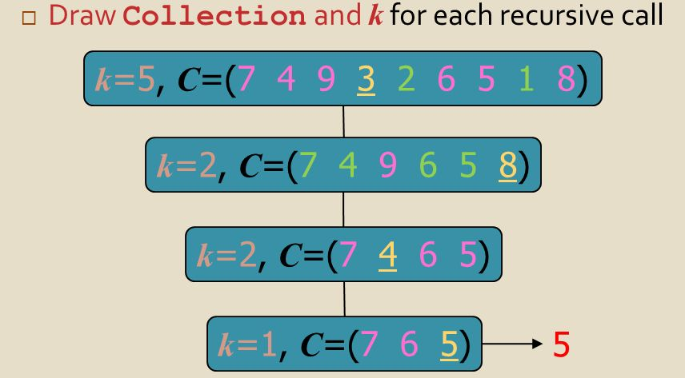
Quick Select Visualization

Slide 16
Implementation :
This function returns k'th smallest element in arr[l..r] using QuickSort based method.
ASSUMPTION: ALL ELEMENTS IN ARR[] ARE DISTINCT
int kthSmallest(int arr[], int l, int r, int k) { //Only if k is in the range of the array
if (k > 0 && k <= r - l + 1) { // Partition the array and get new position of pivot
int index = partition(arr, l, r); // If position is same as k
if (index - l == k – 1) {
return arr[index]; // If position is more, recur for left subarray
}
if (index - l > k - 1) {
return kthSmallest(arr, l, index - 1, k);
}
return kthSmallest(arr, index + 1, r, k - index + l - 1);
} else {
return INT_MAX;
}

