Slide 1
Eulerian Tours
By Shaylan Lalloo

Slide 2
What is an Eulerian Tour?
A path that uses every edge exactly once is called an eularian tour. Furthermore, a path that starts and ends at the same vertex and is an eularian tour but is called an eulerian circuit.

Slide 3
When does there exist an eulerian tour?
An eulerian tour exists when the degree of all vertices except for exactly 2 are even and the graph is connected
An eularian circuit exists when the degree of all the vertices are even and the graph is connected

Slide 4
Proof
This can be seen from the fact that every time you enter a vertex in a path, you must be able to leave it unless you are at the beginning or end of the path so this adds 2 to the degree of the vertices on the path not being the starting or ending vertex.

Slide 5
Algorithm for finding eulerian tours
Find the starting node. Then recurse using the following rule
If a node has no neighbours, push it onto the answer vector
If a node has a neighbour, throw the neighbours onto a stack and process them
Processing a node consists of deleting the edge between the current node and neighbour, then recursing on the neighbour. Once that is done, pushing the current node onto the answer vector

Slide 6
Code(Variables)
vector<int> mygraph[10];
int n;
vector<int> mystack;
vector<int> myans;
int curpos = 0;

Slide 7
Reading Inputs
ifstream fin ("myin.txt");
fin >> n;
for (int i = 0; i < n; ++i){
int f, t;
fin >> f >> t;
mygraph[f - 1].push_back(t - 1);
mygraph[t - 1].push_back(f - 1);
}
for (int i = 0; i < 7; ++i){
sort(mygraph[i].begin(), mygraph[i].end(), cmp);
}

Slide 8
Recursion algorithm but using stack
mystack.push_back(0);
while (!mystack.empty()){
curpos = mystack.back();
if (mygraph[curpos].size() == 0){
myans.push_back(curpos);
mystack.pop_back();
}
else {
int neigh = mygraph[curpos].back();
mystack.push_back(neigh);
mygraph[curpos].pop_back();
for (int i = 0; i < mygraph[neigh].size(); ++i){
if (mygraph[neigh][i] == curpos){
mygraph[neigh].erase(mygraph[neigh].begin() + i);
break;
}
}
}
}

Slide 9
Outputting result
cout << "MYANS: ";
for (int i = 0; i < myans.size(); ++i){
cout << myans[i] + 1 << " ";
}
cout << endl;

Slide 10
Pseudocode
# circuit is a global array
find_euler_circuit
circuitpos = 0
find_circuit(node 1)
# nextnode and visited is a local array
# the path will be found in reverse order
find_circuit(node i)
if node i has no neighbors then
circuit(circuitpos) = node i
circuitpos = circuitpos + 1
else
while (node i has neighbors)
pick a random neighbor node j of node i
delete_edges (node j, node i)
find_circuit (node j)
circuit(circuitpos) = node i
circuitpos = circuitpos + 1

Slide 11
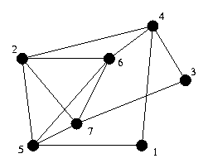
Visual representation of algorithm

Slide 12
Stack: Location: 1 Circuit:

Slide 13
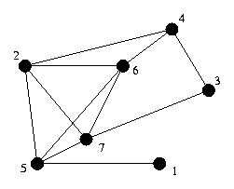
Stack: 1 Location: 4 Circuit:

Slide 14

Stack: 1 4 Location: 2 Circuit:

Slide 15

Stack: 1 4 2 Location: 5 Circuit:

Slide 16

Stack: 1 4 2 5 Location: 1 Circuit:

Slide 17
Stack: 1 4 2 Location: 5 Circuit: 1

Slide 18

Stack: 1 4 2 5 Location: 6 Circuit: 1

Slide 19
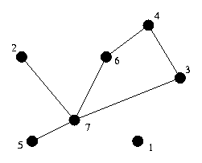
Stack: 1 4 2 5 6 Location: 2 Circuit: 1

Slide 20
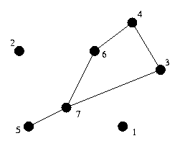
Stack: 1 4 2 5 6 2 Location: 7 Circuit: 1

Slide 21
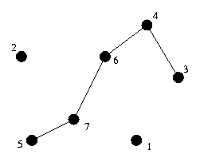
Stack: 1 4 2 5 6 2 7 Location: 3 Circuit: 1

Slide 22
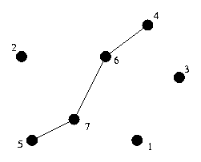
Stack: 1 4 2 5 6 2 7 3 Location: 4 Circuit: 1

Slide 23
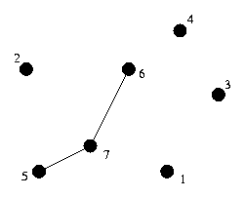
Stack: 1 4 2 5 6 2 7 3 4 Location: 6 Circuit: 1

Slide 24
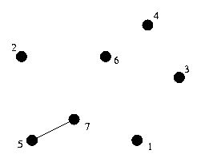
Stack: 1 4 2 5 6 2 7 3 4 6 Location: 7 Circuit: 1

Slide 25
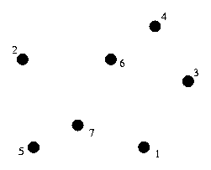
Stack: 1 4 2 5 6 2 7 3 4 6 7 Location: 5 Circuit: 1

Slide 26
Stack: Location: Circuit: 1 5 7 6 4 3 7 2 6 5 2 4 1

Slide 27
Problem involving Eulerian Tour
USACO Riding Fences
Farmer John owns a large number of fences that must be repaired annually. He traverses the fences by riding a horse along each and every one of them (and nowhere else) and fixing the broken parts.
Farmer John is as lazy as the next farmer and hates to ride the same fence twice. Your program must read in a description of a network of fences and tell Farmer John a path to traverse each fence length exactly once, if possible. Farmer J can, if he wishes, start and finish at any fence intersection.
Every fence connects two fence intersections, which are numbered inclusively from 1 through 500 (though some farms have far fewer than 500 intersections). Any number of fences (>=1) can meet at a fence intersection. It is always possible to ride from any fence to any other fence (i.e., all fences are "connected").
Your program must output the path of intersections that, if interpreted as a base 500 number, would have the smallest magnitude.
There will always be at least one solution for each set of input data supplied to your program for testing.

