Slide 1
Linier-Time Sorting and Order Statistics
Bucket Sort
Radix Sort
Randomized-Select
Selection in linier time

Slide 2
Bucket Sort
Uniformly allocate inputs to “buckets” – input must be uniform
Apply insertion sort to each bucket – O(N^2), but ideal for small inputs because small constant factor
Combine buckets
Code (for 0<doubles <1):
Create n buckets (e.g. vectors)
--for i to n:
Insert element i into bucket (int)(element*n)
Insertion sort each bucket (or bucket sort)
Concatenate and print
This is a stable sort if the insertion sort implementation is stable
Runs in O(n) average case

Slide 3
Radix Sort
Useful when sorting an element by a set of properties where there is a strict order of importance for each property and the number of possible states of each property is small: e.g. the digits of an integer, sorting integers.
Radix sort:
-for each property, in order of least importance:
Use a linier stable sort (e.g. bucket sort) on the property for all elements
Takes O(pk) time, where p is the number of properties and k is the time taken by the inner-loop sort: p is generally a constant, and k=O(n).

Slide 4
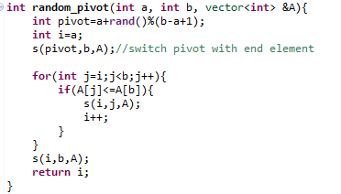
Randomized-Select
Find’s the kth largest number in A[1…n]
Randomized partition function: Chooses a random pivot as in quicksort, and reorders the elements around the pivot such that those smaller than it are on the left, and larger on the right: O(N)

Slide 5
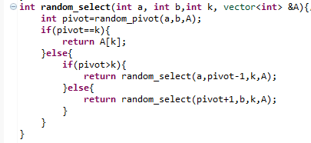
Randomized Select Code:
O(N) average case

Slide 6
Performance (CLOCKS/CLOCKS PER SEC)
N=10^4
0.003 0.008
N=10^5
0.032 0.117
N=10^6
0.077 1.285
0.134 1.369
0.206 1.265
N=10^7
2.117 16.879
1.827 13.924
1.584 14.072

Slide 7
Guaranteed Linier Time Selection
Guarantee a “good” split for partition:
Group all elements of A into groups of 5
Use insertion sort to determine median of each group
Use select function to find the median of medians i.e element (n/5)/2 of the median set
Partition with this median as the pivot, and call select to the left or right accordingly

