Slide 1
Tries
by Tian Cilliers
IOI Training Camp 3 (3-4 March 2018)

Slide 2
Definitions
Trie
A trie (pronounced as in retrieval), also called a prefix or radix tree, is an ordered tree data structure used to store a dynamic set where the keys are usually strings.
Can be used to store any associative data type
Root node is empty
Each node contains the prefix of all its children
Not every node has to define a value, some can be intermediate nodes
Can provide lexicographical sorting

Slide 3
Example
Storing the following values:
cpp
can
cat
in
inn
it
a
a
c
i
a
c
i
a
p
n
ca
cp
in
n
t
p
n
can
cat
cpp
inn

Slide 4
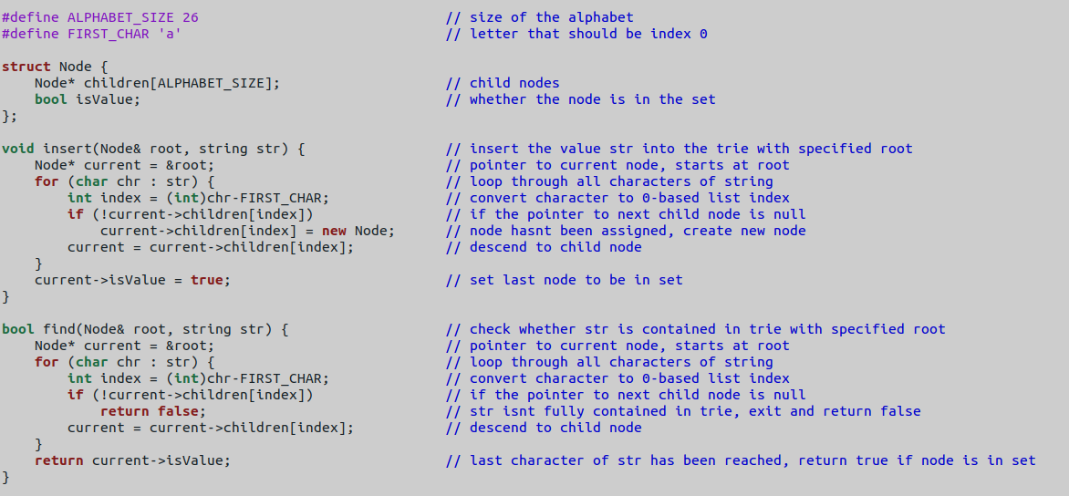
Implementation
Fundamental Structure
The first requirement is to setup a basic tree structure with the following properties:
Each node can point to one child node for each letter in the alphabet
Each node needs to store whether it represents a value in the dataset
Example:

Slide 5
Implementation
Insert Value
Start at root node of tree.
For each character in string value:
If child node corresponding to character doesn’t exist, add new empty node
Descend to child node
Mark last node as valid value

Slide 6
Implementation
Insert Value
Demonstration:
Adding string ‘cpp’ to tree
a
c
i
a
c
i
a
p
n
cpp
ca
cp
in
n
t
p
n
can
cat
cpp
cpp
inn

Slide 7
Implementation
Insert Value
Example:

Slide 8
Implementation
Find Value
Start at root node of tree.
For each character in string value:
If child node corresponding to character doesn’t exist, exit and return false
Descend to child node
Return true if last node is marked as valid

Slide 9
Implementation
Find Value
Demonstration:
Finding string ‘cpr’ in tree
a
c
i
a
c
i
a
p
n
cpr
ca
cp
in
n
t
p
n
FALSE
can
cat
cpp
inn

Slide 10
Implementation
Find Value
Example:

Slide 11
Analysis
Time Complexity:
Insert: O(L)
Find: O(L)
Space Complexity: O(NL)

Slide 12
Example
Longest Prefix (IOI 1996)
Given a set of short strings P and a longer string S, calculate the length of the longest prefix of S such that the prefix equals to a concatenation of some (possibly repeated) elements of P
Sample IO:
Input | Output
A AB BA CA BBC . ABABACABAABC | 11

Slide 13
Example
Longest Prefix (IOI 1996)
Solution:
We use a DP solution to find which characters are reachable by constructing a prefix from some elements of P. Let DP[i] denote whether it is possible to construct a prefix of length i. Initially, DP[0] = true. Firstly, let’s construct a trie containing all the elements of P.
Now, loop through all i for which DP[i] is true, and for each loop we do the following:
Start at the root of the trie
Run a while loop with iterator n, and each time descend down the trie to character S[i+n] setting DP[i+n] = true. If the node doesn’t exist, terminate the inner loop
Time complexity: O(|S|²)

Slide 14
Questions?

