Slide 1
Minimum Spanning Trees
Tian Cilliers | Training Camp 3 | 9-10 March 2019

Slide 2
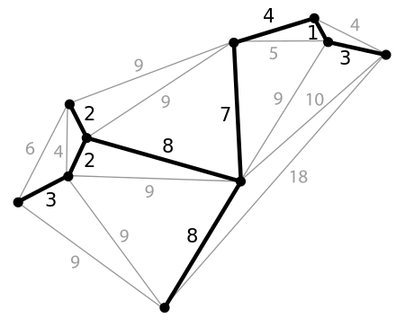
Definition
A minimum spanning tree (MST) is a subset of the edges of a connected, edge-weighted undirected graph that connects all the vertices together, without any cycles and with the minimum possible total edge weight.

Slide 3
Applications
Approximating Travelling Salesman Problem, Perfect Matching, Single-Terminal Maximum Flow
Communications network design, electricity grid or transportation system optimization
Cluster analysis
Taxonomy
A lot of other weird stuff I don’t understand

Slide 4
Determining THE MST

Slide 5
Sample Problem
Given some weighted, undirected graph. Determine the minimum sum of edge weights necessary to connect all nodes.

Slide 6
Possible Solution
Generate all possible spanning trees (connecting all nodes), calculate the sum of their edge weights, and choose their minimum.

Slide 7

Problems with Solution
Obviously, this solution runs in $O(too slow)$.
Is there a faster, greedy way to determine the MST?

Slide 8
Prim’s Algorithm

Slide 9
Algorithm
Start with a single vertex from the graph.
While all vertices has not been processed, do the following:
Retrieve the edge with the smallest weight connecting an unprocessed vertex to the graph.
Connect the vertex to the graph with the edge.
Process all other edges connected to the added vertex for use later.

Slide 10
Visualization

Slide 11
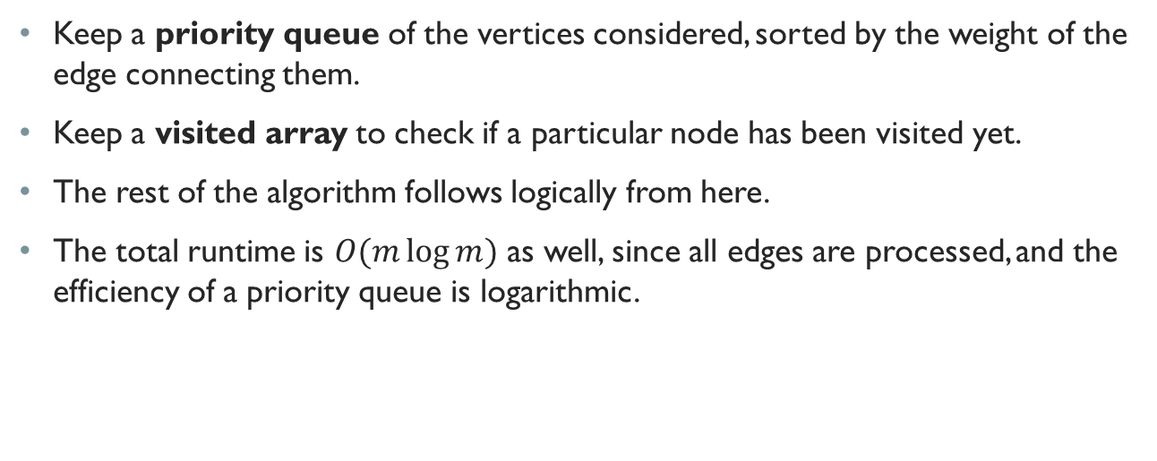
Implementation
Keep a priority queue of the vertices considered, sorted by the weight of the edge connecting them.
Keep a visited array to check if a particular node has been visited yet.
The rest of the algorithm follows logically from here.
The total runtime is $O(m\log{m})$ as well, since all edges are processed, and the efficiency of a priority queue is logarithmic.

Slide 12
Why Bruce is a God

Slide 13
Kruskal’s Algorithm

Slide 14
Algorithm
Start with a separate tree for each vertex, consisting only of that vertex.
While all edges has not been processed and the graph is not spanning, do the following:
Retrieve the unprocessed edge with the lowest weight.
If it connects two unconnected trees in the graph, add it to the graph and join the trees.

Slide 15
Visualization

Slide 16
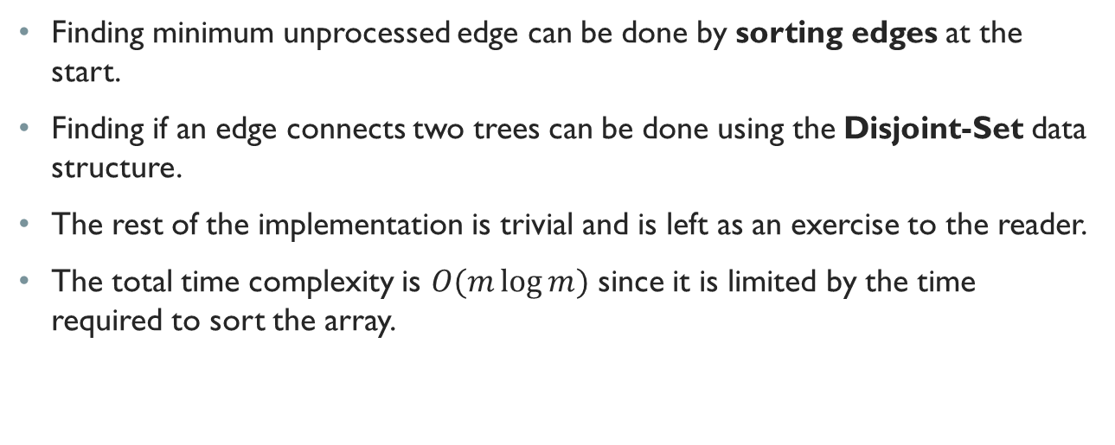
Implementation
Finding minimum unprocessed edge can be done by sorting edges at the start.
Finding if an edge connects two trees can be done using the Disjoint-Set data structure.
The rest of the implementation is trivial and is left as an exercise to the reader.
The total time complexity is $O(m\log{m})$ since it is limited by the time required to sort the array.

Slide 17
Example Problem

Slide 18
Trail Maintenance (Problem)
Cows want to maintain certain trails between fields.
The total length of trails maintained must be minimized.
They start off with no trails, and after each week they discover a new path.
Given the trails they discover each week, you need to determine the total distance of the trails after each week.

Slide 19
Trail Maintenance (Solution)
Recalculate the MST after each week using all previous paths (50%)
Do the same, but only look at the best path between two fields (60%)
Do the same, but only look at the previous MST and the new path (100%)

Slide 20
Questions?

