Slide 1
Maximum Bipartite Matching
Ralph McDougall
3 February 2018
Comeback tour: 9 March 2019

Slide 2
Definitions
A graph is said to be a bipartite graph if it possible to split the nodes into 2 disjoint sets, A and B, such that nodes in set A only have edges leading to nodes in set B
A bipartite matching is a bipartite graph such that no 2 edges have a common endpoint
The maximum bipartite matching of a bipartite graph is the bipartite matching with the most edges

Slide 3
Example: Bipartite Graph
A
B
1
6
2
7
3
8
4
9
5

Slide 4
Example: Bipartite Matching
A
B
1
6
2
7
3
8
4
9
5

Slide 5
Example: NOT Bipartite Matching
A
B
1
6
2
7
3
8
4
9
5

Slide 6
Example: Maximum Bipartite Matching
A
B
1
6
2
7
3
8
4
9
5

Slide 7
Things to note
If there are m nodes in set A and n nodes in set B, then the number of edges in the Maximum Bipartite Matching has an upper bound of min(m, n)
There can be multiple maximum bipartite matchings

Slide 8
How is this useful?
Sample problem:
n people are applying for m jobs. Each person can only do 1 job and each job can only be done by 1 person. Given a list of jobs that each person is applying for, find the highest number of jobs that can be filled.

Slide 9
Sample of sample
Person | Job being applied for
Alice | Accounting
 | Baking
Bob | Baking
Claire | Baking
 | Diving
Dave | Baking
 | Carpentry
 | Diving

Slide 10
Alternate form of sample of sample
Person
Job
Alice
Accounting
Bob
Baking
Claire
Carpentry
Dave
Diving

Slide 11
Maximum Bipartite Matching of alternate form of sample of sample
Person
Job
Alice
Accounting
Bob
Baking
Claire
Carpentry
Dave
Diving

Slide 12
Solution to sample
Alice does Accounting
Bob does Baking
Claire does Diving
Dave does Carpentry

Slide 13
Network Flow
The problem of finding a Maximum Bipartite Matching is a special case of the Network Flow problem
A flow network is a weighted directed graph where each edge has a maximum capacity. Flow is sent from a source to a sink. The total flow into a node must be the same as the total flow out except for the source and the sink. The task is to maximise the flow that ends at the sink
This problem can be solved with the Edmonds-Karp extension of the Ford-Fulkerson algorithm

Slide 14
Edmonds-Karp
Find the path with shortest length from the source to the sink where none of the edges on the path are full (augmenting path)
Pass as much flow as possible through that path
Repeat until there are no more paths from the source to the sink

Slide 15
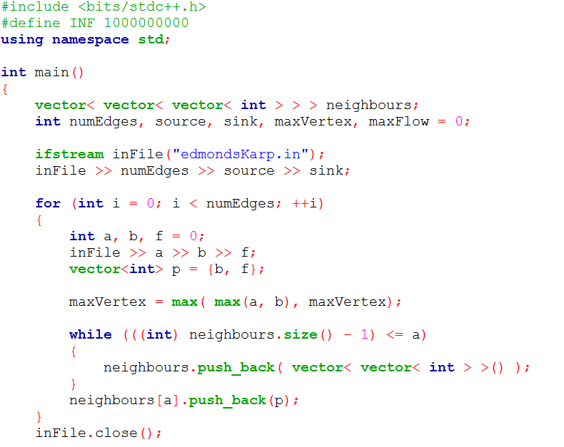
Code: Initialisation and input

Slide 16
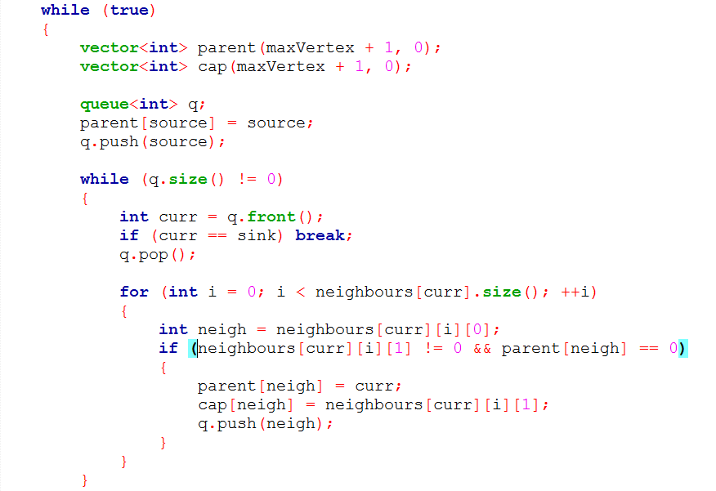
Code: BFS looking for path

Slide 17
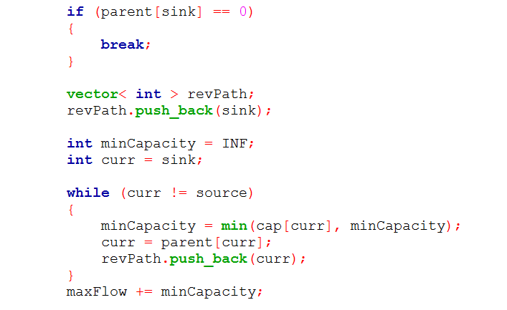
Code: Finding shortest path and flow

Slide 18
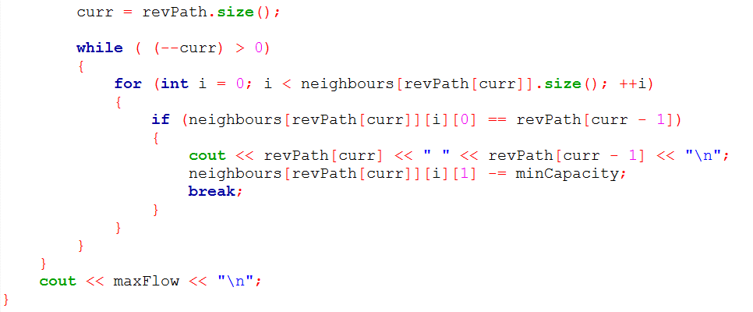
Code: Reducing capacity of path edges

Slide 19
Analysis
This algorithm runs in O(VE²) time
Dinic’s Algorithm can be used to improve this to O(V²E) when the graph is very dense

Slide 20
Back to Maximum Bipartite Matching
To turn the Maximum Bipartite Matching into a Network Flow problem we add a source that is connected to all of the nodes in set A and a sink that is connected to all of the nodes in set B
All edges are given a weight of 1
From here, the problem of finding the Maximum Bipartite Matching is clearly the same as finding the maximum Network Flow
Since Maximum Bipartite Matching is such a special case of Network Flow, there does exist an algorithm than runs in O(VE)

Slide 21
Algorithm
Store the graph as an unweighted directed graph
Construct a sink and source as before
Use a BFS or DFS to find a path from the source to the sink
Reverse the direction of each edge on the path
Repeat the process of finding a path and reversing until no more paths exist
The Maximum Bipartite Matching is the collection of all edges that are reversed

Slide 22
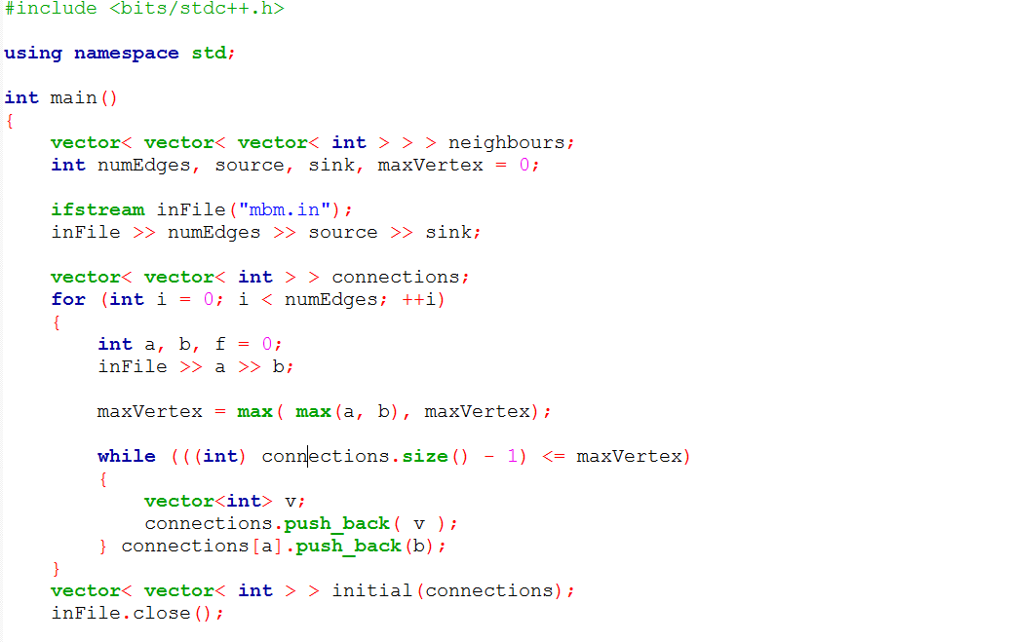
Code: Input and initialisation

Slide 23
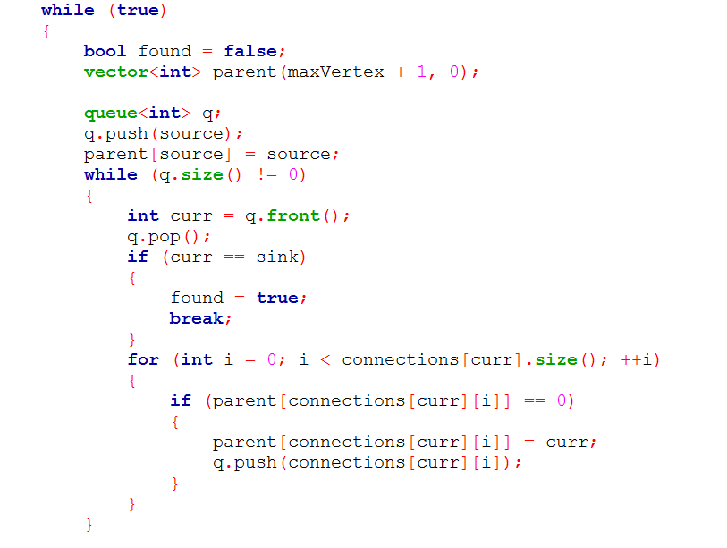
Code: BFS

Slide 24
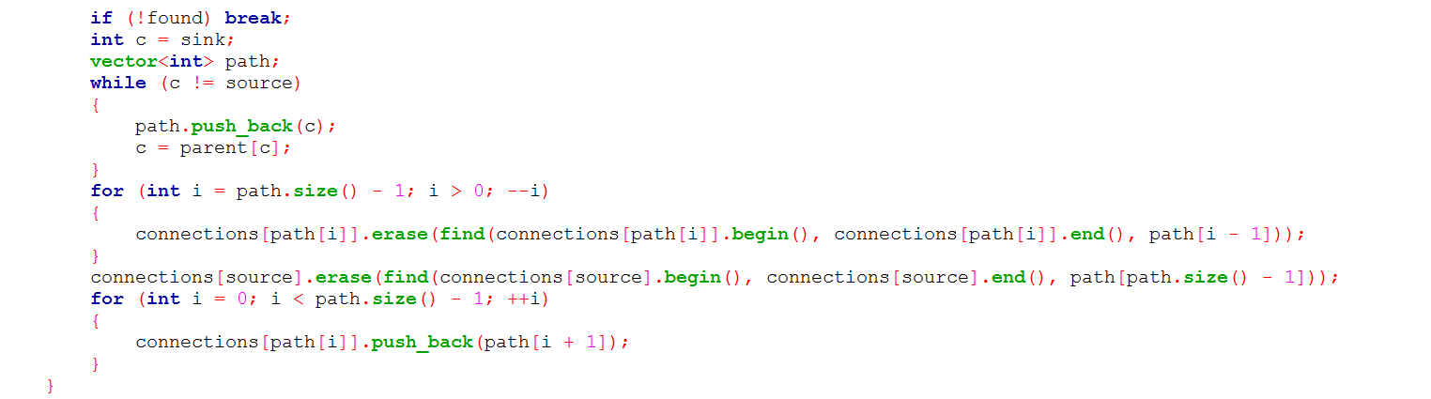
Code: Path Reversal

Slide 25
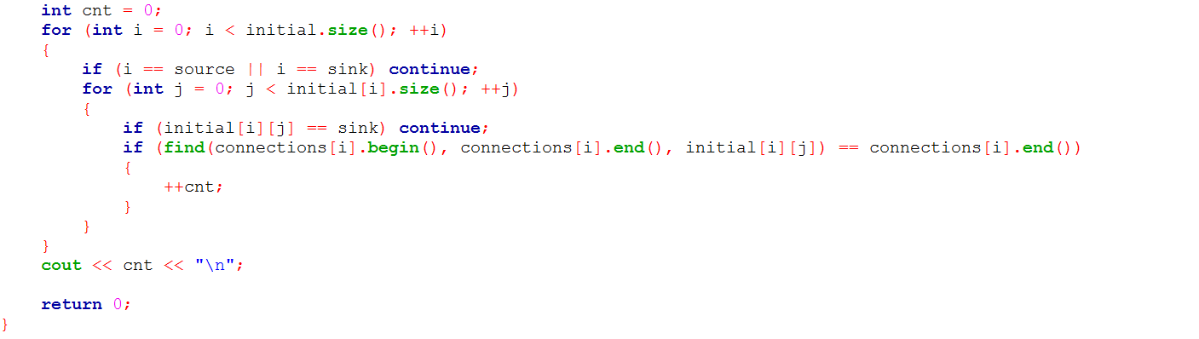
Code: Output

Slide 26
Analysis
The BFS runs in O(E) time
The BFS will run at most V times since the number of edges going to the sink is at most V and decreases by 1 every iteration
Therefore this algorithm runs in O(VE)

