Slide 1

CHECKIN
Hotel Operating System
तुमच्या हॉटेलचा विश्वासू डिजिटल सहकारी
PROJECT आरंभ

Slide 2
आज मी इथे
सॉफ्टवेअर विकायला आलो नाही.
मी तुमच्यासारखाच
एक हॉटेल मालक आहे.

Slide 3
प्रत्येक सकाळ अशीच सुरू होते...
फोन, WhatsApp, बुकिंग, गेस्ट, स्टाफ, पेमेंट्स आणि रिसेप्शनचा गोंधळ
Phone
WhatsApp
Calls and follow-ups
Booking messages
Register
Guests
Manual writing
ID and room details

Slide 4
आपण
हॉटेल चालवतो...
की
फक्त व्यवस्थापन सांभाळतो?

Slide 5
माझा प्रवास
जहाजांवरून हॉटेलपर्यंत
Ship
↓
Hotel
↓
Checkin
व्यापारी जहाजांवर मुख्य अभियंता म्हणून शिकलो...`r`nमोठा व्यवसाय चालवायचा असेल तर प्रणाली लागते.

Slide 6
CHECKIN
Hotel Operating System
आठवणींवर नाही...`r`nप्रणालीवर विश्वास.

Slide 7
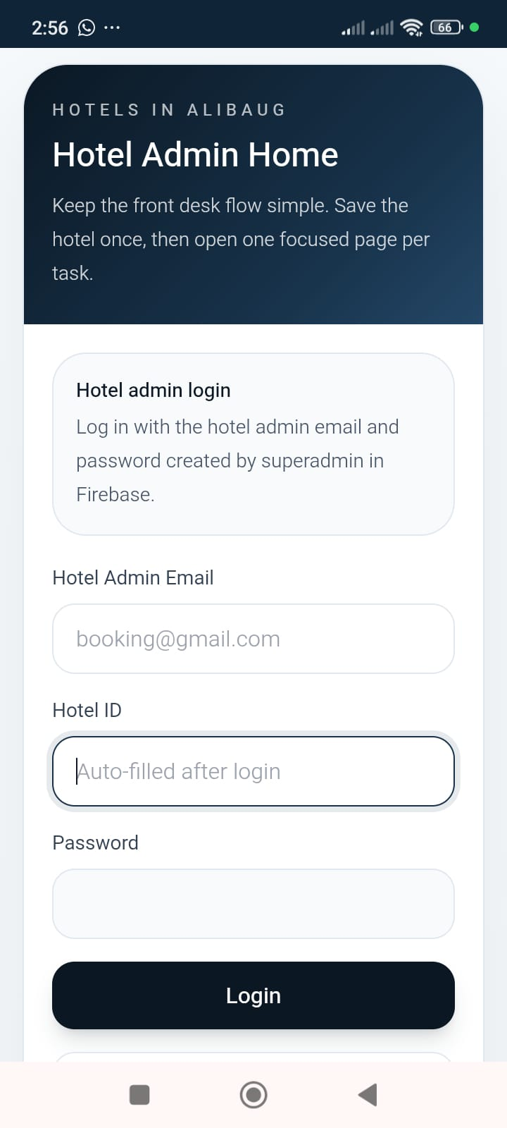
Hotel Admin Login
Secure access for each hotel
• Secure login
• Hotel-specific access
• Cloud based
• Simple to use

Slide 8
एका नजरेत संपूर्ण हॉटेल
Dashboard that shows the operational picture
• Today's check-ins
• Occupancy
• Current guests
• Reports snapshot

Slide 9
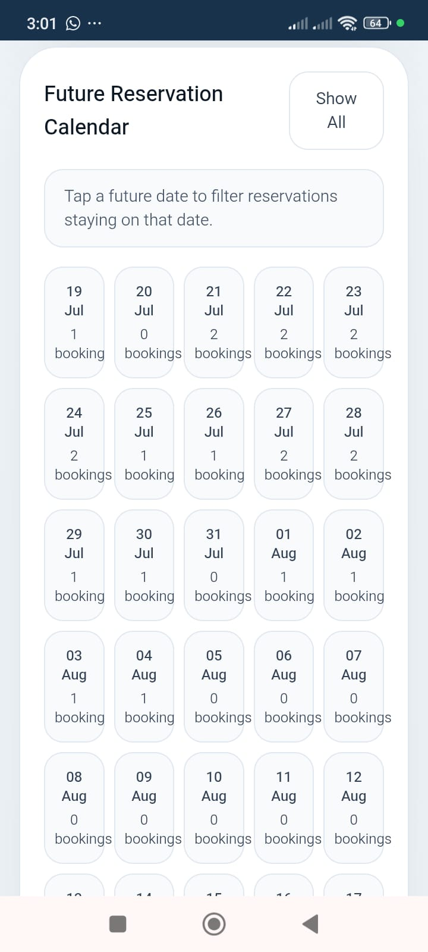
Booking मधील गोंधळ संपला.
Future reservation calendar
• Future planning
• Occupancy visibility
• Availability tracking
• Reservation timeline

Slide 10
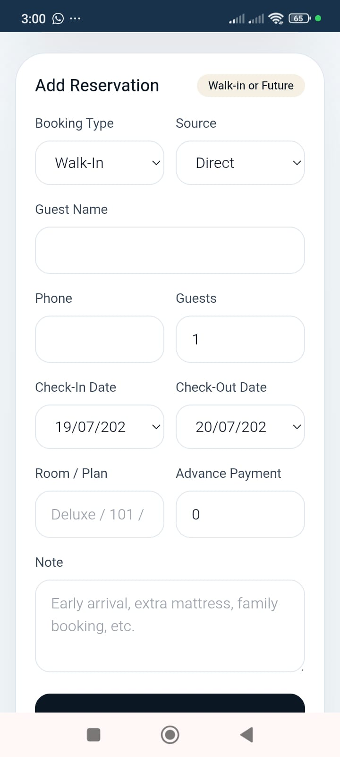
Booking in less than 1 minute
Quick reservation entry workflow
• Walk-in bookings
• Future reservations
• Advance payment notes
• Room allocation

Slide 11
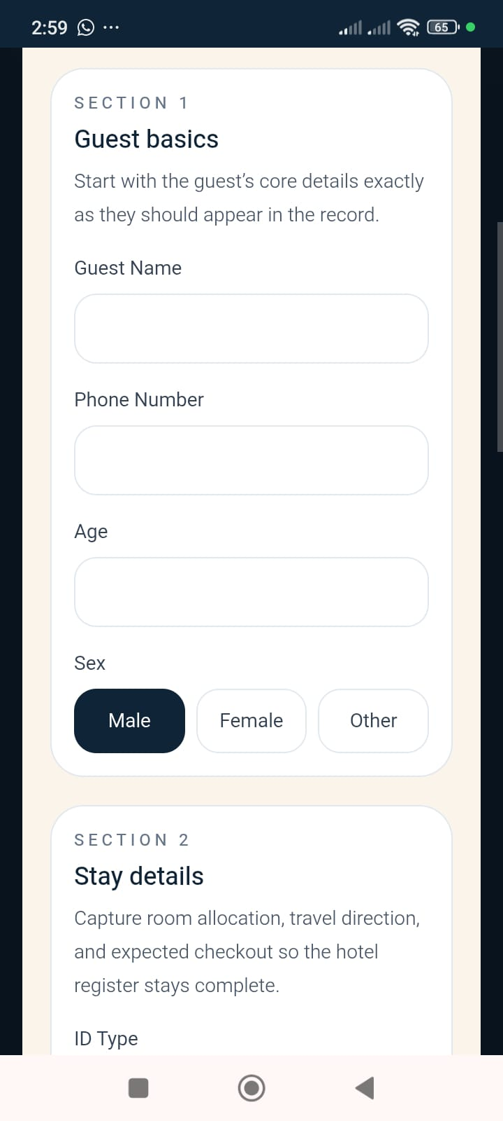
Guest Registration
Structured digital government-ready register
• Guest details
• ID proof
• Travel details
• Stay details
• Room allocation

Slide 12
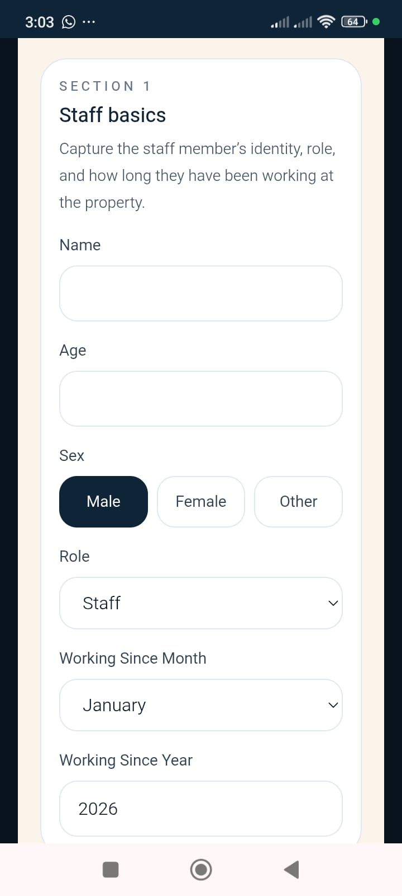
Staff Register
Identity, role and joining records
• Staff records
• Identity proof
• Joining date
• Role and contact

Slide 13
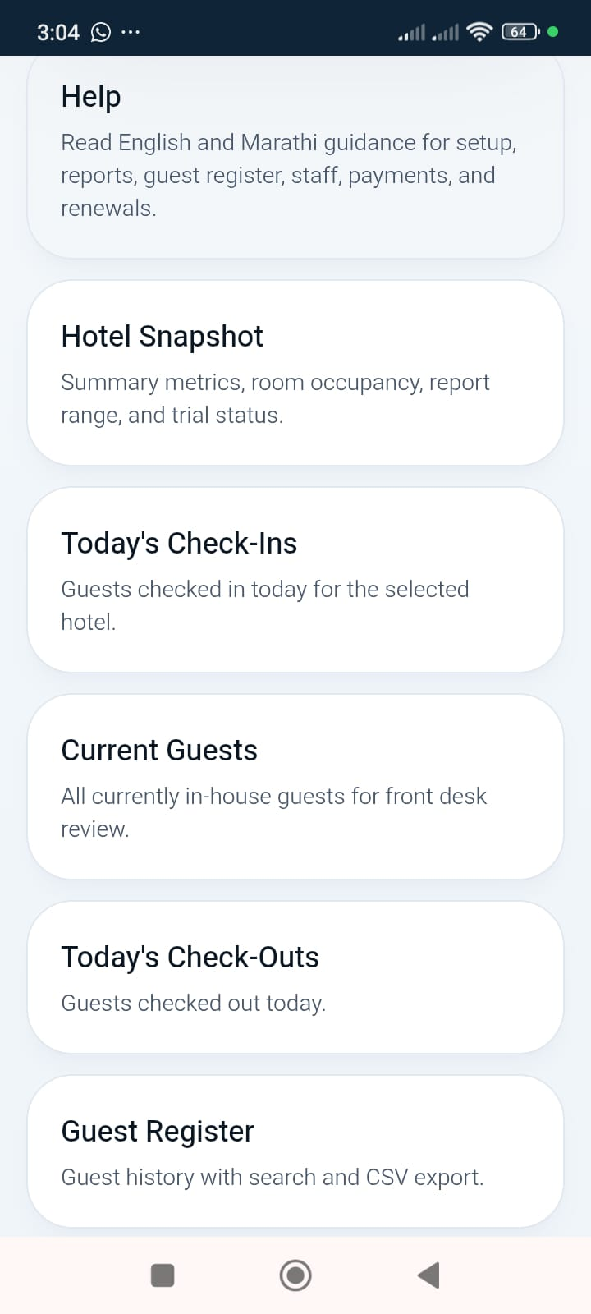
निर्णय अंदाजावर नाही... माहितीवर घ्या.
Reports for current guests and hotel activity
• Current guest list
• Guest register
• Operational summaries
• Searchable reports

Slide 14
Guest Journey
From reservation to reports
Reservation
↓
Arrival
↓
Check-in
↓
Stay
↓
Checkout
↓
Reports

Slide 15
Main Benefits
What hotels feel from day one
Save Time
Reduce Mistakes
Digital Register
Quick Search
Faster front desk
Structured data
No paper chasing
Find records fast

Slide 16
Paper Register vs Checkin
Old process compared with a structured system
Paper Register
Checkin
• Slow writing
• Hard to search
• Manual confusion
• Scattered records
• Fast digital entry
• Quick search
• Structured workflow
• Ready reports

Slide 17
Reservation Workflow
Simple operational flow for the hotel
Guest
↓
Reservation
↓
Room
↓
Check-in
↓
Checkout
↓
Reports

Slide 18
Real Benefits at Reception
Less calls. Less confusion. Less errors.
Less Calls
Less Confusion
Less Errors
Owners get fewer repeated follow-ups
Bookings and guests stay organized
Structured entry reduces mistakes

Slide 19
Hotel Snapshot
The owner sees the business at a glance
Occupancy
Guests
Reports
Current room status
Active and historical
Decision-ready information
Discipline
Systematic hotel operations

Slide 20
Professional Reports
Search, filter and export
• Professional report pages
• CSV export
• Fast search
• Daily operational review

Slide 21
Speed
Everything within one minute
Reservation, guest entry, QR generation, and report access are designed to be quick enough for real reception work.

Slide 22
Simple Interface
Few clicks. Large controls. Mobile-friendly use.

Slide 23
Security
Cloud, backups and role-based control
• Cloud-based access
• Hotel-owned Google Drive storage
• Role-based access
• Controlled police-ready review

Slide 24
Works Anywhere
Mobile, tablet and desktop
Mobile
Tablet
Desktop
Reception friendly
Desk use
Office use

Slide 25
Support
English, Marathi, Phone and WhatsApp
• English support
• Marathi support
• Phone guidance
• WhatsApp assistance
Support that hotel owners can actually use.

Slide 26
Who is it for?
Made for hospitality businesses
Hotels
Resorts
Homestays
Daily guest operations
Structured front desk
Simple digital records
Lodges
Villas
Fast check-in
Property-wise control

Slide 27
Why Choose Checkin?
Built to be practical, affordable and reliable
• Easy to understand
• Affordable room-wise pricing
• Reliable workflow
• Built by a hotel owner

Slide 28
Start Free Trial
Book demo and see the system in action
• Free trial till 31 October 2026
• Charges apply from 1 November 2026
• Live demo available
• QR placeholder for brochure or meeting use
QR Placeholder

Slide 29
Contact
Let us show how Checkin can fit your hotel
CHECKIN
WhatsApp
+91 72089 93899
Email
checkin.hotelsinalibaug@gmail.com

Slide 30
तुम्ही पाहुण्यांची काळजी घ्या...
व्यवस्थापनाची काळजी
CHECKIN
घेईल.

