Slide 1

Hotels In Alibaug Guest Check-In App
2-minute demo presentation for hotels, resorts, lodges, and homestays

Slide 2
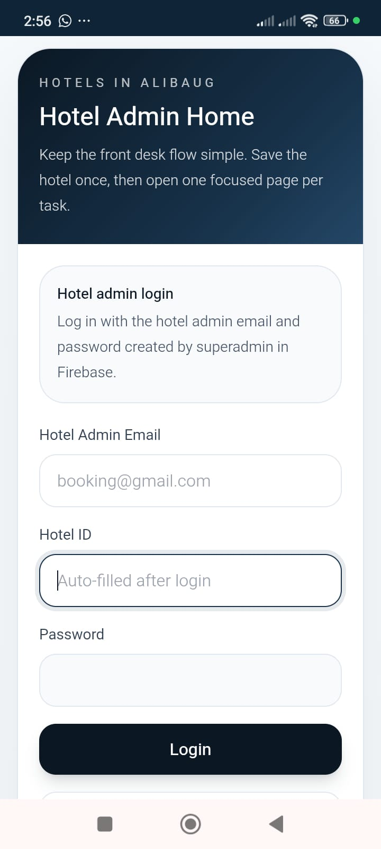
1. One Private Hotel Dashboard
• Hotel operations from one mobile-friendly main page
• Open profile, guest QR, staff, bookings, reports, and alerts
• Built for practical front-desk use

Slide 3
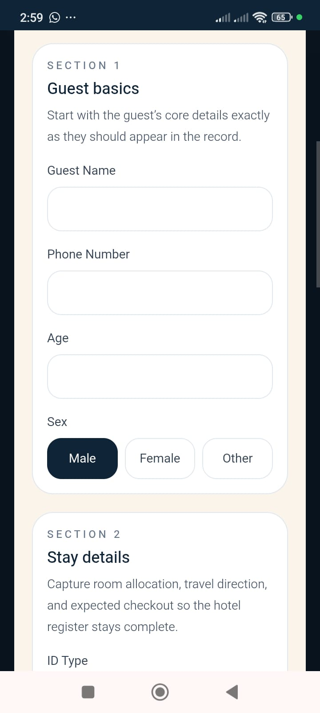
2. QR Guest Self Check-In
• Reception can generate a guest QR code
• Guests fill details on their own phone
• Reduces manual writing and saves time

Slide 4
3. Family Room Entry
• One room can include the main guest plus family members
• Structured ID proof capture for each member
• Practical for real family bookings

Slide 5
4. Hotel-Owned Google Drive Proof Storage
• Proof images stay in the hotel's connected Google Drive
• Records remain hotel-owned
• Police and superadmin review happens through controlled in-app access

Slide 6
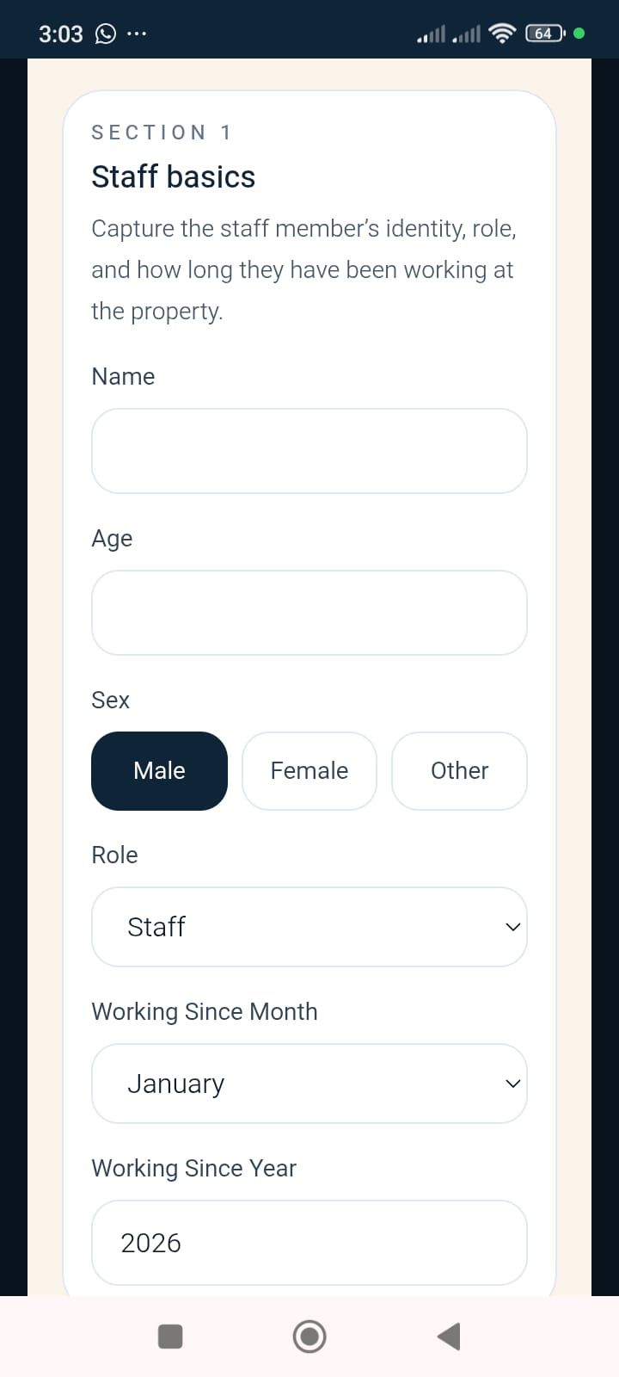
5. Digital Staff Register
• Store staff details, roles, contacts, and proofs
• Edit and manage records from mobile
• Useful for audits and day-to-day hotel administration

Slide 7
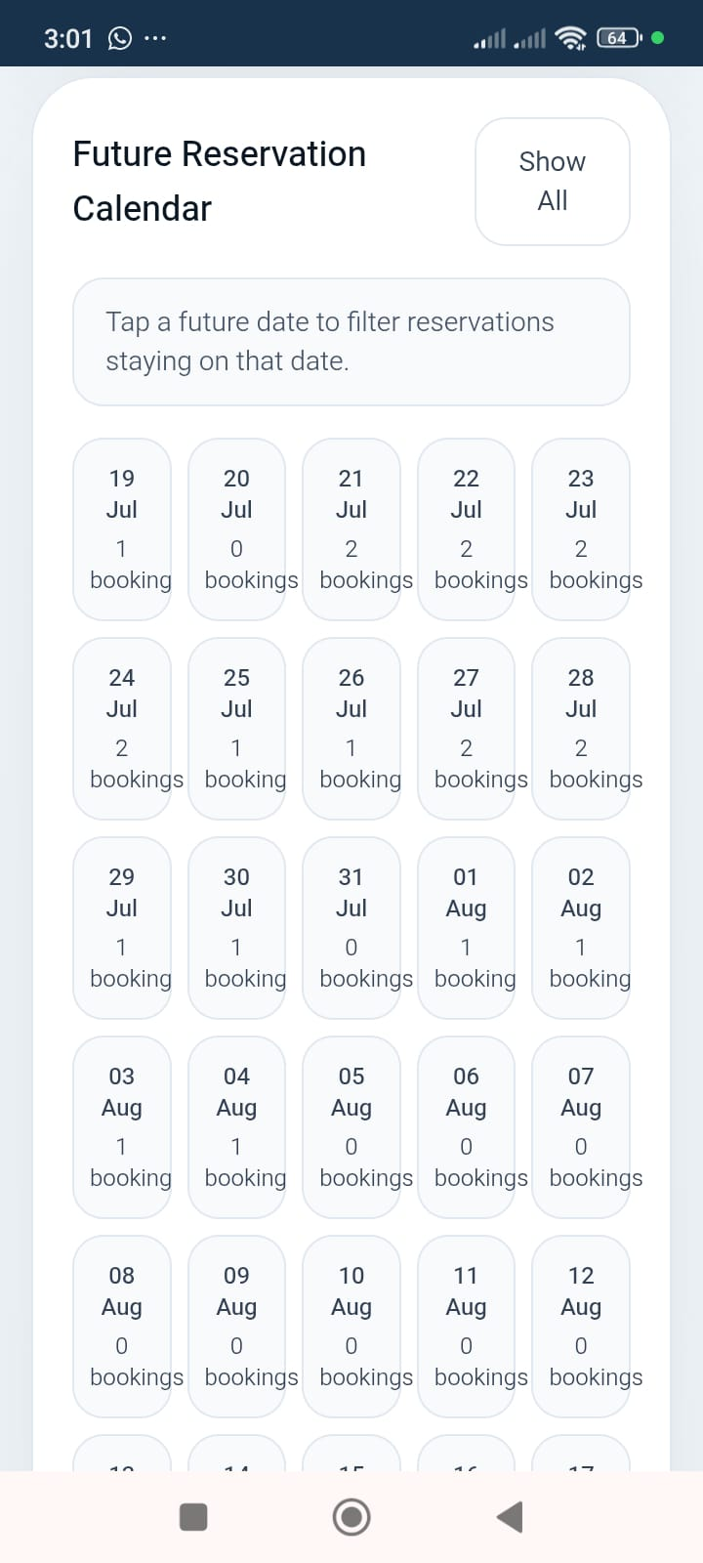
6. Future Reservation Calendar
• Track upcoming bookings clearly
• See stay dates and occupancy plan ahead
• Useful for reception and owner planning

Slide 8
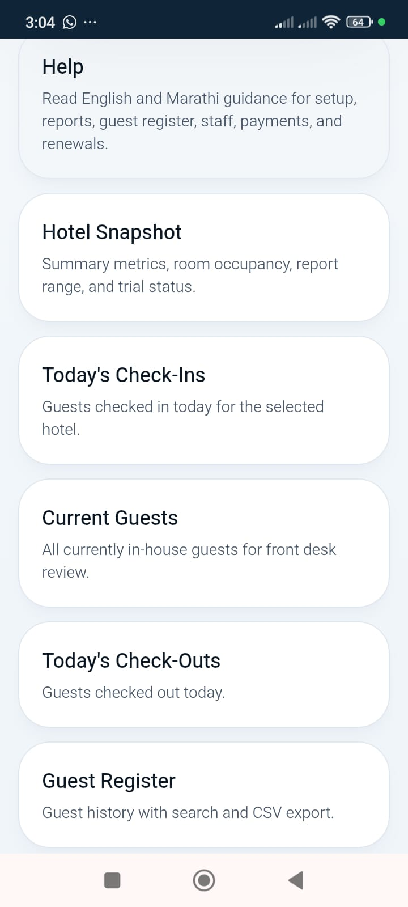
7. Reports for Daily Operations
• Current guests, guest register, occupancy, and summaries
• Structured reports instead of paper searching
• Hotel owner gets ready visibility instantly

Slide 9
8. Controlled Police-Ready Access
• Police users get structured in-app access
• Faster review when guest data is required
• No open browsing of hotel proof storage

Slide 10
Pricing and Trial Offer
Monthly Plan
Annual Plan
Free Trial
Rs. 10
Rs. 100
Till 31 October 2026
Per room per month
Per room per year
Charges apply from 1 November 2026
Secure hotel-owned records. Controlled police-ready access. Mobile-friendly daily hotel workflow.

Slide 11
9. Closing Message
• Free trial till 31 October 2026
• Monthly: Rs. 10 per room
• Annual: Rs. 100 per room
• Contact Hotels In Alibaug for live demo and onboarding
Contact
WhatsApp
+91 72089 93899
Email
checkin.hotelsinalibaug@gmail.com

