Slide 1


CHECKIN / HOTEL OPERATING SYSTEM
01 / 12

Slide 2
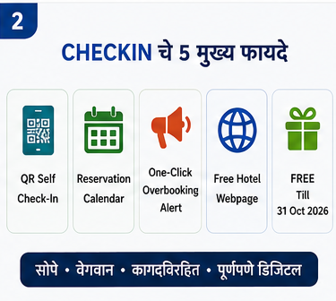
CHECKIN / HOTEL OPERATING SYSTEM
02 / 12

Slide 3
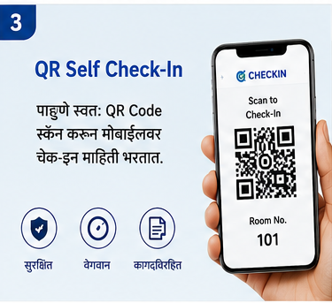
CHECKIN / HOTEL OPERATING SYSTEM
03 / 12

Slide 4
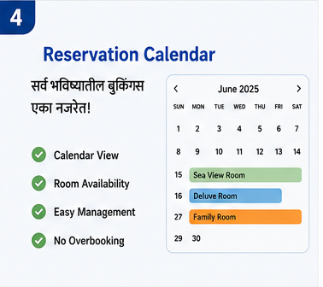
CHECKIN / HOTEL OPERATING SYSTEM
04 / 12

Slide 5
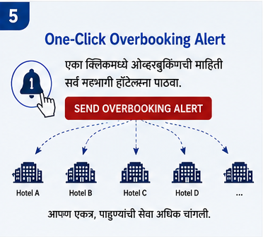
CHECKIN / HOTEL OPERATING SYSTEM
05 / 12

Slide 6

CHECKIN / HOTEL OPERATING SYSTEM
06 / 12

Slide 7
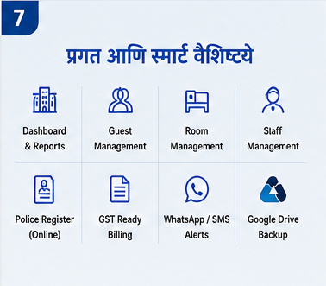
CHECKIN / HOTEL OPERATING SYSTEM
07 / 12

Slide 8
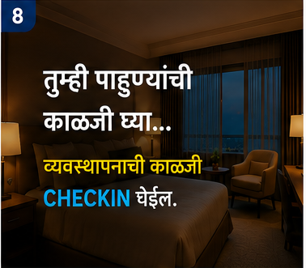
CHECKIN / HOTEL OPERATING SYSTEM
08 / 12

Slide 9

CHECKIN / HOTEL OPERATING SYSTEM
09 / 12

Slide 10

CHECKIN / HOTEL OPERATING SYSTEM
10 / 12

Slide 11
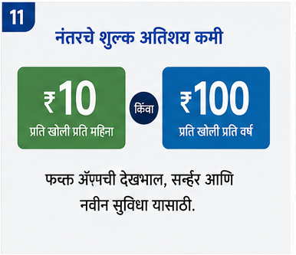
CHECKIN / HOTEL OPERATING SYSTEM
11 / 12

Slide 12

CHECKIN / HOTEL OPERATING SYSTEM
12 / 12

