Slide 1
字 / 表 / 圖
egg

Slide 2
目錄
1
2
3
4
字
表
圖
結論
TeX system, developed by Donald E. Knuth at the end of the 1970s, is another widespread and powerful automated typesetting system that has set high standards, especially for typesetting mathematics.

Slide 3
1
字
PART 01
words

Slide 4
2
表
PART 02
tables

Slide 6
3
圖
PART 03
figures

Slide 7
4
結論
PART 04
conclusions

Slide 8
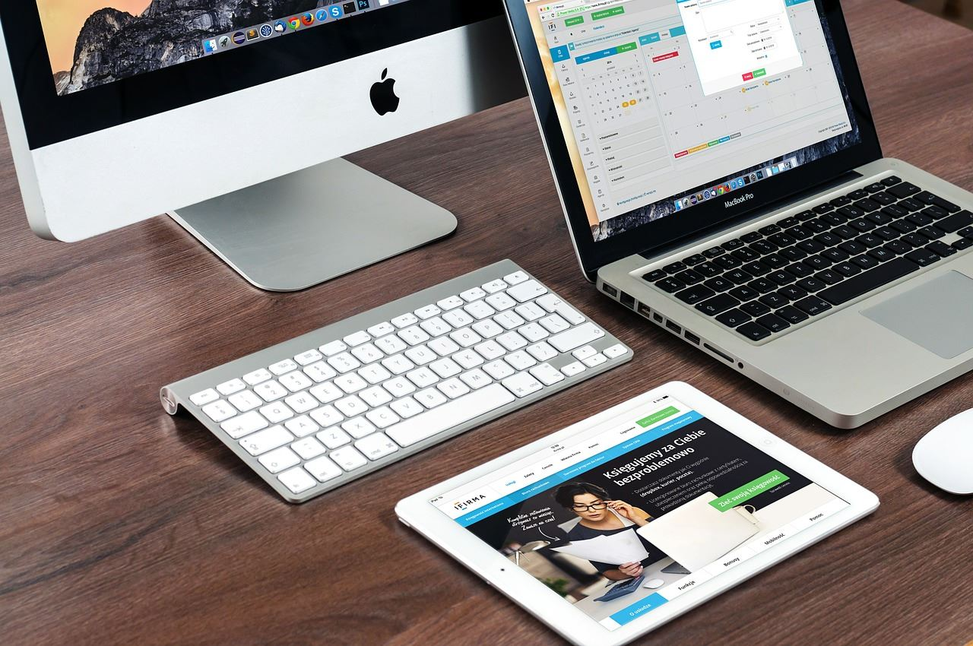
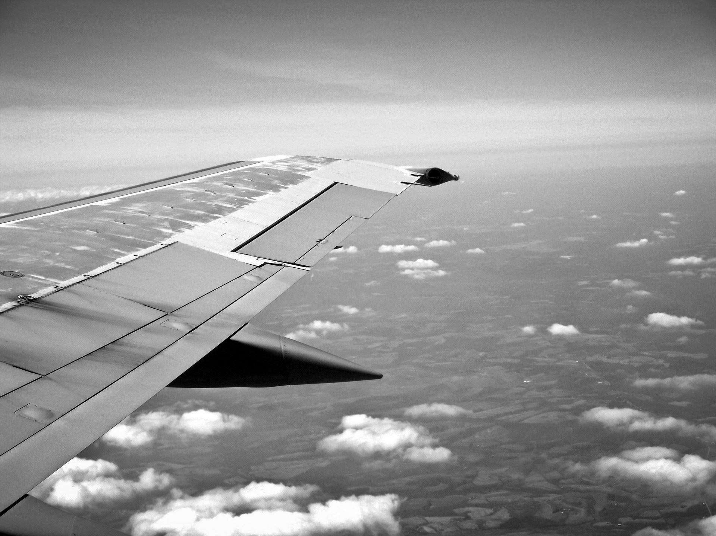
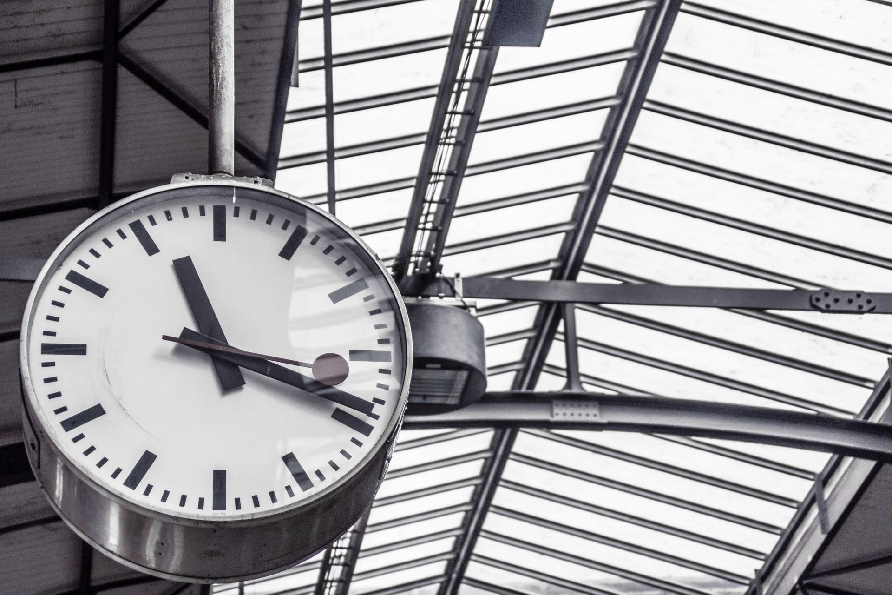

01
年度工作概述
print the presentation and make it into a film to be used in a wider field
标题文字添加
标题文字添加
The user can demonstrate on a projector or computer, or presentation and make it film to be used in a wider field
The user can demonstrate on a projector or computer, or presentation and make it film to be used in a wider field

Slide 9
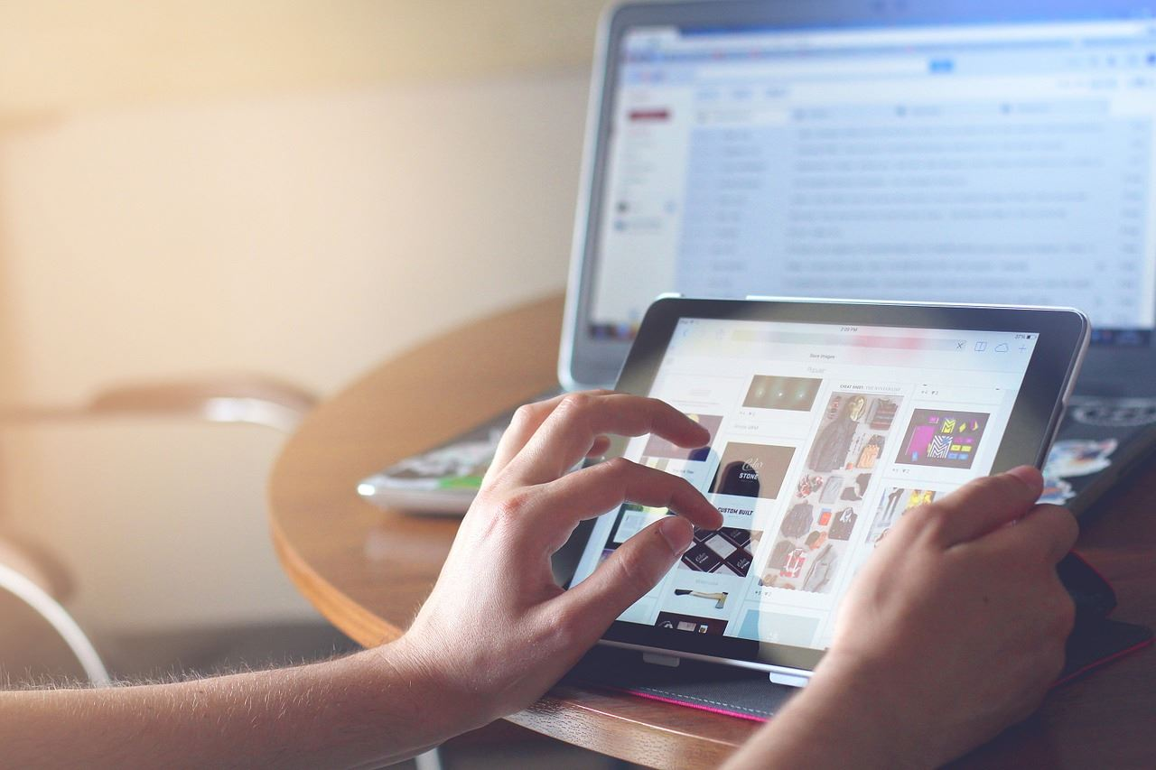
01
年度工作概述
print the presentation and make it into a film to be used in a wider field
标题文字添加
10%
25%
标题文字添加
The user can demonstrate on a projector or computerwider field
The user can demonstrate on a projector or computerwider field
标题文字添加
45%
70%
标题文字添加
The user can demonstrate on a projector or computerwider field
The user can demonstrate on a projector or computerwider field

Slide 10
01
年度工作概述
print the presentation and make it into a film to be used in a wider field
45%
文字添加
文字添加
The user can demonstrate on a projector or computer, or presentation and make it film to be used in a wider field
The user can demonstrate on a projector or computer, or presentation and make it film to be used in a wider field
65%
83%
文字添加
文字添加
78%
The user can demonstrate on a projector or computer, or presentation and make it film to be used in a wider field
The user can demonstrate on a projector or computer, or presentation and make it film to be used in a wider field

Slide 11
02
工作完成情况
print the presentation and make it into a film to be used in a wider field
年度工作概述
年度工作概述
年度工作概述
年度工作概述
1
2
3
4
The user can demonstrate on a projector or computer, or presentation and make it film to be used
The user can demonstrate on a projector or computer, or presentation and make it film to be used
The user can demonstrate on a projector or computer, or presentation and make it film to be used
The user can demonstrate on a projector or computer, or presentation and make it film to be used

Slide 12
02
工作完成情况
print the presentation and make it into a film to be used in a wider field
标题文本预设
标题文本预设
标题文本预设
标题文本预设
标题文本预设
标题文本预设
标题文本预设
标题文本预设
标题文本预设
标题文本预设
标题文本预设
标题文本预设
标题文本预设
标题文本预设
标题文本预设
标题文本预设
标题文本预设

Slide 13
02
工作完成情况
print the presentation and make it into a film to be used in a wider field
标题文字添加
标题文字添加
标题文字添加
The user can demonstrate on a projector or computer, or presentation wider field
The user can demonstrate on a projector or computer, or presentation wider field
The user can demonstrate on a projector or computer, or presentation wider field
2015
2016
2017
2018
2019
2020
标题文字添加
标题文字添加
标题文字添加
The user can demonstrate on a projector or computer, or presentation wider field
The user can demonstrate on a projector or computer, or presentation wider field
The user can demonstrate on a projector or computer, or presentation wider field

Slide 14
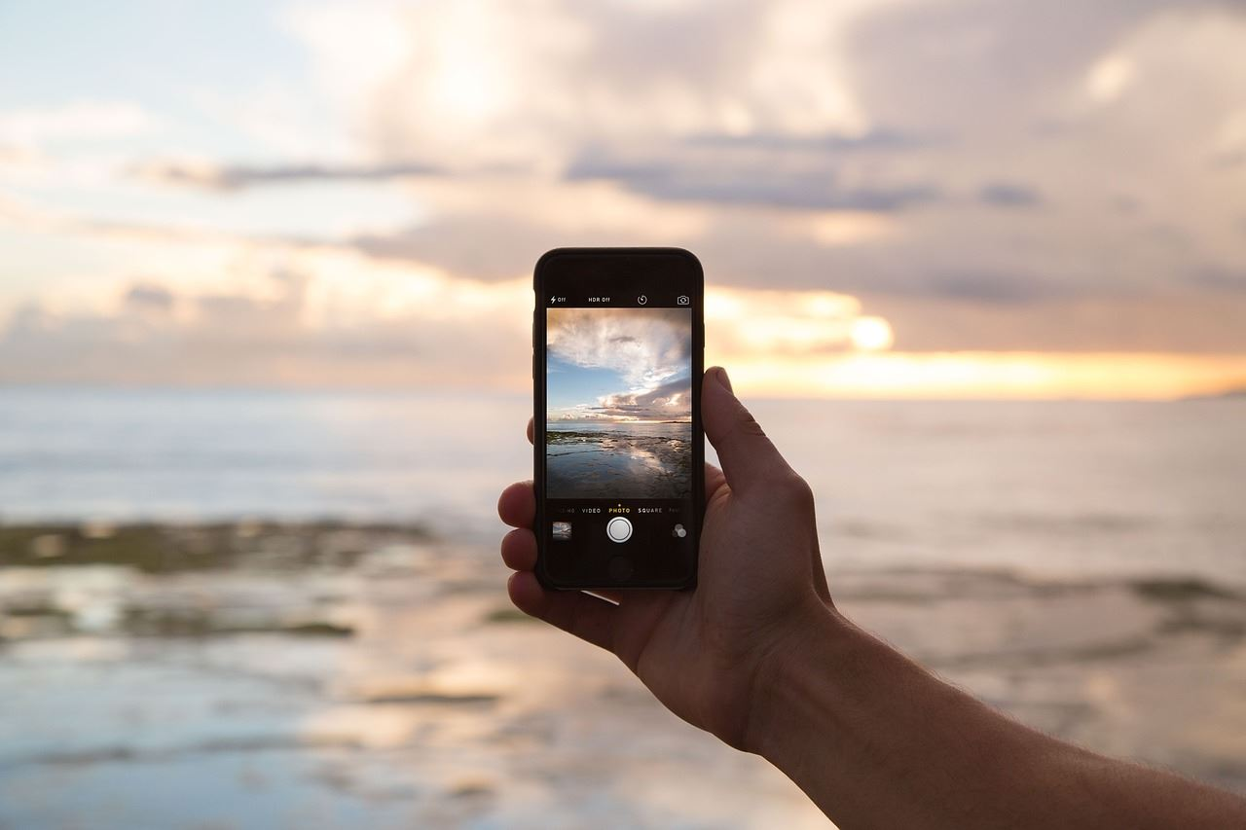
02
工作完成情况
print the presentation and make it into a film to be used in a wider field
标题文字添加
标题文字添加
标题文字添加
标题文字添加
presentation and make it film to be a wider field
presentation and make it film to be a wider field
presentation and make it film to be a wider field
presentation and make it film to be a wider field

Slide 15
02
工作完成情况
print the presentation and make it into a film to be used in a wider field
标题文字添加
标题文字添加
The user can demonstrate on a projector or computer, ilm to be used in a wider field
The user can demonstrate on a projector or computer, ilm to be used in a wider field
标题文字添加
标题文字添加
标题文字添加
The user can demonstrate on a projector or computer, ilm to be used in a wider field
The user can demonstrate on a projector or computer, ilm to be used in a wider field
The user can demonstrate on a projector or computer, ilm to be used in a wider field

Slide 16
3
工作存在不足
PART 03
print the presentation and make it into a film to be used in a wider field The user can demonstrate on a projector or computer

Slide 17
03
工作存在不足
print the presentation and make it into a film to be used in a wider field
标题文字添加
The user can demonstrate on a projector or computer, or presentation and make it film to be used in a wider field
标题文字添加
The user can demonstrate on a projector or computer, or presentation and make it film to be used in a wider field
标题文字添加
The user can demonstrate on a projector or computer, or presentation and make it film to be used in a wider field
标题文字添加
The user can demonstrate on a projector or computer, or presentation and make it film to be used in a wider field

Slide 18
03
工作存在不足
print the presentation and make it into a film to be used in a wider field
125,000
150,000
170,000
The user can demonstrate on a projector or computer, or presentation and make it film to be used in a wider field
The user can demonstrate on a projector or computer, or presentation and make it film to be used in a wider field
The user can demonstrate on a projector or computer, or presentation and make it film to be used in a wider field
标题文本预设
标题文本预设
标题文本预设

Slide 19
03
工作存在不足
print the presentation and make it into a film to be used in a wider field
标题文字添加
标题文字添加
The user can demonstrate on a projector or computer, or presentation and make it film to be used in a wider field
The user can demonstrate on a projector or computer, or presentation and make it film to be used in a wider field
标题文字添加
标题文字添加
The user can demonstrate on a projector or computer, or presentation and make it film to be used in a wider field
The user can demonstrate on a projector or computer, or presentation and make it film to be used in a wider field

Slide 20
03
工作存在不足
print the presentation and make it into a film to be used in a wider field
标题文字添加
标题文字添加
presentation and make it film to be used in a wider field
presentation and make it film to be used in a wider field
标题文字添加
标题文字添加
presentation and make it film to be used in a wider field
presentation and make it film to be used in a wider field
标题文字添加
标题文字添加
presentation and make it film to be used in a wider field
presentation and make it film to be used in a wider field

Slide 21
4
明年工作计划
PART 04
print the presentation and make it into a film to be used in a wider field The user can demonstrate on a projector or computer

Slide 22
04
明年工作计划
print the presentation and make it into a film to be used in a wider field
90%
presentation and make it film to be used in a wider field
标题文字添加
70%
presentation and make it film to be used in a wider field
标题文字添加
95%
presentation and make it film to be used in a wider field
标题文字添加
45%
presentation and make it film to be used in a wider field
标题文字添加
75%
presentation and make it film to be used in a wider field
标题文字添加

Slide 23
04
明年工作计划
print the presentation and make it into a film to be used in a wider field
文字添加
文字添加
文字添加
文字添加
文字添加
文字添加
文字添加
The user can demonstrate on a projector or computer, or presentation and make it film to be used in a wider field

Slide 24
04
明年工作计划
print the presentation and make it into a film to be used in a wider field
标题文字添加
标题文字添加
标题文字添加
标题文字添加
标题文字添加
The user can demonstrate on a projector or computer
The user can demonstrate on a projector or computer
The user can demonstrate on a projector or computer
The user can demonstrate on a projector or computer
The user can demonstrate on a projector or computer

Slide 25
04
明年工作计划
print the presentation and make it into a film to be used in a wider field
关键词
标题文本预设
1
2
3
4
5
6
7
8
9
10
11
12
13
14
15
16
17
18
19
20
21
关键词
关键词
关键词
关键词
标题文字添加
The user can demonstrate on a projector or computer, or presentation and make it film to be used in a wider field

Slide 26
# | 名次 | 姓名 | 個人資料 |  |  | 得票
 |  |  | 姓別 | 年齡 | 政黨 | 得票 | 得票率 | 凍蒜
1 | 5 | 吳萼洋 | 男 | 58 | 蜂蜜黨 | 5,617 | 0.40%
2 | 2 | 丁守中 | 男 | 62 | 國民黨 | 577,566 | 40.82%
3 | 3 | 姚文智 | 男 | 50 | 民進黨 | 244,641 | 17.29%
4 | 1 | 柯文哲 | 男 | 55 | 無 | 580,820 | 41.05% | ◎
5 | 4 | 李錫錕 | 男 | 60 | 無 | 6,172 | 0.44%

Slide 28
# | 名次 | 姓名 | 個人資料 |  |  | 得票
 |  |  | 姓別 | 年齡 | 政黨 | 得票 | 得票率 | 凍蒜
1 | 5 | 吳萼洋 | 男 | 58 | 蜂蜜黨 | 5,617 | 0.40%
2 | 2 | 丁守中 | 男 | 62 | 國民黨 | 577,566 | 40.82%
3 | 3 | 姚文智 | 男 | 50 | 民進黨 | 244,641 | 17.29%
4 | 1 | 柯文哲 | 男 | 55 | 無 | 580,820 | 41.05% | ◎
5 | 4 | 李錫錕 | 男 | 60 | 無 | 6,172 | 0.44%

Slide 29
# | 名次 | 姓名 | 個人資料 |  |  | 得票
 |  |  | 姓別 | 年齡 | 政黨 | 得票 | 得票率 | 凍蒜
1 | 5 | 吳萼洋 | 男 | 58 | 蜂蜜黨 | 5,617 | 0.40%
2 | 2 | 丁守中 | 男 | 62 | 國民黨 | 577,566 | 40.82%
3 | 3 | 姚文智 | 男 | 50 | 民進黨 | 244,641 | 17.29%
4 | 1 | 柯文哲 | 男 | 55 | 無 | 580,820 | 41.05% | ◎
5 | 4 | 李錫錕 | 男 | 60 | 無 | 6,172 | 0.44%

