Slide 1
Customer-Retention Project

Slide 2
Exploratory Data Analysis

Slide 3
Steps
Importing the libraries needed for my project
Loading the dataset/Creating my dataframe
Checking the head of the dataset(first five rows)
Checking the shape of the dataset, there are 71 columns where we have to work upon.
Checking the datatypes
Checking for null values if any
These data analysis steps help us to get an overview of our dataset and also help us in our preprocessing of our data.

Slide 4
Preprocessing of the data

Slide 5
Steps and Description
I have renamed almost all the columns of the dataset and minimise the lengthy names of the columns.
I have checked the value counts of all the columns to get some valuable information.
In the dataset ,almost all the columns are object type ,so I have used Label Encoder to encode those columns.
For data visualization, I have used histogram .

Slide 6
Observation
When I started analysing my data, I have observed that my data is all about Indian online shoppers and customer satisfaction.
I have observed that most of the columns are object type, which needs to be encoded so that machine can process it .
As columns are of object type, there is no need for outliers removal. We generally go for outliers removal for continuous type data.
I also observed that among all the online shopping websites ,amazon.in is considered best among the customers in many aspects.

Slide 7
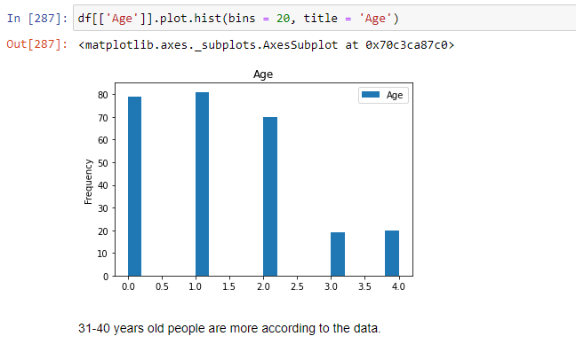
Some more preprocessing steps
Some visualization is done using histogram. I have attached some of the screenshots.

Slide 8
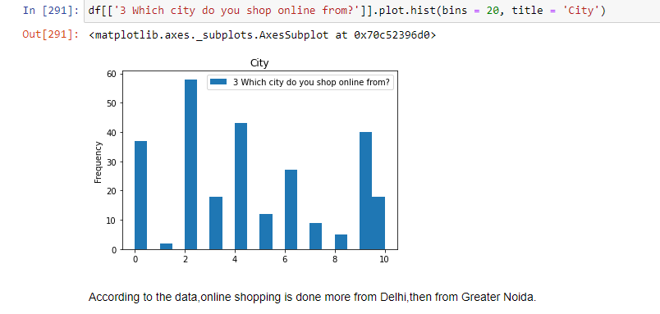
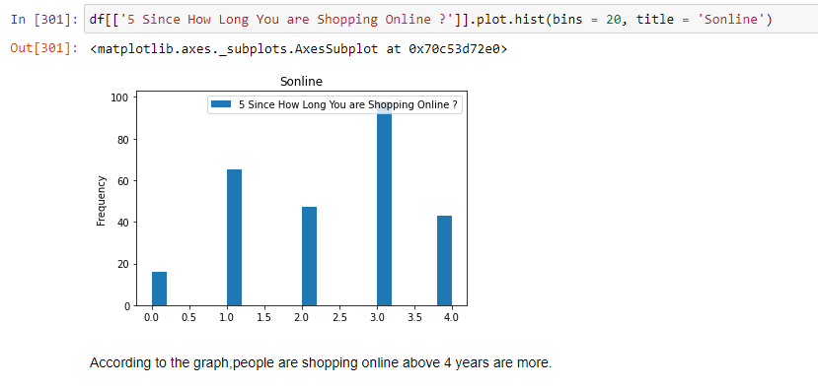

Slide 9
Preprocessing (contd…)
At the end of the preprocessing, I have checked the renamed columns again.
I have found amazon.in the most recommended Indian online retailer.

