Slide 1
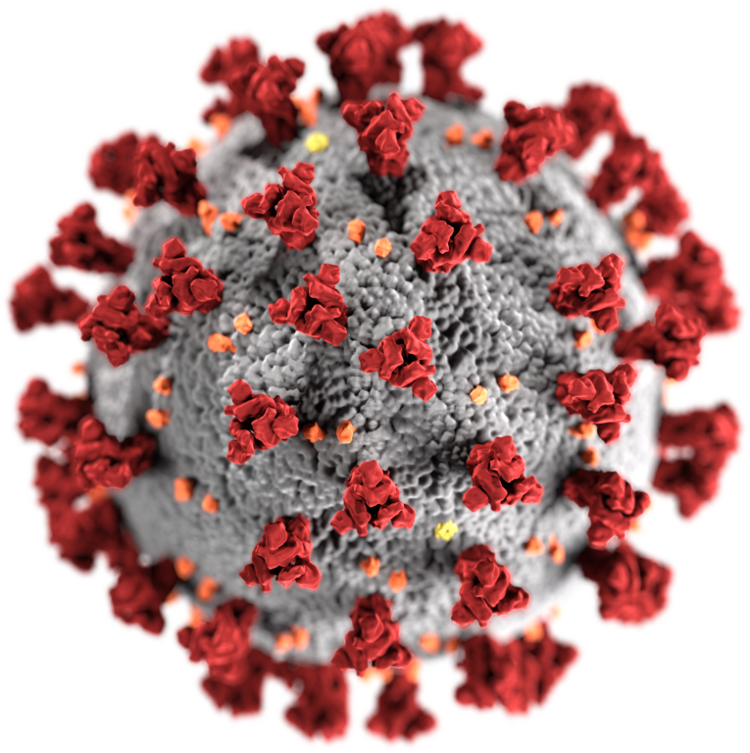











Covid – 19 : Vaccines Tweets Globally(Real Time Processing)

