Slide 1
How to Meet the Pass Criteria
You have already been supplied with the criteria you need to meet in order to achieve a pass on the main assignment.
The objective of this talk is to go into slightly more detail on the ‘Pass Example’ that you saw demonstrated earlier in the course.
Note the following will be taken as read as it is assumed that everyone will be able to achieve this.
Acceptable program structure, code style, readability
Acceptable User Interface Design
Acceptable program execution, correctness and completeness

Slide 2
What Java classes may you need?
Character.java
This class should contain all the information that is pertinent to both Heroes and Villains
Hero.java
Store all the information pertinent to Heroes – extended from Character
Villian.java
Store all the information pertinent to Villains – extended from Character
Crime.java
All the information associated with Crimes
a string giving a description of the crime
a string giving the result of fighting the crime
how much energy needed to fight the crime
the ‘points’ scored for successfully fighting the crime (or points deducted for
ignoring the crime)

Slide 3
Status.java
An enum holding HERO,VILLIAN, etc
UISetup.java extended from Character
This will contain all the code associated with displaying the graphics
Frames
Progress Bars
Buttons
Layouts
Action Listeners
UITester.java – the main program which will set the game in motion

Slide 4
Character.java
Information that is relevant to both Heroes & Villains
name of character
what ‘type’ of character – hero, villain, etc
how much energy the character has available/used
an image of he hero/villain
The necessary methods that manipulate this information – basically the ‘setters’ and ‘getters’ and a constructor for initialisation

Slide 5
Hero.java & Villain.java
Information that is relevant just to a Hero or a Villain
an ArrayList of Crimes – just think these up for yourself
This will be a separate class
See the previous slides for the typical information that you may decide to store
You should generate the crimes randomly. So generate a random number
Random random = new Random();
Built in Java class
crimeList.get(random.nextInt(x));
Generate a random number between zero and the number of crimes that you have set up.
Name of your ArrayList

Slide 6
You can ‘prepare’ the screens that you need before they are actually needed and then whenever they are use them. Remember if you declare several JFrames such as
JFrame frame1 = new JFrame();
JFrame frame2 = new JFrame();
then you make frame1 visible by the statement
frame1.setVisible(true);
When you are ‘finished’ with this frame and want to make frame2 visible you would have
frame1.setVisible(false);
frame2.setVisible(true);

Slide 7
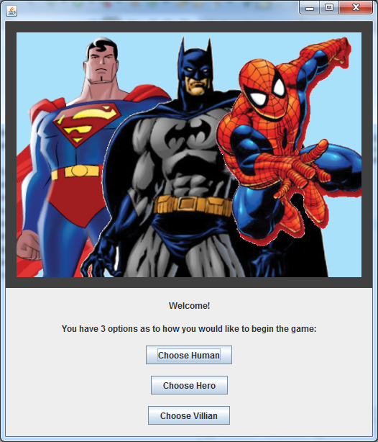
The initial screen
JLabel (containing an ImageIcon)
JLabel (containing text)
JButton

Slide 8
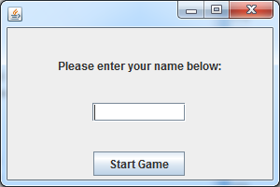
Whenever one of the options is chosen the previous window is ‘set invisible’ and the following window which should already have been ‘created’ is displayed
JLabel
JTextField
JButton
Whenever a name has been entered and the Start Game button pressed, this window is set to invisible and the appropriate window – Hero, Villain or Human is displayed.

Slide 9
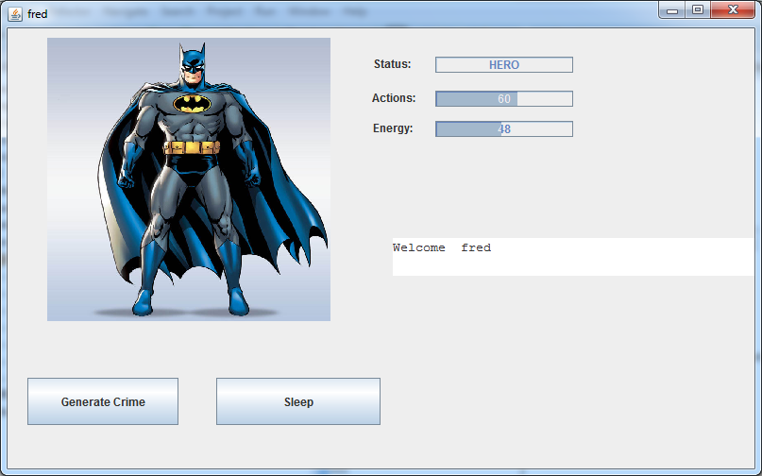
JProgressBar
JLabel
JTextArea
JButton

Slide 10
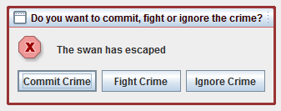
Clicking on the Generate Crime button results in the following being presented to a user.
JOptionPane
JButton
In the Hero and Villain classes there should be an ArrayList that stores the crimes. The crimes can be the same but the ‘cost’ of either committing a crime or fighting a crime will be different so that the Energy and Action progress bars keep increasing/decreasing.

Slide 11
For each JButton that you have in your program you will also need an ActionListener which is ‘invoked’ whenever the relevant button is pressed.
Also, if you do not do anything, the energy progress bar will keep decreasing – you will need a Timer to achieve this.
Similarly if crimes are continually ignored the action level should also decrease.

Slide 12
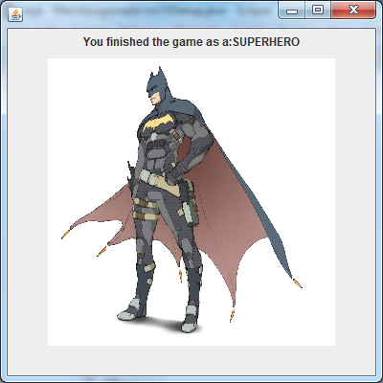
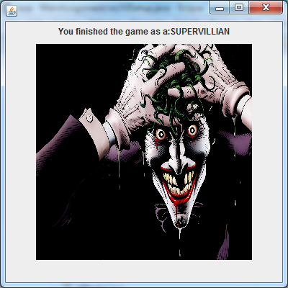
Whenever the energy level reaches zero the game will end and you can then display the relevant image
Again you can set these up in your program and set them visible whenever necessary – remembering to set the window previously displayed to invisible.

Slide 13
Probably the most ‘difficult’ aspect of this is deciding on the Layout Manager that you wish to use for each of the windows – you are not constrained to using the same layout manager for all of them.
For example whenever you finish the game you will display a graphic showing a super hero/villain so you could use just a simple FlowLayout for this.
JFrame gameOverWindow = new JFrame();
gameOverWindow.add(new JLabel(new ImageIcon("graphic to display")));
gameOverWindow.setLayout(new FlowLayout());
gameOverWindow.setSize(400,400);
gameOverWindow.pack();
gameOverWindow.setVisible(true);
Set window size
Remove ‘extra’ space
Make the JFrame visible

Slide 14
You should also study
CSC1011_SEM02_MAIN_ASSIGNMEMT_START_v2
which has been uploaded to QOL as this will give you a valuable starting point for your main assignment., especially with the structure of the ‘game’ program that you are required to write and the layout of the ‘game’, etc.

