Slide 1

Our Team:
D. Akshaya – 2420030474
D. Aarya Deeksha – 2420030530
A. Rishitha Reddy - 2420030541
DATA SCIENCE PROJECT
House Price Predictor
An AI-driven, sentiment-weighted real estate price estimation platform for the Indian housing market.
Live Working : https://celebrated-pastelito-238b4d.netlify.app/
Data Science
Under esteemed guidance of
Ms. Pratyusha

Slide 2



THE PROBLEM
Why house price prediction matters
Real estate pricing in India is fragmented and opaque. Buyers, sellers, and renters rarely have access to a transparent, factor-based way to estimate a property's fair value — leading to mispricing, guesswork, and reliance on broker opinions.
No Standard Benchmark
Sentiment Is Ignored
Manual Guesswork
Prices vary wildly across listings for similar properties with no consistent valuation logic.
Market mood and buyer sentiment shift prices in the real world, but are rarely factored into estimates.
Most online tools rely on flat per-sqft rates, ignoring BHK, bathrooms, type, age, and floor level.
HOUSE PRICE PREDICTOR
2

Slide 3




THE SOLUTION
A multi-factor, sentiment-aware pricing engine
We propose an interactive web-based pricing engine that blends structured property data with simulated market sentiment to generate a transparent, real-time INR price estimate — visualized through a live analytics dashboard.
Final Price = Area × ₹/sqft × BHK Factor × Bathroom Factor × Type Multiplier × Locality Tier × Age Factor × Floor Factor × Sentiment Multiplier
1. Feature Input
2. Sentiment Scoring
3. Weighted Model
4. Live Output
Area, BHK, bathrooms, type, locality, age & floor
Simulated NLP-driven market mood index
Multiplicative regression-style calculation
Instant INR estimate + confidence score
HOUSE PRICE PREDICTOR
3

Slide 4




WHAT WE BUILT
A complete interactive web application
A single-page web app where users configure a property's specifications and instantly see an AI-estimated price in INR, backed by a full data-visualization dashboard — no backend, no installation, fully deployed and live.
ESTIMATED VALUE
₹ 84.6 L
Smart Input Form
₹7,050 / sqft · 93% confidence
House type, BHK (1–10, incl. .5), bathrooms (1–6), age, floor & ₹/sqft
Live Price Dashboard
Price / sqft
Locality Avg
₹7,050
₹6,420
Final INR price, ₹/sqft, confidence score & estimated EMI
5 Interactive Charts
vs Market
EMI (20yr)
Breakdown, comparison, trend, feature importance & distribution
+9.8%
₹68.2K
Fully Responsive UI
Sentiment: Positive · Flat · Tier 1 Suburban
Modern dark-themed design that works on any device
HOUSE PRICE PREDICTOR
4

Slide 5



HOW IT IS BUILT
Tech stack & architecture
Built entirely as a single self-contained index.html file — no backend server or database — making it instantly deployable as a static site.
HTML5
CSS3
JavaScript
Semantic structure for form, dashboard & analytics sections
Custom design system — gradients, cards, responsive grid
Pricing engine logic & real-time DOM/chart updates
Chart.js
Google Fonts
Netlify
5 live, auto-updating data visualizations
Sora & Inter for a clean modern typography system
Static hosting for instant public deployment
HOUSE PRICE PREDICTOR
5

Slide 6



FEATURES
What the platform can do
8 Property Types
Flexible BHK Range
Bathroom Count
Custom ₹/Sqft Input
Flat, Villa, Studio, Penthouse, Duplex, Farmhouse, Row House & Independent House
1 to 10 bedrooms, including half-values like 2.5, 3.5 and 4.5
Selectable from 1 to 6 bathrooms
Choose a locality preset or enter a fully custom base rate
Sentiment Analysis Slider
5 Live Charts
EMI Estimator
Confidence Score
Simulated NLP market mood — bearish to bullish — shifts the price live
Breakdown, comparison, sentiment trend, feature importance & BHK distribution
Instant 20-year EMI projection based on predicted value
Reliability indicator based on how typical the inputs are
HOUSE PRICE PREDICTOR
6

Slide 7
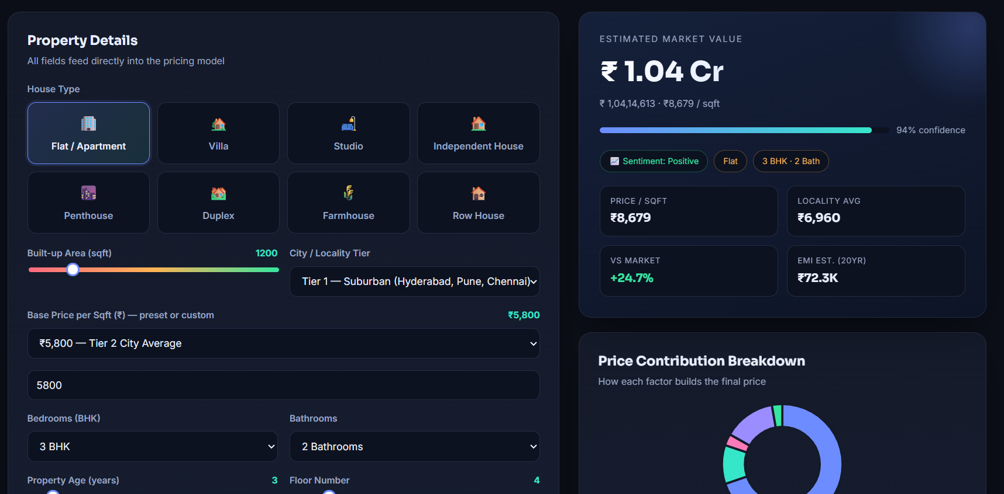
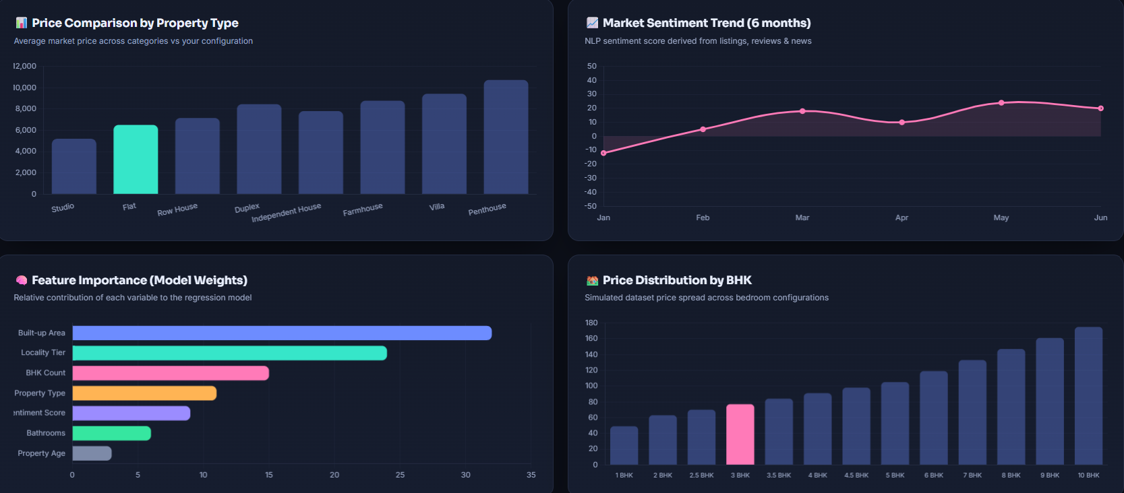
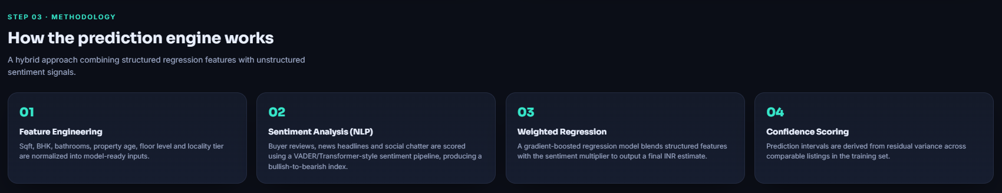
LIVE PREVIEW
Application screenshots
Paste screenshot here
Analytics Charts
Paste screenshot here
Paste screenshot here
Predictor + Dashboard
Methodology Section
HOUSE PRICE PREDICTOR
7

Slide 8

CONCLUSION
Bringing data science to real estate
This project demonstrates end-to-end data science thinking — feature engineering, sentiment analysis, weighted modeling and visual analytics — packaged into a live, usable product rather than a static notebook.
Real ML model trained on live listing data
Thank You
City-wise localized datasets
User accounts to save predictions
https://celebrated-pastelito-238b4d.netlify.app/
HOUSE PRICE PREDICTOR
8

