Slide 1


Customer Churn Management
SIC 801 Team 2
BD Course
Under Supervision : Eng Bassmala
Notes:
Note:

Slide 2

Agenda
Team
Introduction
Problem Statement
Methodology
Key Tasks
Results and Insights
Conclusion
Q&A
Notes:
Note:

Slide 3





Team Members
Youssef Khaled
Sara Mohamed
Ahmed Mohamed
Adham Mohamed
Data ingestion
Data Sourcing & Data Transformation & ML
Data Transformation & ML
Data Warehouse Modeling
Notes:
Note:

Slide 4
Agenda
Team
Introduction
Problem Statement
Methodology
Key Tasks
Results and Insights
Conclusion
Q&A
Notes:
Note:

Slide 5

Introduction
This project focuses on Customer Churn Analysis in the banking sector. It explores customer data to understand customer behavior, engagement, and interactions with banking products and services. The project brings together different sources of customer information, including customer profiles, product usage, support tickets, and banking offers, to provide a comprehensive view of each customer.

Slide 6
Agenda
Team
Introduction
Problem Statement
Key Tasks
Methodology
Results and Insights
Conclusion
Q&A
Notes:
Note:

Slide 7

Problem Statement
Banks can lose significant revenue and customer lifetime value when existing customers leave. The challenge is that customer data is often distributed across separate systems, such as customer profiles, product usage, marketing offers, and support interactions, making it difficult to have a unified view of customer behavior.
The goal of this project is to integrate these different data sources into a single Customer 360 view and analyze customer behavior to uncover the key factors and patterns associated with churn. This unified view will help the bank better understand who is more likely to churn and what behaviors or interactions are associated with their decision to leave.

Slide 8
Business Case
By understanding churn patterns, the bank can move from a reactive approach, where customers are addressed after they leave, to a more data-driven retention approach. The insights from the analysis can help identify high-risk customer segments, improve customer engagement, and support more targeted retention strategies.

Slide 9
Agenda
Team
Introduction
Problem Statement
Methodology
Key Tasks
Results and Insights
Conclusion
Q&A
Notes:
Note:

Slide 10
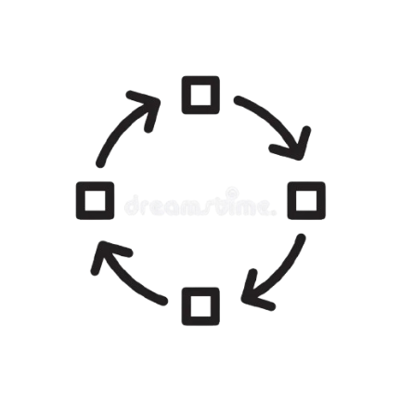
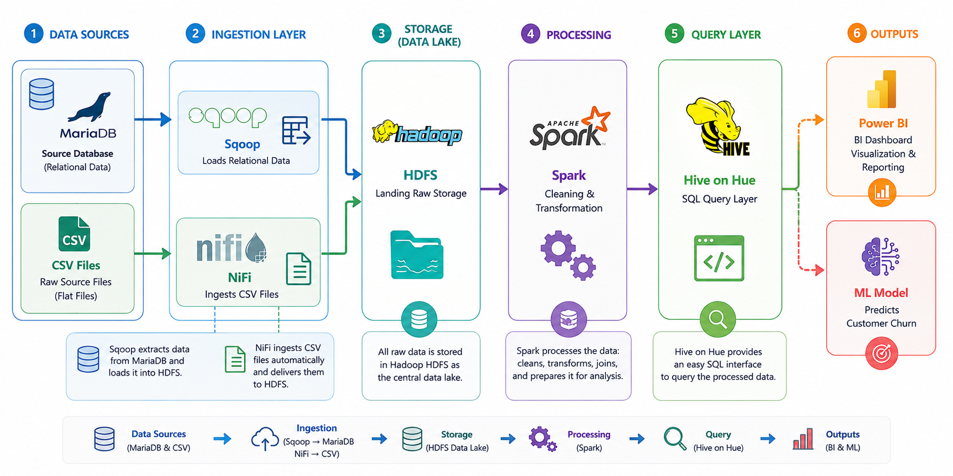
Methodology

Slide 11
Agenda
Team
Introduction
Problem Statement
Methodology
Key Tasks
Results and Insights
Conclusion
Q&A
Notes:
Note:

Slide 12

Key Tasks
Design the banking database schemaDesigned a relational schema in MariaDB with 3 related tables (Customer, Usage, Offers), defined primary/foreign keys to maintain referential integrity, and loaded the generated CSV datasets into MariaDB.
Ingest data into HDFS from two sourcesUsed Apache Sqoop to bulk-ingest the structured MariaDB tables into HDFS, and Apache NiFi to ingest the standalone CSV files, converting them to Parquet before landing them in HDFS.
Handle missing values based on business logicInstead of dropping or blindly filling nulls, applied business-aware rules with PySpark — example a missing ticket resolution time was treated as "still open" rather than an error and left as null
Clean illogical / invalid values Identified and corrected categorical values that didn't make business sense — inconsistent spellings and casing and out-of-range or contradictory entries — standardizing each column to a single consistent set of valid values.

Slide 13
Key Tasks
Standardize date formats Unified inconsistent date formats across all four tables (some stored as yyyy-MM-dd, others as yyyy/MM/dd) into a single consistent date type, enabling reliable time-based joins and analysis.
Design the dimensional data warehouse Modeled a star schema with Fact_Customer_Monthly_Activity as the central fact table (grain: one row per customer per month), connected to Dim_Customer and Dim_Date dimensions.
Build Hive tables and query via Hue Built the Hive DDLs on top of the cleaned/aggregated Spark output, making the warehouse queryable through Hue for both the BI layer and downstream analysis
Build the BI dashboard and ML modelUsed the curated warehouse tables to power a BI dashboard for reporting, and trained an ML model on the engineered features to predict/cluster customer churn.

Slide 14
Agenda
Team
Introduction
Problem Statement
Methodology
Key Tasks
Results and Insights
Conclusion
Q&A
Notes:
Note:

Slide 15

Results and Insights
Business Questions :
What customer behaviors are linked to higher churn?
Does customer support experience affect churn?
Are customers who engage more with offers less likely to churn?
Which customers have higher business value, and how does their churn rate compare?

Slide 16
Results and Insights
Business Questions :
What customer behaviors are linked to higher churn? Churned and non-churned customers show similar behavioral patterns, so these factors alone are not strong evidence of churn.
Does customer support experience affect churn? Medium support friction has the highest churn rate, while high friction does not show the highest churn in this dataset
Are customers who engage more with offers less likely to churn? Customers with high offer acceptance have the lowest churn rate, suggesting an association between offer engagement and better retention
Which customers have higher business value, and how does their churn rate compare? Higher-value customers show lower churn rates, but the High Value group contains only 4 customers, so this result should be interpreted cautiously

Slide 17

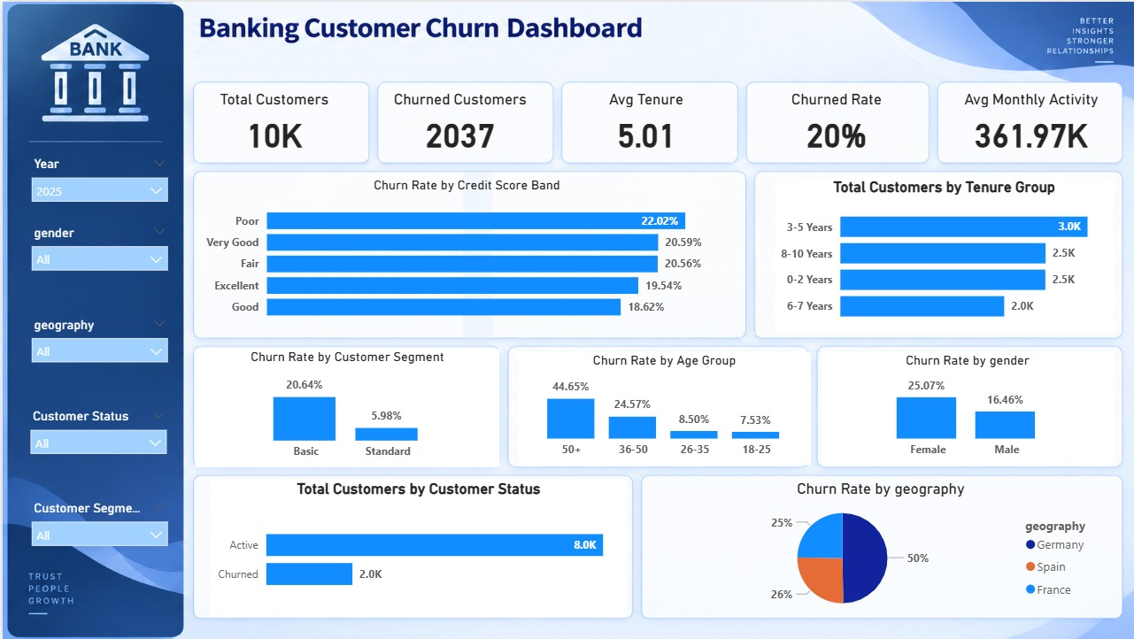
Dashboard

Slide 18

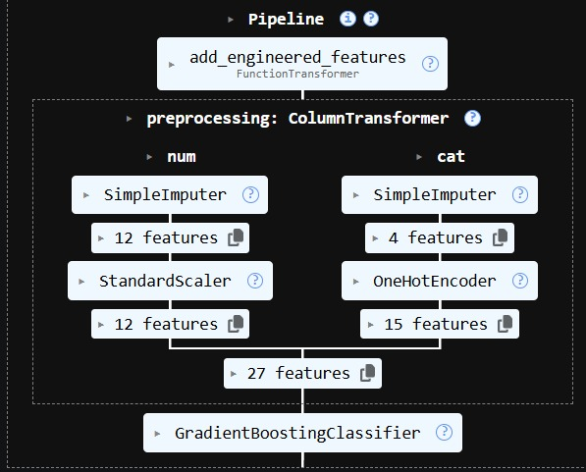
ML Model
ML Pipeline

Slide 19
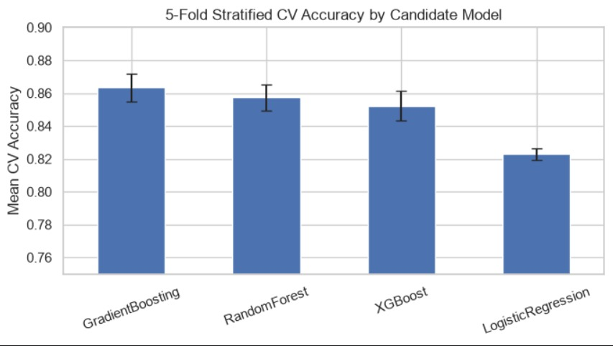
Model Comparison

Slide 20
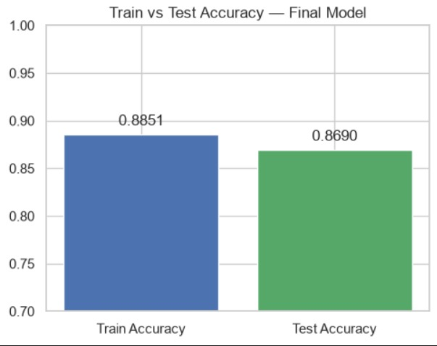
Model Accuracy

Slide 21
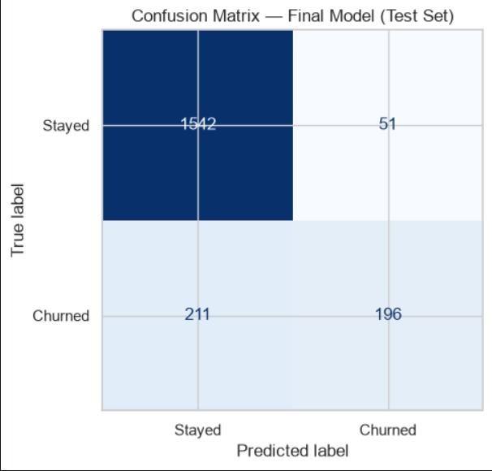
Confusion Matrix

Slide 22
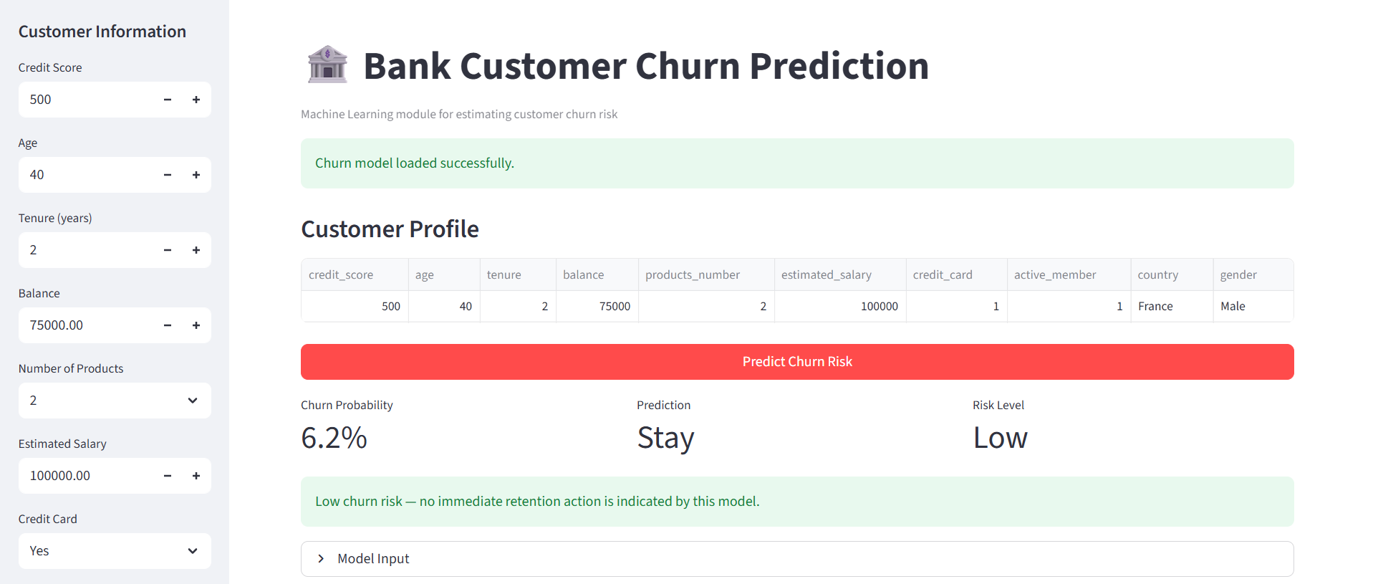
Model Deploy

Slide 23
Agenda
Team
Introduction
Problem Statement
Methodology
Key Tasks
Results and Insights
Conclusion
Q&A
Notes:
Note:

Slide 24

Conclusion
Customer churn remains a significant retention challenge, with 20.37% of customers having churned. The analysis shows that no single factor clearly explains churn. However, higher offer engagement is associated with lower churn, while support friction shows no simple direct relationship with churn. Higher-value customers also show lower churn rates, although this segment is very small. These findings can help the business improve retention by combining multiple customer signals, improving engagement, and prioritizing valuable customers.

Slide 25
Agenda
Team
Introduction
Problem Statement
Methodology
Key Tasks
Results and Insights
Conclusion
Q&A
Notes:
Note:

Slide 26

Q&A
Questions & Discussion
We’d be happy to answer any questions about the project, data pipeline, analysis, or business insight

Slide 27

Thank You

