Slide 1
Git Tutorial
Presented by
AMS Graduate Student Chapter
Rachel Domagalski

Slide 2
This Workshop Will Cover
Version Control
Basic Git
Basic GitHub and GitLab
Notes:
Lesson descriptions should be brief.

Slide 3
Version Control
Daily Workflow:
Create things
Save things
Edit things
Save again (the goal!)
When, why, how?
Track the history
Notes:
Example objectives
At the end of this lesson, you will be able to:
Save files to the team Web server.
Move files to different locations on the team Web server.
Share files on the team Web server.

Slide 4
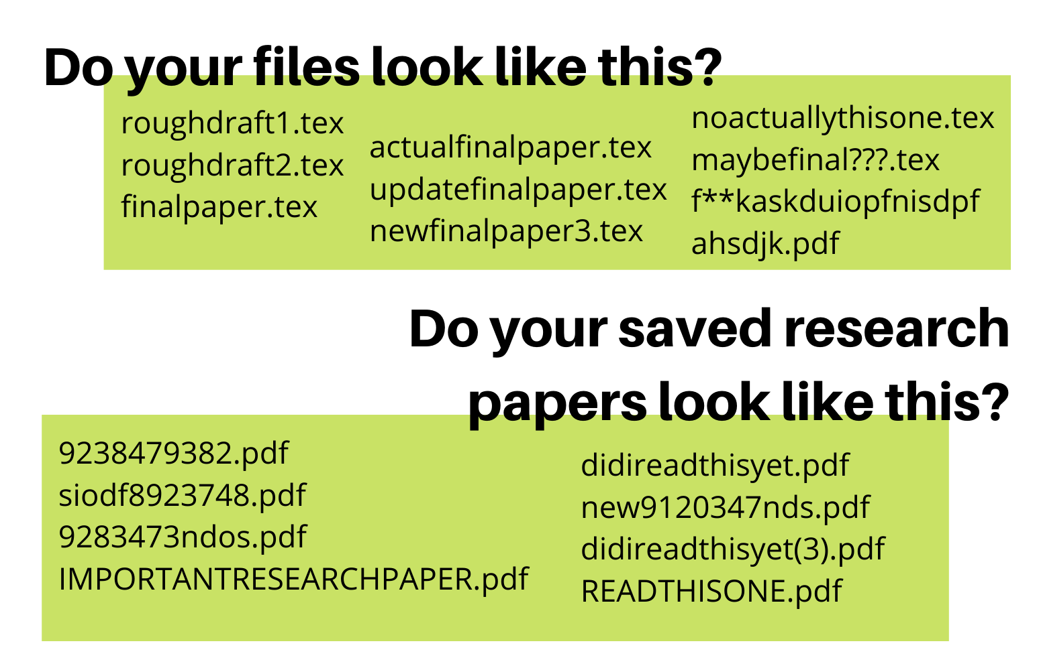
The Way of Inevitable Pain and Suffering
Notes:
Example objectives
At the end of this lesson, you will be able to:
Save files to the team Web server.
Move files to different locations on the team Web server.
Share files on the team Web server.

Slide 5
The Way of Inevitable Pain and Suffering
What if you could keep track of what each file is, what changes have been made, who made them, and be able to switch back and forth to any version you want?
Notes:
Example objectives
At the end of this lesson, you will be able to:
Save files to the team Web server.
Move files to different locations on the team Web server.
Share files on the team Web server.

Slide 6


























Version Control Perks
Notes:
Example objectives
At the end of this lesson, you will be able to:
Save files to the team Web server.
Move files to different locations on the team Web server.
Share files on the team Web server.

Slide 7












































Version Control Perks
Notes:
Example objectives
At the end of this lesson, you will be able to:
Save files to the team Web server.
Move files to different locations on the team Web server.
Share files on the team Web server.

Slide 8
















Version Control Perks
Notes:
Example objectives
At the end of this lesson, you will be able to:
Save files to the team Web server.
Move files to different locations on the team Web server.
Share files on the team Web server.

Slide 9
Version Control Perks
GIT LETS US DO ALL THESE THINGS
Notes:
Example objectives
At the end of this lesson, you will be able to:
Save files to the team Web server.
Move files to different locations on the team Web server.
Share files on the team Web server.

Slide 10
Lesson 2: Introduction to Git
Download Git from https://git-scm.com/downloads
Install… (default install settings work fine)
Run (as administrator)
Configure username & email address
These are local designators to tell Git who worked on a project
TYPE: git config --global user.name “Your Name Here”
TYPE: git config --global user.email “Your Email Here@email.com”
TYPE: git config –global core.editor nano
Check to see if it worked
TYPE: git config user.name
TYPE: git config user.email
You should see what you entered when you do this

Slide 11
Create a Repository
Let’s create a project to work on!
(May want to change directory to where you’d like this to go)
TYPE: git init myfirstgitproject
TYPE: cd myfirstgitproject/
This will initialize a new git repository aka a place for you to place files you want to use git with
This changes your directory to the repository location

Slide 12





























Add a file to your repository and Git

Slide 13
Add a file to your repository and Git
Create a file in the current directory (inside terminal, outside terminal)
Example, TYPE: echo “text for git” >> GitTest.txt
Tell git to add it to the staging area
TYPE: git add GitTest.txt
Commit the file to the repo (have git save it, time stamp it, keep track of the changes)
TYPE: git commit -m “added GitTest.txt to the repo”
(or “initial commit”)

Slide 14
Make a change in the file
Make a change however you’d like (inside terminal, outside terminal)
Ask git what’s changed
TYPE: git status
TYPE: git diff
Add to the staging area
TYPE: git add GitTest.txt
Recommit
TYPE: git commit -m “added some text”
See the process
TYPE: git log

Slide 15
Undo that change
What’s the file currently look like?
TYPE: cat GitTest.txt
See what’s been done
TYPE: git log
TYPE: git log --oneline
Undo the latest change
TYPE: git revert HEAD
In nano, TYPE: ctrl O, ctrl X
In VIM, TYPE: :wq then press enter
See what’s been done
TYPE: git log
TYPE: cat GitTest.txt

Slide 16























Create a branch

Slide 17
Create a branch
Create a branch
TYPE: git checkout -b testbranch1
See all the branches
TYPE: git branch
Switch branch
TYPE: git checkout master
TRY: switch back to testbranch1
Make a change on the new branch!
TRY: change GitTest.txt
TRY: make a new file entirely
TRY: commit these changes to the new branch

Slide 18
Merge Branch
Switch back to master
Notice changes are not here
Merge changes from branch to master
TYPE: git merge testbranch1
Check that all of the files have updated! Yay!
Now, we delete the branch since we don’t need it to test our changes anymore
TYPE: git branch -d testbranch1

Slide 19
Recap - Local Git
Installed Git
Initialized a Git Repository
Learned how to commit changes
Learned how to create branches
Learned how to merge branches

Slide 20
GitHub and GitLab - Remote Server Repositories
Using a remote server allows you to
Collaborate
Access your files from different devices
Contribute to other’s projects
Share your files with the world

Slide 21
Cloning a Repository
Cloning creates a copy of the repository for you to use
Remember those LaTeX templates? They’re on GitHub!
Clone this repository by visiting
https://github.com/domagal9/MSU-LaTeX-Templates
Click on clone and copy the HTTPS (or clone with SSH if set up)
Change to the directory you want to save the files in
TYPE: git clone https://github.com/domagal9/MSU-LaTeX-Templates.git
This creates a directory called MSU-LaTeX-Templates on your computer with all the files!

Slide 22
Creating your own repository on GitHub or GitLab
Log in… https://github.com/
Create new repository! Let’s call it “testrepo” (don’t add a readme)
TYPE: git remote add origin git@github.com:yourusername/testrepo.git
TYPE: git push -u origin master
Log in… https://gitlab.msu.edu/
Create a project!
TYPE: git remote add origin https://gitlab.msu.edu/yourusername/testrepo.git
TYPE: git push -u origin master
Note you’ll have to log in again once you push to verify MSU status

Slide 23
Creating your own repository on GitHub or GitLab
You can also create the repository locally and then use console to put on GitHub/GitLab!
Example:
echo "# testrepo" >> README.md
git init
git add README.md
git commit -m "first commit"
git remote add origin git@github.com:yourusername/testrepo.git
git push -u origin master

Slide 24
Making Changes Locally and Online
Make a change on your repository online & save
It is not automatically on your computer!
Update your local repository with the online one
TYPE: git pull origin
Check if it worked!
You can make changes locally, commit them, and push them back as before

Slide 25
Cloning vs. Forking
A full copy of the original project
You can affect the original project if you have permission from the project owner
A new copy of a repository that you can change without affecting the original project
Use this to contribute to other people’s projects
Used to create pull requests, aka merging your changes into someone else’s project

Slide 26
Let’s all make a change to the same project!
https://gitlab.msu.edu/domagal9/git-tutorial
https://github.com/domagal9/git-tutorial
Fork the repository - This gives your account a copy
Clone to your computer - This gives you the master branch
Create a new branch for your personal changes
Change to your new branch and update the “workshop attendees” file
Commit and merge to master
Push your changes to your forked version
Submit a pull/merge request on GitHub/GitLab (ask the creator to update)

Slide 27
Recap - GitHub & GitLab
Create account
Add our current repository
Create a repository
Clone a repository
Fork someone else’s repository
Submit a pull request

Slide 28
Extras
Great for testing code in different branches
Keeping a record of files (CV, class notes, personal statements)
Allows collaboration of the same files at the same time
Don’t commit compiled files
Don’t mess with master unless it’s just you (make your changes on a branch in general)

Slide 29
References
https://git-scm.com/book/en/v2/Getting-Started-About-Version-Control
https://github.github.com/training-kit/downloads/github-git-cheat-sheet.pdf
https://guides.github.com/introduction/git-handbook/
https://www.atlassian.com/git/tutorials/learn-git-with-bitbucket-cloud
https://thenewstack.io/getting-legit-with-git-and-github-your-first-pull-request/
https://try.github.io/
https://guides.github.com/activities/forking/
https://thenewstack.io/dont-mess-with-the-master-working-with-branches-in-git-and-github/

